Slide 1
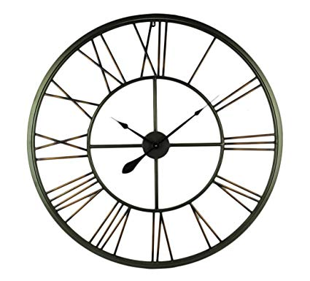
Time
Zoya Yeprem

Slide 2
Time
What is system time and why is it important?
Notes:
System time represents a computer system's notion of the passing of time.
measured by a system clock, it’s the count of the number of ticks that have transpired since Epoch.
OS runs on schedules and their locks are based on time
Multitasking needs time (to avoid inconsistency)
Network communication need time for accuracy and consistency
Realtime systems need time

Slide 3
MayFly
What are the challenges in Intermittently powered devices programming?
High level problem
Notes:
Might loose power anytime so volatile-memory, execution progress and time will reset
Timekeeping in intermittent powered devices
What is useful and what is not after a reboot?
How to reduce burden of managing time on such devices for programmers?
How to gather data in Realtime
Data accuracy depends on time and other relative data
Value of data is correlated with their time gathered

Slide 4
MayFly
How are programs in MayFly different?
Approach
Notes:
MayFly language is a directed dataflow graph.
Nodes are tasks and edges are flow of data
Predicate -> [if…then] adjust behavior
Policies -> how to determine priority
Constrains -> how is data treated as it flows (Expire, MISD, Collect)
MayFly runtime is a task scheduler that keeps temporal aspect of data across power failures

Slide 5
MayFly
What makes MayFly suitable for intermittent programming?
Strengths
Notes:
Timekeeping and Timestamping are task based
Easy and accurate management of time and aging of data
Built on Embedded-C -> allows programmers to import their libraries from it
Provides visualization tool shows how program graph looks like after compile

Slide 6
MayFly
What are weaknesses?
Weakness
Notes:
If no expiration or MISD is set, data remains in buffer forever -> could set a default
(not actual weakness) Programmer has to be mindful of task size, if too big may fail more often

Slide 7
MayFly
In MayFly, tasks and schedules are compiled together. Can we separate them?
Discussion
Notes:
For example when device is deployed and its operator, after using it, concludes that instead of reading data every 2 secs, they need data read after 4 secs, in current approach, they have to contact programmer and they need to change that in their code, recompile and give them back the firmware. But if schedule can be separated form tasks during compilation, schedules can be done dynamically.
May need to increase nonvolatile memory to keep schedules in them (outside of compiled program)

Slide 8
OpenClock
What does OpenClock offer?
High level problem
Notes:
Testbed to test synchronization protocols
Provide similar test environment to test and compare multiple protocols
Has network attack simulator

Slide 9
OpenClock
What are key design points?
Design

Slide 10
OpenClock
What compels you want to test your algorithm on OpenClock?
Strengths

Slide 11
OpenClock
What are the weaknesses?
Weakness

