Slide 1
Embedded OS for IoT
Tu Le
Nov 19, 2018

Slide 2
Tethys
Motivation?

Slide 3
Tethys
Infrastructure-free
Data at per-fixture granularity
Long-term deployment (energy-harvesting)
Security & Privacy in data transmission

Slide 4
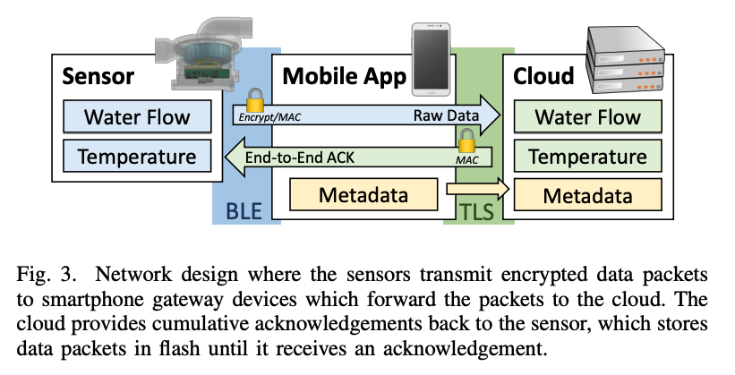
Tethys
Weaknesses?

Slide 5
Tethys
Encryption algorithms on low-power
Energy consumption in data transmission
Bluetooth attack vector

Slide 6
Ditio
Motivation?

Slide 7
Ditio
Assures sensor activities systematically
Assurance for both owner and 3rd party
Takes advantages of trusted zones and provides legacy version
Security & Privacy in data transmission

Slide 8
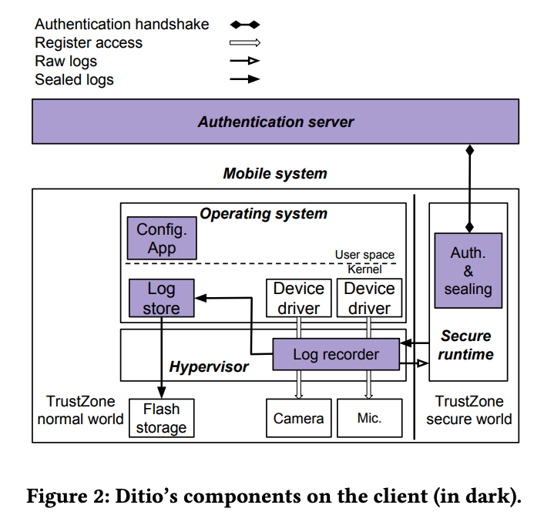
Ditio
Weaknesses?

Slide 9
Ditio
Client-server communication attack vectors (MITM)
Deployment challenges (legacy devices, modification to system software, etc.)
Sealing on low-power
User experience

