Slide 1
User Interface
Emily Camacho
LumiWatch
Distance Pointing

Slide 2
What about it?
What comes to mind when you think of user interface?
Why is it important?
What factors play into this concept?

Slide 3
Motivation
Factors
Multiple functionality
Data Flow
FOR THE USER
Notes:
Motivation:
- If its for the user, he/she should understand it
- makes things run more efficiently
- gets people more invested
- Bottom line is if you want a good program you need a good user interface
- The whole purpose of a program (generally speaking) is that its for people, improving their lives somehow
Factors:
- Visibility
- Comfortability
- Ease of learning

Slide 4
How does this relate to OS?
The general purpose remains the same
Bottom line is input and output need to be managed
In LumiWatch this is easy to see
Notes:
You still want the system to run efficiently so you would still benefit from an OS to manage the resources that makes the interface more usable
Memory management is still relevant, scheduling is still important.
I think the biggest thing with user interface is that theres input and output, it mostly comes down to that. But theres a lot happening there and an OS can serve to keep things orderly and running efficiently
In LumiWatch this is easy to see, specially when you consider that in many ways a smart watch is essentially an extension of your mobile device (well it depends, but for LumiWatch anyway)

Slide 5
LumiWatch
A solution for input/output bottleneck in wearables
On-skin touch interface in place of small screens
Notes:
LumiWatch aims to provide a solution for input/output bottleneck in wearables.
The idea is that these devices have significant computation capabilities and what’s really holding them back is their small screens. What LumiWatch presents as a solution is basically to extend the screen to a higher surface area by way of projection. So essentially you can carry out all the things you would on your screen but on your hand or arm, which is significantly bigger than a wearable’s screen.
They argue this would be most convenient and immediately available, as opposed to conventional mobile devices (which sidenote, I didn’t really buy because you have to remember to put on the watch just like you do to carry your phone and I mean reaching for your phone in your pocket doesn’t seem like such a hassle to me)
But they also argue that proprioreception is innate which seems fair to me and if nothing else then just because it’s cool and we’ve seen it in movies and it’d be really neat to see that in real life

Slide 6
What are the specific concerns?
Battery life
Size
Comfortability
Heat dissipation
Projection visibility
Sensing capability
Notes:
What are the specific concerns for wearables in relation to user interface?
Takes input accurately
Output display
Class List (left)
Article List (right)
-Projection brightness
-Sensing robustness
-Compute power

Slide 7
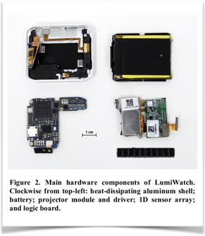
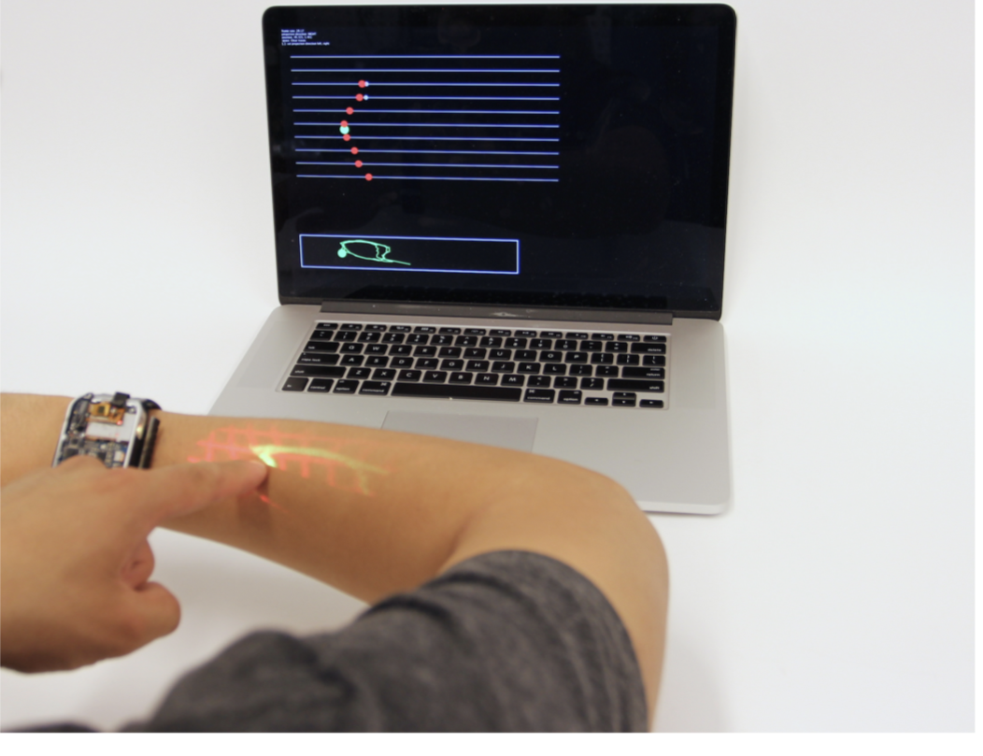
Sensing
Hardware
Depth Sensing Array
All 10 measurements ~36ms, touch tracking frame rate of 27.5 Hz
2D position tracking
Taps and swipes based on finger strokes
Type to enter a caption.
Notes:
1-D depth sensing array made of 10 time-of-flight sensors. Time of flight sensors are able to measure the distance between a sensor and an object, based on the time difference between the emission of a signal (in this case pulsed infrared light) and its return to the sensor, after being reflected by an object.
“Each individual sensor determines the distance to the nearest object within a 25degree cone by emitting pulsed infrared light and timing the returned reflection.”
https://www.youtube.com/watch?v=OMDfQC0m4i4
(2:11)
“The conical fields of view of each individual time-of-flight sensor overlap significantly, so that a single finger will always appear in several sensors simultaneously. However, the finger will always be closest to the sensor most directly inline with the sensing axis, allowing us to infer a finger’s tangential y position on the arm (in addition to the axial x position along the arm provided by the distance measurement itself).
In addition to basic x and y finger position, LumiWatch can detect finger taps and swipes. They both depend on finger strokes, which they define as the trace from initial detection to disappearance.
———
“The position of a finger tap is taken as the point of minimum velocity during a short stroke. The swipe orientation (horizontal or vertical) is determined by comparing the total x and y travel distances across the long stroke”
… “ a stroke that travels at least 3 times further in the x direction as the y direction is considered horizontal. This factor of 3 accounts for the proportions of the arm, as strokes along the arm were observed to be significantly longer than vertical ones.”

Slide 8
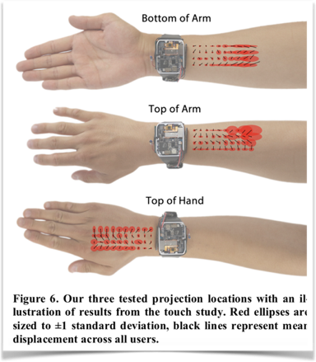

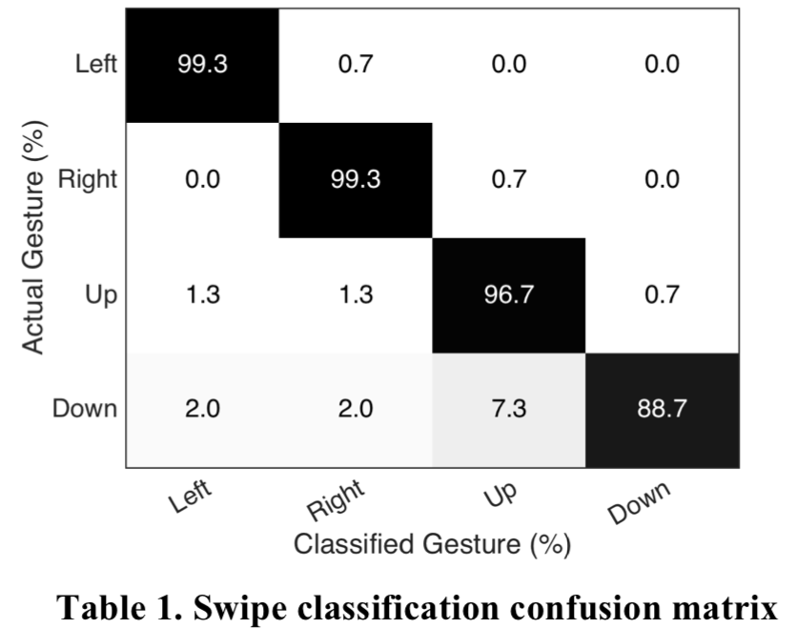
Sensing evaluated
How does this affect the user interface?
Notes:
These images show the results of study 1. They had 5 people participating for 30 minutes.
They had tap tasks and swipe tasks.
The left shows tap tasks results. The article claims the location didn’t make much of a difference, and from the overall trials 596 out of 600 taps were detected
For swipes, they were able to reach a 100% accuracy on detection. While the classification of that detection has an average accuracy of 96.0%.
The right shows the classification confusion matrix. “The biggest source of error was down-swipes being misclassified as up-swipes.”
Positively affects user interface because seems accurate overall, user can be confident their input is being processed rightly

Slide 9
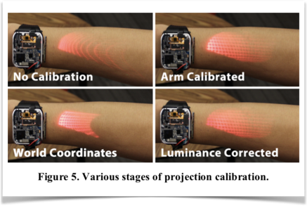
Projection
Hardware
Elevated projector
Projection calibration
World coordinate rectification
Luminance Correction
Dynamic projection-input calibration
Notes:
Elevate the projector as high as possible without wasting space by making it the top most component of the watch. This helps keep the projections from being coarse and handles variations in arms angle and geometry better.
“poor results on hairy arms as a large fraction of the light was lost before illuminating the skin. Furthermore, the hairs themselves become illuminated and interfere with content rendered on skin below. This suggests that there is an ideal minimum height for the projector”
——
World coordinate: determining the mapping between the projector’s image coordinates and real-world 3D coordinates, it is specially important as these will show the touch input positions.
Arm calibration accounts for cylindrical shape of an arm. Removes curvature
Luminance correction: the pixels near to the projector are brighter than those farther away. This reduces the brightness of the pixels closest to the projector, for a more uniform appearance.
Dynamic projection-input: determine the precise angle between a wearer’s wrist and forearm so pixels are not off. Achieved by comparing the actual axial position (when the user swipes to unlock) with the assumed position of the slider and applying trigonometry.
arm angle calibrated seamlessly
Aligns the projection
Verifies user’s intent to interact

Slide 10
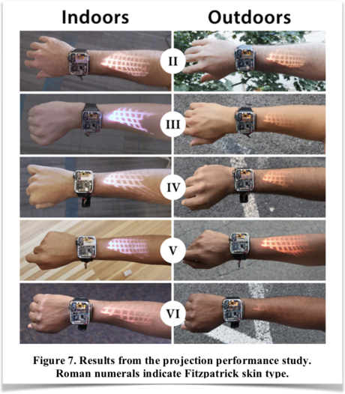
Projection evaluated
Study 2
How does this affect the user interface?
Notes:
Figure 7 is based on the results from study 2. Were they evaluated projection on 5 participants of different skin tones based on the Fitzpatrick scale, who also had varying levels of hair.
“Skin color significantly affects projection visibility due to variable absorption of light.”
Visibility, rectification accuracy and scale accuracy
Projection is important because it’s how the user gets the output. You want to be able to see it.
I also thought it was interesting they mounted the projector in such a way that allowed the watch to be thin. —> Matters in comfortability.

Slide 11
Power
Battery life
Heat dissipation
Scanned-laser projector
Notes:
Lithium-ion battery that is self contained. Over one hour of continuous projection with everything active, but expected to last about a day if intermittently active. Another thing the OS could help with.
Aluminum shell helps dissipate heat from projector and logic board. And since battery sits closest to skin the user isn’t really feeling that.
They claim scanned-laser projector allows then to save power and display brighter images. And it’s focus free (focus at all distances) so more compact —> matters in both comfortability and style
Compared to LCoS or DLP systems where a large percentage of the light source is redirected or absorbed to produce black or dark imagery.

Slide 12
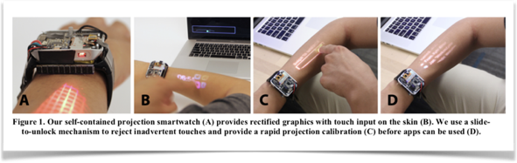
Overall Evaluation
What did you think of the article in general?
How did they do from a user interface stand point?

Slide 13

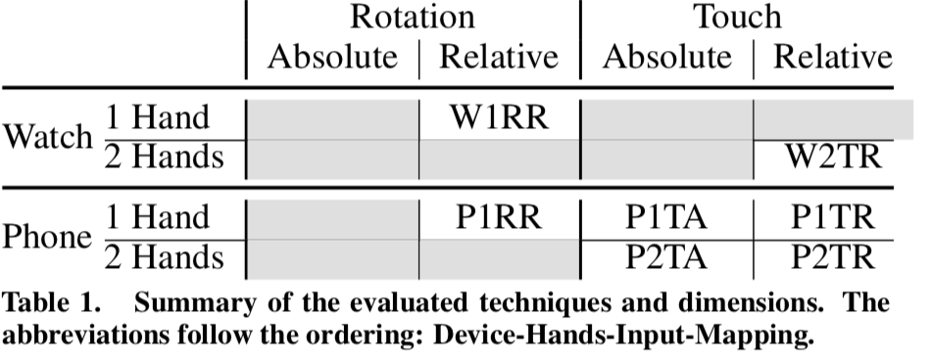
Distance Pointing
Deals with interactions with large displays from a distance
Compares 7 distal pointing techniques
Notes:
four dimensions to define possible mid-air pointing techniques:
- Device: SmartPhone (p) or SmartWatch(W)
- Handedness: ONE OR 2
- CONTRol: Rotation of device (R) or touch input on touchscreen (T)
Mapping: Relative to user’s movements (R) or absolute mapping to the location of end effector (A)
21 participants (21-26 yrs old) perform a sequence of pointing operations as quickly and accurately as possible.
Apparatus:
LG G watch R
Nexus 5

Slide 14
Specific concerns
Notes:
How is this different than LumiWatch?
Is there any overlap in what we’re looking for?
List of same concerns (left)
Input/output in general but this one is much more limited to signaling (the output is displayed on screen)
Same goal in trying to make it easier to interact (surface area issue in LumiWatch, distance issue in Distance pointing)
List of new/different concerns (right)
It’s a survey so not so focused on inner performance but comparatively
Convenience
Quick & Accurate performance: Ease of use in selection

Slide 15
Convenience
Survey questions
365 people (aged 17 - 73), online social media
96% familiar with touch based interactions on smartphones
86% familiar with trackpads
49% wear a wristwatch
9% wear a smartwatch
Notes:
Evaluate convenience
“Questions involved generic background information question (age, gender, country of residence, assessed handedness); whether the participant owns and uses a smartphone, wrist- watch of any kind (including smartwatches), and specifically a smartwatch; and which side he uses to hold them during asymmetric bi-manual use: holding hand for smartphones, wearing wrist for watches. We also asked which hand they used on trackpads.”
So phone is more convenient than smart watch

Slide 16
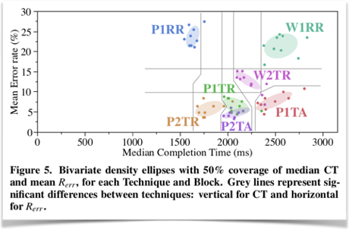

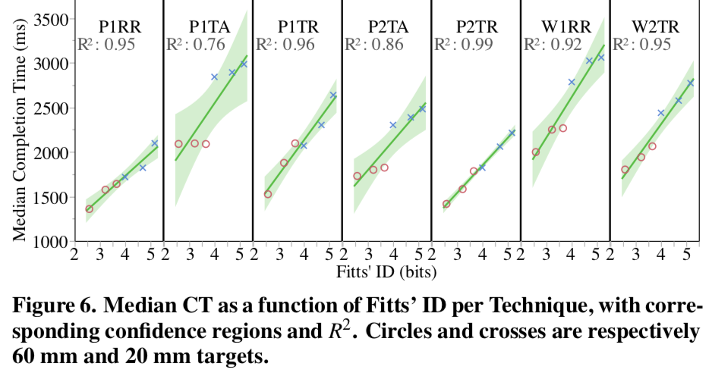
Overview of techniques
Errors: P1TA, P1TR, P2TR, P2TA ≪ W2TR ≪ W1RR, P1RR
Completion time: P1RR ≪ P2TR ≪ P1TR, P2TA ≪ W2TR ≪ W1RR, P1TA
Overall best: P2TR
Notes:
Ease of use?
(smaller is better, when evaluating error and CT)
In terms of pure performance, using a smartphone as a bimanual relative trackpad (P2TR) is the “best” technique

Slide 17
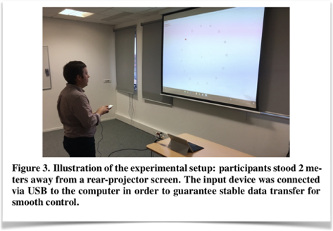
Overall Evaluation
What did you think of the article in general?
How did they do from a user interface stand point?
How does it compare to LumiWatch?

Slide 18
Take Away Points
Input/Output is at the core of user interface
Both LumiWatch and Distance Pointing evaluate user interface in some way
LumiWatch is concerned with only one device so it’s a little more detailed
Distance Pointing takes a more general approach but compares 7 different techniques
User interface motivation and factors revisited
Do the articles support our concept of user interface?
Notes:
Back to motivation and factors delineated earlier in class. Did we miss anything? Maybe after discussing these 2 articles we want to add more?
Hopefully we can all agree the articles do support our concept of user interface.

