Slide 1
Coordination and Robotics
Will Ashe

Slide 2
Overview
Robotics Platforms
Connected Drones Analysis
Connected Actuation Platforms
Robotic Softness Discussion
Example

Slide 3
Software for Robotics
Today’s Ecosystem
ROS
Robotic Operating System
Provides
messaging,
information sharing
many robotic hardware abstractions (point-to-point coordinate transforms, pose estimation, localization, and navigation)
ArduPilot
Sparki

Slide 4

Hardware for Mobile Robotics
Today’s Ecosystem
Consumer Platforms
The ground vehicles
iRobot Create
The humanoids
Nao and Pepper
The drones
DJI
Parrot

Slide 5
So where does this class fit?
Hard to develop an open, usable, highly functional robotics platform
Many of the OS functions have been split up to support development
Leads to three classes of robotic research:
Private robotic development (e.g. Boston Dynamics)
Low-level research (Controls/AMR)
High-level research (Hacking and Augmentation)
Software will not always be designed in conjunction with the control algorithms!

Slide 6
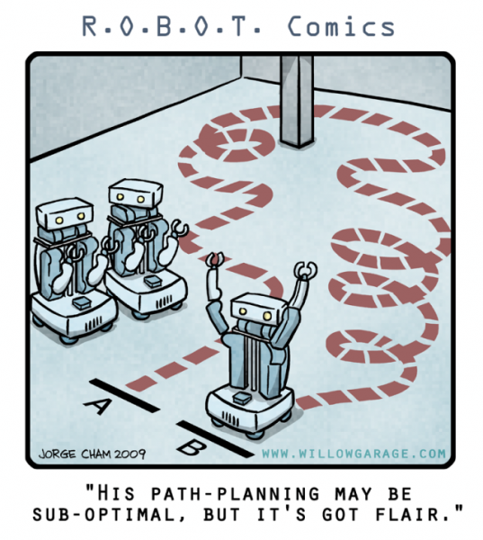

Slide 7
Connected Drones: Motivation
What ideas are they getting at?
What are they trying to solve?
What is the intended use for this technology? What else could it accomplish?
Notes:
IOT expansion – will include drones
Connected autonomy – rather than simply abstracting the autonomous aspect, it abstracts flight instructions to a known path
Device abstraction – remove focus from singular drones
Swarm synchronization – accomplishing tasks as a group (requires communication, time)

Slide 8
Connected Drones: Implementation
What constraints are placed on the environment?
What kinds of commands can be sent?
How does the system know where the drone is?
Likes? Dislikes?
What else could they have included?

Slide 9
Connected Drones: Evaluation
How well did they evaluate their platform?
What would you have liked to have seen?
Notes:
Security

Slide 10
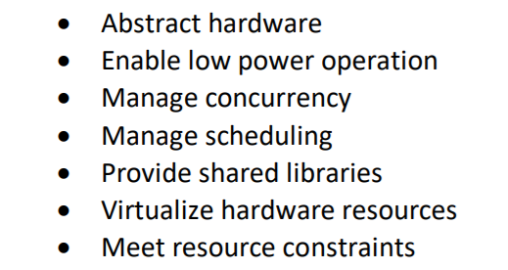
Connected Drones: Context
What functions are required of a drone OS to enable a system like the one described?
What additional functions typically provided by an OS would add functionality?
Notes:
Security

Slide 11
Software for Connected Actuation
Proprietary
Ships with the arm
Open Source (ROS)
Rhino-Grasshopper-Plugins
Somewhere in between
Hacking
Demo: Grasshopper

Slide 12
Arms for Connected Actuation
Low budget
Serial/USB connection, gripper
Cheaper Industrial Arms
Proprietary software defines control
Research-Oriented Arms
Low-level control, niche applications
Modular Light-Weight Arms
Low-level control, modularity, light-weight, deployable

Slide 13
Robotic Softness
Soft Systems
Agent-Based System
Performance Criteria
End Effector – alternating grippers
Feedback System – Kinect + Kuka Robot Sensor Interface (RSI)

Slide 14
Example ABS Construction
Institute for Computational Design (ICD) and the Institute of Building Structures and Structural Design (ITKE) at the University of Stuttgart
Annual pavilion collaboration
2014-15: http://icd.uni-stuttgart.de/?p=12965

Slide 15
Expanding Robotic Softness
What OS functions are split throughout the CPS?
How does the resulting system measure against the OS goals?
What would be the effect of one integrated actuator and sensor module running an OS? Additional motes?

