Slide 1
The Discotective
Milestone 1

Slide 2
Milestone 1 Goals
Have a working model of our project in MATLAB.
Development of all preprocessing and classification algorithms
Convert our MATLAB algorithms to C code
Significant progress with the hardware
Execute simple programs
Capture images
Interface with other necessary peripherals

Slide 3
MATLAB
Preprocessing
Done
Segmentation
Done
Classification
50%

Slide 4
Conversion to C
A work in progress
API and data types being defined
Many little functions written
Need to work on the main algorithms

Slide 5
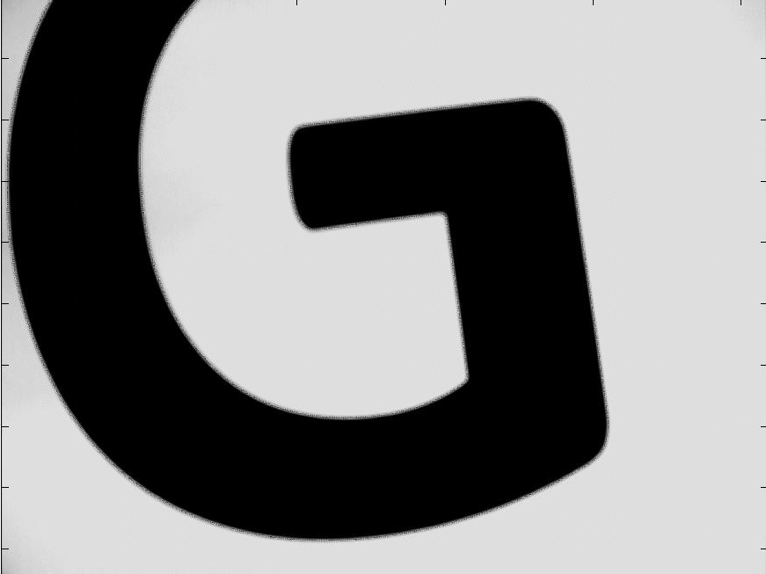
Hardware Progress
Camera
Have full resolution images from camera
8 bit gray scale
Stored in SDRAM
Need to work on demosaicing algorithm and conversion to gray scale
Nios II
Have working processor
Verified that it can read SDRAM
Working on VGA output and frame buffer

