Slide 1
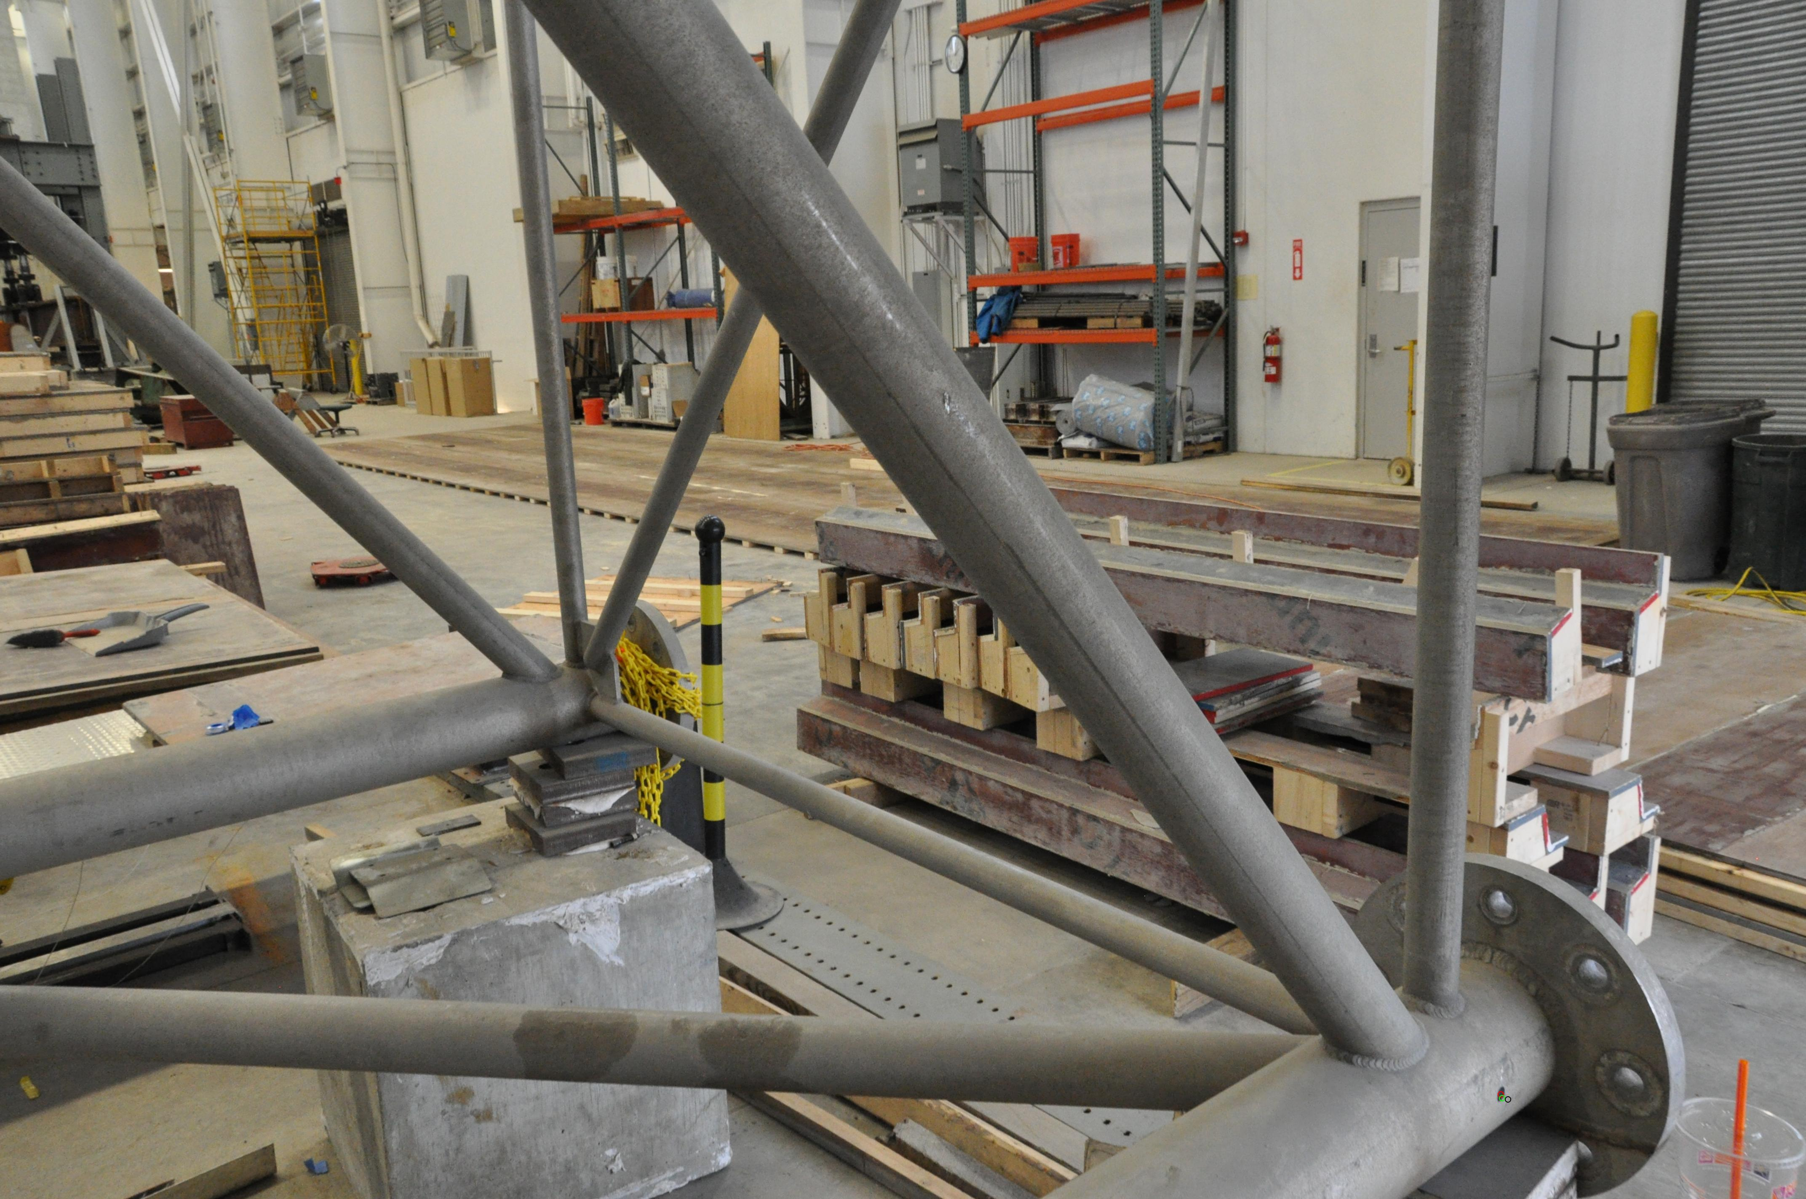
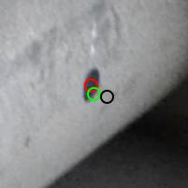
: point selected on the image
: P × X^{S}
: P × M⁻¹ × X^{T}

