Slide 1
Network optimization
case study: Lima, Peru –

Slide 2
Questions to answer
Project context
jhjghjhg
How does the network coverage looks like for Lima?
Which are the areas that are not well covered by the network?
Which are the areas that are too congested?

Slide 3
STEP 1: Access analysis
STEP 2: Optimization analysis
Origins
weight
Destinations
weight
Road Network
speed limits
GOSTnets
(python)
Optimization
(julia)
Origin – Destination Matrix (OD)
Solver
-small problem: Open source solver : XYZ
-medium/large problem: Commercial solver: XYZ
-travel time (driving, walking)
-travel distance
-weighted (optional)

Slide 4
STEP 1: Access analysis
Origins
weight
Python / Jupyter Notebook
Destinations
weight
1. Script: url
2. Script:
3. Script:
Road Network
speed limits
4. Script:
Implementation
GOSTnets
ArcGIS/QGIS
Origin – Destination Matrix (OD)
Geospatial data manipulation
-travel time (driving, walking)
-travel distance
-weighted (optional)

Slide 5
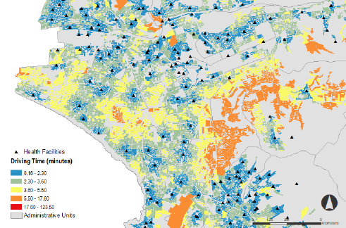
Spatial Data: Apartment Blocks
-constitutes the origins of the access analysis
Quantitative Data: Population information at block level (census)
-will represent the weight of each block in the access analysis
Spatial Data: Health Facilities
-constitutes the destinations of the access analysis
GOSTnets library
Compute the Origin Destination Matrix
Output: access to health facilities
Quantitative Data: Capacity of each facility (personnel, number of beds)
-will represent the weight of each facility in the optimization analysis
Spatial Data: Road Network
-to compute travel time and travel distance from each origin to each destination
Quantitative Data: Speed limits for each road segment
-will influence the travel time between each origin and destination

Slide 6
STEP 2: Optimization analysis
Origin – Destination Matrix (OD)
-travel time (driving, walking)
-travel distance
-weighted (optional)

Slide 7
