Slide 1

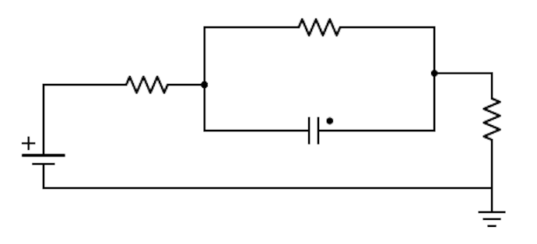
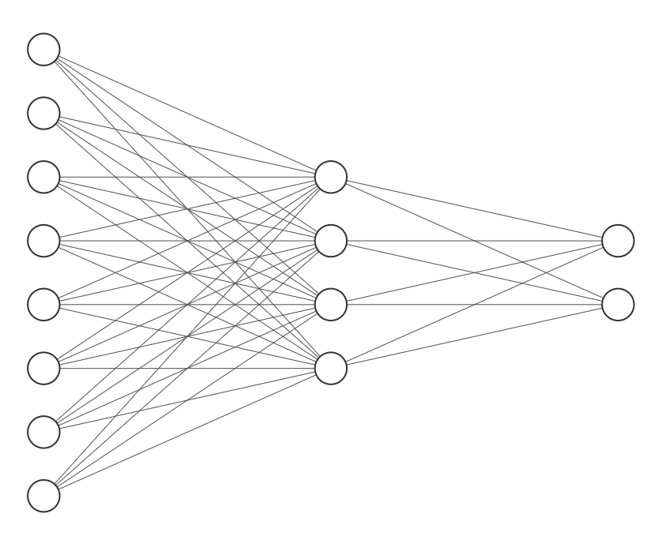
Machine learning based models for lithium ion batteries
Bradley Barnhart and Travis McGuire
{bbarnhar, travis.mcguire} @ stanford.edu
Motivation
Results
Our project aims to address whether ML can be used to model battery voltage
We hope ML may offer an alternative more accurate than circuit models and more computationally feasible than physics models
ML generalizes for battery voltage prediction
(DONE) An unzoomed US06 drive cycle
Predictions generalize to new drive cycles
Error and temperature appear related
(FIX AXIS) Cost vs validation run with x axis binned by temp
(GET CODE FROM ORIG NOTEBOOK) Show zoomed drive cycle plot before including T
ML models including temperature offer more robust prediction
(GET CODE FROM ORIG NOTEBOOK) Show zoomed drive cycle plot including T
(FIX AXIS) Cost vs validation run with x axis binned by temp for model including T
(MAKE SCATTER INTO BOXPLOT) Validation cost vs model w/ mean and std dev
Methodology
nn_relu and nn_tanh 3 layer NNs with the architecture above and relu / tanh activations
lstm a 2 layer NN with 20 recurrent neurons using tanh activations and sigmoid connections followed by 1 neuron FC linear layer
I
V
SoC
I
SoC
V
T
Conclusions
Data
ML models work, generalizing well to battery voltage prediction (measured by squared error)
ML models show promise generalizing to previously unseen drive cycles, especially incorporating additional inputs like temperature
Data was acquired from six NCR18650B cells at these temperatures and cycles
Temperature: 5°C, 25°C, 35°C
Cycle: Const. Curr., HPPC, US06, UDDS
First validation held out one of each drive cycle
Second validation held out all of one drive cycle
Acknowledgements
We would like to thank our mentors Anirudh Allam, Thomas Navidi, Simona Onori, Ram Rajagopal, and Abbas El Gamal.

