Slide 1

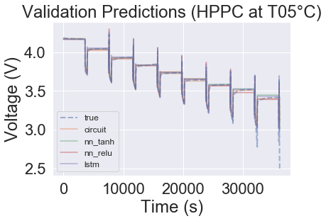
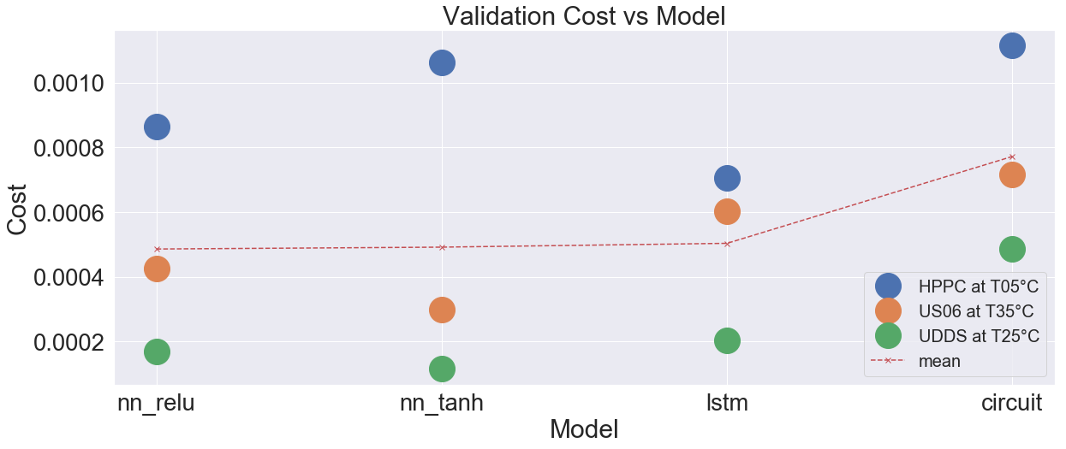
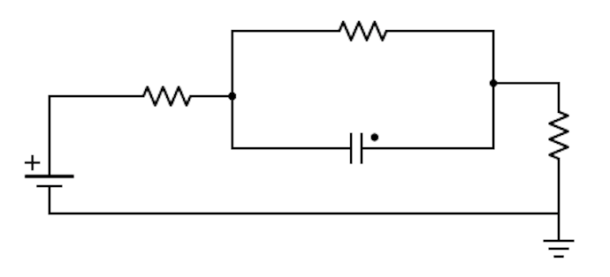
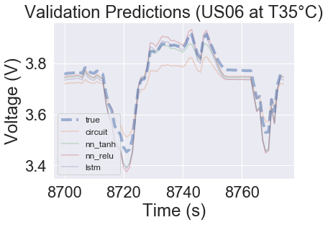
Machine learning based models for lithium ion batteries
Bradley Barnhart and Travis McGuire
{bbarnhar, travis.mcguire} @ stanford.edu
Motivation
Data
Our project aims to address whether ML can be used to model battery voltage
We hope ML may be more accurate than circuit models and more computationally feasible than physics models
Data was acquired from six NCR18650B cells at these temperatures and cycles
Temperature: 5°C, 25°C, 35°C
Cycle: Const. Curr., HPPC, US06, UDDS
For validation, one of each drive cycle was held out at different temperatures
Methodology
Results
We compare performance of ML models with circuit models, so we ensure the ML models use the same inputs (I and SoC)
Three ML models were used
nn_relu a 3 layer NN with [8, 4, 2] neurons per layer and relu activations
nn_tanh a 3 layer NN with [8, 4, 2] neurons per layer and tanh activations
lstm 2 layer N with 20 recurrent neurons with tanh activations and sigmoid connections followed by 1 neuron with linear activations
Blah
I
V
SoC
I
ML Model
V
SoC
Conclusions
ML models work, demonstrating lower squared error on every run in the validation set versus the circuit model
Key takeaway: ML models perform well, outperforming the circuit model in modeling complex drive cycle behavior
Acknowledgements
We would like to thank our mentors Anirudh Allam, Thomas Navidi, Simona Onori, Ram Rajagopal, and Abbas El Gamal.
Notes:
Looking at HPPC … plots voltage pred vs time, squared error in pred vs time, zoomed plot

