Slide 1

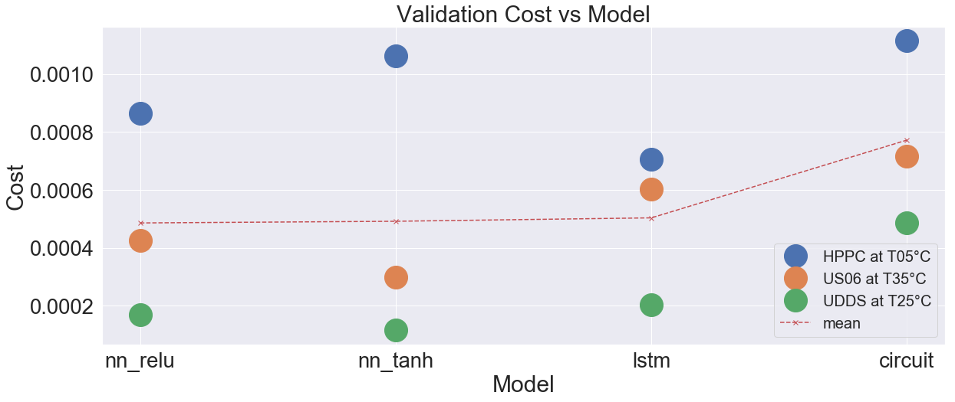
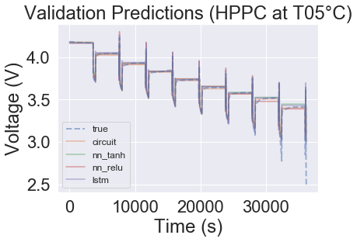
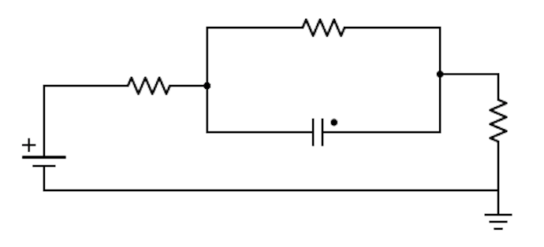
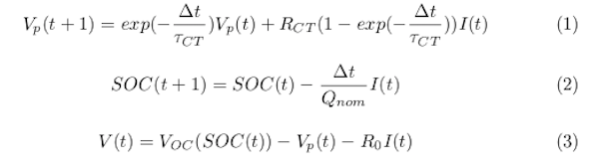
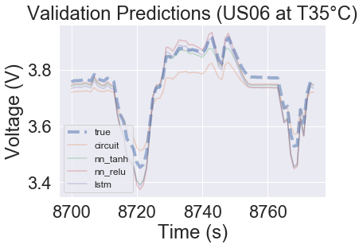
Machine learning based models for lithium ion batteries
Bradley Barnhart and Travis McGuire
{bbarnhar, travis.mcguire} @ stanford.edu
Motivation
Results
Conclusions
Our project aims to address whether ML can be used to model battery voltage
Physics models are state of the art, but computational limits cause traditional circuit model to be used in practice
We hope ML may be more accurate than circuit models and more computationally feasible than physics models
Our data was discharge cycles of six NCR18650B cells at three temperatures for five constant discharge cycles and three real world drive cycles
Key takeaway: ML models perform well, outperforming the circuit model in modeling complex drive cycle behavior
ML models work, demonstrating lower cost (squared error) on every run in the validation set versus the circuit model
Methodology
We compare performance of ML models with circuit models, so we ensure the ML models use the same inputs (I and SoC)
ML models make different assumptions about the form of V = f(I, SoC) than the circuit model, and learn f from data
Future Work
I
V
This work has shown promise in ML models, but two important next steps are determining the architecture best suited to the task and the approach’s generalizability to more use cases.
SoC
Acknowledgements
& Bibliography
I
ML Model
V
SoC
We would like to thank our mentors Anirudh Allam, Thomas Navidi, Simona Onori, Ram Rajagopal, and Abbas El Gamal.
1. Taborelli, Carlo, and Simona Onori. "State of charge estimation using extended Kalman filters for battery management system." 2014 IEEE International Electric Vehicle Conference (IEVC). IEEE, 2014.

