Slide 1

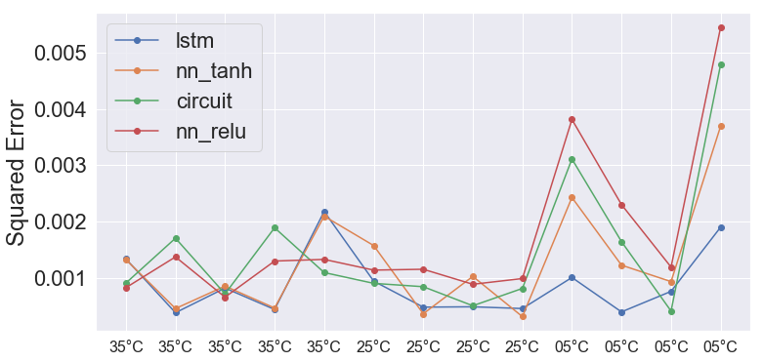
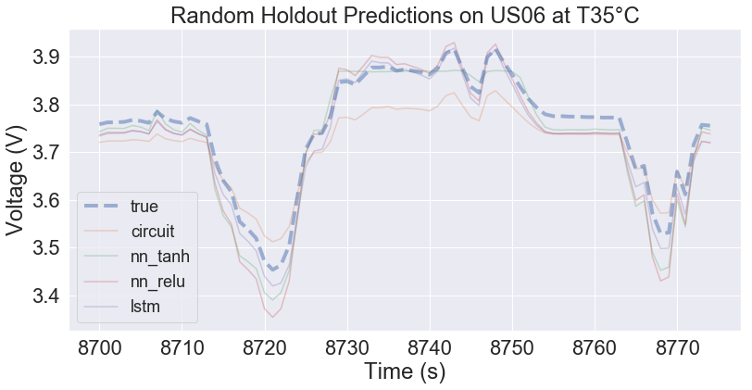
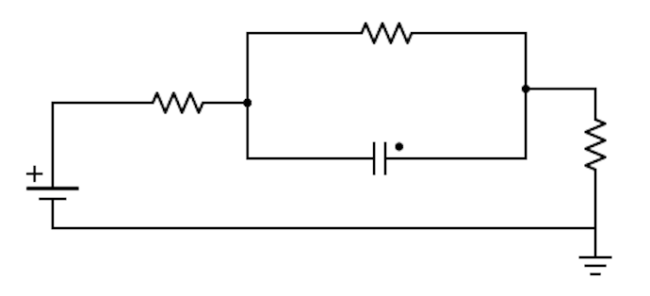
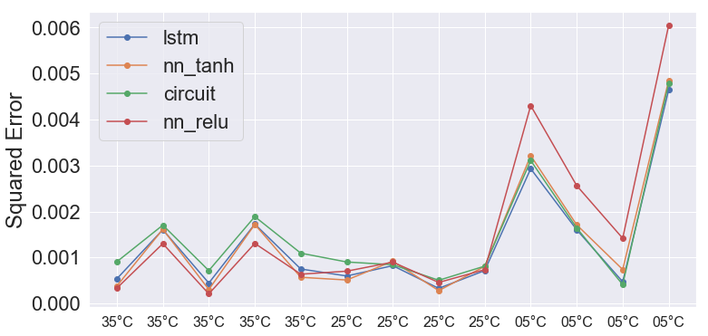
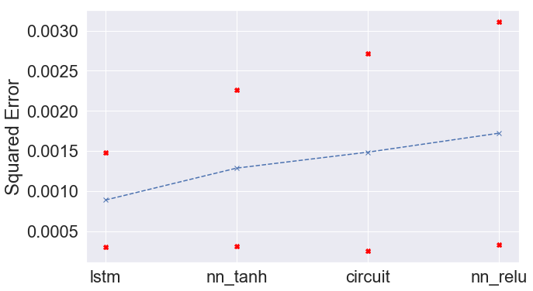
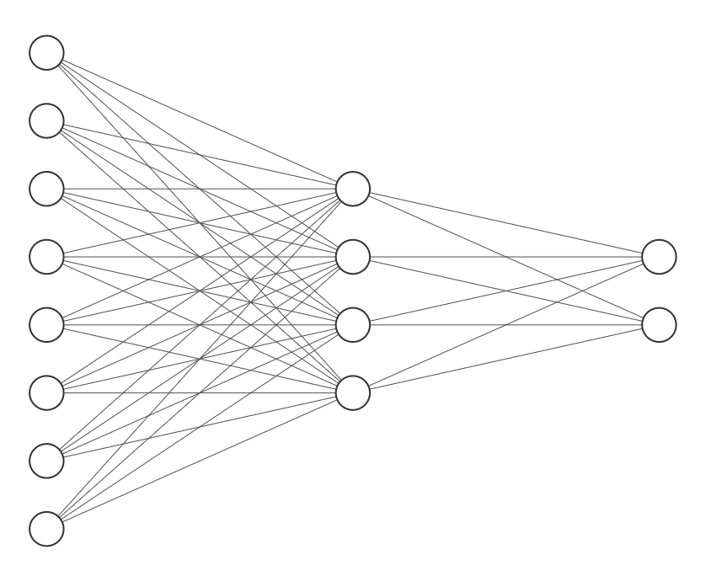
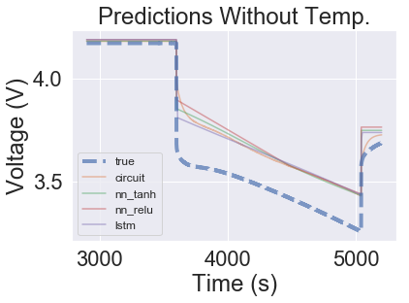
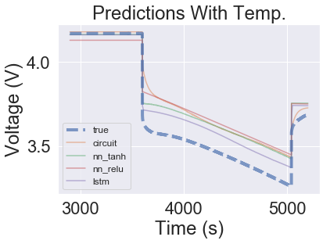
Machine learning based models for lithium ion batteries
Bradley Barnhart and Travis McGuire
{bbarnhar, travis.mcguire} @ stanford.edu
Motivation
Results
Fig 5. ML with temperature gives more robust prediction
Fig 6. Model mean performance with std. deviations
Our project aims to address whether ML can be used to model battery voltage
We hope ML may offer an alternative to equivalent circuit and physics models
Fig 2. ML generalizes for battery voltage prediction
Fig 3. Predictions generalize to new drive cycles, additionally error and temperature appear related
Fig 4. Including temperature allows more complex fits
Methodology
Fig 1. Model architecture
nn_relu and nn_tanh 3 layer NNs with the architecture above and relu / tanh activations
lstm a 2 layer NN with 20 recurrent neurons using tanh activations and sigmoid connections followed by 1 neuron FC linear layer
I
V
SoC
I
SoC
V
T
Conclusions
Data
ML models work, generalizing well to battery voltage prediction (measured by squared error)
ML models show promise generalizing to previously unseen drive cycles, especially after incorporating temperature
Data were acquired from six NCR18650B cells at these temperatures and cycles
Temperature: 5°C, 25°C, 35°C
Cycle: Const. Curr., HPPC, US06, UDDS
First validation held out random drive cycles
Second validation held out all US06 drive cycles
Acknowledgements
We would like to thank our mentors Anirudh Allam, Thomas Navidi, Simona Onori, Ram Rajagopal, and Abbas El Gamal.

