Slide 1

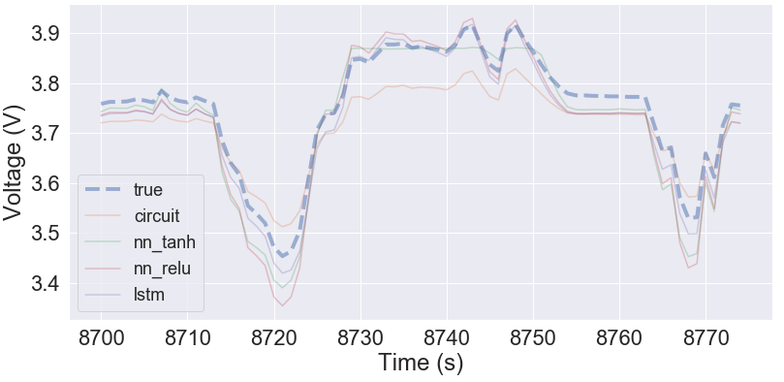
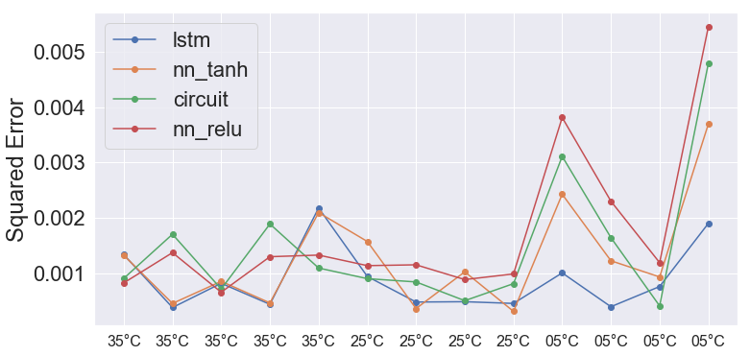
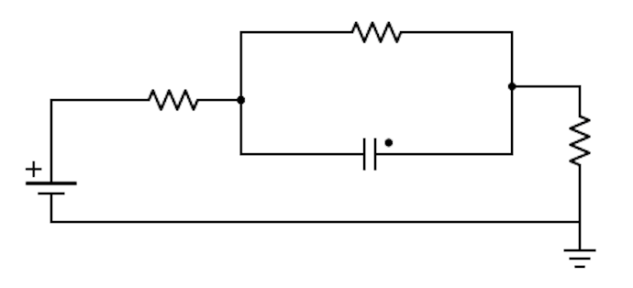
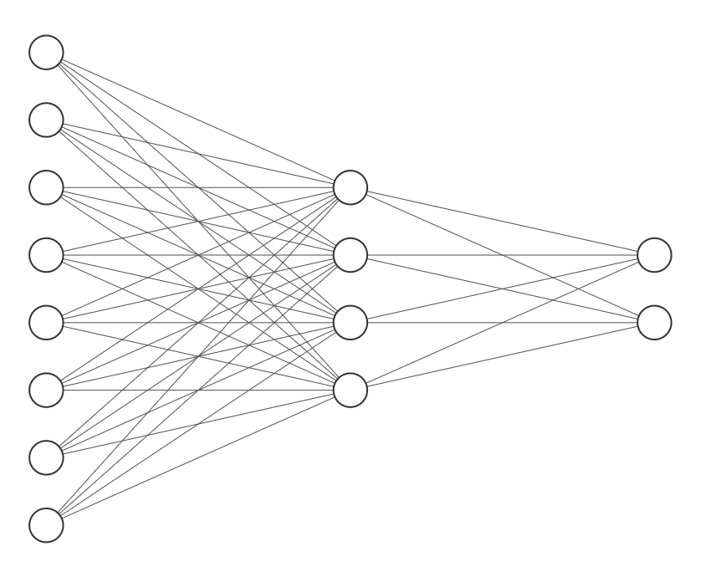
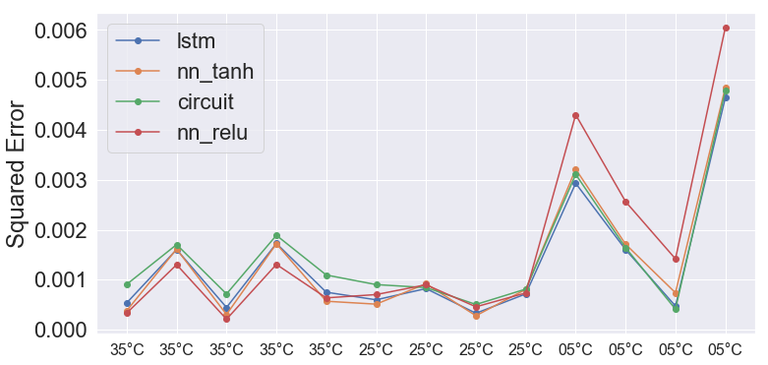
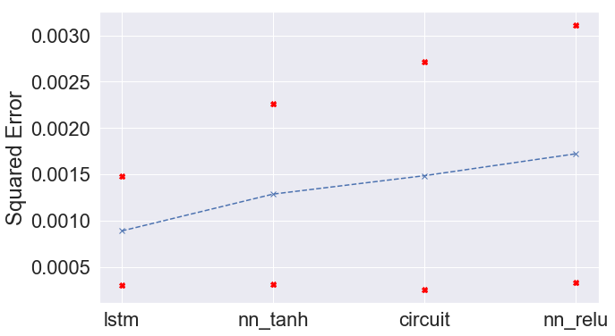
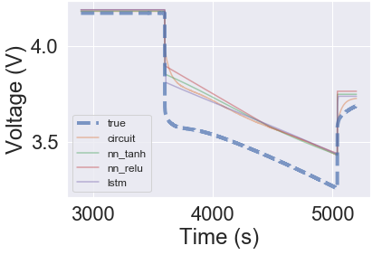
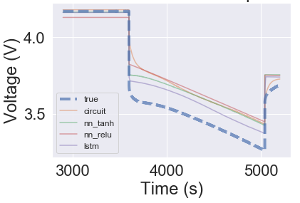
Machine learning based models for lithium ion batteries
Bradley Barnhart and Travis McGuire
{bbarnhar, travis.mcguire} @ stanford.edu
Motivation
Results
Our project aims to address whether ML can be used to model battery voltage
We hope ML may offer an alternative to equivalent circuit and physics models
Fig 3. ML generalizes for battery voltage prediction (Validation set 1)
Fig 4. Predictions generalize to new drive cycles, and error and temperature appear related
(Validation set 2)
Fig 5. Including temperature allows more complex fits, fit without temperature as input on left and with on right
(Validation set 2)
Fig 6. ML with temperature gives more robust prediction
(Validation set 2)
Fig 7. Average model performance on validation set with standard deviations
(Validation set 2)
Methodology
I
Fig 1. Circuit model architecture
Fig 2. ML model architecture
nn_relu and nn_tanh are 3 layer NNs with the architecture above and relu / tanh activations
lstm is a 2 layer NN with 20 recurrent neurons using tanh activations and sigmoid connections followed by 1 neuron FC linear layer
V
SoC
I
SoC
V
T
Data
Conclusions
Data were acquired from six NCR18650B cells at these temperatures and cycles
Temperature: 5°C, 25°C, 35°C
Cycle: Const. Curr., HPPC, US06, UDDS
Two runs were looked at using different validation sets, intending to address different questions:
Validation set 1: held out random drive cycles
Can the model generalize to data like training set?
Validation set 2: held out all US06 drive cycles
Is the learning applicable to new usage data?
ML models work, generalizing well to battery voltage prediction (measured by squared error)
ML models show promise generalizing to previously unseen drive cycles, especially after incorporating temperature
Acknowledgements
We would like to thank our mentors Anirudh Allam, Thomas Navidi, Simona Onori, Ram Rajagopal, and Abbas El Gamal.

