Slide 1


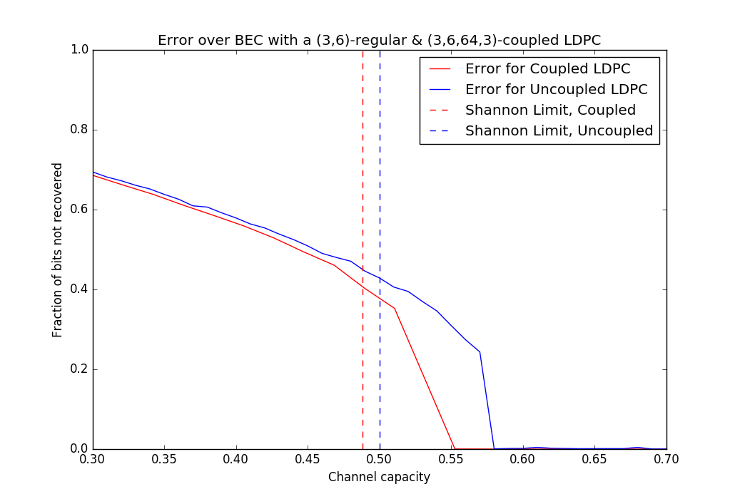
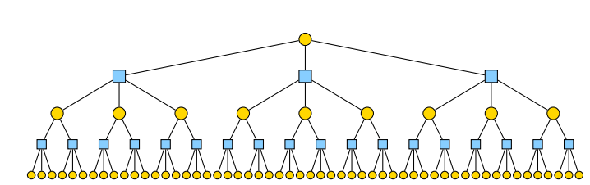
Spatially Coupled Low-Density Parity Check Codes
Geng Zhao, Bradley Emi
Abstract
LDPC Construction
Simulation Results
Low-Density Parity Check (LDPC) coding is a simple, but powerful linear block coding scheme which has been proven to approach the Shannon channel capacity in the large block size limit. In the LDPC scheme, redundant parity checks between bits in the block are sent over the channel. Parity checks and bit values can be viewed as nodes in a probabilistic graphical model called a factor graph, where parity checks are connected to the bit values that contribute to the check. A decoder based on the belief propagation algorithm on the factor graph can be used to determine the maximum likelihood codeword. Spatially coupled LDPCs, inspired by the supercooling phenomenon in statistical physics, are a special case of LDPCs which introduce a structured irregularity into the adjacency matrix. This structured irregularity acts as a seed for the belief propagation algorithm to converge with high probability in the same way a crystal can act as a seed for freezing a supercooled liquid. We implement and analyze spatially-coupled codes and discuss their strengths and weaknesses.
Further Work
Spatial Coupling
Rate loss of O(w/L) and large block length difficult to overcome in practical settings because node outdegrees must be small: Come up with improved performance in finite block and bounded rate situations, improve speed of convergence to the MAP limit
Understand more deeply the connection between statistical physics and spatial coupling/threshold saturation phenomenon
Although coupled codes are optimal in the asymptotic limit, it is unknown what the precise gap for a general channel is as a function of block length. Known to be N^{1/4} for polar codes, unknown for spatially coupled LDPC. Finding a tight bound on this gap is an important theoretical question.
Belief propagation on loopy graphs not guaranteed to converge to correct marginal probabilities over non-BEC channels. Need to understand shortcomings of algorithm on different channels.
Proving Optimality: Density Evolution
If the graph is locally sparse, from the perspective of a single variable node, the graph looks like a tree. We can calculate probability of a node being erased as the numbers of layers in the tree → infinity. This limit is the BP Noise Threshold.
Image Credit: Henry Pfister, A Brief Introduction to Spatially Coupled Codes
References
We can also (in theory) enumerate every possible input codeword given an output and calculate the probability of every input given the output and take the maximum a posteriori input. This succeeds if the error probability is below the MAP Threshold. It can be proved rigorously (Kudekar, Richardson, Urbanke) that in the limit as w, the coupling coefficient → infinity, BP threshold → the MAP threshold. The proof is outlined in the project report.
Costello, D. “Spatial Coupling vs. Block Coding, A Comparison,” Coding From Theory to Practice, UC Berkeley, Feb. 2015.
Hassani, S. Hamed. “Polarization and Spatial Coupling: Two Techniques to Boost Performance. “ PhD Thesis., EPFL, March 2013.
Iyengar, R., P. Siegal, R. Urbanke, J. Wolf, Windowed Decoding of Spatially Coupled Codes. IEEE Transactions on Information Theory, March 2012.
Kudekar, S., T. Richardson, R. Urbanke, Threshold Saturation via Spatial Coupling: Why Convolutional LDPC Ensembles Perform so well over the BEC. IEEE Transactions on Information Theory, Facets of Coding Theory: from Algorithms to Networks, 2010.
MacKay, David J.C., Information Theory, Inference, and Learning Algorithms. Cambridge University Press, March 2005.
Pfister, Henry D. “A Brief Introduction to Spatially-Coupled Codes and Threshold Saturation.” Chinese University of Hong Kong, June 22, 2015.
Pfister, Henry D. and K. Narayanan. An Introduction to Spatially Coupled Codes via Practical Examples. General Assembly and Scientific Symposium, Aug. 2014.
Urbanke, Ruediger. “Spatial Coupling: A Primer.” SP Coding School, March 2015.

