Slide 1
Analyzing EEG Scans (with DBSCAN and supervised learning)
By Bradley Kaplan
Advisor: Professor Timothy Hickey

Slide 2
Background
Have CSV files of EEG scan data using 4 nodes across 5 types of brainwaves (20 total variables)
People were scanned in several sessions each for about 20 minutes each session, spending about 5 minutes doing each of the following (in order): math GRE problems, meditating with eyes closed, verbal reasoning GRE problems, and meditating with eyes open

Slide 3
DBSCAN
Used DBSCAN unsupervised learning method to separate observations
Constructed an objective function to optimally find 2-4 separate groups (since there were 4 separate activities) but also rewarded finding up to 12 groups (due to basis paper) and then penalized additional groups
Equation: 2*size of 2nd group + 2.5*size of 3rd group + 3*size of 4th group + 1.7*size of 5th group (if above median size) + … +1.0*size of 12th group (if above median size) - 1.35*size of things not counted or in the 1st group
Maximizing the objective function for a chosen session produced 3 groups (as well as noise group)

Slide 4
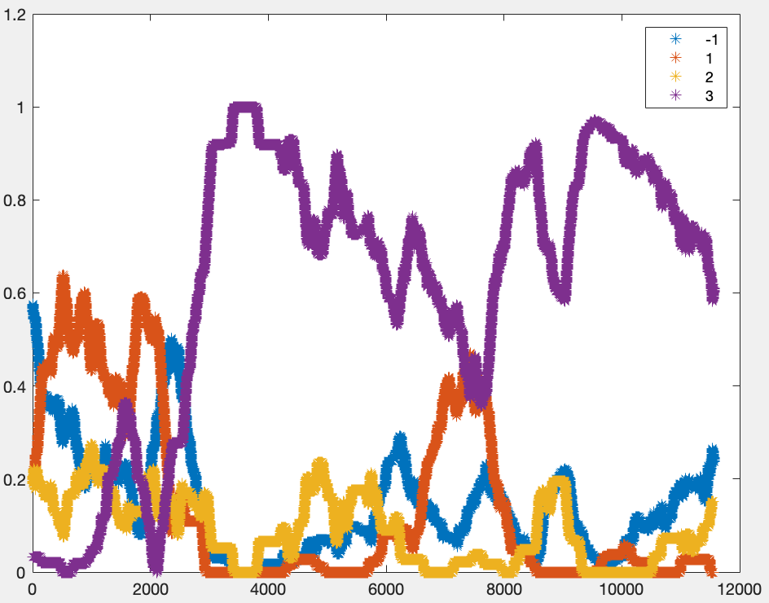
DBSCAN results of 1 session percent density graph (timestep = 500 rows = 50 seconds)
-1 is the noise category

Slide 5
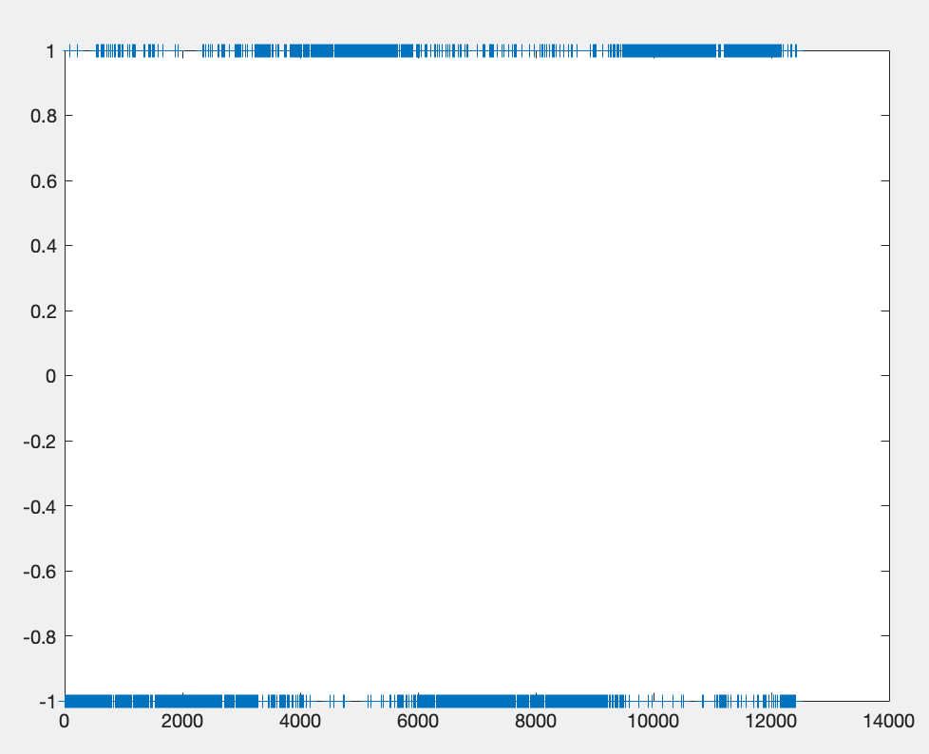
Supervised Learning
Used ensemble categorical learning (built in MATLAB method, using LogitBoost) to see if it could sort GRE and non-GRE activities and got promising results
This graph is the most promising, using a single session as training data for a completely different session (-1 is associated with GRE, 1 is associated with meditation)

Slide 6
Future Research Ideas
Are optimal parameters for DBSCAN mostly consistent across scan sessions?
Does labeling the noise category (after masking labeled data) from DBSCAN produce something promising?
Can DBSCAN be used with supervised learning to mask some noisy data and improve results through that?
Is there a critical mass of data where supervised learning becomes significantly more accurate for a single person or across people?
Does integrating confidence scores for supervised learning seem to improve accuracy?
How well does explicitly labeling 4 categories in supervised learning work?
Does calculating distance between observations in 20 dimensions provide something interesting?

Slide 7
Bibliography
Qu, Xiaodong, et al. A Personalized Reading Coach Using Wearable EEG Sensors A Pilot Study of Brainwave Learning Analytics. Accessed 5 June 2023.

