Slide 1
Masters of MongoDB
Day 54
May 23, 2016

Slide 2
Project Recap

Slide 3
Josh’s Advice For Next Time
The last 10% of work takes 50% of the time. Start early. Get to that last 10% quickly.
Practice, Practice, Practice This stuff isn’t a natural talent. You have to acquire it through hard work.
Don’t be afraid to take charge Learn to start being confident. Chime in when you can. Look for ways to lead in the groups you find yourself in.

Slide 4
Next Steps
Presentations Saturday: We will taking all day Saturday to present all applications.
Create a Guest Login: Make sure logging in for the presentation is easy. Add this guest login to startup of your App so anyone can pull your repo and start the code. Put creds in the README.md of your project.
List your Niche Skills on LinkedIn: All of you should be listing out Node, Express, SQL, Data Visualization, etc. on your Linkedin Pages.

Slide 5
Next Steps
List your Project on LinkedIn: If you don’t have a lot of tech experience on LinkedIn milk the project you created for all it’s worth – especially if it was really good.
Consider Writing each Other Recommendations: I will remind you about this later as well… but consider writing recommendations for your group members and peers. Right now, you all are “students”, but you won’t be for long. Spread the credit!

Slide 6
Road Ahead…

Slide 7




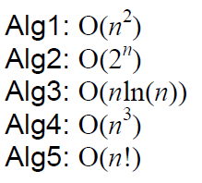
The Road Ahead…
Your Castle of Knowledge
Your Final Journey

Slide 8

This Should be You
A Castle of Knowledge

Slide 9

But if this is you…
A Crappy Castle of Knowledge

Slide 10
Double Down
Then it’s time to double-down and get caught up.
You have access to myself and the TAs for 2 months.
Look through the code base. Identify your weaknesses.
Schedule a help session during office hours.
And put in the hard hours!
This is the absolute best time to learn this material.

Slide 11
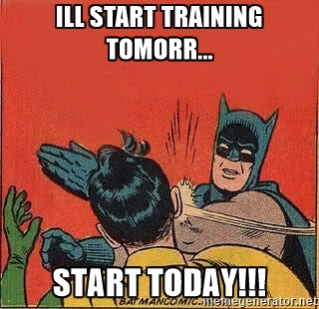
Start Now.
Because let’s be real.
You aren’t going to start when you graduate.

Slide 12
Your Goals – Beginning of the Year
“To land a solid career.. and be able to support a family.”
“Hope to make something of myself one day…”
“An opportunity to be more creative in my day-to-day work.”
“…to get a better paying job.”
“I want nothing more in the entire world than to be a game designer.”
“Change careers and become a web developer.”
“…to build mastery. To learn a skill that I haven’t yet explored.”
“[a chapter] better than the last.”

Slide 13
For Reference…
Students who tend to be doing well in our classes are putting in an average of 17 hours per week.

Slide 14
MongoDB

Slide 15

What’s MongoDB?
MongoDB is a very popular noSQL Database
It uses a document-oriented model as opposed to a table-based relational model (SQL)
MongoDB stores data in BSON Format (effectively compressed JSONs)
MongoDB has tons of drivers and packages for connecting to Node, C++, Java, etc.

Slide 16
Relational Databases (SQL)
ID | Title | Author | Published
1 | The History of Blah | Blah Matic | 2010
2 | The Chronicles of Blahrnia | Sir Blahston | 2011
3 | Love in the Time of Blah | Gabriel Garcia Blah | 2013
SQL relies on Joins to combine relevant data
Author | Email | Phone Number
Blah Matic | blahston@gmail.com | 911-546-5454
Sir Blahston | blahby@gmail.com | 911-544-5112
Gabriel Garcia Blah | blahby231@gmail.com | 125-215-5645

Slide 17
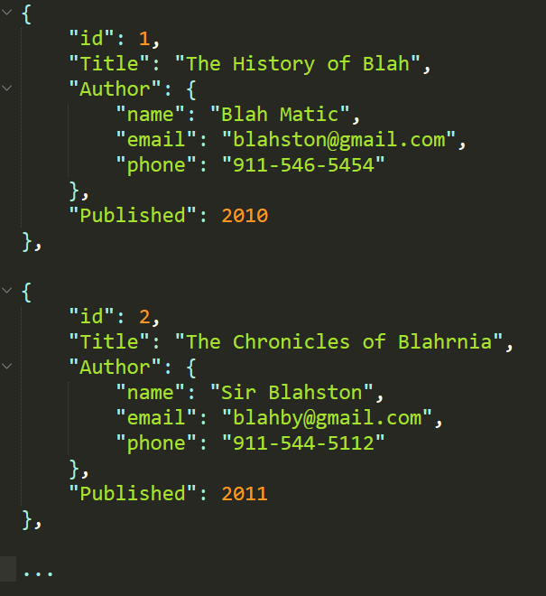
Document Database (noSQL)
noSQL Databases on the other hand are effectively JSONs.
They excel at heterogeneous data formats and are easy to implement.

Slide 18
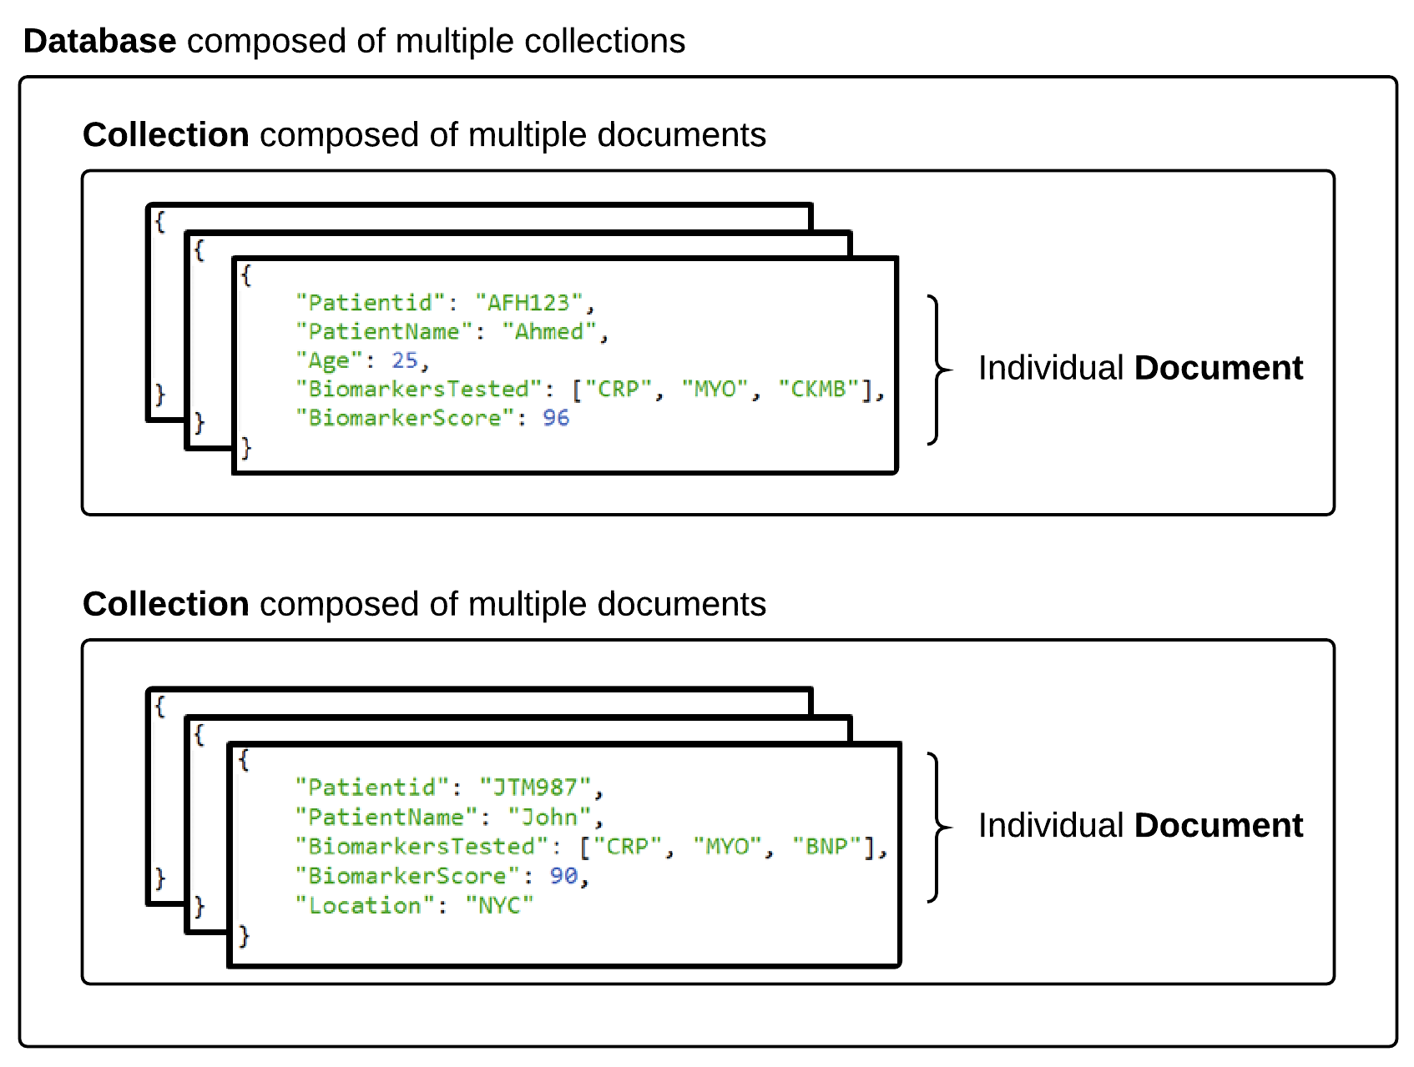

MongoDB Storage

Slide 19
MongoDB Storage
SQL Term | noSQL Term
Database | Database
Table | Collection
Row | Document
Field | Field
Terms are slightly different in the noSQL context.
Take note!

Slide 20
> YOUR TURN!!
Quick Activity:
Work with your neighbors to research the following
What are the advantages of using a noSQL database like MongoDB according to the MongoDB Website?
What are the advantages of using a noSQL database like MongoDB according to the web (places like Quora)?
What are the disadvantages of using a noSQL database like MongoDB according to the web (places like Quora)?

Slide 21
Code Time!

