Slide 1
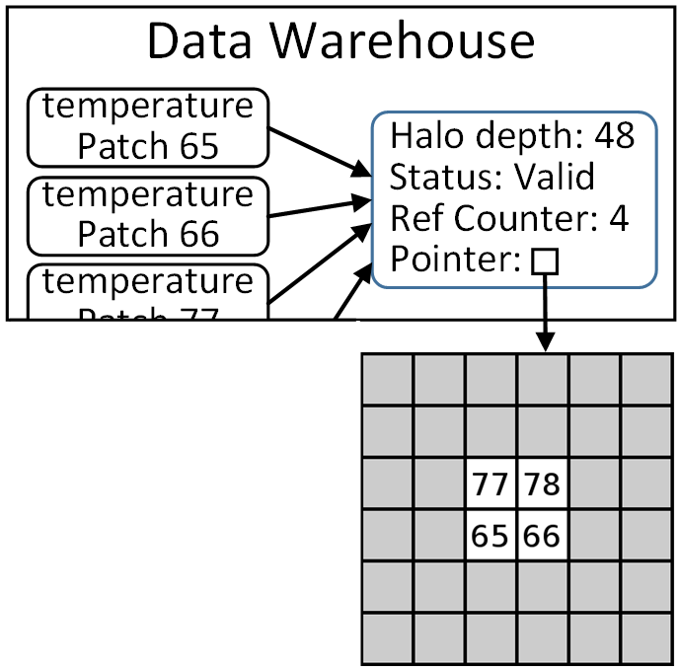
Global Halos - Avoiding Duplicated Halo Data in GPU Memory
Scenario: Large halos fully encompasses adjacent neighbor patches.
Support added for Uintah to “box” groups of patches.
This boxing process can occur asynchronously and not block other scheduler threads.
End result: Avoids duplication of halo data. Memory usage significantly reduced.

Slide 2
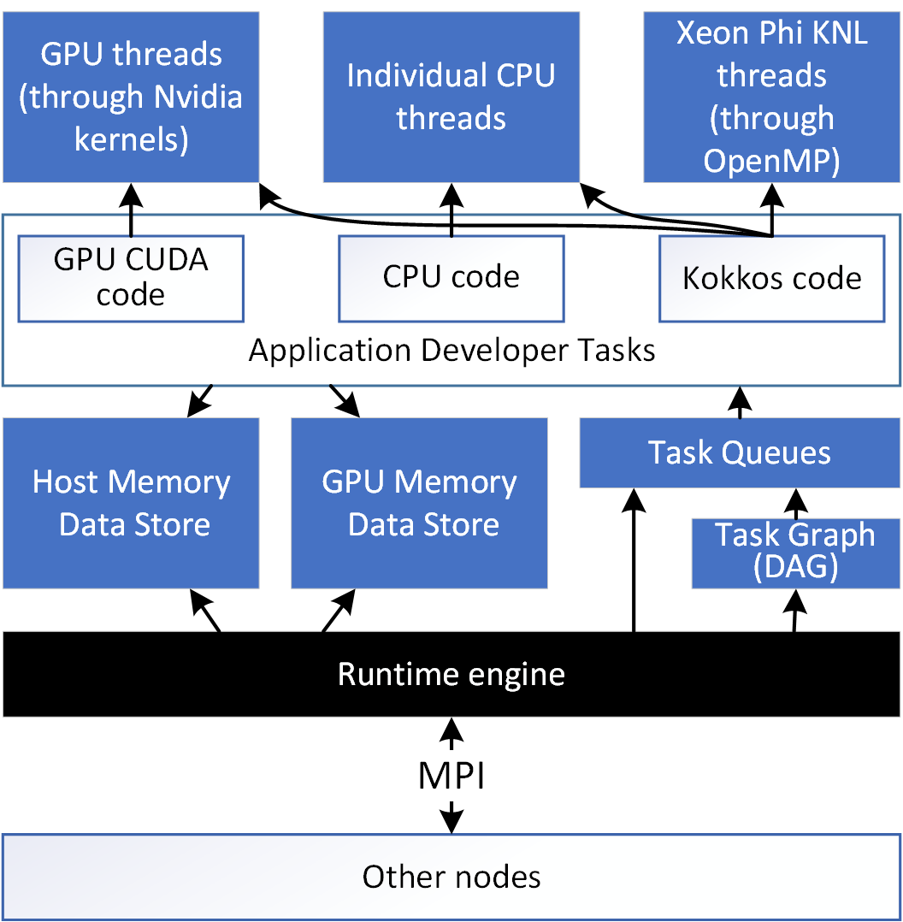
Using Kokkos in Uintah
Goal is to use Kokkos for code portability.
Uintah would not use Kokkos managed memory tools.
We already handle data coherency and task concurrency.
Additional work required to fully utilize Kokkos with Uintah for GPUs and Xeon Phis.

Slide 3
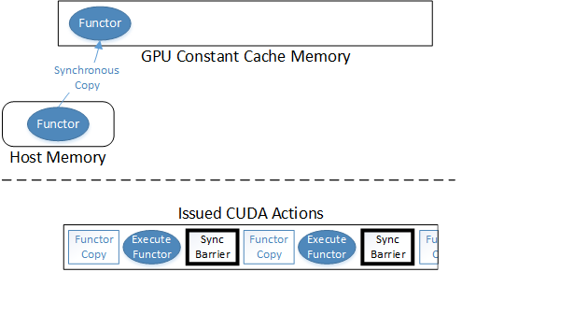
Current Status of Kokkos for GPUs
Kokkos::parallel_for loops compiled as functors using gcc, nvcc, Intel’s compiler, etc.
Task functor info placed into GPU Constant Cache Memory and executed.
Execution speed equivalent to CUDA code as GPU Constant Cache Memory acts as read-only registers.
Only supports serialized execution!
Also requires significant GPU synchronization which blocks other asynchrony (e.g. mem copies).

Slide 4
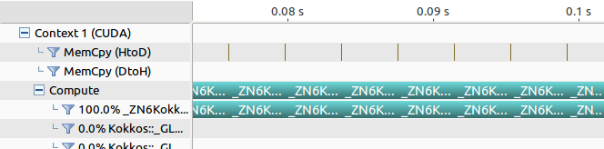
Current Kokkos – Serialized GPU Execution
Only one Kokkos functor can be executed at a time.
This makes it difficult to properly fill target GPU!
Uintah has many smaller GPU tasks. We need asynchrony to execute tasks and to fill a GPU.

Slide 5
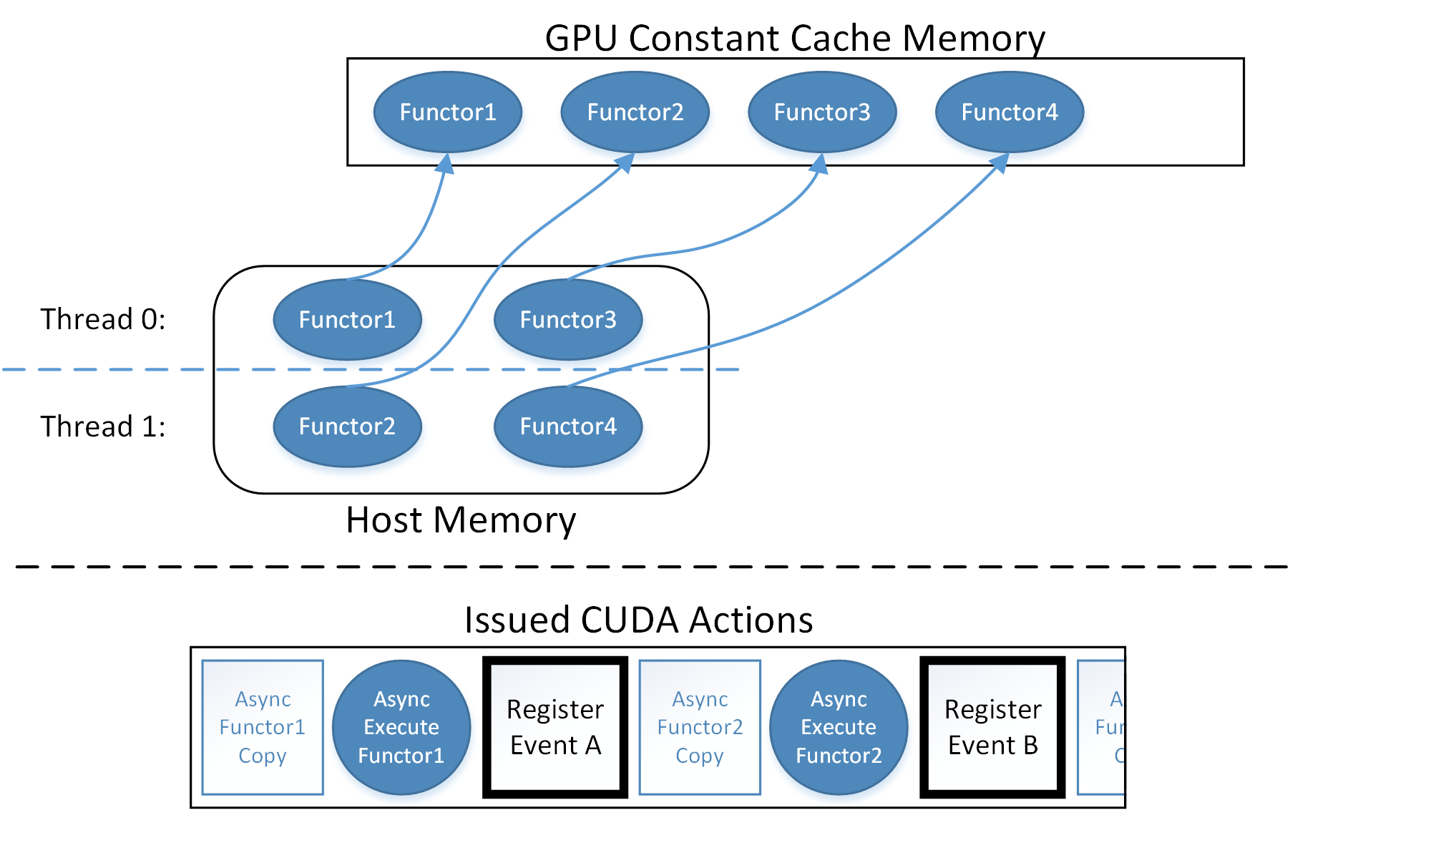
Modifying Kokkos for Multiple Functors
We implemented a lock free allocation bitmap for functors.
If the bitmap is full of functors, Kokkos checks all CUDA events to see if a prior functor completed, then can free that constant cache space.

Slide 6
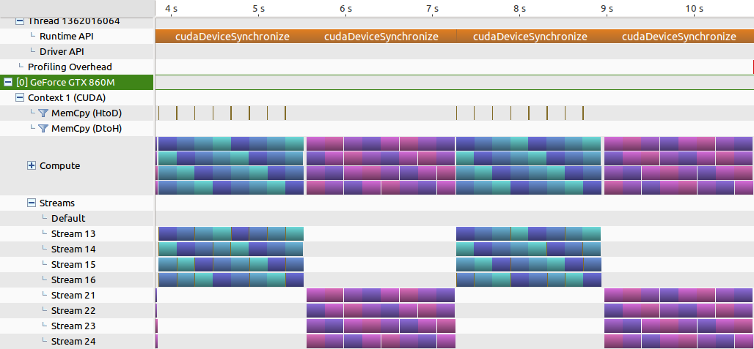
Current Kokkos Asynchrony Results
Blue is Kokkos parallel_for loops using Kokkos Cuda Instances.
Purple is CUDA code using CUDA streams (both code sets use same logic).
Both are executing on 4 streams and 4 different kernels/functors.
Work is preliminary.

Slide 7
GPU Asynchrony for Kokkos::parallel_reduce
Kokkos again requires modification, work is ongoing.
Significantly more complicated than Kokkos::parallel_for.
Needs asynchronous data movement within Kokkos for reduction result.
Also requires creation of some kind of Kokkos::future object to store the reduction result (C++11 futures do not provide needed features).
Fortunately much of the already completed parallel_for engine work can be reused here.

