Slide 1

Equip, Invest, Contract December 5nd, 2018
Final Project Presentation
EIC
Team member names
Mitchell Pebbles (PO)
Bruce Shepard
Henry Cheng
Bradley Puckett

Slide 2
EIC Goals/Overview
Final Project Presentation
Link students, professionals and companies
Provide system for recommended resources/getting help
Provide service opportunities for industry professionals
Provide labor for contract work to companies

Slide 3
Project Motivation
Final Project Presentation
Students want a website to link them with professionals and potential employers in a field and know the skills called for in these jobs.
We want web app lets students find these connections, learn from related resources, and find posted contracts on the site.

Slide 4
Project Goals
Final Project Presentation
Create a web application which links people wanting to learn a skill, industry professionals willing to answer questions, and companies wanting to contract work to people with desired skill sets.
All three parties will have access to a central resources page, which provides resources for students to reference/learn from, such as links to helpful learning sites/documents.
Students will be able to create connections with someone in their desired industry (a “buddy”) in order to ask them questions which are not clearly answered in the resources.
Companies are able to create contracts which students can view in order to learn the skills listed in the contracts.

Slide 5
Goals Achieved
Final Project Presentation
We were able to deploy a web application and create each specified account on it.
Company accounts are able to post resources and contracts that student accounts are able to view.
Students and industry buddies are able to find and connect with one another.

Slide 6
Project Challenges
Final Project Presentation
The interfacing between unfamiliar technology created challenging issues in development and deployment.
Using Google’s token service for account tracking was useful, but created problems later in development and in replication of data for testing.

Slide 7
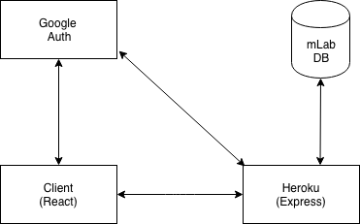
System Overview
Final Project Presentation

Slide 8
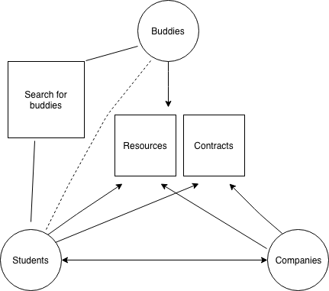
Account Relationships
Final Project Presentation

Slide 9
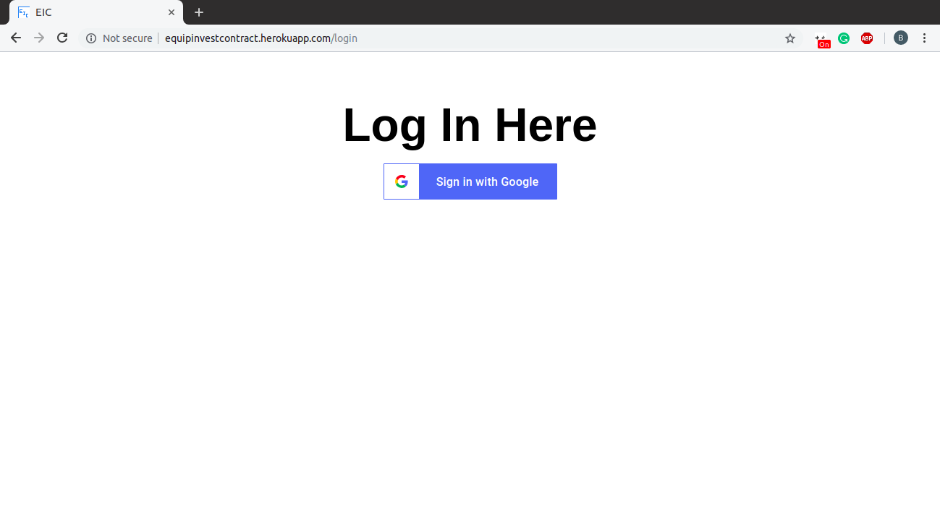
Workflow: Log in

Slide 10
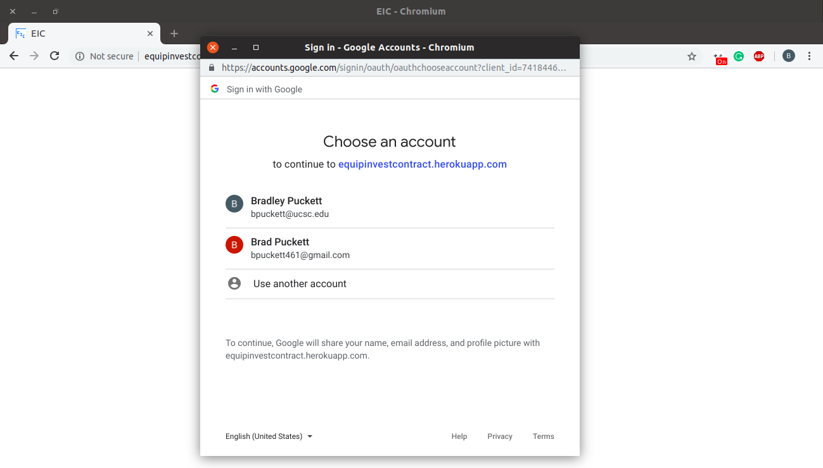
Workflow: Log in

Slide 11
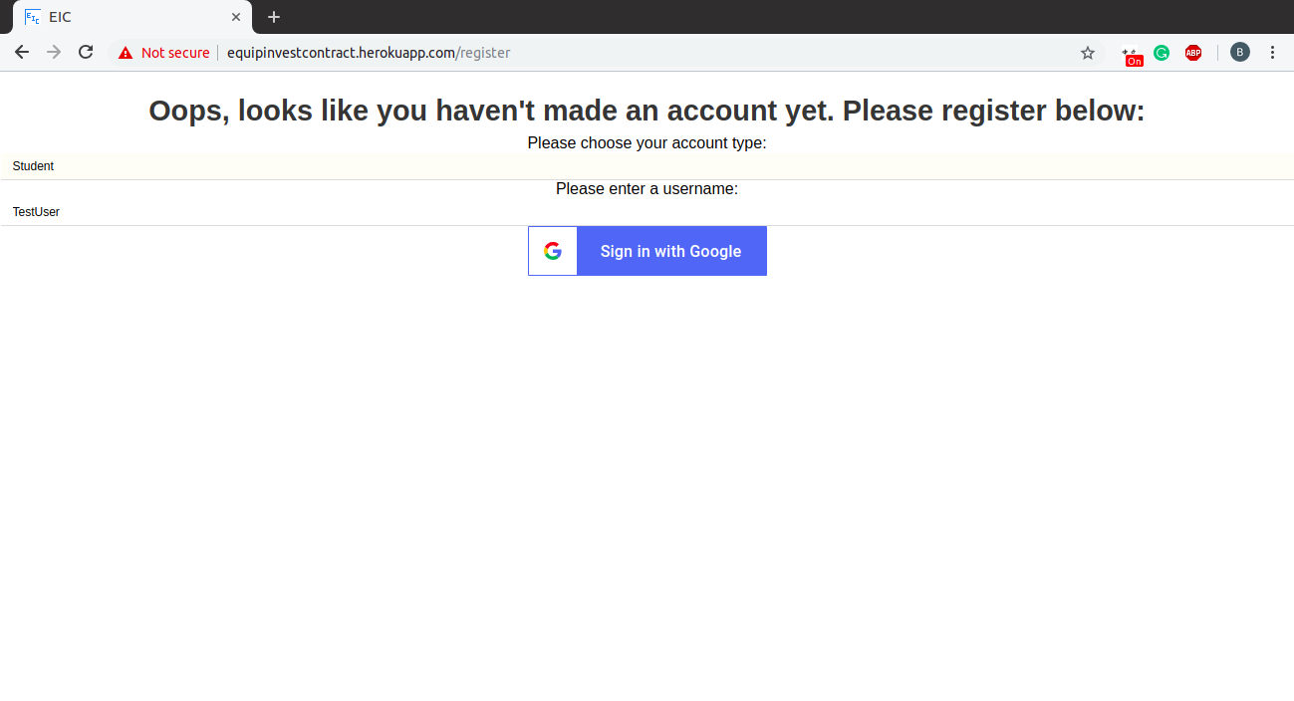
Workflow: Create account

Slide 12
Workflow: Create account

Slide 13
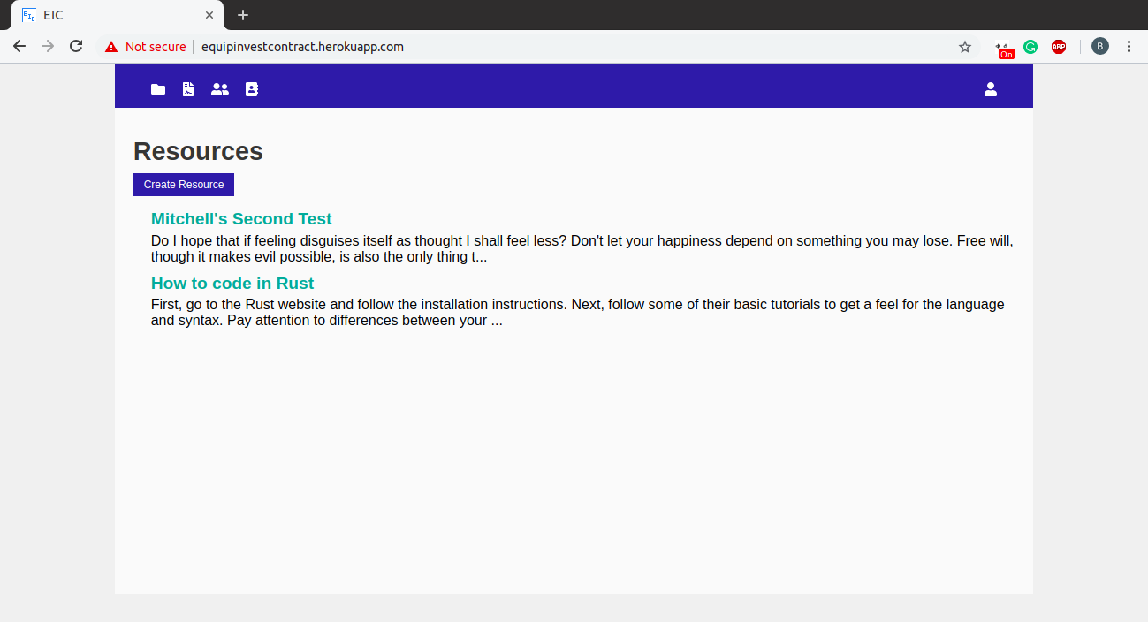
Workflow: Create resource

Slide 14
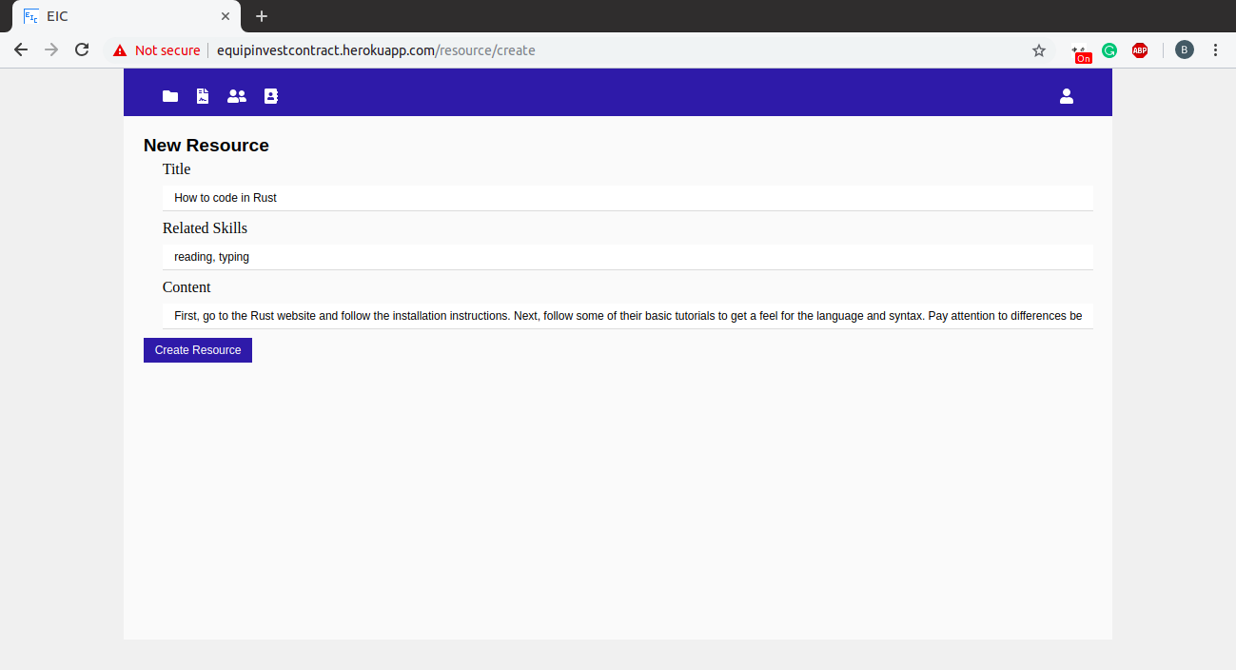
Workflow: Create resource

Slide 15
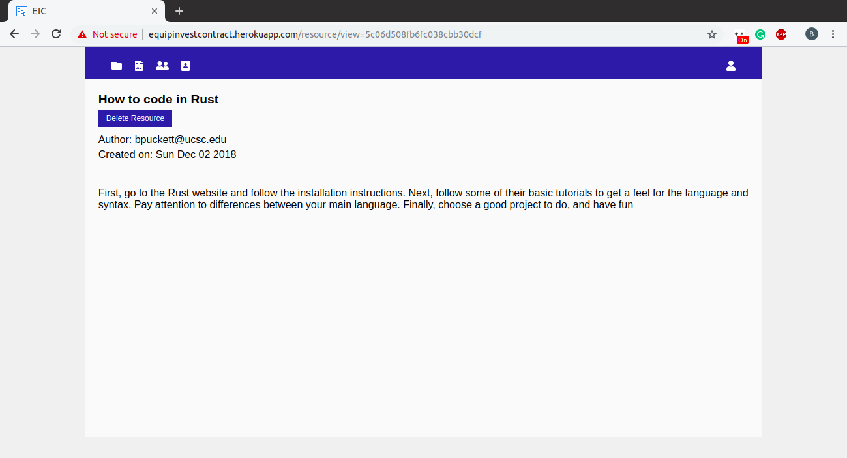
Workflow: Create resource

Slide 16
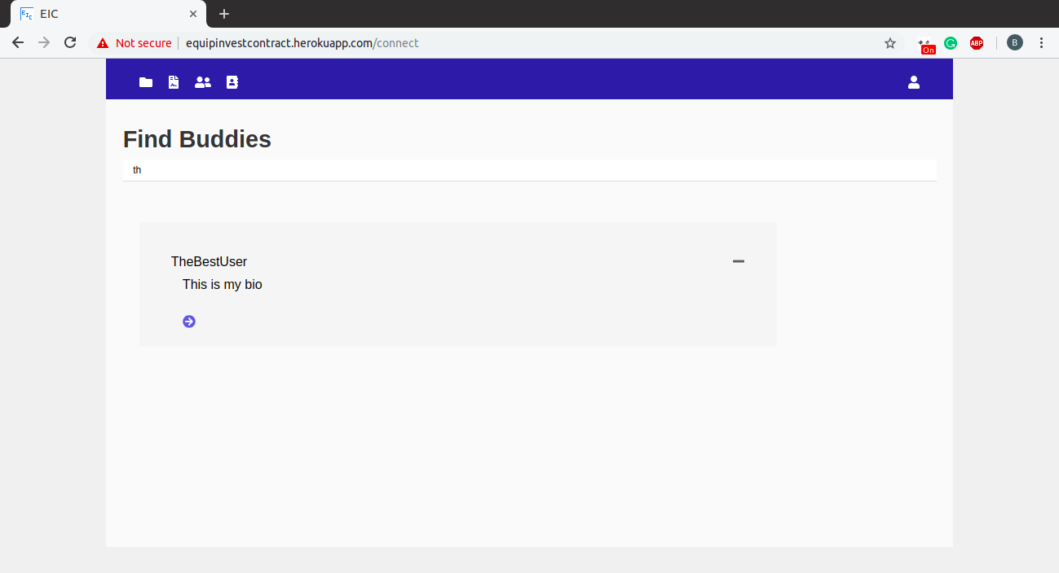
Workflow: Search for buddy

Slide 17



Technologies Used
Final Project Presentation

Slide 18





Technologies Used
Final Project Presentation
Google Drive
Document collaboration
Chai
Express server unit testing
Prettier-atom
Automatic code formatting
Heroku
Application hosting
ESLint
Static analysis

Slide 19
Project Management
Final Project Presentation
Scrum Methodology
Product Owner and Scrum Master
Sprint review
Daily Scrum
Use of Slack
Used to communicate with teammates

Slide 20
Overall Experience
Final Project Presentation
Enjoyed
Working together as a team
Learning together
Getting experience on a new platform
Didn’t enjoy
When different technologies don’t work nicely together

Slide 21
Lessons Learned
Final Project Presentation
What Worked
Communicating constantly and being responsive
Completing each task and properly unit testing them
Starting early
What didn’t work
Having user stories that were dependent on each other finished at different times
What we wished we did
Implemented unit testing earlier

