Slide 1

Equip, Invest, Contract October 10th, 2018
Project Release Plan
EIC
Team member names
Mitchell Pebbles (PO)
Bruce Shepard
Henry Cheng
Bradley Puckett (SM)

Slide 2
EIC
Project Release Plan
Link students, professionals and companies
Provide system for recommended resources/getting help
Provide service opportunities for industry professionals
Provide labor for contract work to companies

Slide 3
EIC
Project Release Plan – User Stories
Sprint 1 user stories
(32) User story 1 ("As a developer, I need to have a basic knowledge of React in order to build a modern front end”)
(32) User story 2 (“As a developer, I need to have a basic knowledge of Express.js in order to build a modern back end”)
(8) User story 3 (“As a developer, I need to have an initial database schema so there is cohesive design for the initial project prototype”)
(8) User story 4 (“As a developer, I need to have a high-level UI plan in order to prototype the app”)
(8) User story 5 (“As a team, we need to allow the front end React app to access data from the backend”)

Slide 4
EIC
Project Release Plan – User Stories
Sprint 2 user stories
(16) User story 6 ("As a student, I need to be able to create an account in order to use the platform”)
(16) User story 7 ("As a buddy, I need to be able to create an account in order to use the platform”)
(16) User story 8 ("As a student, I need to be able to send requests to a buddy in order to obtain buddies”)

Slide 5
EIC
Project Release Plan – User Stories
Sprint 3 user stories
(16)User story 9 (“As a student/buddy, I need to be able to send a request and accept/decline buddies”)
(16)User story 10 (“As a student/buddy, I need to be able to view and create posts to the central resource page”)
(8)User story 11 (“As a company, I need to be able to create an account”)

Slide 6
EIC
Project Release Plan – User Stories
Sprint 4 user stories
(16) User story 12 (“As a company, I need to be able create contracts for students to apply to”)
(8) User story 13 (“As a company, I need to be able to post to central resources page”)
(4) User story 14 (“As a company, I need to be able to contact students that they are interested in”)
(4) User story 15 (“As a student, I need the ability to contact companies that I am interested in”)

Slide 7
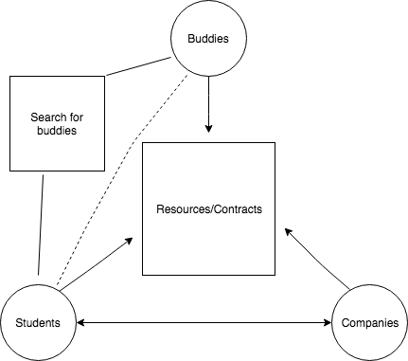
EIC
Project Release Plan – Architecture

Slide 8
EIC
Project Release Plan – Challenges/Risks
Challenge/Risk 1 : Working with unfamiliar technologies
Challenge/Risk 2 : Dealing with multiple frameworks
Challenge/Risk 3: Implementing multiple frameworks
together
Challenge/Risk 4: Working with new people

Slide 9
EIC
Project Release Plan – Technologies
Technology 1 React JS (Front-End)
Technology 2 Express JS (Back-End)
Technology 3 MongoDB (Database)

