Slide 1

Equip, Invest, Contract October 10th, 2018
Project Release Plan
EIC
Team member names
Mitchell Pebbles (PO)
Bruce Shepard
Henry Cheng
Bradley Puckett (SM)

Slide 2
EIC Goals/Overview
Project Release Plan
Link students, professionals and companies
Provide system for recommended resources/getting help
Provide service opportunities for industry professionals
Provide labor for contract work to companies

Slide 3
EIC
Project Release Plan – User Stories
Sprint 1 user stories
As a user, I need to have a web app served to me so I can access the platform
As a user, I need to have a UI so I can use the web app

Slide 4
EIC
Project Release Plan – User Stories
Sprint 2 user stories
As a student, I need to be able to create an account in order to use the platform
As a buddy, I need to be able to create an account in order to use the platform
As a student, I need to be able to send requests to a buddy in order to obtain buddies

Slide 5
EIC
Project Release Plan – User Stories
Sprint 3 user stories
As a buddy, I need to be able to accept requests from students in order to be a buddy to them
As a student/buddy, I need to be able to view and create posts to the central resource page so that there is content there
As a company, I need to be able to create an account so that I can use the app

Slide 6
EIC
Project Release Plan – User Stories
Sprint 4 user stories
As a company, I need to be able create contracts so that students see what I am looking for in a contractor.
As a company, I need to be able to post to central resources page so that I can provide helpful resources to students/buddies
As a company, I need to be able to contact students that I’m interested in order to notify them of my interest
As a student, I need the ability to contact companies that I am interested in order to apply for contracts

Slide 7
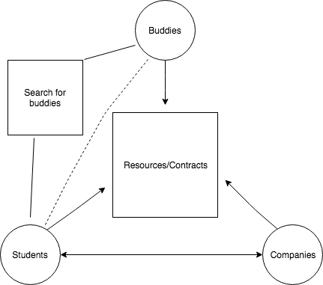
EIC
Project Release Plan – Architecture

Slide 8
EIC
Project Release Plan – Challenges/Risks
Challenge/Risk 1 : Working with unfamiliar technologies
Challenge/Risk 2 : Dealing with multiple frameworks
Challenge/Risk 3: Implementing multiple frameworks
together
Challenge/Risk 4: Working with new people

Slide 9
EIC
Project Release Plan – Technologies
Technology 1 React JS (Front-End)
Technology 2 HTML/CSS (Front-End)
Technology 3 Express JS (Back-End)
Technology 4 MongoDB (Database)

