Slide 1
SSRS Subscriptions
Bradley Schacht
Twitter: @BradleySchacht
Email: BSchacht@PragmaticWorks.com
Blog: www.BradleySchacht.com

Slide 2

About Me

Slide 3

About Me
BI Consultant and Trainer with Pragmatic Works
Blogs at BradleySchacht.com
Frequently travels to exotic locations such as Minneapolis, MN
Has spoke at past events like User Group, Code Camps, and SQL Saturdays

Slide 4
Problem?
“I need The Ninja report every day and I’m too lazy to go get it myself.” –Susan in Finance
“I’ll see what I can do.” –BI Developer
“But make sure Becky doesn’t see MY numbers.” –Susan in Finance
“Ummm….is this really about the report?” –BI Developer

Slide 5
Solution!
Reporting Services Subscriptions

Slide 6

Subscription Basics
Deliver data on schedule
Variety of formats
Variety of methods

Slide 7

Security
Recipient doesn’t need access
Owned by user creating subscription
Transfer owner programmatically(2008 R2 and later)
Modify and delete your subscriptions

Slide 8
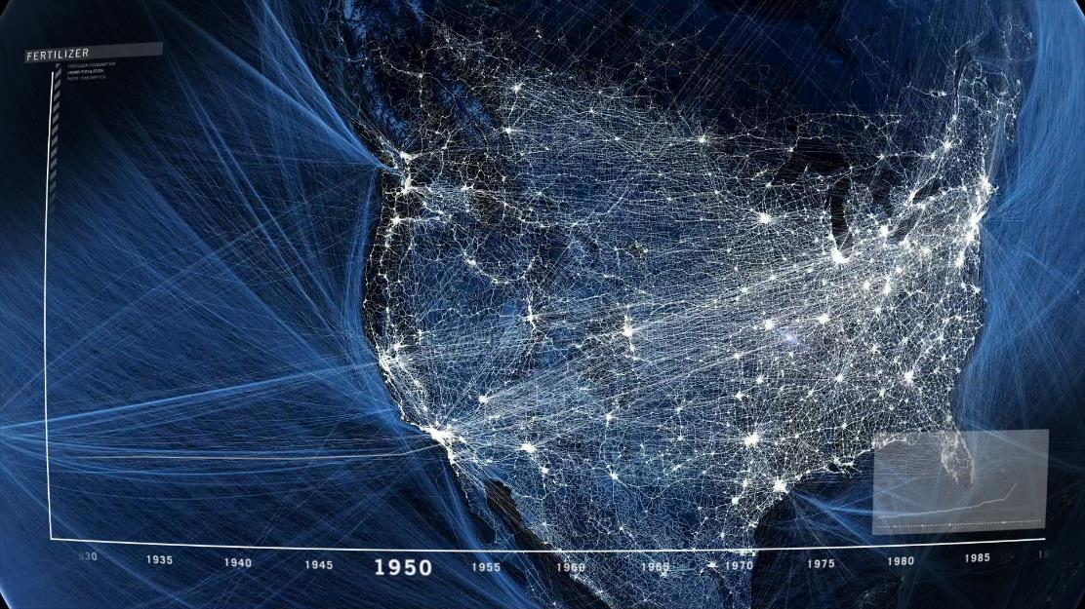
Types of Subscriptions
Regular and Data Driven

Slide 9

Subscriptions
Static reports (specify single parameter)
Schedule time or snapshot
One subscription = one file produced
Not dynamic. Plain. Boring.
Tied to a single report.

Slide 10
Subscription Delivery Methods
SharePoint Library (SP Integrated Mode Only)
Email (Must configure in SSRS)
File Share
Modify RSReportServer.config to remove options

Slide 11
Standard Subscriptions
DEMO

Slide 12

Data Driven Subscriptions
Dynamic report output
Parameters from query
Custom report data for each recipient
Vary output formats for each recipient
Tied to a single report

Slide 13
Data Driven Subscriptions
SharePoint Library (SP Integrated Mode Only)
Email (Must configure in SSRS)
File Share
NULL Delivery Provider
Modify RSReportServer.config to remove options

Slide 14
Data Driven Subscriptions
DEMO

Slide 15
Data Driven Subscriptions
Unique use: cache warming
NULL Delivery Provider
Reports run from cache not live

Slide 16
Data Driven Subscriptions
DEMO

Slide 17

Data Alerts
SharePoint Only
Notification of event (email only)
No data sent
Links to report

Slide 18
Data Alerts
DEMO

Slide 19
Questions and Comments
Bradley Schacht
Email: Bschacht@PragmaticWorks.com
Twitter: @BradleySchacht
Blog: www.BradleySchacht.com

