Slide 1

Hacking the Denver RTD
A snapshot of bus locations
By Grace, Sumner, Mark, Daniel

Slide 2

We’ve seen multiple valid ways to help with the “Where’s my bus!” problem. This approach assumes the user will search for a map and we can display relevant data in a meaningful way. The search could begin via mobile device or on site display. A website/mobile app should satisfy the former and on site equipment the latter.

Slide 3
Problem: I’m at the bus stop on the map, now where is the bus on the map?
Solution: Create a map of bus locations based on user chosen bus stop or route.
Means to an end: Prompt user for input. Get RTD GTFS-RT Open Data and parse based on user input. Identify and mark relevant busses on map.

Slide 4
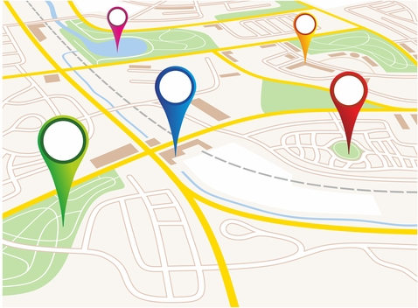
Software
Node.JS Server
HTML/JavaScript App
GTFS-RT data
Google Maps API
A Node.JS server that collects data from RTD through GTFS-RealTime data and a static JSON file. The data is sent to a web app by HTTP requests and visualised with the help of the Google Maps API.

Slide 5
Demo
Connect to CU Denver wifi
Enter this IP address into you browser
10.134.211.179:3001
Enjoy!
Sample route: 20
Sample stop: 12850,26108,
34118,17756

Slide 6
Future Improvements
Show traffic conditions (green, yellow, red).
Color coded bus route map.
Mobile app. Use web browser geolocation to eliminate user interaction.
Include all this in a demo at a popular bus stop.
Build a more robust server capable of sending out more specific information.

Slide 7




Closing
Multiple angles to tackle the “Where’s my bus!” conundrum. If we piggy back off each other an impressive application is only weeks/months away. Thank you for your time.
Questions? Comments?

