Slide 1
This Month's
Underprepared
Command Line Talk
Part Three
David Spencer
Bradford Linux Users Group
26th September 2012
formerly known as
HUMAN CENTIPEDE

Slide 2


Slide 3


Slide 4


Slide 5
Last time

Slide 6

Last time

Slide 7
This time

Slide 8
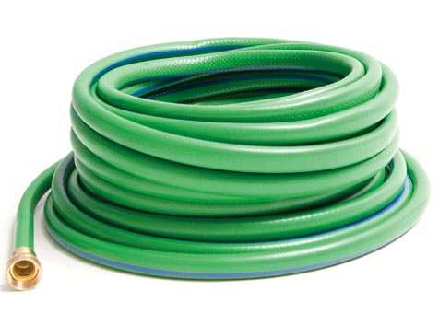

Slide 9
Next time

Slide 10


Slide 11


Slide 12
This time

Slide 13
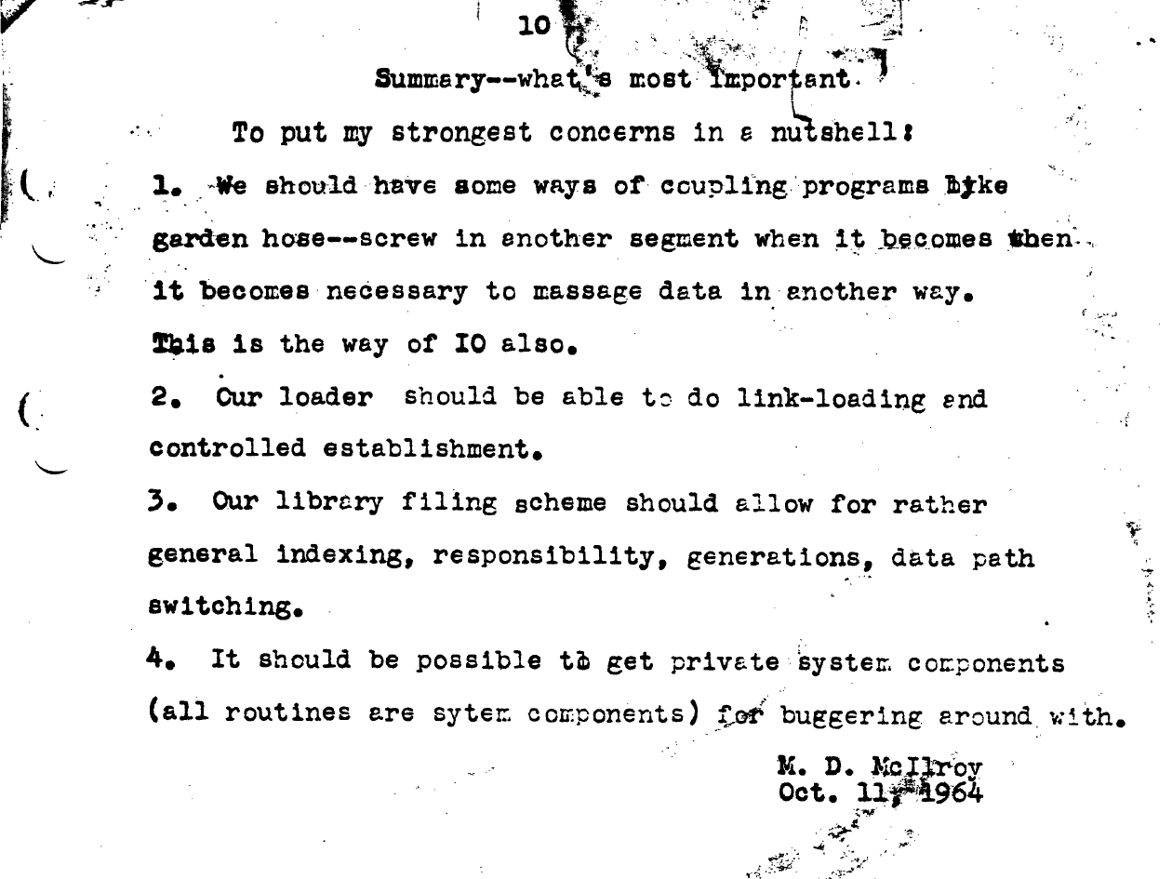

Slide 14
Notation
cmd1 | cmd2

Slide 15
Notation
cmd1 | cmd2 | cmd3
cmd1 < inputfile
cmd2 > outputfile

Slide 16
Unix / C input and output
0 stdin
1 stdout
2 stderr

Slide 17
cmd1 | cmd2
Efficient implementation
(in the kernel)
No worries about buffering, synchronisation, resources

Slide 18
cmd1 > outputfile
cmd1 >> outputfile
cmd2 < inputfile
cmd2 <infile >outfile

Slide 19
Trivial examples
Print the name of the newest file
ls -t | head -1
Print how many files
ls | wc -l
Concatenate three files
cat file1 file2 file3 > allfiles

Slide 20
Filter
Input stream
transform
Output stream

Slide 21
Filters
tr
sort
grep
cut sed
gzip bzip2 xz
fmt fromdos ffmpeg
and many many many more

Slide 22
More useful examples
dd bs=512 < /dev/cdrom > rip.iso
dd bs=512 < /dev/cdrom | \
cmp - originalimage.iso

Slide 23
Guess what this does
ssh user@host 'mpg321 -' < fart.mp3

Slide 24
Copy a disk image over the net
ddrescue bs=512 < /dev/sda | \
gzip | \
ssh user@host 'cat > sda.img.gz'

Slide 25
Standard error
Error messages don't pass down the pipeline...
... unless you want them to
cmd1 |& cmd2
cmd1 2>&1 | cmd2

Slide 26
A famous example
Read a file of text
Determine the n most frequently used words
Print out a sorted list of those words along with their frequencies

Slide 27
Knuth's solution
"Literate programming"
10 pages of Pascal
Custom data structure
Copious documentation

Slide 28
McIlroy's solution
tr -cs A-Za-z '\n' | \
tr A-Z a-z | \
sort | \
uniq -c | \
sort -rn | \
head -n

Slide 29
Recap of notation
cmd1 <infile | cmd2 | cmd3 >outfile
cmd1 >>appendfile
cmd1 |& cmd2
cmd1 >/dev/null 2>&1
cmd1 &> /dev/null
long_command --with-args \
--and-some <more_args

Slide 30

We learned something today

Slide 31

You can couple programs like
garden hose
Finding appropriate programs
is your job

