Slide 2
BradLUG:
the fifth year

Slide 3

We began with …
a birthday cake
selenium
pipes …

Slide 4
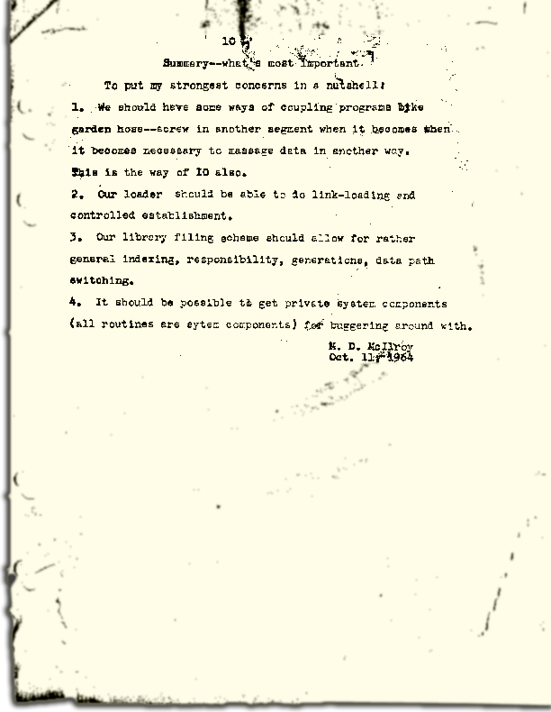

Slide 5

… another instalment in David's marathon survey of the command line which continued with contributions on:
wildcards
variables
scripts

Slide 6
BCB's loss …
… of a technician led to invitations to
advise them on finding a replacement
take over the IT slot in the station's schedule and
The first IT Stuff December 2012

Slide 7
The New Year brought …
A new treasurer ― Nick
A new night ― Monday
A trip to Airedale Fablab
A reorganised website

Slide 8
Shi and Kriss …
brought
Ghosts and Spies, their winning Raspberry Pi game, to the January meeting
Oculus Rift to the May meeting
themselves to IT Stuff

Slide 9

Some bleeding edge …
… developments in web scaling described by Alice involve moving from this
↓

Slide 10


through this →
to this ↓

Slide 11
Software presentations
during the year included …
Andy on GIMP
Shi on LMMS
David S on memtest86+
Alice on vagrant and Audacity
John H on inkscape and Xfig
Brian on FreePBX on the Pi

Slide 12
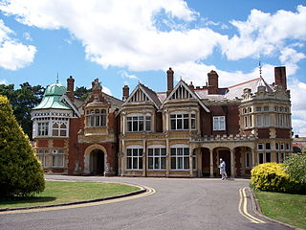
Summer brought …
A trip to
Bletchley Park
(image courtesy of Wikipedia)

Slide 13
David S …
… presented one outcome of the Stanbury Hill Project ― a research report produced using only free and open source software …
… in fact, all the software used during the project had been free and open source …

Slide 14

IT stuff covered …
Raspberry Pi
Bradford's ‘free’ WiFi
Microsoft's fine
Ubuntu's direction
RepRap
FabLab
the snooper's charter
Oculus Rift
Leeds Hack Day
and much much more …

Slide 15
Videos we saw included …
Steve Wittens on vector animation — along with some js1k demonstrations
John Graham- Cumming on Turing's curse

Slide 16

FOSS articles for CVS …
… covered
Web developments
LyX
GIMP
Mobile web strategy
Raspberry Pi
Coding Freedom
Samba

Slide 17
It's been a good year ―
what more can you say?

