Slide 1

David Spencer
Bradford Linux Users Group
21st July 2014
Slackware Linux
21 years and still not tried it?
What are you waiting for?

Slide 2
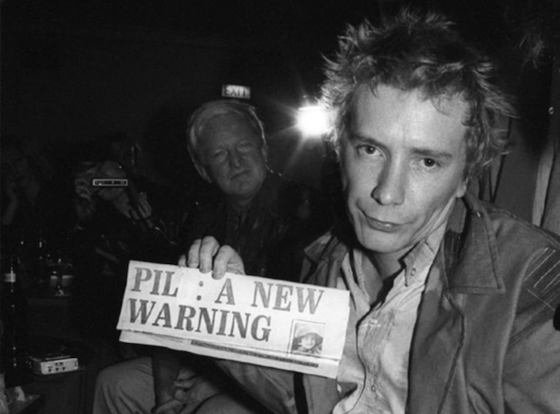
Public Image

Slide 3
Slackware is ...
based on
the best
dead
down
dying
too hard for me
fast
Source: Google Search predictive text

Slide 4
Slackware is based on
Slackware has been an independent distro since the first public release, branched from SLS
17 July 1993
(or 16th... timezone edge effects, like Apollo 11)
Quick Quiz:
Name other distros branched from Slackware
“Most Unix-like distro”
dubious claim: Unix is a moving target
but BSD-ish traditions are held in high esteem

Slide 5
Slackware is the best
Grow up and stop the fanboi rubbish!
It depends on your requirements
Diversity is good
Poor distros die
Better distros find a niche and survive
Empirically, Slackware has survived longest
which leads us on to...

Slide 6
Slackware is dead / down / dying
Empirically untrue
Bizarre memes of doom that will not die
Central team is agile
... occasional SPOFs
... which don’t matter: it’s not a rolling release distro, and the community is leet

Slide 7
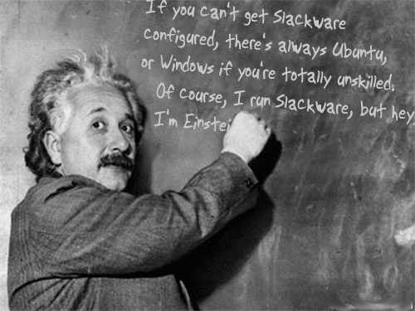
Slackware is too hard for me

Slide 8
Slackware is too hard for me
Geek nostalgia threads always have posts that say
‘I learnt Linux by starting on Slackware’
“Slackware is well known for its simplicity and the fact that we try to bring software to you in the condition that the authors intended”
Biggest problem is ‘deprogramming’ the expectations of people coming from other distros
prime example: the installer

Slide 9
Slackware is fast
Actually, no, it isn’t particularly fast
Most stuff compiled with ‘-O2’ for reliability
‘-march=i486 -mtune=i686’
Benchmarks? meh

Slide 10

Core Team
Core Values
It’s all about the
software
Stability
Simplicity
Minimally patched
Beer
Grateful Dead
Subgenius

Slide 11
Core team
Development:
Patrick Volkerding, Sebeka, MN, USA
(How would the NSA suborn such a man in such a place?)
Voluntary basis: Eric, Robby, Stuart, et al
Support:
Community support at LinuxQuestions.org
(officially designated by, but not run by, the Slackware Project)

Slide 12
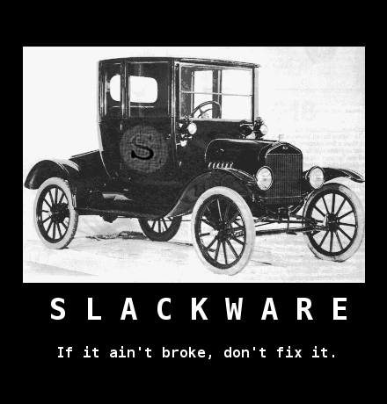
Core values
Stable
Simple
Pragmatic
Dogma-free
Independent
Agile

Slide 13
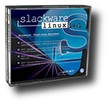
Release cycle
Approx 1 to 2 years
x86_64, i486, arm
Official DVD, downloads
Then occasional patches
going back many releases
Maybe six months after release
-current diverges from -stable
and the cycle begins again
slowly at first and ending in triumph :)
Often more up to date than other distros

Slide 14

Distinctiveness

Slide 15
What is a distribution?
Installer
plus
Package management
plus
Community
Not much else

Slide 16
Installer
Simple
like Debian...
... but simpler

Slide 17
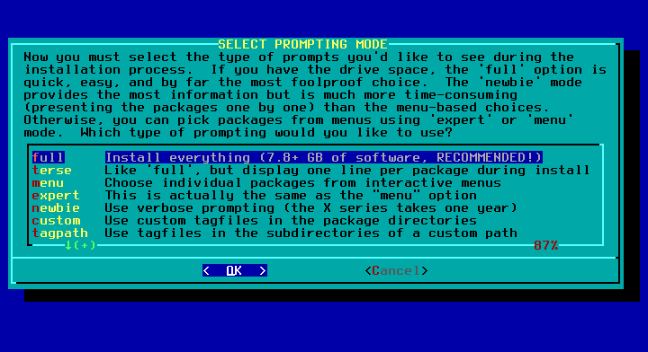

Slide 18
Package management
Not rpm
Not deb
SIMPLE
installpkg upgradepkg removepkg
slackpkg
Has no automatic dependency resolution
THIS IS A POSITIVE CHOICE
THIS IS A GOOD THING
THIS SAVES A METRIC FUCKTON OF HASSLE

Slide 19
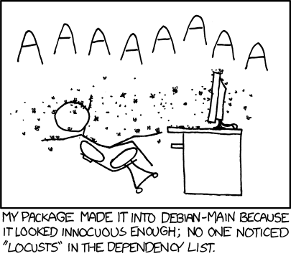
Dependencies

Slide 20
Dependencies
Just install everything
7.8 Gb of good stuff
all linked to work together
If you fancy trimming that, of course you can
(due to no automatic dependency resolution)

Slide 21
Package management
What if you want something
that’s not in
Slackware?

Slide 22
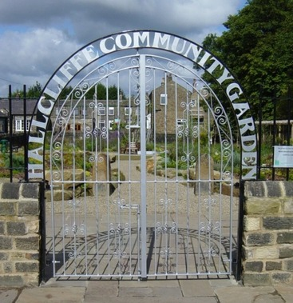
Community

Slide 23
Community
Common model for distros:
official core packages
community additions (PPA, AUR, ...)
The Slackware community
has a twist on this model

Slide 24
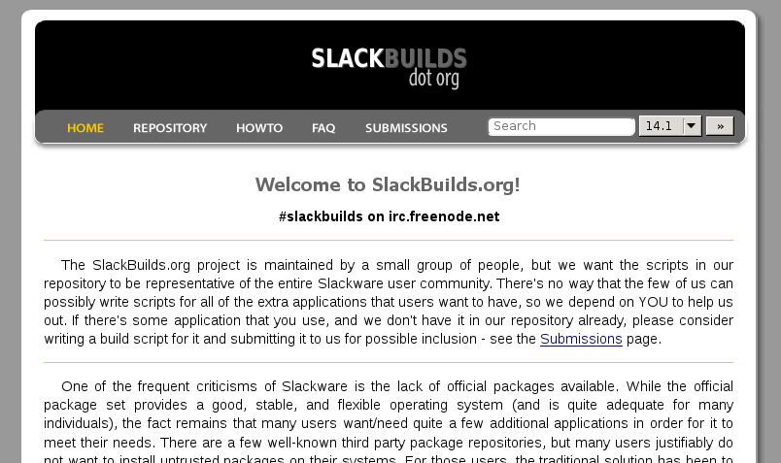
Community
Most distros are binary distributions
some distros are source distributions (most famously Gentoo)
The Slackware community has given this a twist
The core distribution is binary, but the communuity additions are predominantly source based

Slide 25
SlackBuilds - why?
Source based packaging solves some really hard problems
Trust
You Ubuntists install stuff from random PPAs,
how do you sleep at night?
Restrictive upstream licences
Oracle Java, Broadcom firmware, Flash, ...
Diversity
Every package is customised for your system and your options

Slide 26
SlackBuilds - the technology
Gentoo has ebuilds
Arch has pkgbuilds
Fedora has SRPMs
Slackware has SlackBuilds
Really really simple
just a shell script that does the needful
e.g. configure / make / make install
... or *anything*, as necessary
The core distribution is built this way
and the community provides them for >4000 additional packages
You can run them by hand
but the community provides easy to use tools
for end users to run them (sbopkg)

Slide 27
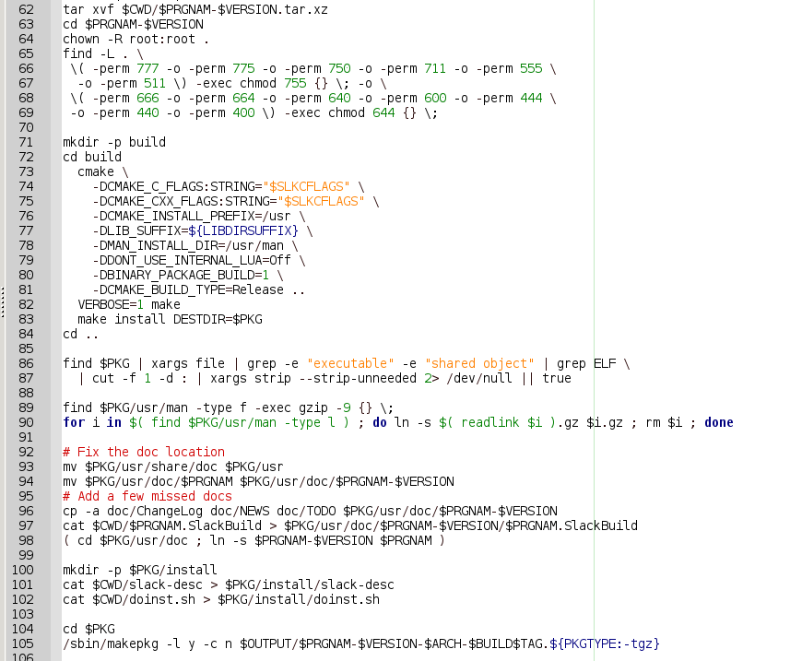

Slide 28
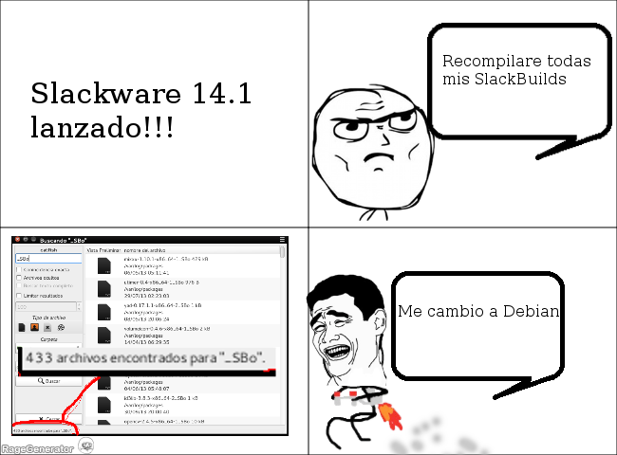

Slide 29
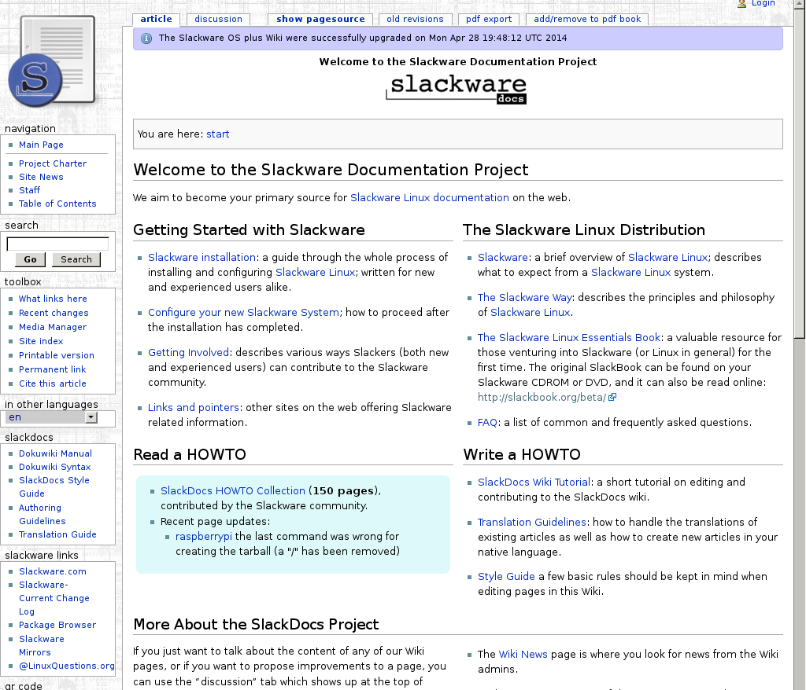
Community - documentation

Slide 30
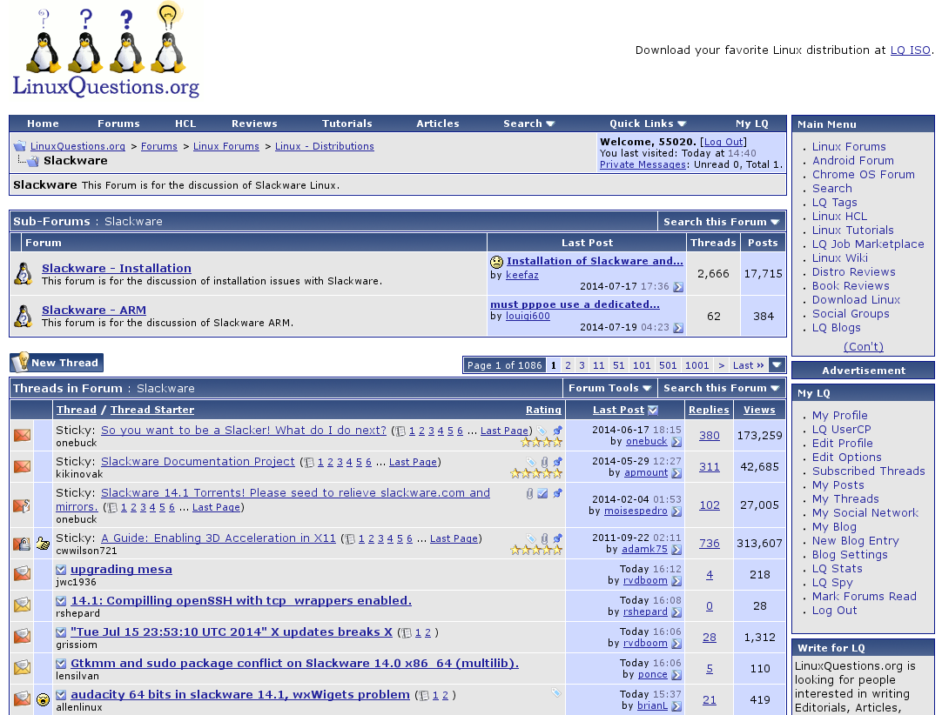
Community - support

Slide 31
Slackware Linux
21 years and still not tried it?
What are you waiting for?
Maybe it’s not for you
That’s ok
Diversity is good
The vitality of Linux depends on diversity
which is why you can shove systemd
up your corporate arses

