Slide 1


Configuration
Management
and
Salt
David Spencer
Bradford Linux Users Group
14 November 2016

Slide 2
So you’ve got a new lappie
you know the routine
wipe Windows, install Linux
add your favourite applications
customise the user environment
Remembered everything?
Bookmarks? passwords? documents?
Consistent with your desktop box?

Slide 3

So you’ve got a new job
lots of systems, big mess
and heaven knows you’re miserable now
What’s installed where?
Are they all set up right?
Are they all secure?
Are they all up to date?

Slide 4
lappie problem job problem these have the same solution
(maybe a tiny bit overengineered for just one lappie)

Slide 5
Configuration Management
control
single source of truth
captured and version managed
the power to make it happen
repeatably
scale
manage thousands as if they were one

Slide 6
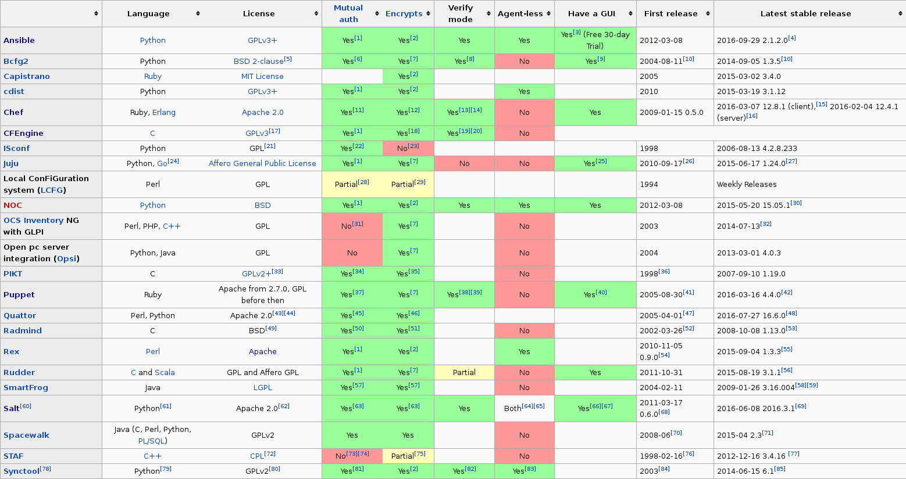
Comparison
https://en.wikipedia.org/wiki/Comparison_of_open-source_configuration_management_software
https://www.emir.works/configuration-management-battlefield/
http://blog.takipi.com/deployment-management-tools-chef-vs-puppet-vs-ansible-vs-saltstack-vs-fabric/

Slide 7


Ansible
Provisioning
Configuration Management
Application Deployment
Continuous Delivery
Security and Compliance
Orchestration
The name "Ansible" references a fictional instantaneous hyperspace communication system (as featured in Orson Scott Card's Ender's Game (1985), and originally invented by Ursula K. Le Guin for her novel Rocannon's World (1966)).

Slide 8

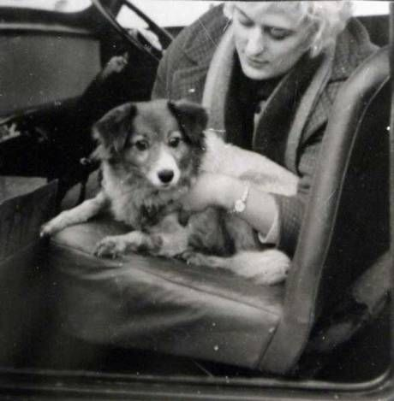
Puppet

Slide 9

Chef
bash awk grep perl sed df du
vi troff su fsck rm * halt awk awk awk

Slide 10

which brings us on to ...

Slide 11
Salt
daft name
“When looking for a name for the project, I was watching the Lord of the Rings and the topic of “salted pork” came up. Then it hit me: salt makes everything better. Thus the name Salt—because it makes system management better.”
Unrelated to libsodium, nacl, ...
daft non-metaphors (pillars, grains, mines)
“This is called the grains interface, because it presents salt with grains of information”
free software
“SaltStack is the company behind Salt”
“Salt is 100% committed to being open-source, including all of our APIs. It is developed under the Apache 2.0 license”

Slide 12
Implementation
Python – modular – extensible
ZeroMQ message handling
YAML configuration
Jinja2 templating
With or without agent

Slide 13


Structure
master
Config files
Rendering
State system
Secure message bus
minions
Secure message bus
Execute & return results

Slide 14
Terminology
target — which minions do I mean?
  a list, or a wildcard, or the whole roster
state — what do I want to end up with?
  declarative, not imperative
module — what will Salt do to make it happen?
  install, configure, remove files/packages,
  hiding differences between platforms
  run commands

Slide 15

Terminology
target — which minions do I mean?
  a list, or a wildcard, or the whole roster
state — what do I want to end up with?
  declarative, not imperative
module — what will Salt do to make it happen?
  install, configure, remove files/packages,
  hiding differences between platforms
  run commands
All that complexity
just to end up with the equivalent of a shell script?

Slide 16
Terminology
grain — data about the minion, calculated and stored on the minion when the minion starts
  operating system, hardware ...
pillar — data about the minion, configured on the master (by you)
  server roles, config parameters, secrets, ...
file server — somewhere on the master where you can keep files you’re going to send to the minion
  nothing special, but has templating, can access git

Slide 17
Setup
Install distro salt-master package on master
Either
  Install distro salt-minion package on minions
  start master and minion daemons
  exchange keys
Or
  Copy public ssh key to minions
  and use salt-ssh (agentless)
Then write and test configuration files

Slide 18
Configuration: YAML
Data structures as text
application independent
transformable to JSON
Off-the-shelf config format
Ugly, and picky as heck
until you compare it to XML
https://docs.saltstack.com/en/latest/topics/troubleshooting/yaml_idiosyncrasies.html
apache2:
pkg:
- installed
service:
- running
- enable: True
- reload: True

Slide 19
Configuration: Jinja2
Template engine
because YAML
isn’t sufficient
apache2:
pkg:
- installed
service:
- running
- enable: True
- reload: True
{% if 'htpasswd' in pillar %}
/etc/apache2/htpasswd:
file.managed:
- contents_pillar: htpasswd
- makedirs: True
{% endif %}
variable substitution
conditionals
loops
includes, macros
data structures
access to grains/pillars

Slide 20
When worlds collide
YAML is indentation sensitive (like Python)
so you can't use indentation to make Jinja readable
# WRONG
# The Jinja in this YAML comment is still executed!
# {% set got_apache = 'apache' in salt.pkg.list_pkgs() %}
# OFFICIAL SOLUTION
# The Jinja in this Jinja comment will not be executed.
{# {% set got_apache = 'apache' in salt.pkg.list_pkgs() %} #}
# BETTER SOLUTION
# more readable, doesn’t insert a blank line
# {# {% set got_apache = 'apache' in salt.pkg.list_pkgs() %} #}
YAML and Jinja are replaceable (but people tend not to)

Slide 21
Commands
salt [options] '<target>' <function> [arguments]
salt-ssh [options] '<target>' <function> [arguments]
salt-key salt-call salt-run
salt '*' test.ping
salt-ssh '*' -r 'df -k'
salt-ssh '*' pkg.list_upgrades
salt-ssh '*' system.reboot
salt-ssh newbox state.apply apache2
salt '*' state.highstate test=True

Slide 22

Chocolatey + Salt
a sane way to manage
a network of
Windows boxes
salt mylappie chocolatey.install wireshark
salt -G 'os:Windows' chocolatey.upgrade
salt '*' system.reboot

Slide 23
Only part of a bigger picture
Provisioning
Cloud, Containers
Monitoring
Workflow
Where do you stop?

Slide 24
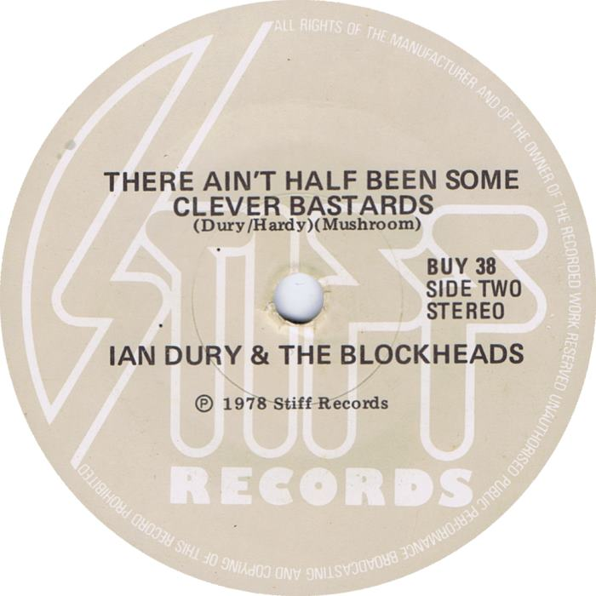
Clever stuff
Runners
  depending on one minion,
  do something on another
  (orchestration)
Events
  another application
  writes to message bus,
  master reacts
Cloud; Topology; Python API

Slide 25
Salt isn’t very good at...
Cleaning up obsolete states, random bodges
Random operational stuff (pssh/ClusterSSH)
Facilitating the handling of secrets
Expressing dependencies
Expressing simple things simply (YAML limitations)
Behold! the hellspawn of Cobol, Reverse Polish and Dokuwiki!
(but at least it's not XML or Ruby)
Orthogonality (why can’t I have a list? wildcards?)
Module documentation: “how” and “why”
Prototyping; debugging your config
  salt target state.apply newsls test=True

Slide 26
Salt isn’t very good at...
Salt is quite good at...
Atypical use cases
Unholy mix of policy rules, roles for instances, raw data
“Formulas” not well signposted, mostly atrocious
Configuration management :-)
Not trashing your boxes when you mess up
Respectful, constructive bugtracker dialogues
that date from 2014, went nowhere, and are still open

Slide 27
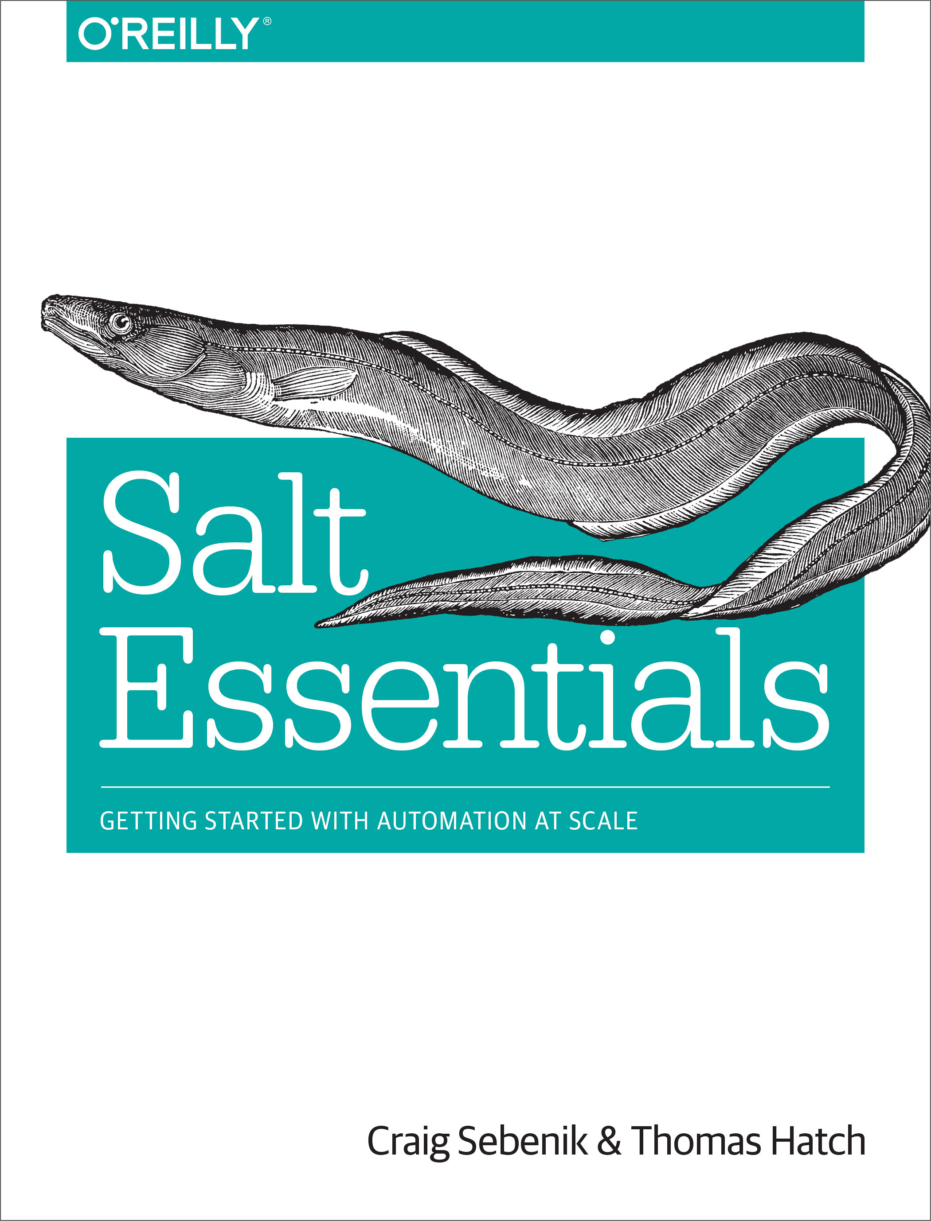
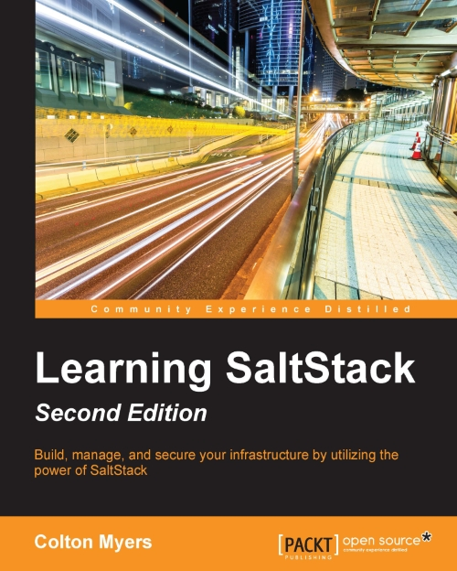
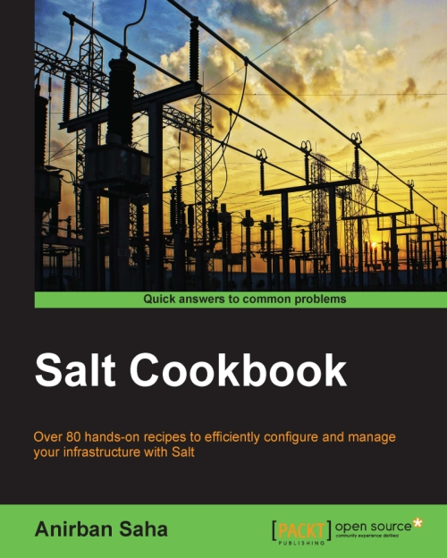
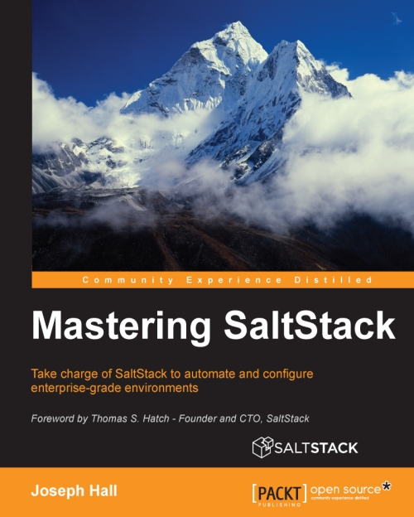
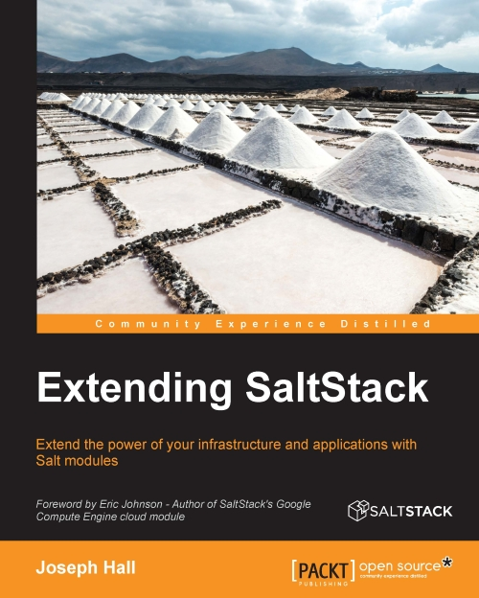
Resources
Formulas
https://github.com/saltstack-formulas
and plagiarism
Documentation
https://docs.saltstack.com/en/latest/contents.html
Tutorials
https://docs.saltstack.com/en/latest/topics/tutorials/
Salt best practices
https://docs.saltstack.com/en/latest/topics/best_practices.html
FAQ
https://docs.saltstack.com/en/latest/faq.html
Books
(preferably the PACKT one, top right)

Slide 28


