Slide 1
Bradford GNU/LUG
Thoughts on our second birthday
29 September 2010

Slide 2
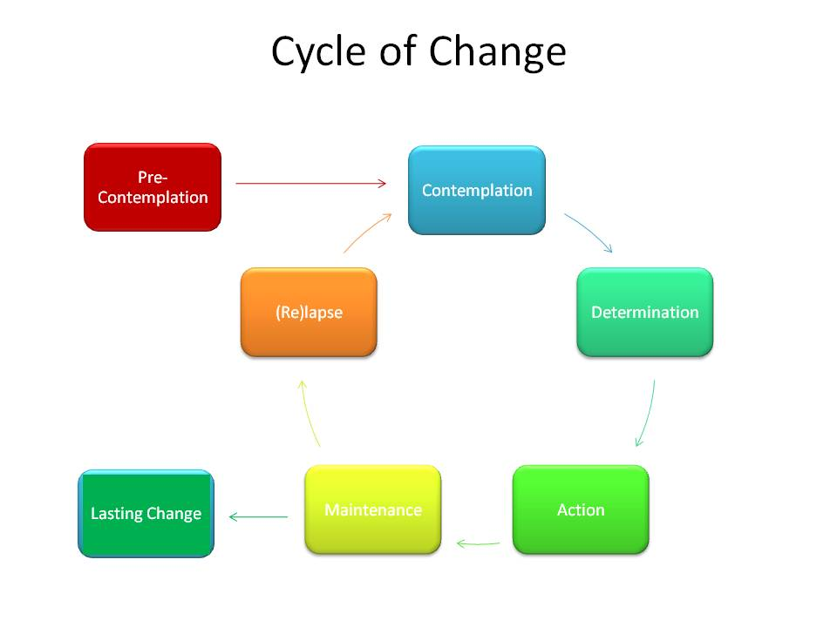
Anybody remember this?

Slide 3
Or this?

Slide 4
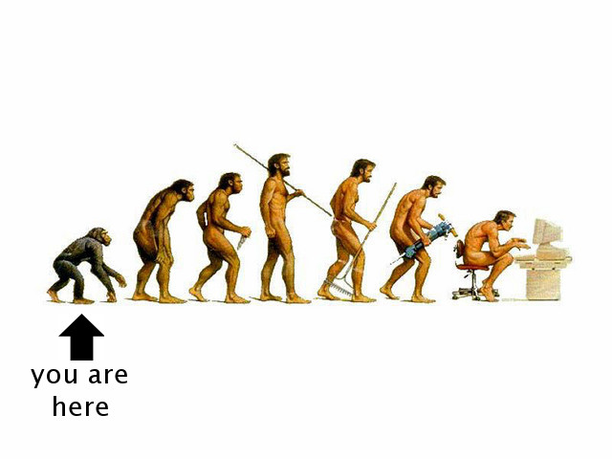
1
The digital revolution
Notes:
So what do I mean when I refer to a digital revolution in photography?
People are vaguely aware that film cameras have pretty much disappeared, but they rarely reflect on the deeper story of the digital revolution. Let's step back and contemplate what's been happening.

Slide 5
Likes (John)
Runs without a committee/bureaucracy
Diverse membership and participation
Wide range of topics covered
Opportunities for smaller groups to do own thing

Slide 6
Likes (group)
It's cheap, it's regular
Truly interesting people, no pretentiousness
100% fab
Like the talks, different perspectives
Cake is good/more talks
More talks/more guests/more show and tell/more competitions

Slide 7
Dislikes (1)
Haven't taken over the world yet
Do we want a plan for world domination or are we happy as a clique of awesome friends?
This pen is rubbish
Are we running out of ideas for talks?

Slide 8
Dislikes (2)
Lack of local business support/awareness
Less postit notes
Temperature of room
Talks too webtech, rather than Linux based
Lack of collaborative work

Slide 9
Other
New dictator RB
Unified agreed method of communication
Free room

Slide 10
Meetings (John)
Regular monthly meeting a useful anchor
No reason not to have lots of different meetings to suit different interests
Would only attend occasional ones beyond monthly meeting because of other commitments
Happy to contribute to/participate in tutorials/workshops

Slide 11
Meetings (group)
Regular monthly meeting plus mid monthly meeting for other talks/projects
A way to reimburse external speakers' costs and to invite more
People say what they have been doing in past month, what OS they favour and why
Talks split into talks and demos
More external speakers

Slide 12
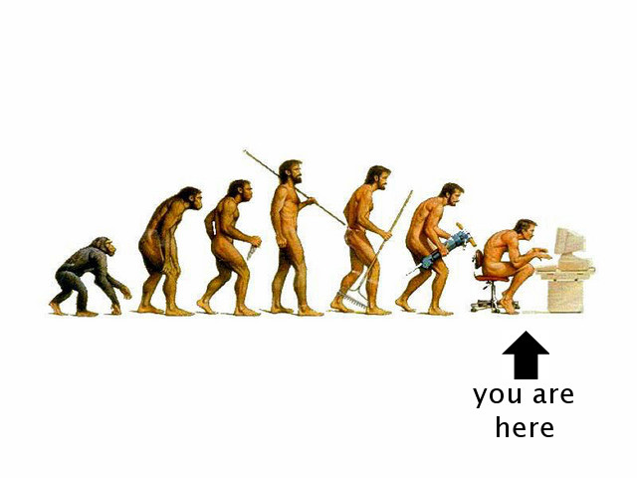
7
Wrap-up
Notes:
So that's it. Let's take stock.

Slide 13
That's all, folks

