Slide 1
The Great Command Line Chill-out Trilogy In At Least One Part
David Spencer
Bradford Linux Users Group
25 July 2012
Part 1
Ey Up Whats All Them Dashes About Then

Slide 2
Why?

Slide 3
Where do commands
come from?

Slide 4
sin(x)
function(a,b,c)
copy(old,new)
rm("-rf","/")

Slide 5
TERROR!!!
rm -rf /

Slide 6
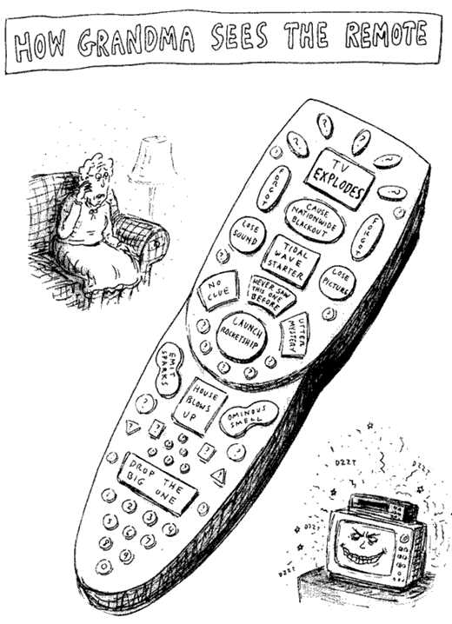

Slide 7
The shell

Slide 8
rm -rf /
/usr/bin/rm ("-rf", "/")

Slide 9
*.pdf
variables
scripts

Slide 10
The command itself

Slide 11
Does whatever it likes
Ultimate flexibility
No universal standard
(this sucks)

Slide 12
Lovelace (Ll)
The amount of force (measured in dynes)
it takes to draw a round ball
weighing e Troy Ounces
down a tube it fits exactly (in air)
at a speed of pi attoparsecs/microfortnight

Slide 13
You
MUST
read the manual

Slide 14
Learn the commands you need, one by one
Read the manual, all the time
Take notes
Keep useful snippets
Keep them in a personal wiki like tomboy or dokuwiki
Copy and paste them when you need them
It's what everyone does, don't feel insecure!

Slide 15
How to read the manual
(RTFM HOWTO)

Slide 16
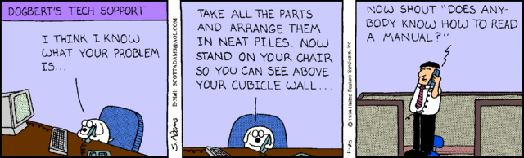

Slide 17
1 Commands (Programs)
2 System calls
3 Library calls
4 Special files (devices)
5 File formats and conventions
6 Games
7 Conventions and miscellaneous
8 System management commands

Slide 18
man 1 sleep -> sleep(1)
man 3 sleep -> sleep(3)

Slide 19
NAME
SYNOPSIS
DESCRIPTION
EXAMPLES
SEE ALSO

Slide 20
SYNOPSIS = SYNTAX
filenames
control arguments
keywords
other stuff

Slide 21
[optional]
repeated in a list...
this | that, also comma
-control_args
ORDER IS IMPORTANT

Slide 22

THE LIVING HELL
OF
CONTROL ARGUMENTS

Slide 23
ls -l -r -t /tmp
shortened to
ls -lrt /tmp

Slide 24
Not enough letters?
Longer control arguments
often with double dash
e.g. ls
sometimes with single dash
e.g. xpaint

Slide 25
What if a file name
starts with - ?
rm -- -silly-filename

Slide 26
Control arguments can have arguments
Sometimes with =
wget --secure-protocol=auto --timeout=30 -i - -O /tmp/ppv6.tmp
Sometimes without
ip6tables -A FORWARD -p tcp --tcp-flags SYN,RST SYN -j TCPMSS --clamp-mss-to-pmtu

Slide 27
Control argument or keyword?
Subcommands often use keywords
e.g. git add, git commit, git push
but not e.g. mdadm --build, mdadm --monitor
Sometimes a keyword is just a keyword
parted -s --align cylinder /dev/sdb

Slide 28
keywords with =
dd if=inputfile of=outputfile bs=1024
keywords without =
ifconfig eth0 192.168.128.0 netmask 255.255.255.0

Slide 29
Atrocity exhibition
tar xvf backup.tar.gz
cdrecord -v speed=4 dev=/dev/cdrom -eject -data ubuntu.iso
tail -40 /var/log/messages
set -x, set +x

Slide 30
When man pages go bad
poorly written
GNU info?!
read online
watch out for duff sources

Slide 31
Focus on the EXAMPLES
Follow what other people do (web articles etc)
Keep on trying variations until it works, then make notes
Once you've got something sussed, stick to what you know

Slide 32

We learned something today
You're hopelessly confused because
it's hopeless and confusing

Slide 33
IN THE NEXT EPISODE
Files and the commands that devour them:
The Unix Filestore and GNU Coreutils

Slide 34
Reading list
The Elements Of Style: UNIX As Literature
Thomas Scoville
http://theody.net/elements.html
In The Beginning Was The Command line
Neal Stephenson
http://www.cryptonomicon.com/command.zip
History of UNIX Manpages
http://manpages.bsd.lv/history.html

Slide 35
Final Thought
Mastery of UNIX, like mastery of language, offers real freedom.
The price of freedom is always dear, but there's no substitute.
Personally, I'd rather pay for my freedom than live in a
bitmapped, pop-up-happy dungeon like NT.
I'm hoping that as IT folks become more seasoned and less impressed
by superficial convenience at the expense of real freedom,
they will yearn for the kind of freedom and responsibility UNIX allows.
When they do, UNIX will be there to fill the need.

