Slide 1
If you wish to participate please install mosquitto-clients
sudo apt-get install mosquitto-clients
We will make use of this later

Slide 2
WiFi
Once you have installed the software please switch WiFi network.
SSID: Hackroyd
Password: malaga29631

Slide 3
IoT Technologies
MQTT - Message Queuing Telemetry Transport
A way of sending concise messages across a network, to & from IoT devices via a ‘broker’
e.g. Mosquitto

Slide 4
Install Mosquitto
sudo apt-get install mosquitto
sudo apt-get install mosquitto-clients
If required to ‘listen’ to messages we need to put a file in /etc/mosquitto/conf.d of anyname.conf
Then edit the file and add:
listener 1883
  Where 1883 is the listening port

Slide 5
Start Mosquitto & start listening
sudo service mosquitto start
sudo mosquitto_sub -d -t hello/world
Where t implies that the topic name will follow.
A topic might be one used by a
thermostat for example. It can send back
Information.
Received messages carrying that topic will be displayed.

Slide 6
Please Participate
If you have a laptop you might want to install
sudo apt-get install mosquitto-clients
Then you can send a message as though you were the IoT device.
sudo mosquitto_pub -d -h 192.168.178.55 -t hello/world -m "This is a message……..."

Slide 7
Node-RED
It is a graphical tool for wiring together hardware devices, APIs and online services in new and interesting ways.
We call our creation, on the screen, a 'flow'.
It provides a browser-based flow editor, like Scratch or MIT App Inventor, that makes it easy to wire together different nodes. These nodes are available in modules that we can install into node-red.
Nodes can include, for example: switches, Twitter, MongoDb, udp, tcp, MQTT in and out, http response, etc.
JavaScript functions can be created within the editor.
A built-in library allows you to save useful functions, templates (or flows) for re-use.

Slide 8
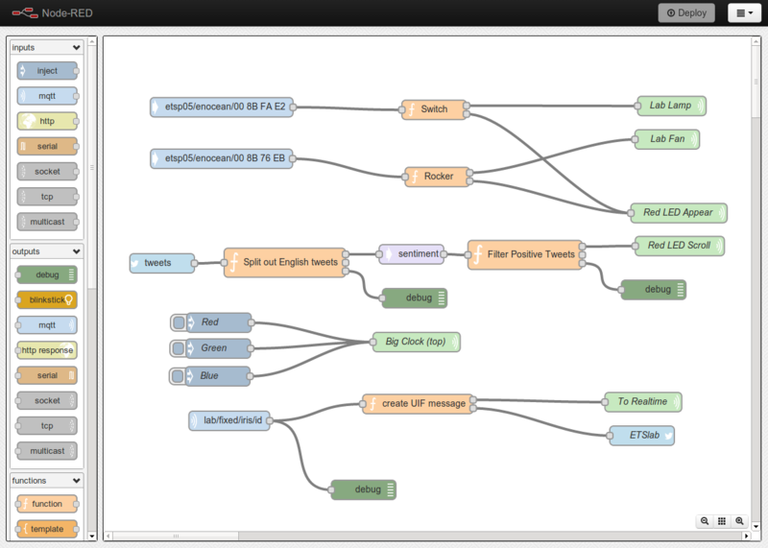

Slide 9
Node-RED
Can be installed easily on a Raspberry Pi for example.
sudo apt-get install node-red
Additional modules can be installed:-
sudo npn -g install npm-package-name
e.g.
sudo npn -g install node-red-contrib-ui
View editor in a browser
http://IP:1880/ui
Where IP is the IP address where Node-RED is running

Slide 10
Node-RED
With Node-RED installed on a Raspberry Pi which has its GPIO ports connected to LEDs, switches or other hardware devices/sensors it is possible to control these with very little effort.
Uses
A 'slider' can be used in the Node-RED editor as a dimmer control for an LED.
A particular phrase on Twitter can be detected and an LED be switched on in response.
We can link into an MQTT system and thus detect signals from thermostats etc. or, say, send a switching signal to control a boiler.
The list is endless….

Slide 11
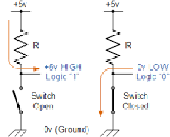
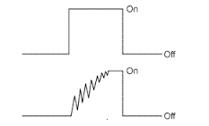
Logic Levels and Switch Bounce
Levels
Logic 0 0 - 0.8V
Logic 1 2.4 - 5V
Switch Bounce
The effect of this problem can be circumvented by means of software or hardware (use of a latch).
The hardware solution is best but obviously costs more to implement.

