Slide 2
KDE 1.1.2
or
My first Linux desktop

Slide 3
Hardware
HP Brio BA400
64 Mb RAM
Intel Celeron (Mendocino) 433MHz
Intel i810 graphics
4Gb Hard disk

Slide 4
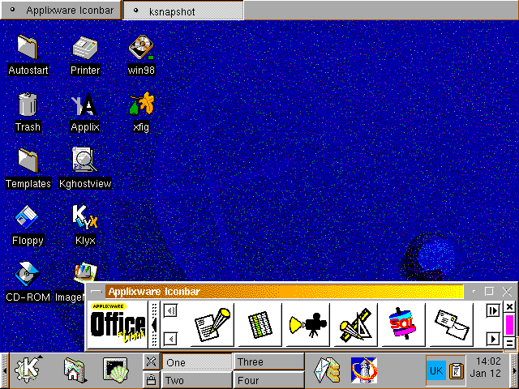
Desktop

Slide 5
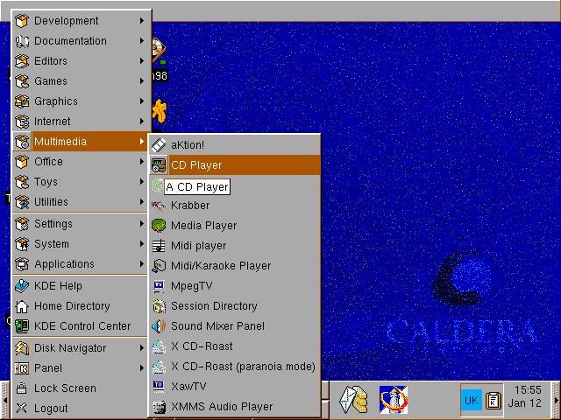
Application launcher

Slide 6
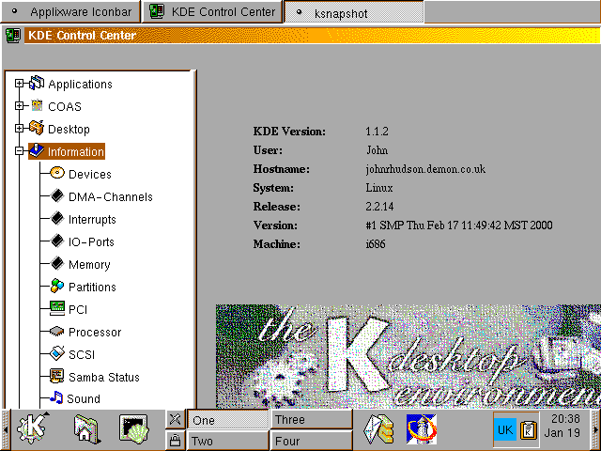
Control center

Slide 7
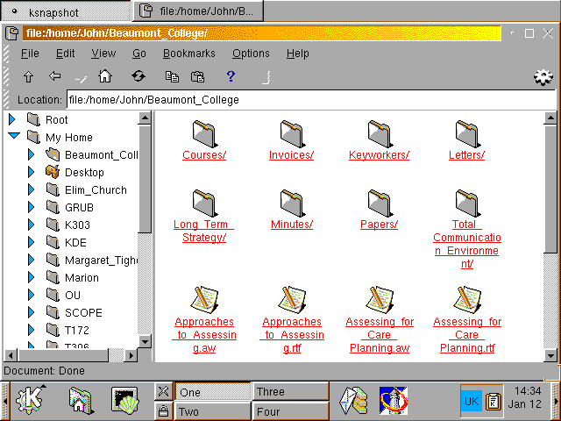
File manager

Slide 8
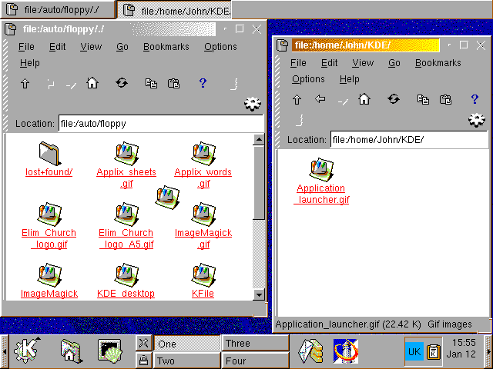
File copying

Slide 9
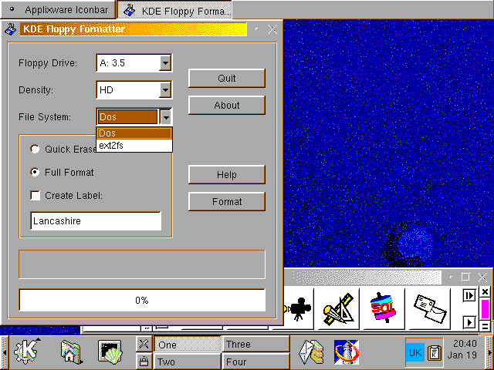
KFloppy

Slide 10
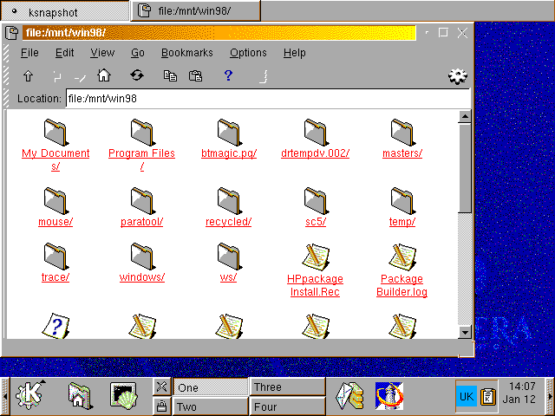
Windows folder

Slide 11
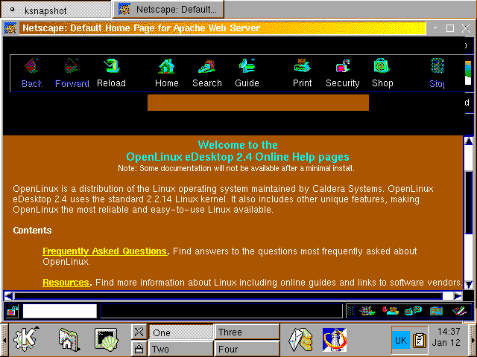
Web browser

Slide 12
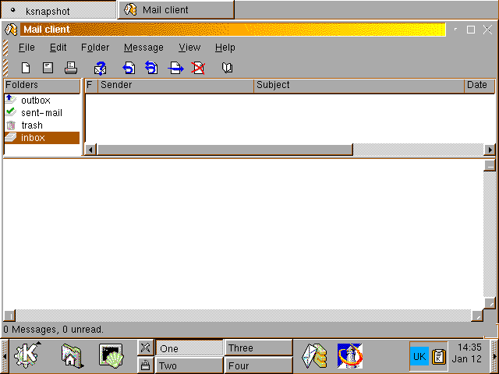
Email client

Slide 13
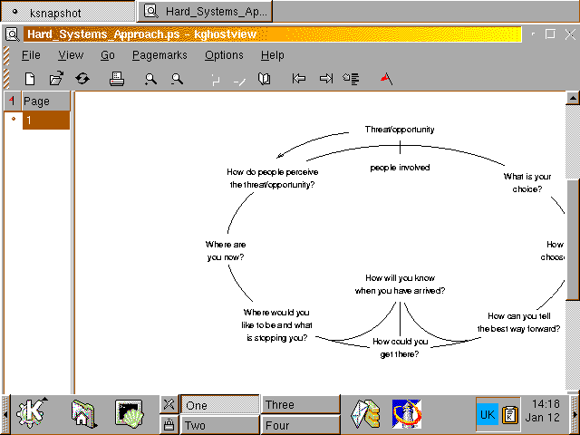
Postscript viewer: then

Slide 14
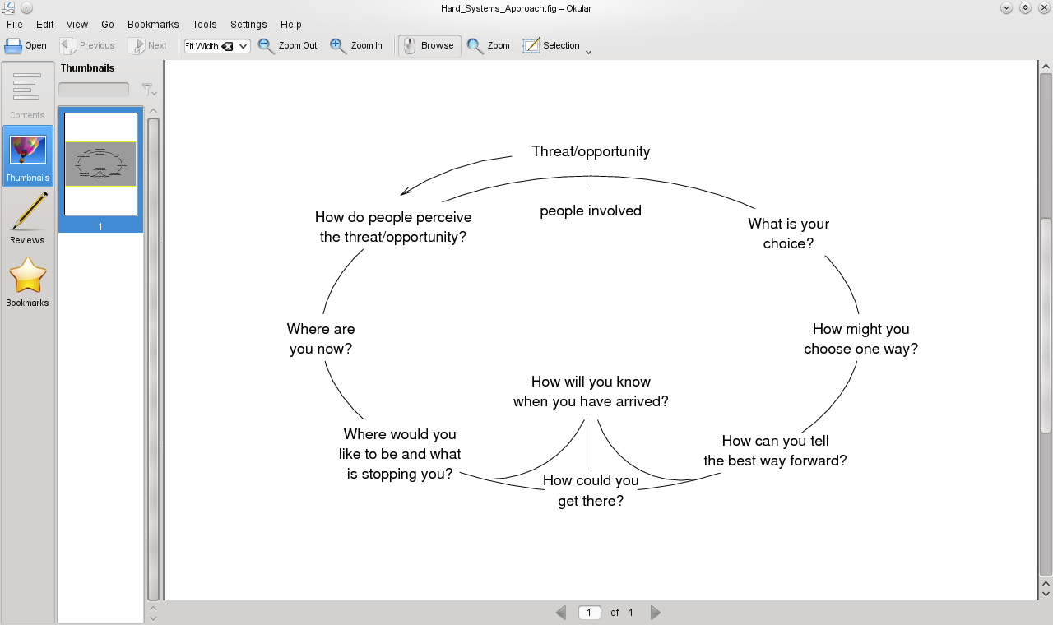
Postscript viewer: now

Slide 15
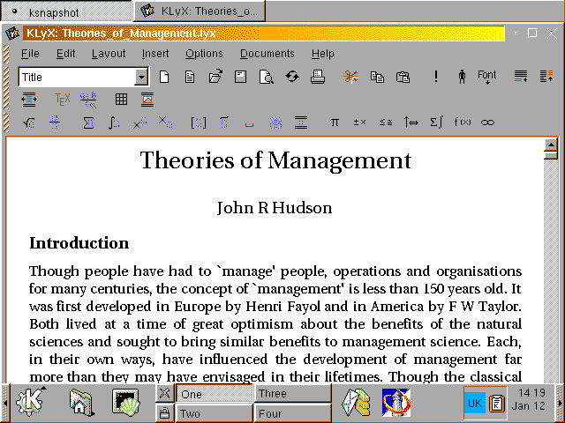
KLyX: Matthias Ettrick's first attempt at a GUI

Slide 16
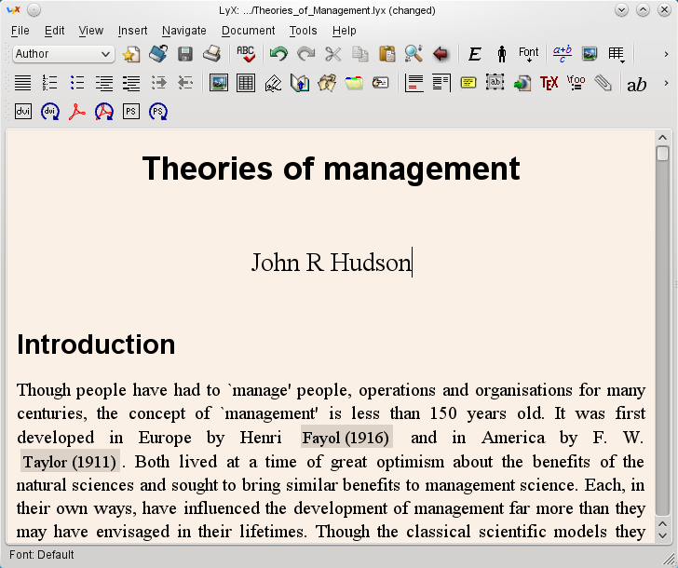
LyX today: Qt4 but no longer KDE

Slide 17
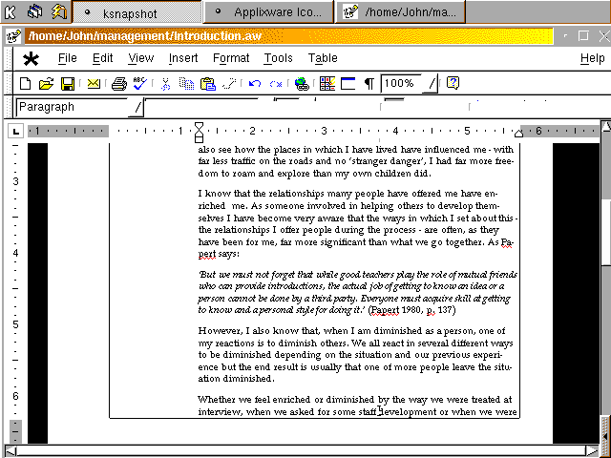
Office suite: Applix words

Slide 18
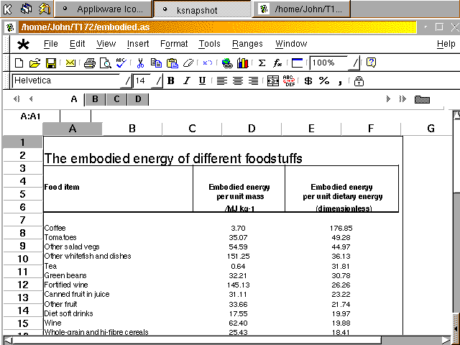
Office suite: Applix sheets

Slide 19
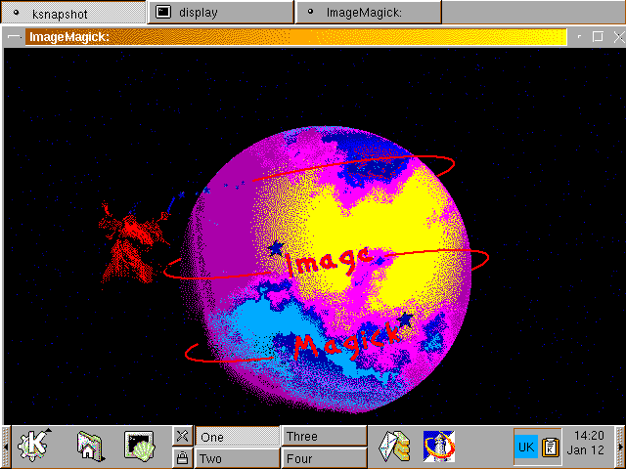
ImageMagick

Slide 20
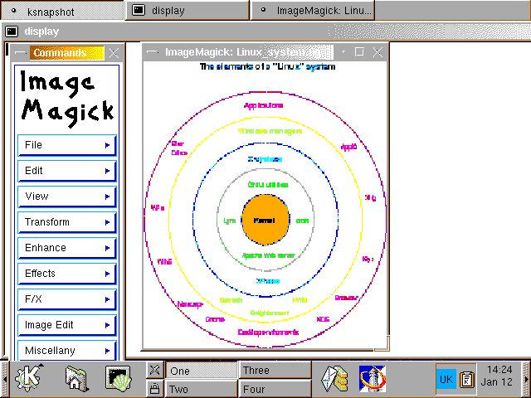
ImageMagick: display – then

Slide 21
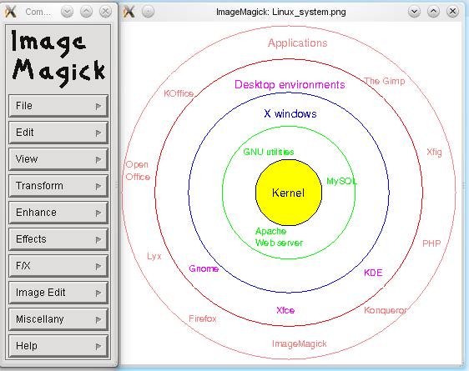
ImageMagick: display – now

Slide 22
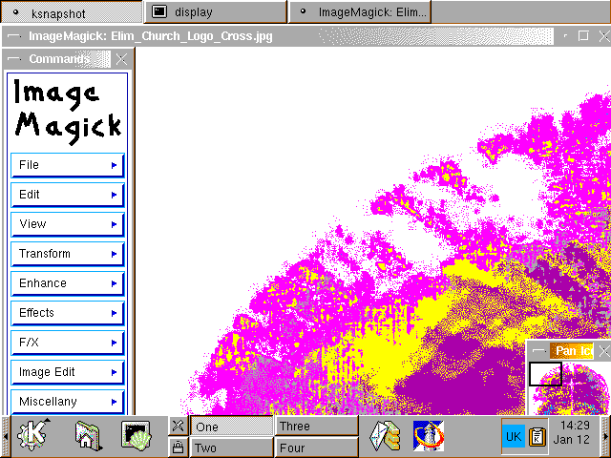
Logo: approx. A1

Slide 23
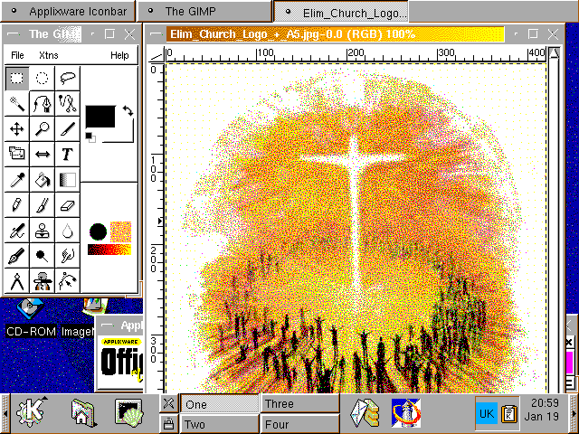
The GIMP: Logo A5

Slide 24
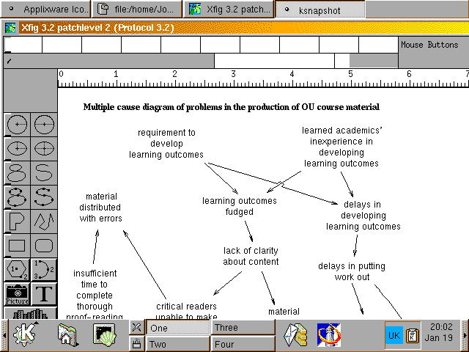
xfig: then

Slide 25
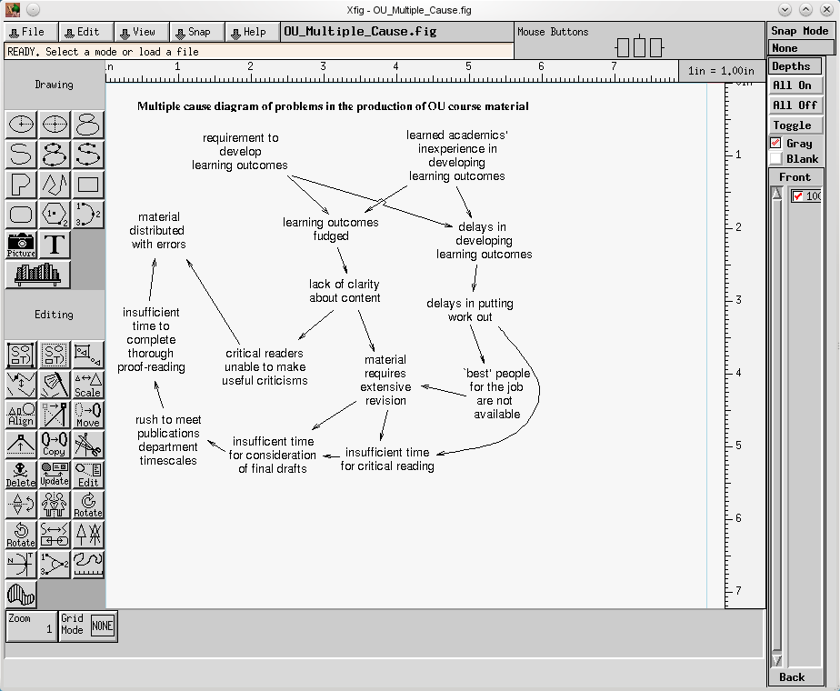
xfig: now

Slide 26
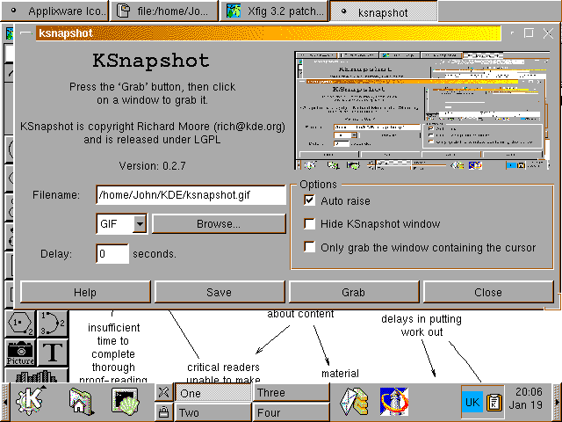
KSnapshot: without which . . .

Slide 27
The applications that made the difference
xfig: vector graphics
Applix: imported most formats, exported to MS Word and MS Excel
ImageMagick: graphics manipulation
KLyX: maths functions

