Slide 2
BradLUG: the ninth year
started with

Slide 3
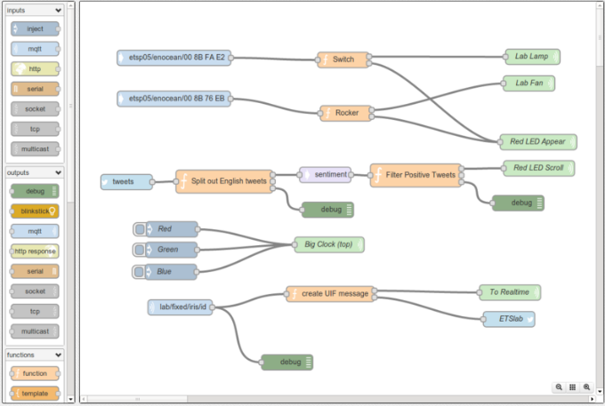
a presentation from Brian

Slide 4
and ended with
a presentation from Brian
In between we had talks, demonstrations, reports, discussions about software and much more and we said «Au revoir» to Stephane

Slide 5
Demonstrations included
Automating kernel security patches David (January)
Automating kernel updates David (February)
Jitsi Meet John David (February)
Git repository Alice (April)
CiviCRM John (May)

Slide 6
We had talks on
Linux micro-benchmarks Matt (September)
Configuration management David (November)
PIC Microcontroller Roger (December)
Ham radio logging Stephane (December)
Automating static websites Kriss and Shi (January)

Slide 7
and on
Test driven development Darren (June)
Wireguard Oliver (June)
Slackbuilds David (July)
LyX John (August)

Slide 8
We had news of
Nick’s move to Leeds University Department of Engineering
Manchester BarCamp Brian and Ash (October)
An intrusion David (October)
openSUSE Leap 42.2/LXQt John (December)
TU100 My digital life Darren (January)

Slide 9
We explored
LowEndSpirit VPS Darren (February)
Repology David (February)
Shodan Alice (May)
AppImage Brian (July)
StarPlot Bernard (July)

Slide 10
and we touched on
Fixing rows and columns in LibreOffice John W (March)
EdgeXFoundry Brian (May)
Intel AMT bug Alice (May)
Ponysay Alice (May)
Guacamole Brian (June)
Ansible (June)
Pydio Brian (June)
Tmux Oliver (June)

Slide 11
Meanwhile, over at ITStuff
We said farewell to Adobe Flash, MS Paint and paper books from O’Reilly
We heard that squirrels are as effective as a DDOS at taking the Internet down
We heard about the Tesco Bank hack, the TalkTalk fine and the Yahoo hacks and the NSA

Slide 12
as well as . . .
the 53rd anniversary of BASIC and Google Street View’s anniversary
Wannacry, LyreBird, evil Teddy Bears, April the giraffe, Pinebook, fines for local spammers, Britain’s official Investigatory Powers Tribunal
and much more . . .

Slide 13
Happy
1001th
Birthday
BradLUG

