Slide 1
RasPi FreePBX +
1.The things that don't go into the 'guides'.

Slide 2
1.1
SD Card
Using a class 4 card isn't a good idea unless you want it to take even longer for pages to present on FreePBX
The class number is the same as the MB/s
e.g. Class 4 up to 4MB/s
Class 10s followed the same rule but now it's possible to get Class 10s with a greater than 10MB/s – e.g. 30MB/s and more.

Slide 3
1.2
Set Static IPs on your LAN
Setting static IPs for VoIP is essential
Assign static IPs to all your network devices in the router as well as the devices.
In '/etc/hosts' assign names to the IPs so they are easy to access via SSH.

Slide 4
1.3.0
Got a Dynamic WAN IP?
Need to fix that!
The outside world must be able to find your PBX. If your WAN IP changes then the connection will break.
Get a domain name that will track your WAN IP and use that domain name and NOT the WAN IP.
E.g. Free domain name from dyndns.org

Slide 5
1.3.1
Notify DynDNS that your WAN has changed
Often routers have this facility built in. You just need to set it up with the appropriate information.
Alternatively, a program like ddclient, installed on the computer, will do this job.
Setup: tinyurl.com/ddclientsetup

Slide 6
1.4
Get a DID
A UK DID (Direct Inward Dial) number can be had for free. Set up the number to direct to your PBX using the domain name you set up with DynDNS.

Slide 7
2
Set up the PBX
We now start setting up the PBX via the FreePBX web interface.
Log into FreePBX via your browser

Slide 8
2.1
Enter our Domain in the Settings
Go to Advanced SIP Settings

Slide 9
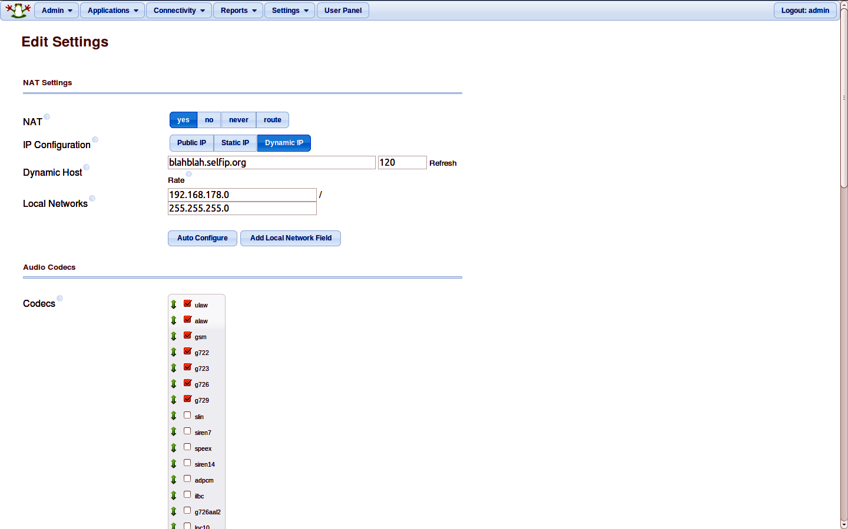

Slide 10
2.2
Install the required modules
This is a lot easier than it might sound.
Go to Admin > Module Admin

Slide 11
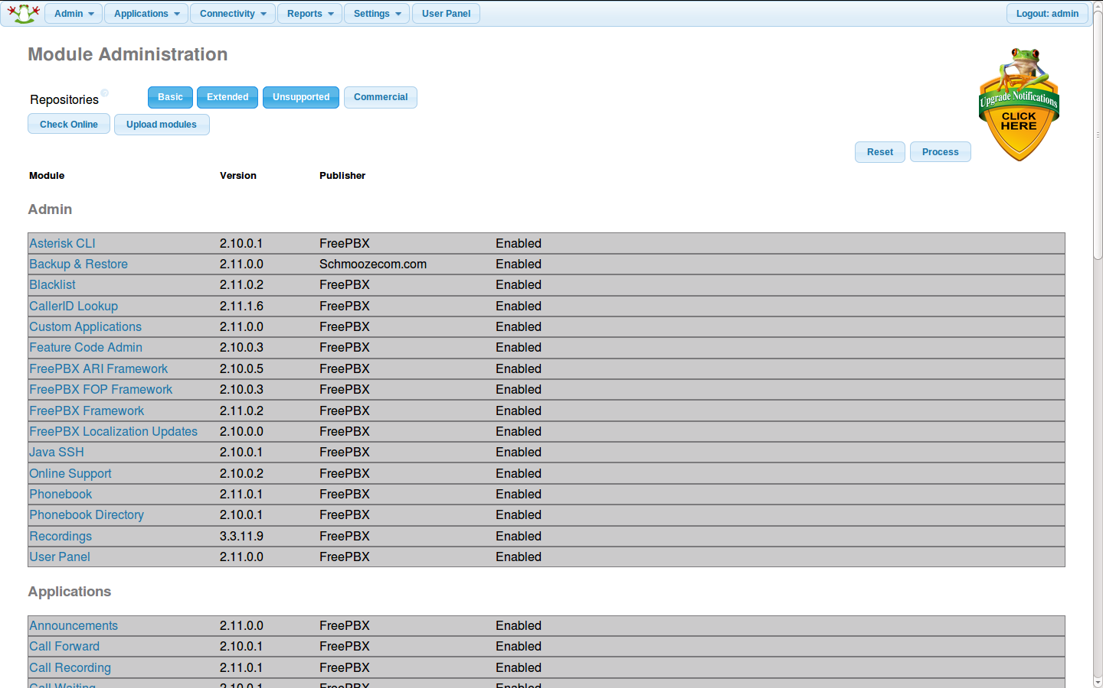

Slide 12
INBOUND
ROUTES
EXTENSIONS
TRUNKS
OUTBOUND
ROUTES
MINIMAL PBX SETUP
WITH 'OUTSIDE' LINES
OUTSIDE WORLD

Slide 13
INBOUND
ROUTE
INTERACTIVE
VOICE
RESPONSE
TIME
ACCESS
TIMED
ACCESS
Out of Hours
Response
EXTENSIONS
OUTSIDE
WORLD
OTHER OPTIONS
SHOWS HOW IVR & TIME OF DAY BASED
ACCESS CAN BE INTERPOSED BETWEEN
INBOUND ROUTE AND EXTENSIONS

Slide 14
2.3
Set up our first extension

Slide 15
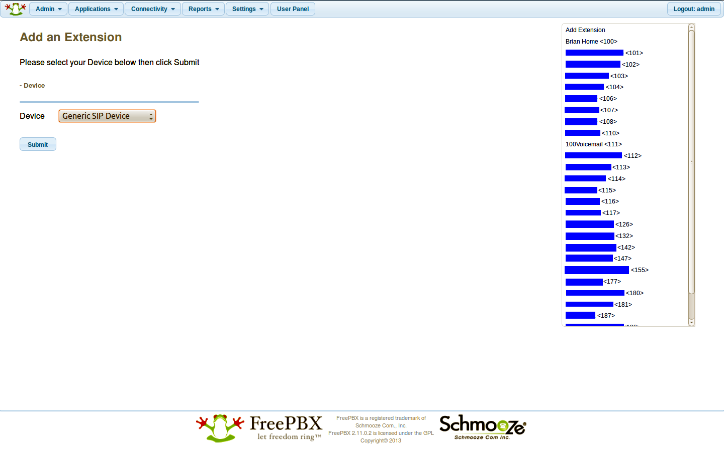

Slide 16
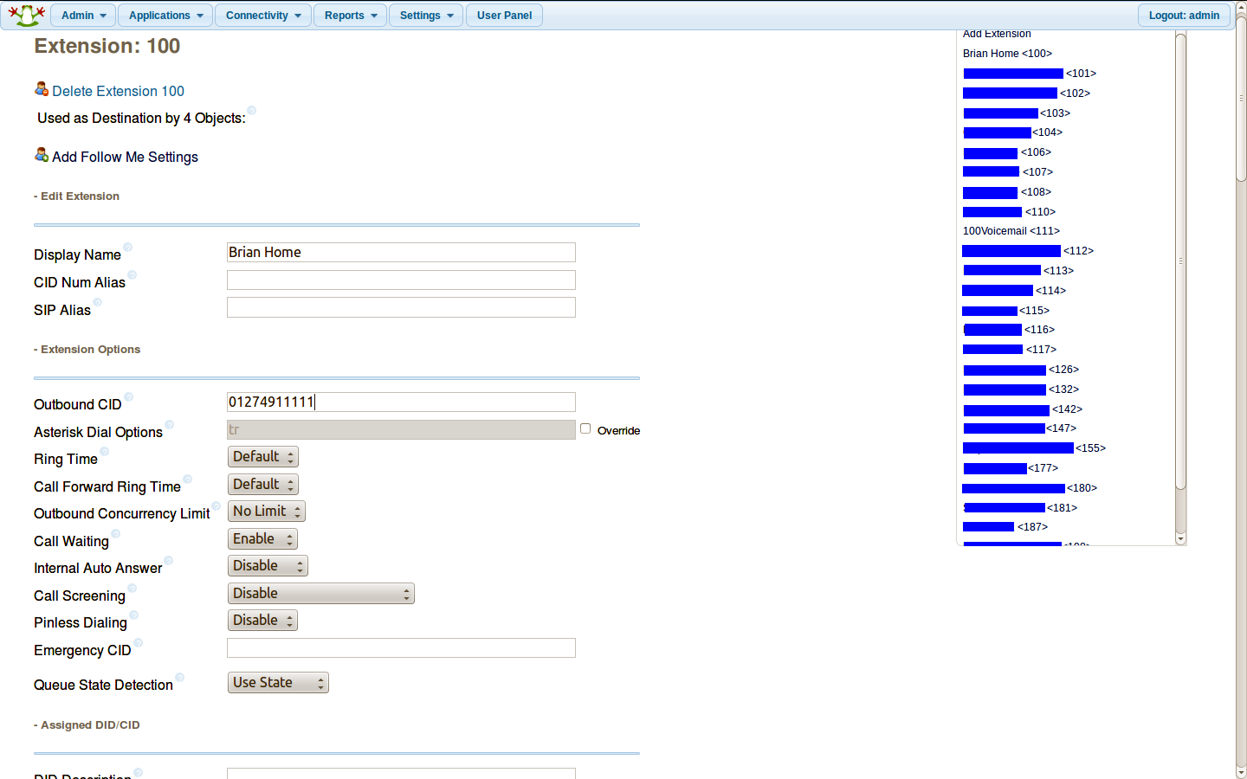

Slide 17
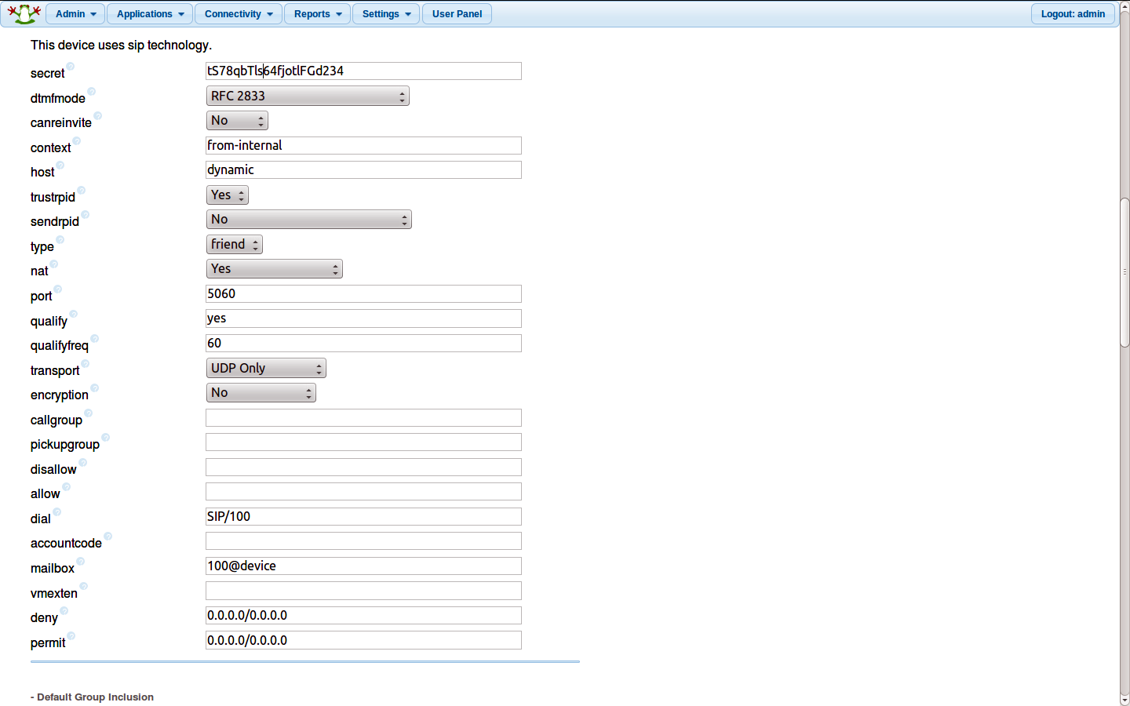

Slide 18
Inbound routes
Set an inbound route to our extension

Slide 19
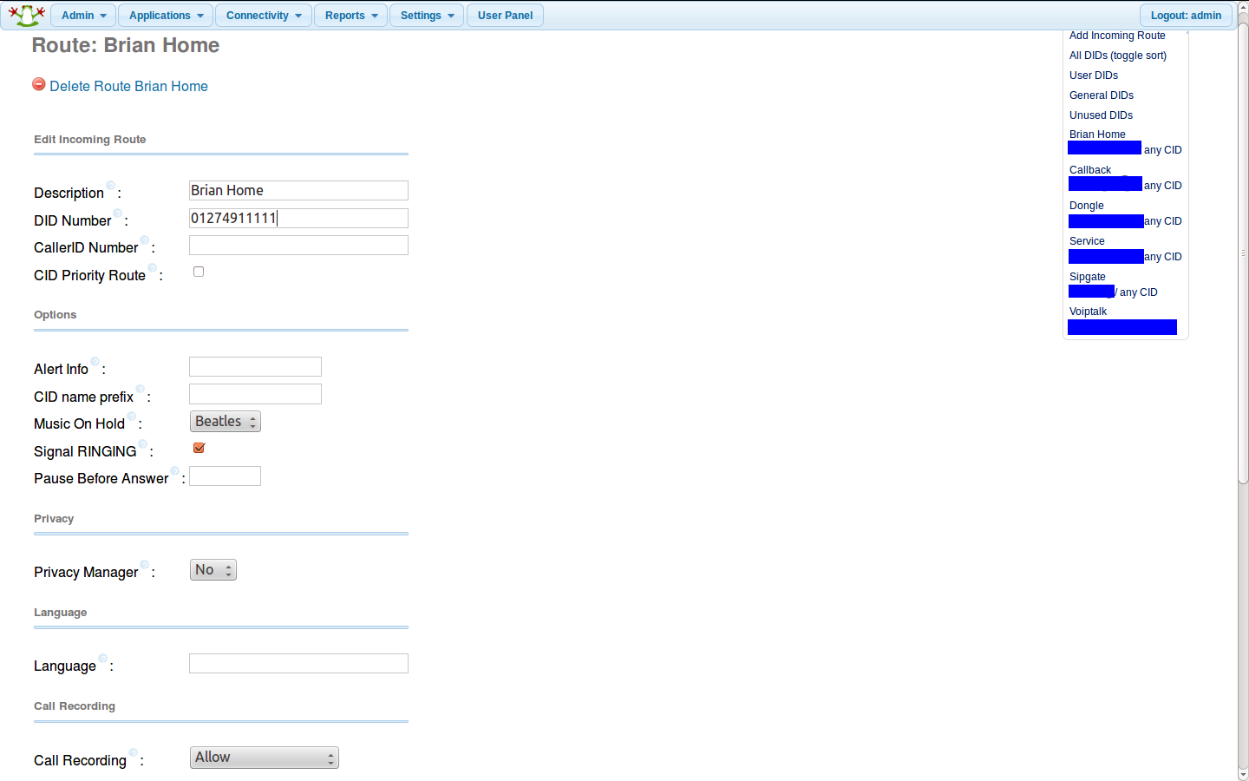

Slide 20
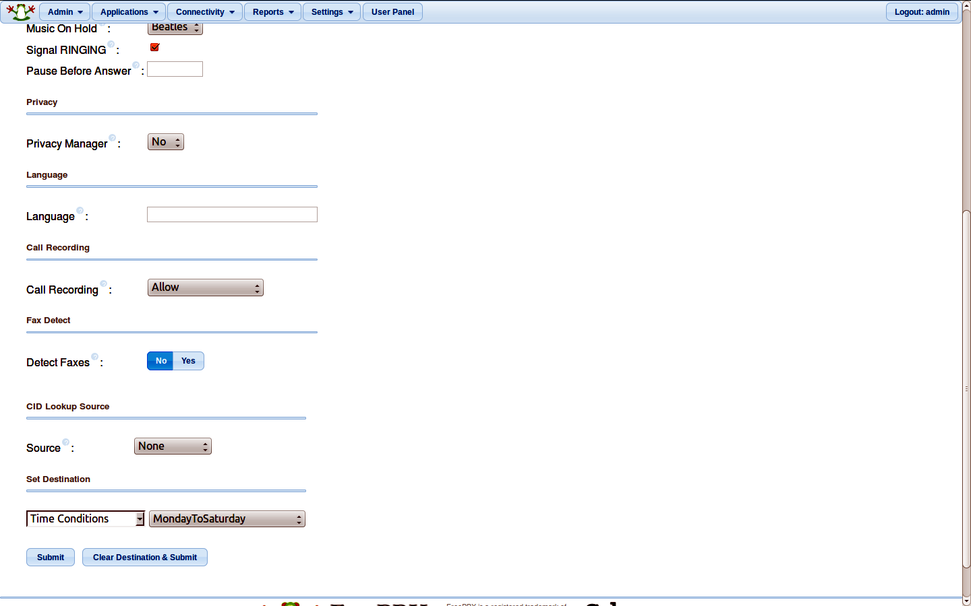

Slide 21
Set outbound route
Set an outbound route for any extension to use
This will route from an extension and then to a 'Trunk' – we set that up later.

Slide 22
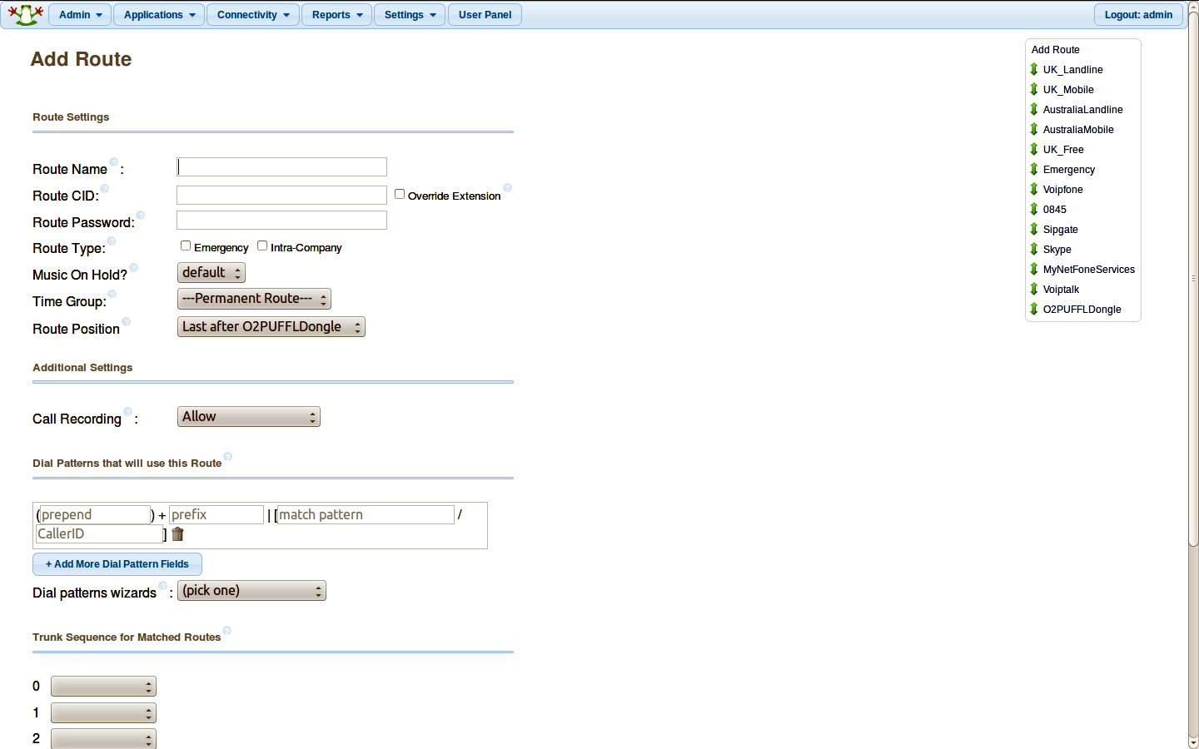

Slide 23
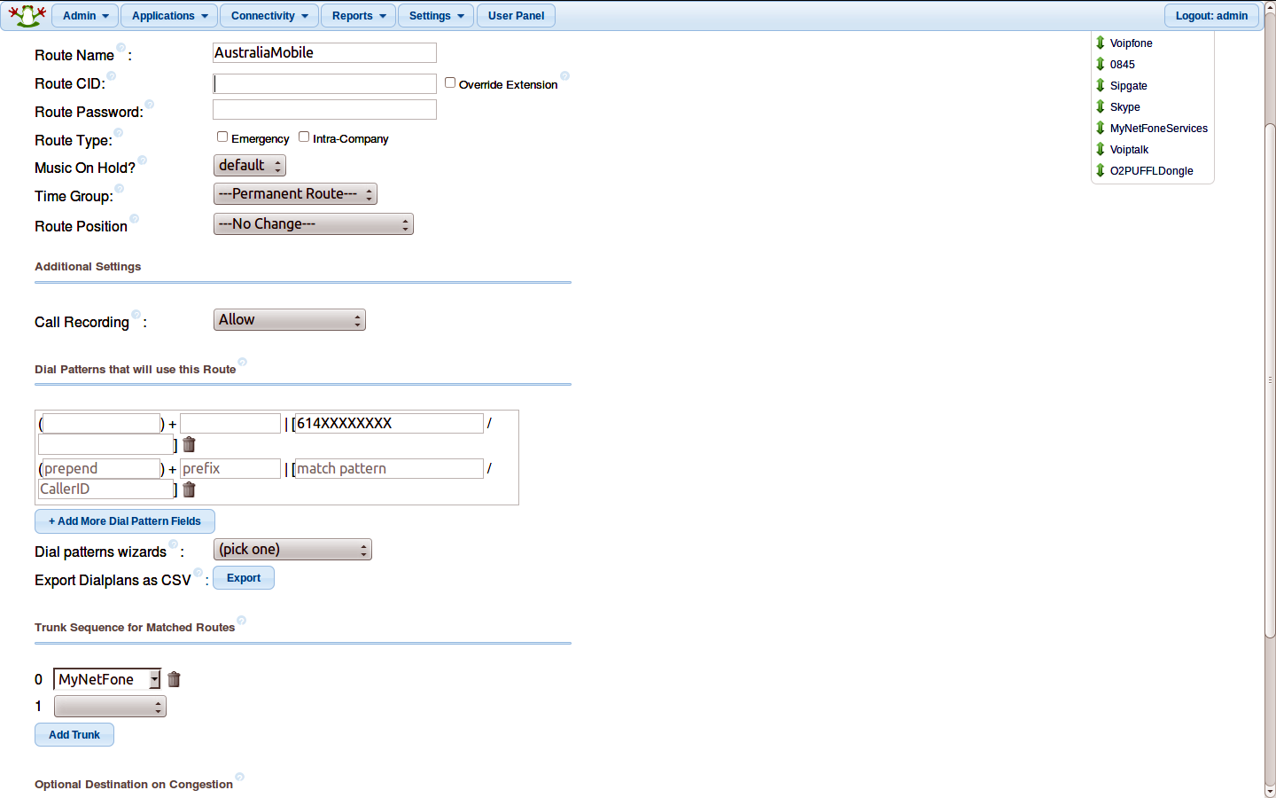

Slide 24
Trunks
These are set up to link to telecom providers of your choice.
Like the outbound routes rules will be set so that only appropriately dialled calls will route via any particular trunk

Slide 25
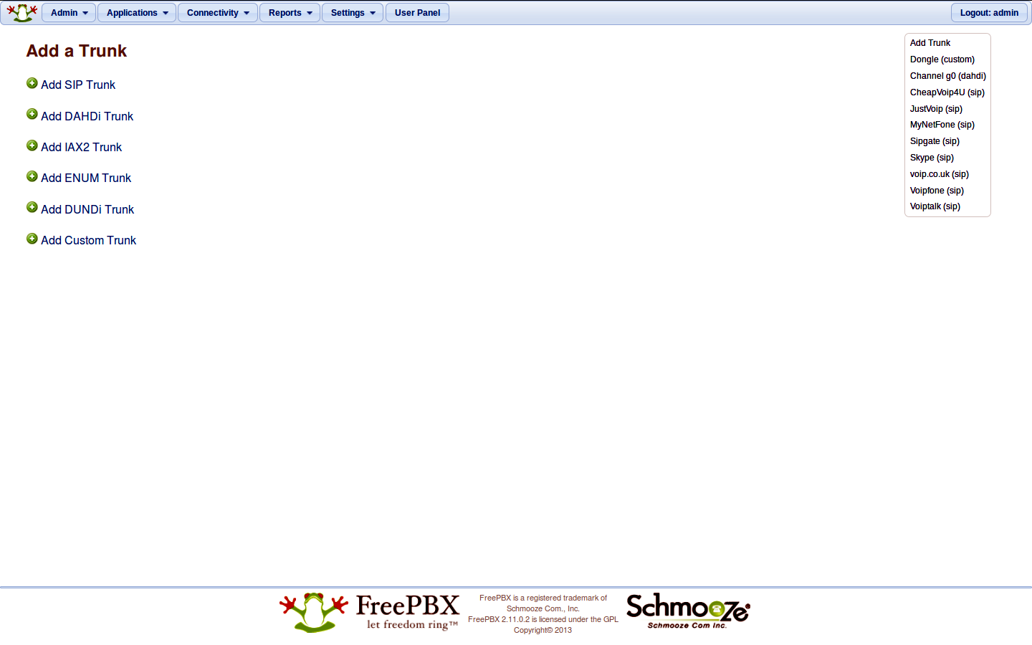

Slide 26
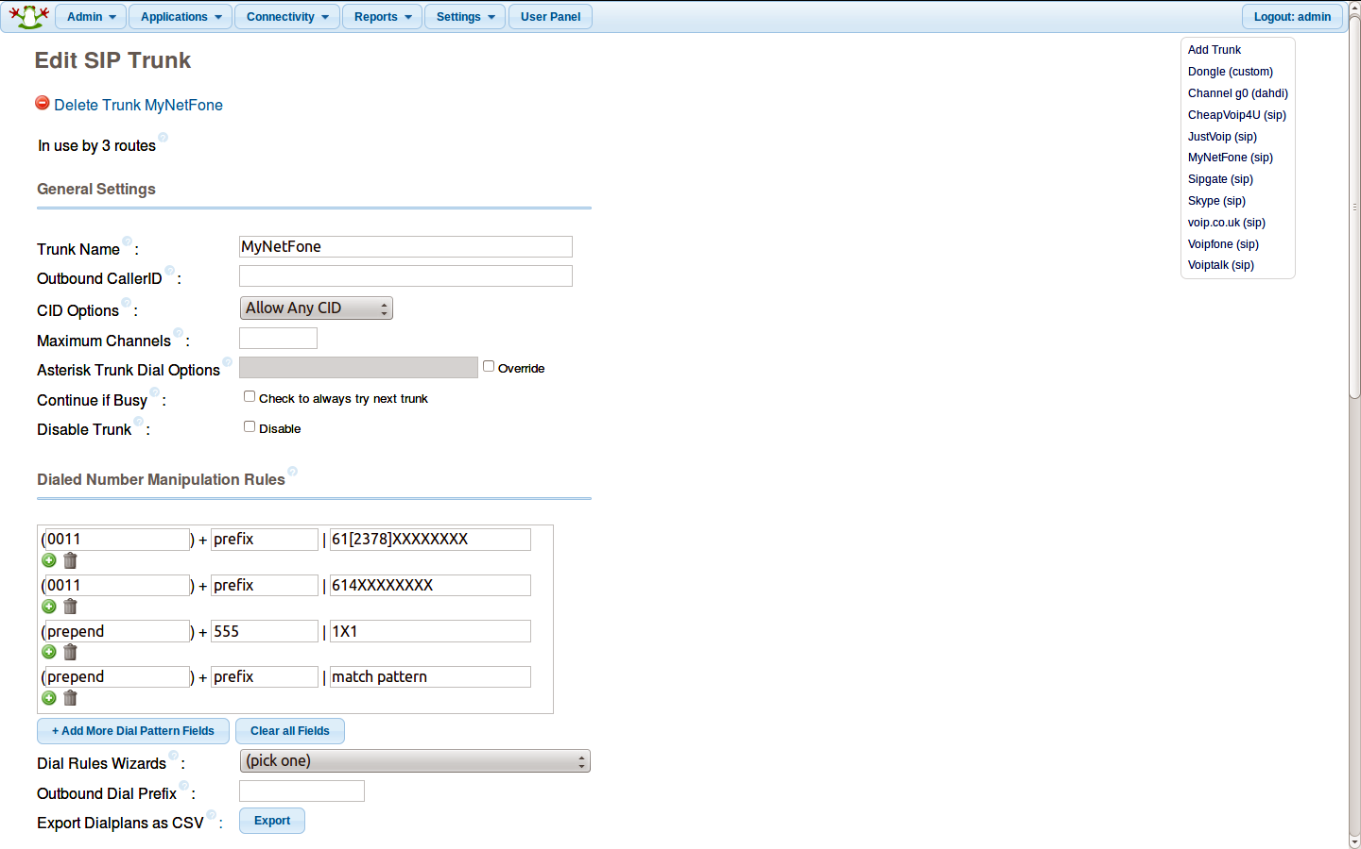

Slide 27
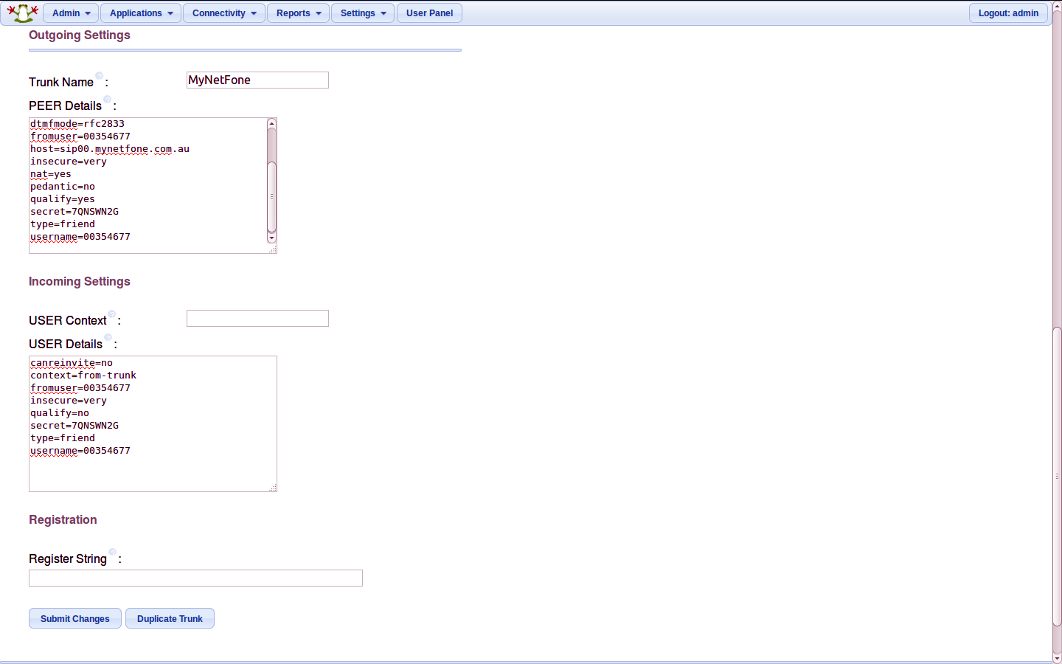

Slide 28
Voicemail
Can set up email on the Pi so that voicemails can be sent via email. I use a Gmail account.
Voicemails are sent as WAV. Can get a WAV player for Android so that the voicemails can be played without the need to call into the PBX.
Email setup is documented online.

Slide 29
Using a Mobile Phone
Two methods:
chan_mobile – uses bluetooth to a mobile phone.
Tried this with PBX in a Flash (PIAF). It worked for incoming and outgoing calls but could only get audio one way.
chan_dongle – Uses a 3G dongle with 'voice' enabled. I have this working, voice and SMS.

Slide 30
Dongle – Incoming Route

Slide 31
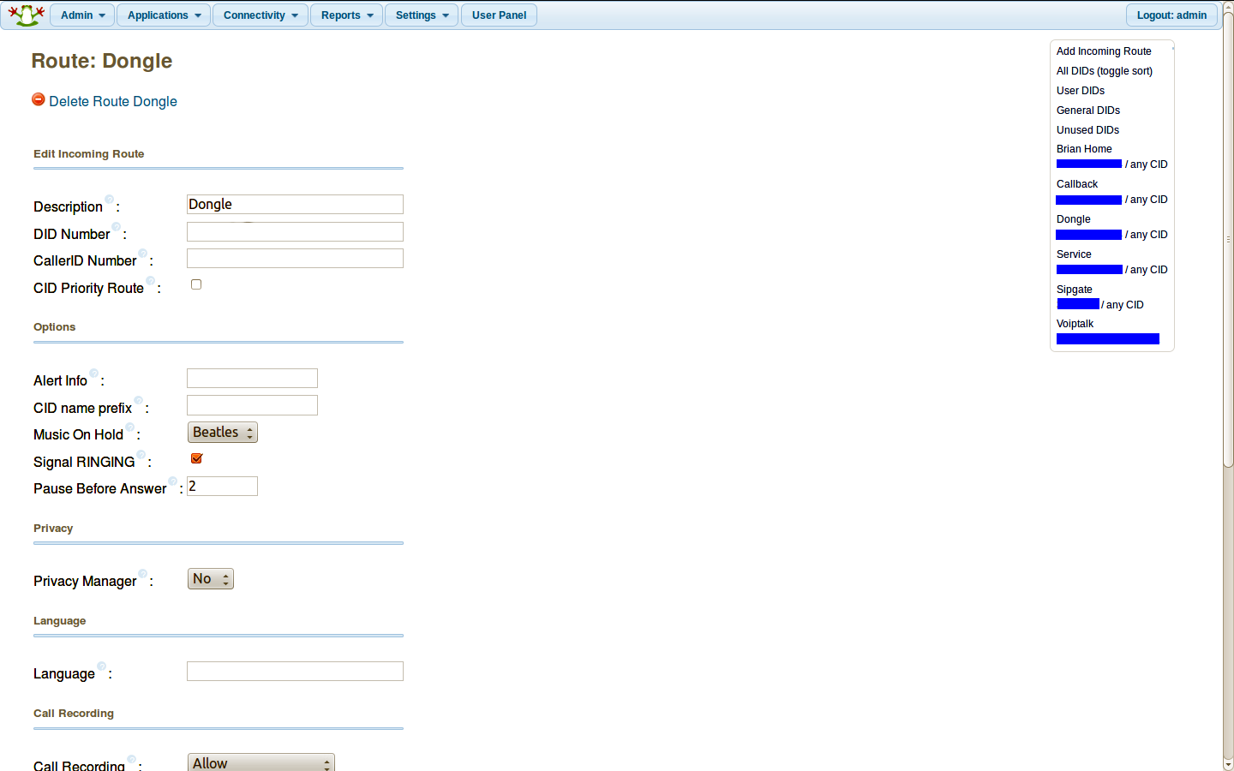

Slide 32
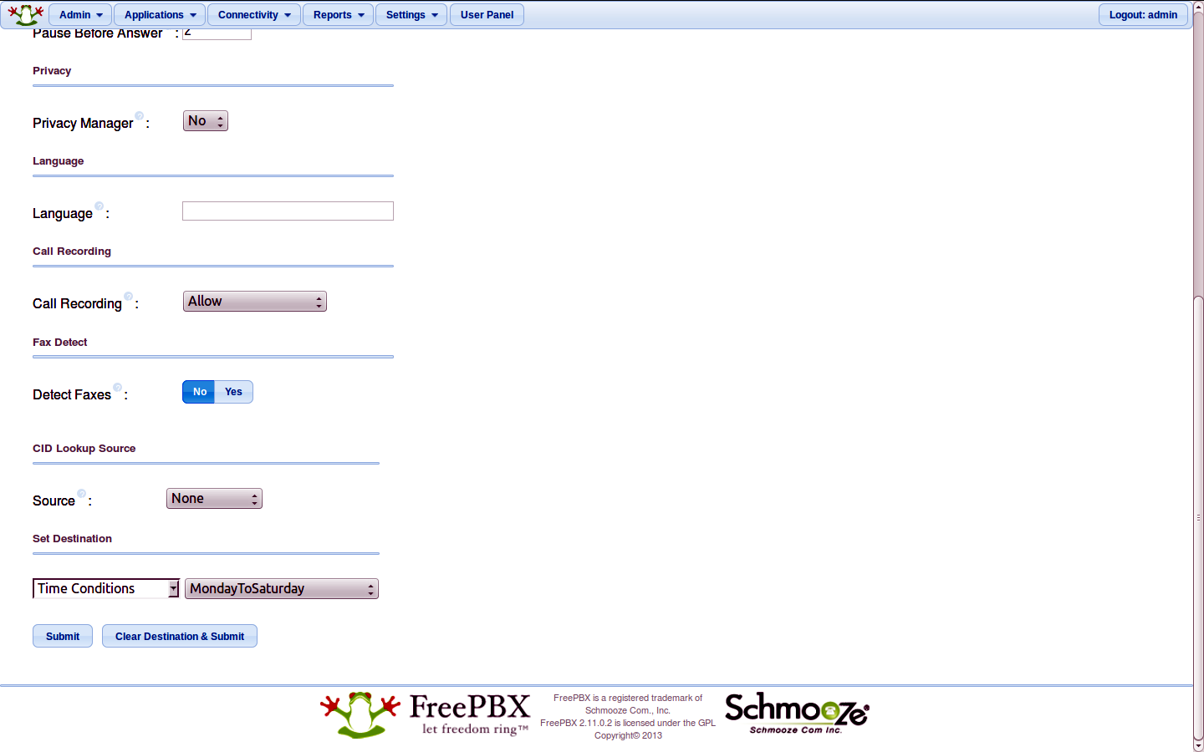

Slide 33
Dongle Trunk

Slide 34
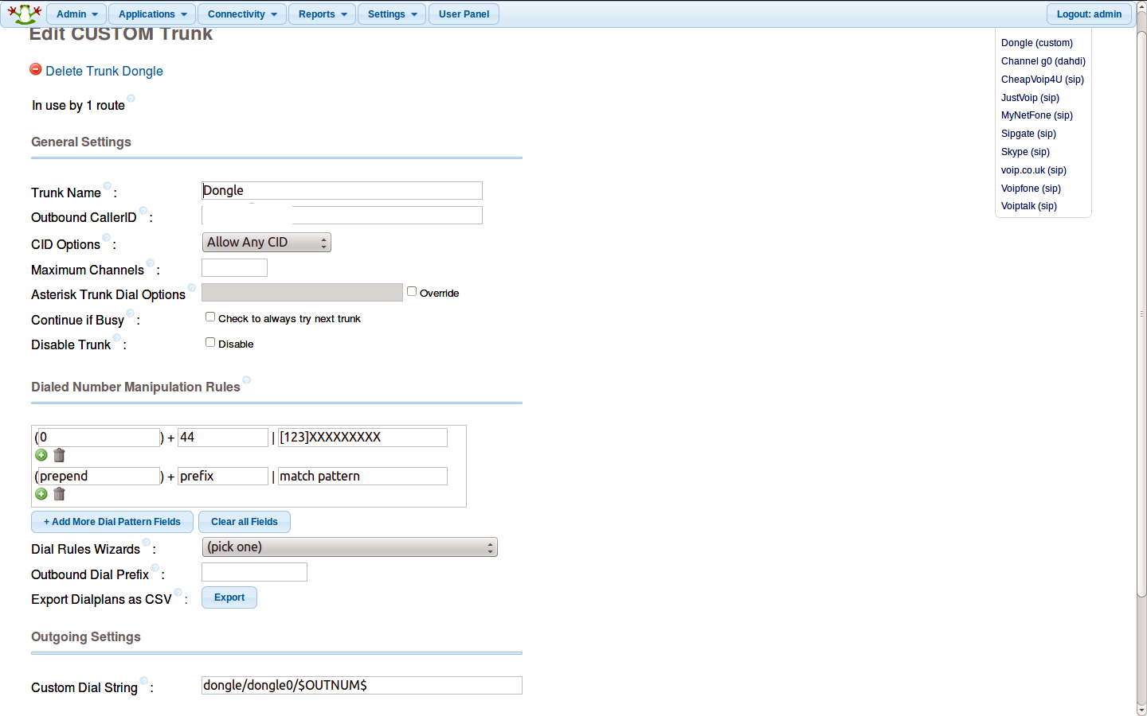

Slide 35
Dongle -Tech Considerations
Dongles are power hungry. Make sure you have a power supply on tour Pi that will supply sufficient current – otherwise you'll be chasing problems that don't necessarily manifest themselves as a power problem.
I have to split a USB extension lead and provide a dedicated supply to my E173 dongle.

Slide 36
Dongles – Tech Considerations continued
Not all Dongles will work.
I used an Huawei E173 but not all of this type will work. Do your homework well before purchase.
Only certain firmware builds will work. Some Dongles need and upgrade – some need a downgrade. Downgrading may not be easily possible.

Slide 37
chan_dongle - SMS
The dongle will receive SMS and can relay these via email.
Replies to SMS can be sent via the command line – SSH in to your Pi.
Work needed to be able to send email to SMS. I might do some work on this when time permits.

