Slide 1
Digital photography
The Free Software
perspective
David Spencer
Bradford Linux User Group
May 2009
Notes:
Welcome to this presentation given to the Bradford
Linux User Group in May 2009.
The advent of digital photography has been one of the most pervasive technological changes of our times. Only mobile telephony and, perhaps, digital broadcasting have seen more widespread adoption.
It's a sustainable argument that digital still and video photography, as the technological underpinning of so-called 'citizen journalism', is having a greater impact on society.
Like computing, photography is on the front line of the struggle between the old "closed" culture and the new "open" culture. We see this in the harassment of street photographers and Google Street View; in new laws about photographing police officers contrasting with evidence gathering by G20 protestors; in camera manufacturers being secretive about how their hardware works; and in three-way culture clashes between the copyright maximalism of commercial photographers, amateur photographers who use Creative Commons licences, and big media corporations that habitually infringe amateur photographers' copyrights.

Slide 2
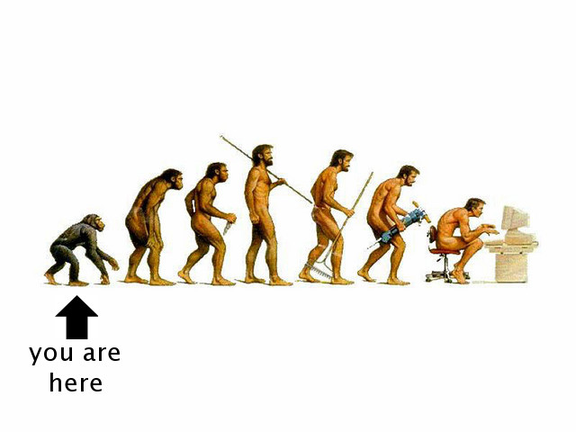
1
The digital revolution
Notes:
So what do I mean when I refer to a digital revolution in photography?
People are vaguely aware that film cameras have pretty much disappeared, but they rarely reflect on the deeper story of the digital revolution. Let's step back and contemplate what's been happening.

Slide 3
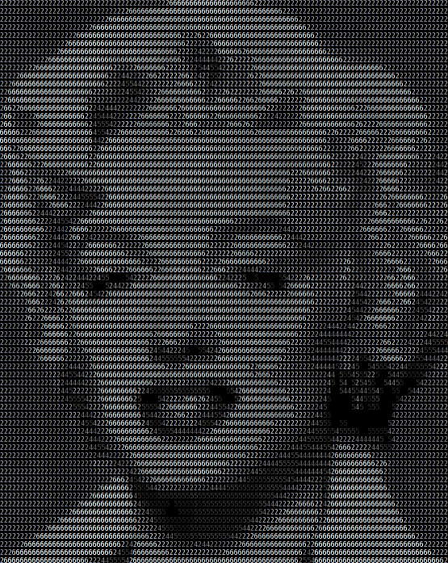
The digital revolution
Images are DATA
Optical physics is MATHS
Information wants to be FREE
Notes:
Our starting point is defined by these three statements of the bleeding obvious.

Slide 4
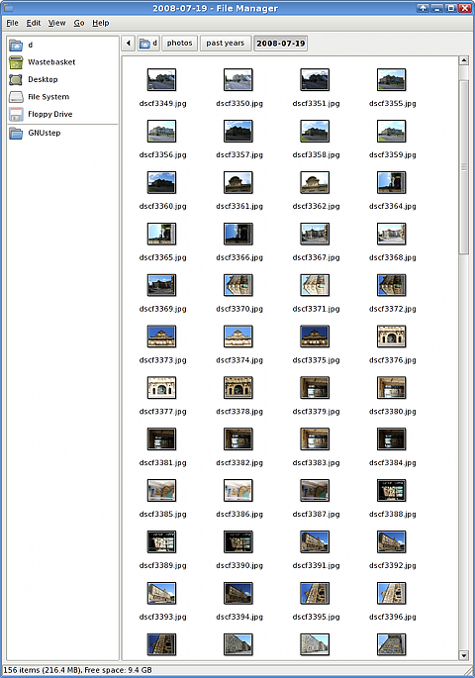
Images are DATA
Marginal cost
of an image
is now zero
Notes:
The first revolutionary change is that it now costs nothing whatsoever to take one more photo. Neglecting storage (which in any case continues its remarkable fall in cost), once your camera has been paid for, your photos are free-as-in-beer. You can take as many photos as you like and just keep the best. And you can keep the rest, too, if you want.

Slide 5
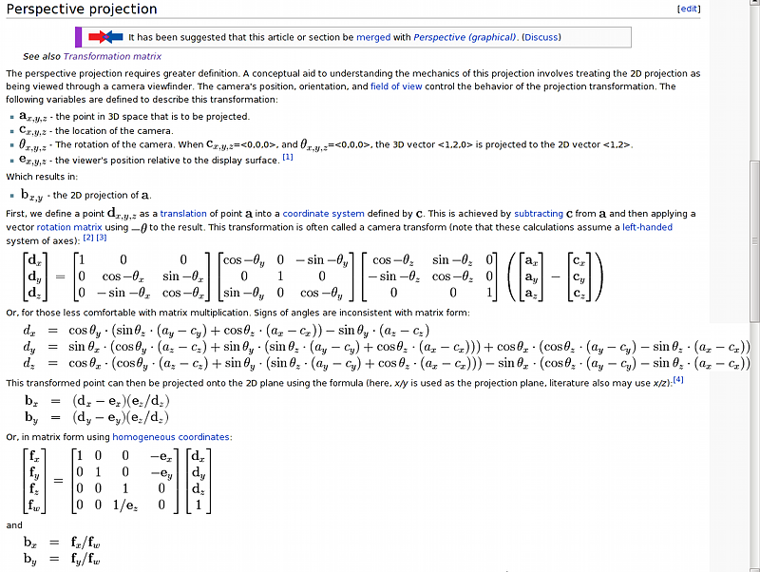
Optical physics is MATHS
Postprocessing
now open to everyone with a PC
Wikipedia
Notes:
The second revolutionary change is that it is finally now practical to manipulate images using maths that has been understood for centuries, and programs to do that are available to anyone with even the humblest PC. In the world of free software, the only constraint is your own level of expertise. I'm here today to work on that constraint. :-)

Slide 6
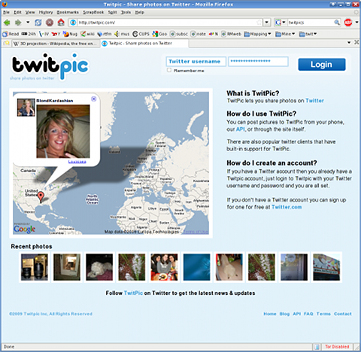
Information wants to be FREE
Net powered explosion of both 'consumers' and 'publishers'
Notes:
The third revolutionary change is the coming of the Net. Since the days of cave painting, human communication has always had a strong visual component. A Net without pictures would be a very austere Net indeed.
Indeed the Net has provided both the means of mass publishing, and the mass audience for that mass publishing.

Slide 7
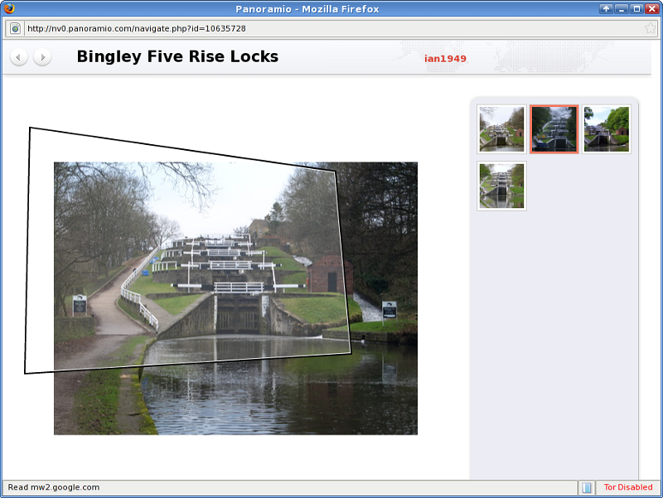
http://nv0.panoramio.com/navigate.php?id=10635728
The ultimate in
Democratized Art
Notes:
I would argue that these three elements of the digital photography revolution - free image capture, free postprocessing, free communication - intersect to produce one of the most accessible, highly democratized means of self-actualisation available to humanity today.
And with a little imagination the three elements can be made to intersect in surprising ways.
For example, there's the 'Look Around' feature on Panoramio. Starting with a profusion of freely contributed geolocated images, they did a bit of number crunching on them, and republished them in a way that makes the whole truly greater than the sum of its parts.

Slide 8
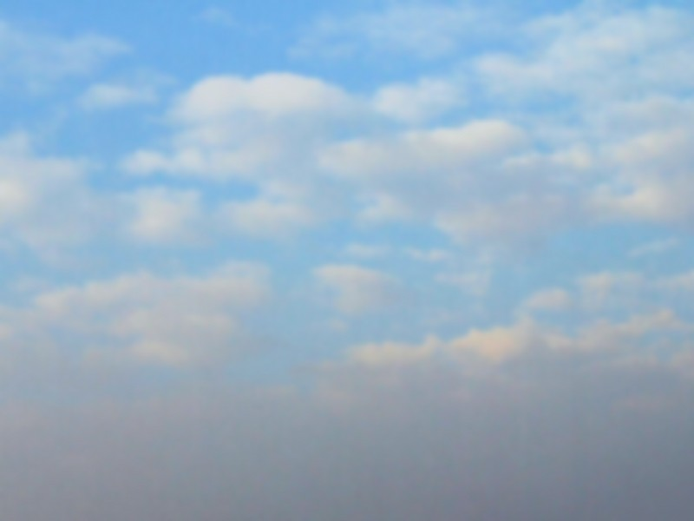

New technology
⇔
New thinking
Notes:
Of course, technology influences thinking, and thinking influences technology. In the case of digital photography, the new technology has a strong resonance with the copyleft and open knowledge community.
Yet, prior to the digital revolution, the typical photographers' mindset was dominated by strong copyright enforcement and venal ambition.
Whenever the old and new mindsets meet - as they do, for example, every day on the Net - there's a bad-tempered clash of cultures. This culture clash will show up again and again in our exploration of digital photography, and whenever it does I'll be drawing attention to it with this natty green Copyleft symbol.

Slide 9
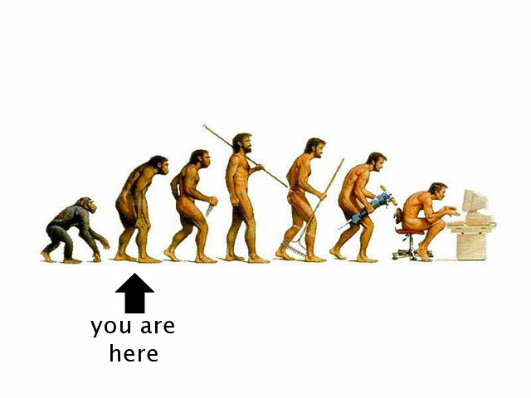
2
Point and shoot
Notes:
But let's start with a quick review of the basics of the technology.

Slide 10
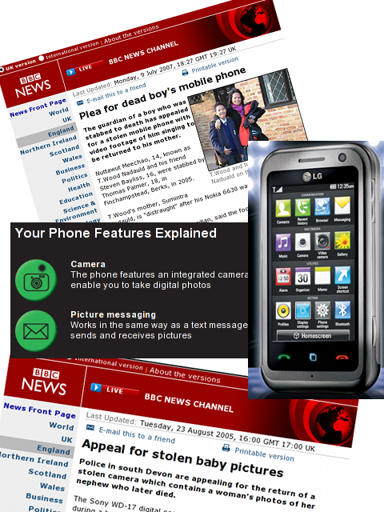
Phone to phone
spontaneous,
ephemeral
Notes:
Probably the most prolific expression of the digital revolution is in the casual, spontaneous, ephemeral, and sometimes frankly obscene sharing of images by the uneducated hordes of mobile phone users.
It's easy to mock, but in fact, from road traffic accidents to baby's first steps, putting such useful spontaneity into the hands of the populace is surely a triumph of technology.
It's so easy to take this technology for granted, but, as we see from the news stories above, the ephemeral nature of these images is not always fully appreciated.
Incidentally, has anyone else noticed how these phone menus have been made to look exactly like snack vending machines? Are we being conditioned to equate mobile devices with instant oral self-gratification?

Slide 11
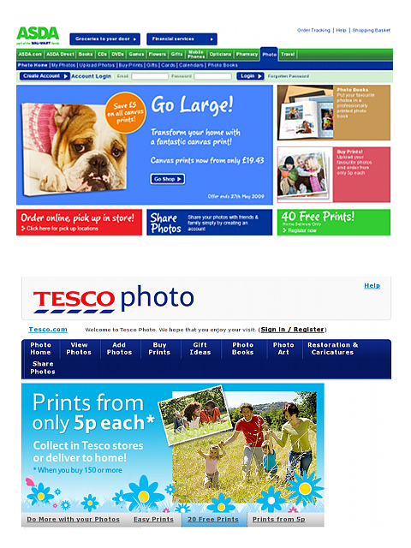
Memory card
to supermarket
to paper
cheap, traditional
Notes:
It's possible to use the new technology in exactly the same way as the old technology was used. The supermarket is the new minilab; the 'cathedral' business model is unchanged. And yet, even at this pitiful level of end user sophistication, the new technology is a clear winner. It doesn't smell as bad, it's quicker, cheaper, and they won't lose your film.
Indeed, it can work out cheaper than using your inkjet at home.

Slide 12
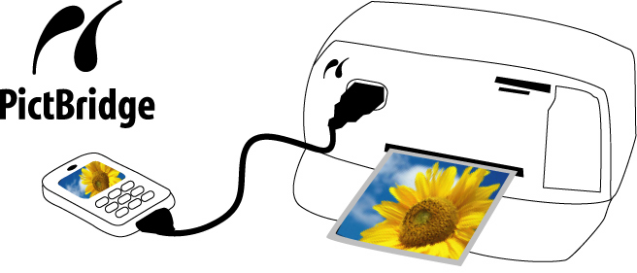
Cable from camera
direct to
PictBridge printer
lame
Notes:
For completeness -
There's also a variant of the new technology apparently aimed at obdurate middle aged clods who don't want anything to do with computers. High end printers can be connected directly to a camera, using a ghastly closed, proprietary protocol over USB.
Frankly there's no advantage to this, nothing to be said in its favour.
It's Lame.
Which is probably why, apparently, nobody can be bothered reverse engineering it as free software.

Slide 13
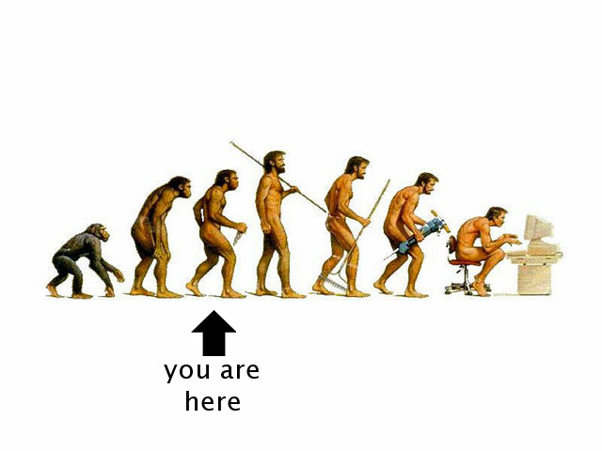
3
Enter the PC
Notes:
We've just about exhausted the possibilities over on the wrong side of the digital divide. Let's move back to our technocratic stronghold.

Slide 14
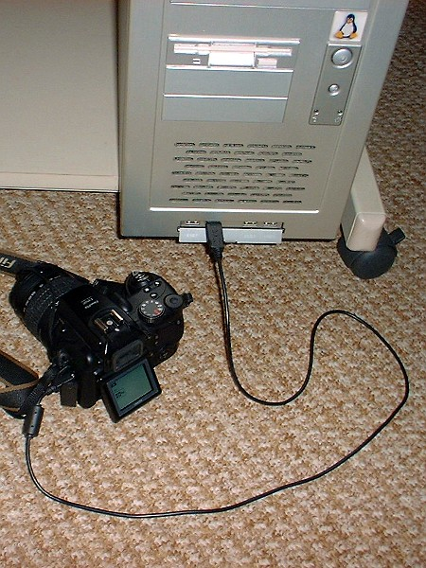
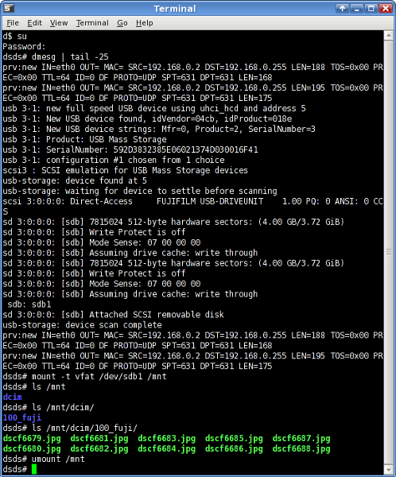
Interfacing
Cable to PC
USB mass storage
Unixy
Notes:
The vast majority of cameras have a USB connector and present themselves as USB mass storage devices.
You can mount them just like you mount external disk drives or 'keyfobs', though many Linux distributions expedite the process with autodetection, automounting and automatic invocation of an appropriate application.
And then it's merely a matter of copying the files onto your PC, and optionally deleting them from the camera.

Slide 15


Interfacing
Cable to PC
gthumb F-Spot digiKam
↑
gphoto2
↑
PTP
Notes:
However, some high-end camera manufacturers - notably Nikon and Canon - have preferred a proprietary, closed protocol, layered onto the USB Image Capture Device (webcam) standards.
On Linux, the reverse-engineered gphoto2 library is used to copy the files from the camera.
Typically you won't use gphoto2 directly - you'll use it, without even knowing, from within an application like gthumb, F-Spot or digiKam.

Slide 16
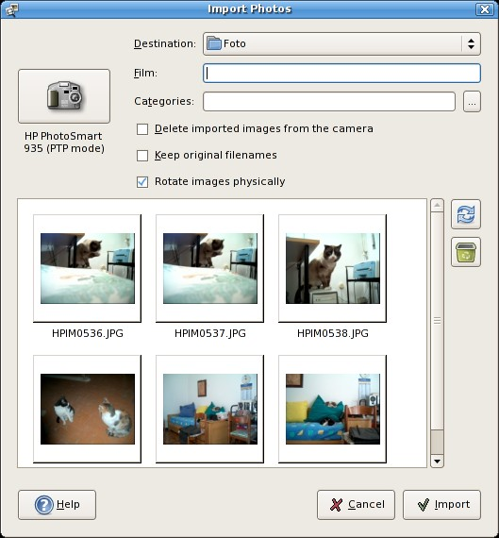
Interfacing
Cable to PC
gthumb F-Spot digiKam
↑
gphoto2
↑
PTP
Notes:
Here's gthumb's 'Import Photos' window, quite impressive.

Slide 17
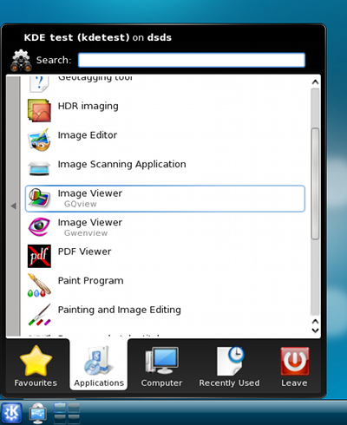
PC apps
Viewing
Notes:
Having acquired your newly captured images onto your PC, you can proceed to view them in diverse ways. Most obviously this is done by relevant PC applications.

Slide 18
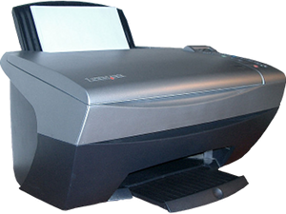
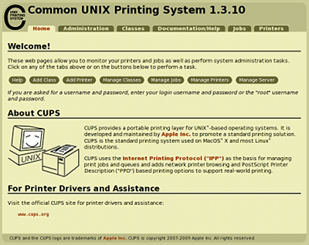
PC apps
printing
Viewing
Notes:
And, also obviously, the PC will allow you to create prints in your own home.

Slide 19
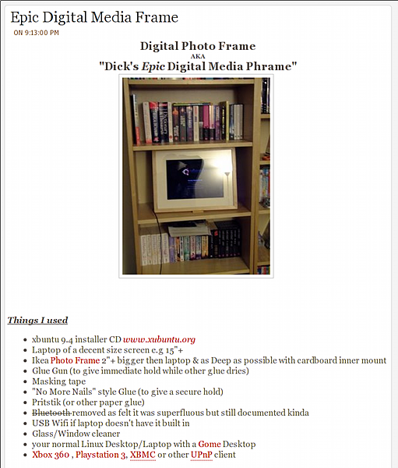
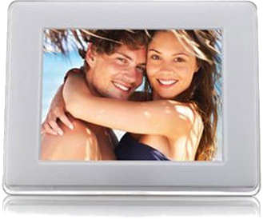
PC apps
printing
digital picture frame
Viewing
http://xpd259.blogspot.com/2009/04/epic-digital-media-frame.html
Notes:
A long heralded idea that still hasn't quite caught on is the 'digital photo frame'. You can plainly see how they are marketed. Yuck.
Here's something far more interesting. It's awesome. It's Epic. It's spoilt only by using an Ikea frame... arguably, Wilko's would have had more street cred.

Slide 20
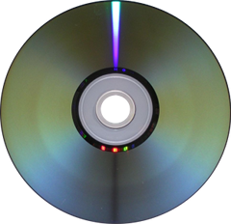
PC apps
printing
digital picture frame
DVD
Viewing
Notes:
Some people like to create slideshows on DVD so they can inflict their pets, children and holidays on grandparents that don't do computers. An old fashioned album would probably be more welcome.

Slide 21
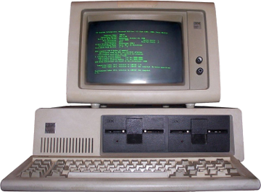
PC
as a
hub
PC apps
printing
digital picture frame
DVD
Notes:
All these new ways of enjoying photos are enabled by conventional PC technology. Despite the 'cloud' fad, the concept of the heavyweight PC as a personal media hub remains valid.

Slide 22
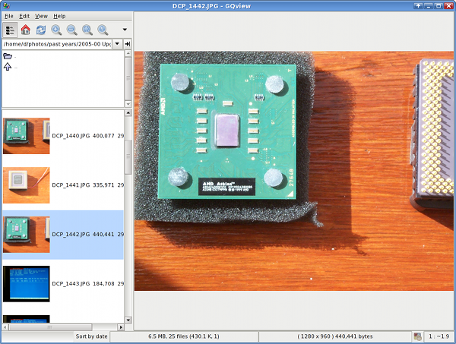
gqview/geeqie
Image viewers
Notes:
Turning to the specialised PC image viewing apps, there are plenty of them for Linux. Everyone will have their own favourite. My favourite, gqview, has recently been unmaintained, but there's now a fork under active development named geeqie.

Slide 23
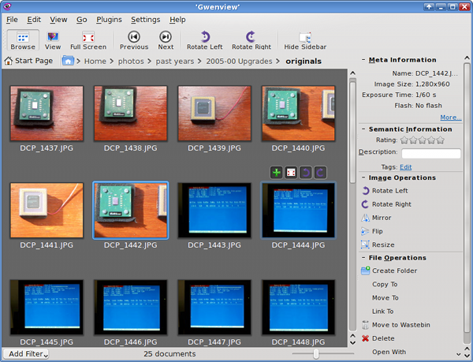
gqview/geeqie
gwenview
Image viewers
Notes:
Here's the thumbnail view in KDE's viewer, gwenview

Slide 24
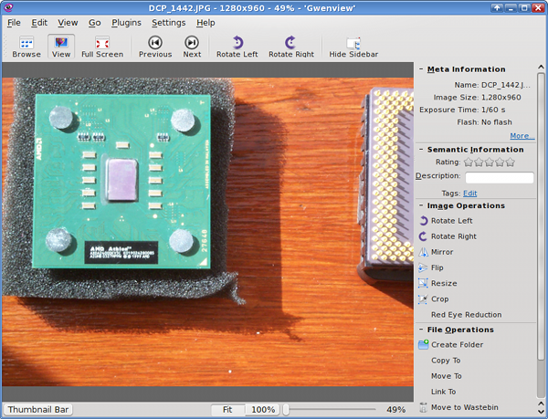
gqview/geeqie
gwenview
Image viewers
Notes:
And here's the full size viewer in gwenview

Slide 25
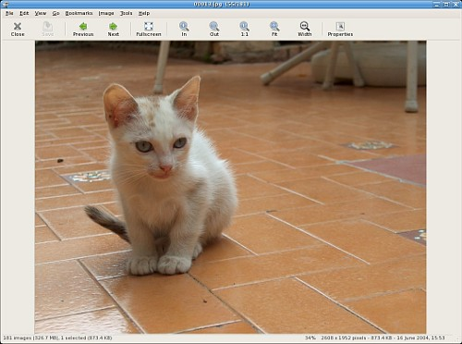
gqview/geeqie
gwenview
gthumb
Image viewers
Notes:
Here's the corresponding window in gthumb (not my photo, not my cat).

Slide 26
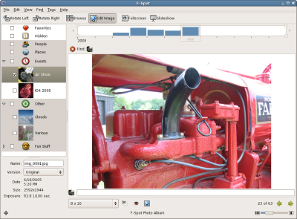
F-Spot
digiKam
Picasa
Image managers
Notes:
The image managers are one step up from the image viewers. They combine image import from the camera, file-manager style image organising, and limited photo editing capabilities. Here's F-Spot.

Slide 27
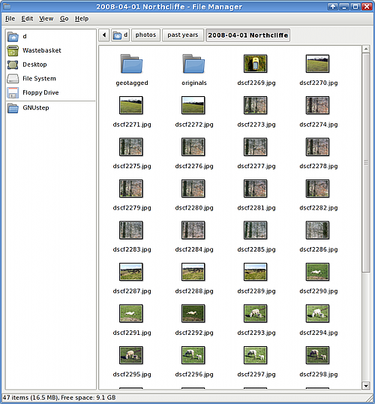

Organising
Filestore centric
  local directories
Application centric
  local collections
Online
Notes:
What matters with organising is not so much how you do it, so long as you really do.
As well as whatever thematic or chronological collections you'll build up, you probably also want to keep the original files safe somewhere.
You can maintain your own directory structure, organised however you like, with a conventional file manager.
You can use the image managers like F-Spot and digiKam.
Or you can put your organised collections online.
Very few people these days self-publish their photos on their own web sites. It used to be quite a common practice. But even with HTML photo gallery software, it's hard work. We won't be discussing this today. Instead, most people use the much-hyped Cloud -- which is what we'll talk about next.

Slide 28



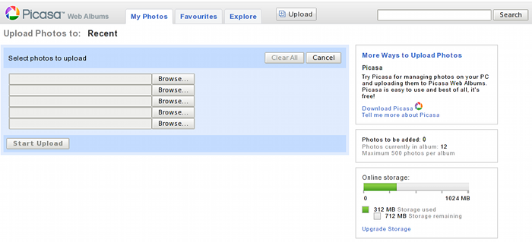
Publishing
flickr
picasa,
fotopic,
panoramio, ...
Notes:
The most widely used photo sharing site is Flickr. As the market leader, its free (as in beer) usage limits are not generous.
The second rank includes Picasa Web Albums, fotopic (popular with transport photographers), Panoramio, and many more.
There's also a site - Smugmug - that's a real nest of the old-thinking copyright maximalist dinosaurs. Not recommended.

Slide 29
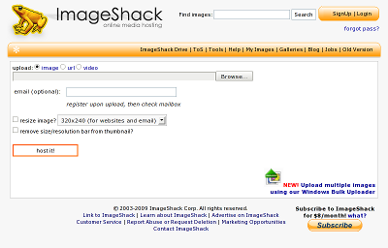
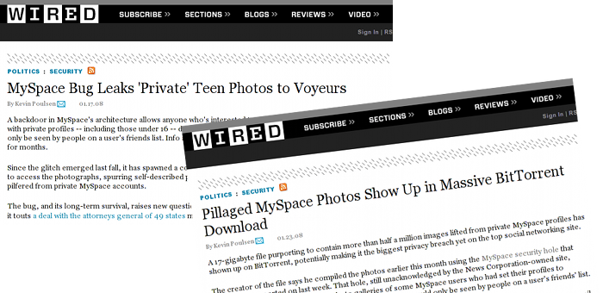
Publishing
imageshack, photobucket
myspace,
facebook,
twitpic, ...
Notes:
Right down in the bargain basement are imageshack and photobucket, which are widely used to host images for embedding elsewhere (for example on HTML enabled message boards that don't provide image storage for users).
There are also the social media sites, to which image storage is an incidental benefit. Of course, news stories appear regularly in the tech media about how these sites fall short of best practice in keeping images private. Please be aware of that when you upload your photos.

Slide 30
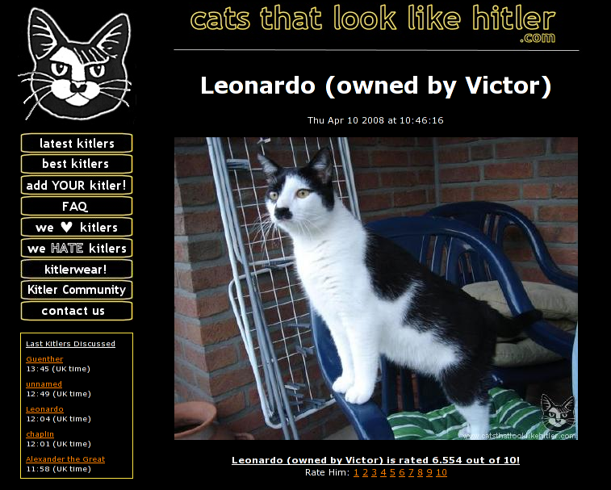
Publishing
Specialised sites
Notes:
And then there are the more specialised sites, fulfilling the needs of exhibitionists of all sorts - salacious and innocent alike.
The presence of a rating system is an infallible indicator of exhibitionism.

Slide 31
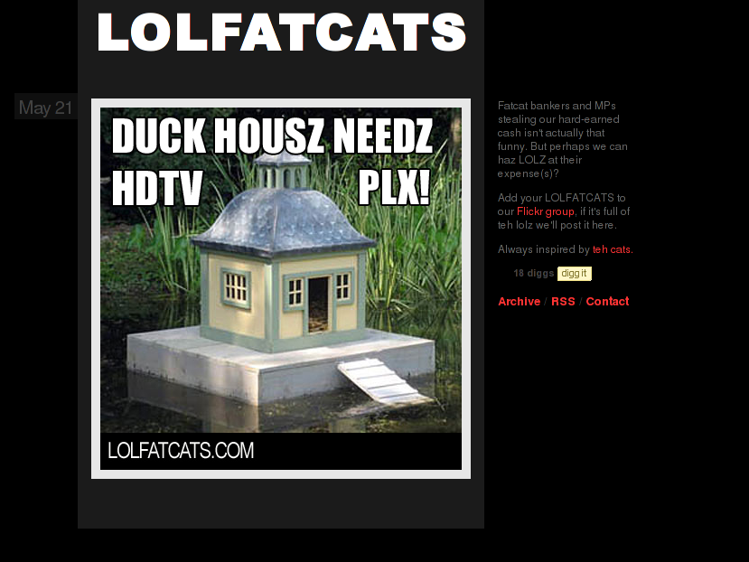
Notes:
One publishing phenomenon nobody predicted is the power of the meme in image form.

Slide 32

Notes:
For balance, here's another one.

Slide 33


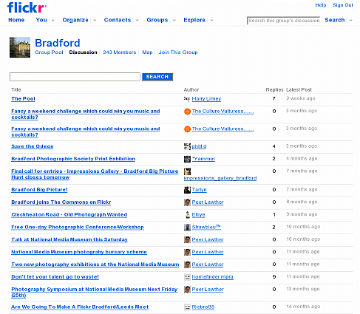
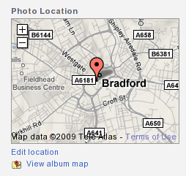
Publishing
Community
Services
Notes:
Sometimes it seems like photo sharing sites are raining down from the heavens. How do you choose between them?
Well, you need to consider two things. First and foremost, you need to find out which sites have the right community of users for you to join
Secondly, you need to consider the services you want from the site. This might include simple things like generous storage, favouring and discussion, or more sophisticated services like RSS and geolocation.

Slide 34
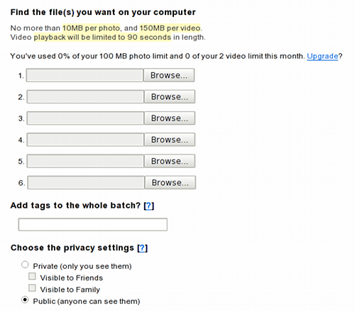
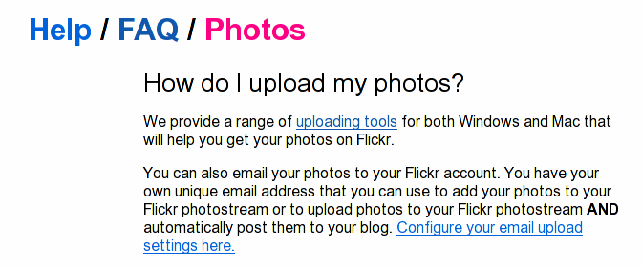

Publishing
Uploading
FAIL
Notes:
Uploading is most usually done through a web browser form. This is usually cumbersome and tedious.
Occasionally sites will provide their own desktop apps to ease the process - support for minority platforms being at the owner's discretion.

Slide 35
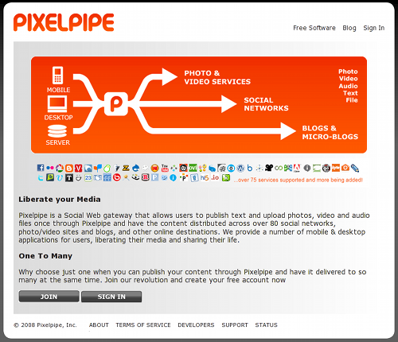
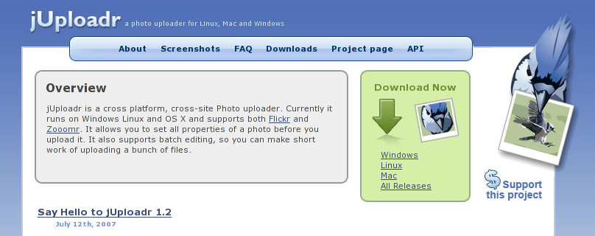
Publishing
Uploading
Notes:
Sometimes there are third party tools that do the same job. Some are multiplatform and single site (eg, jUploadr).
The most prominent multiplatform multisite uploader is Pixelpipe.

Slide 36
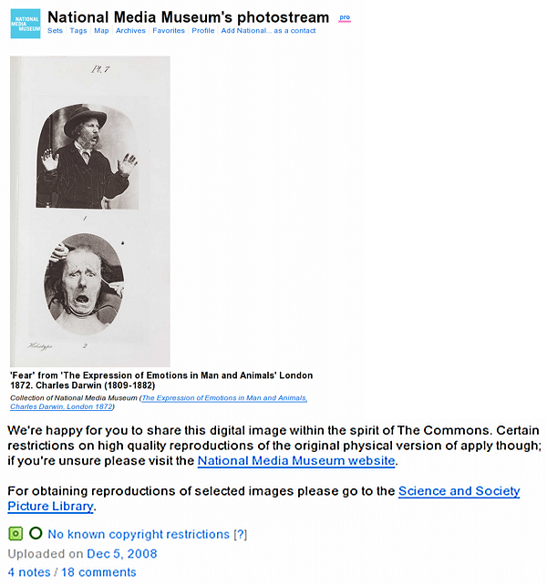
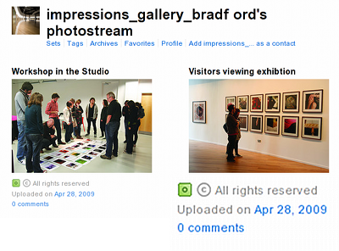
Licences
Culture clash
Notes:
Publishing your photos is all about other people making use of them, and that raises the spectre of copyright and licences.
At one end of the spectrum are people who recognise that publishing is, logically, all about other people making use of the photos.
At the other end of the spectrum are copyright maximalists who habitually slap prohibitive conditions on their work, even when it works against their own interests.

Slide 37
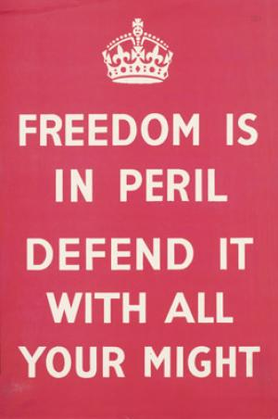




Licences
Copyright in images
Notes:
It is perhaps useful to say something about copyright as it relates to images. The law differs somewhat between the USA and the UK, with British law being less permissive.
For example, this is a Crown Copyright image. Fortunately Crown Copyright expires after fifty years. In the USA, anything produced by the federal government is not copyrightable.
But nevertheless the above image is not freely reproducible in Britain because it has been scanned, and the scanning is itself deemed worthy of full copyright protection. Contrast that with American law, where only protectable expression can be made copyright, and a neutral, faithful reproduction of an image is not in itself protectable expression. Additionally, thumbnail sized images have been found to be 'fair use'. Here in Britain, case law on 'fair dealing' in thumbnail images has not been developed.
But not even in Britain does it infringe copyright to take a photo of a building or a manufactured product.

Slide 38
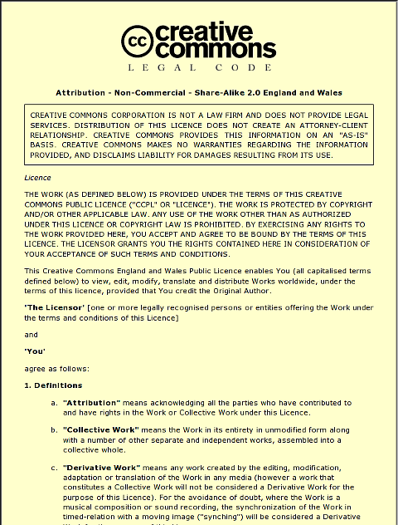
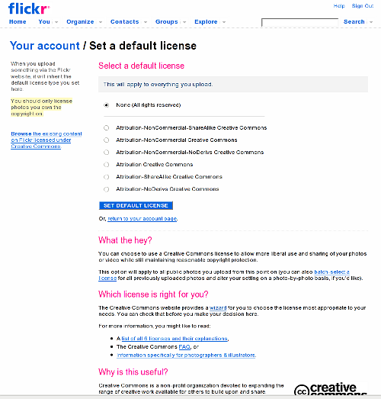
Licences
Creative Commons
Notes:
The only way out of this insanity is to use permissive licences on your work.
Note that the Creative Commons licences are more appropriate for images than the corresponding GNU licences. Amongst the reasons for this are that the GNU licences oblige you to provide a full copy of the licence with the work, and that the Creative Commons licences include specific provisions relating to derogatory treatment.
Placing an explicit Creative Commons licence on your work (for example, at Flickr you can set a default licence on your profile) is helpful because people can search for Creative Commons material that can be used and redistributed freely. This has been invaluable in preparing this presentation.

Slide 39
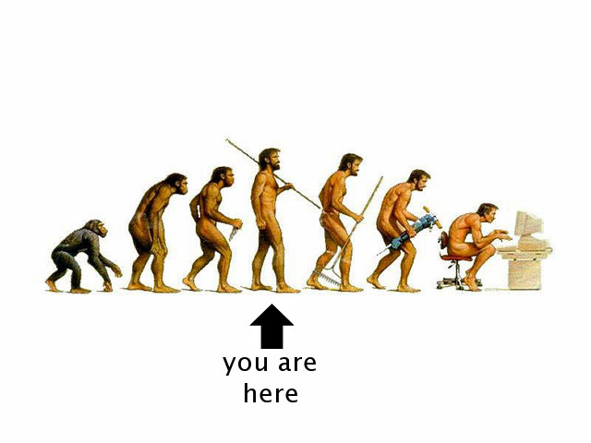
4
Understanding image capture
Notes:
We've already covered everything needed to get up and running, but to move to the next level of expertise we need to talk about how an image is captured by a camera and encapsulated in a file.

Slide 40
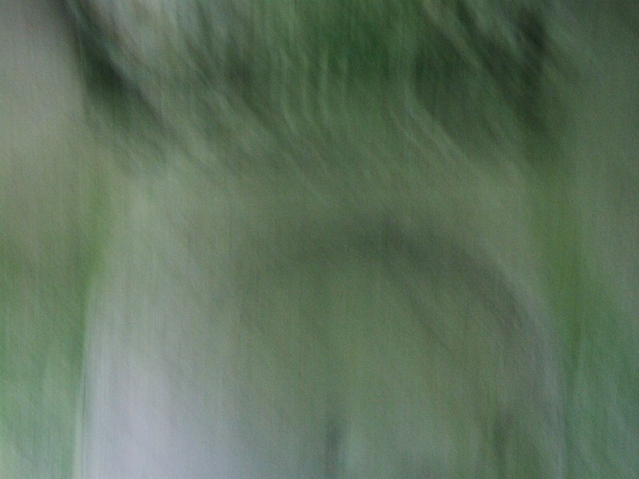
Capture faults
Notes:
Let's talk FAIL. But not all FAIL is alike.

Slide 41
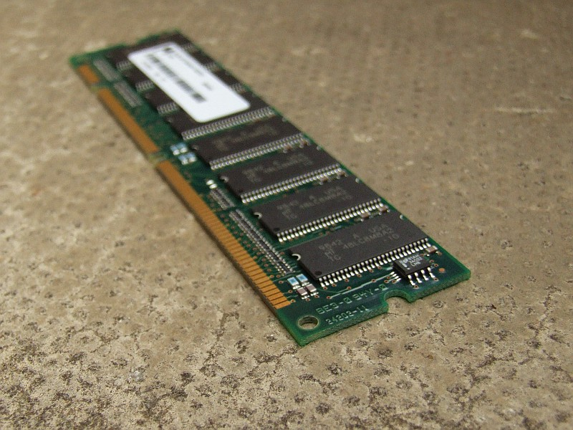
Poor focus
Notes:
You see this kind of FAIL all the time, particularly on eBay. It's trivially easy to do better.
Almost every camera on the planet has a half-way position on the big button. Point at the middle of the object, not the end. Press the button halfway down. The camera will lock its focus on the middle. Now keep the button held halfway and swivel the camera a bit to get the view you want. The camera will stay focussed on the middle of the object. Now press the button all the way. The camera will take a photo where, hopefully, both ends are acceptably focussed.

Slide 42
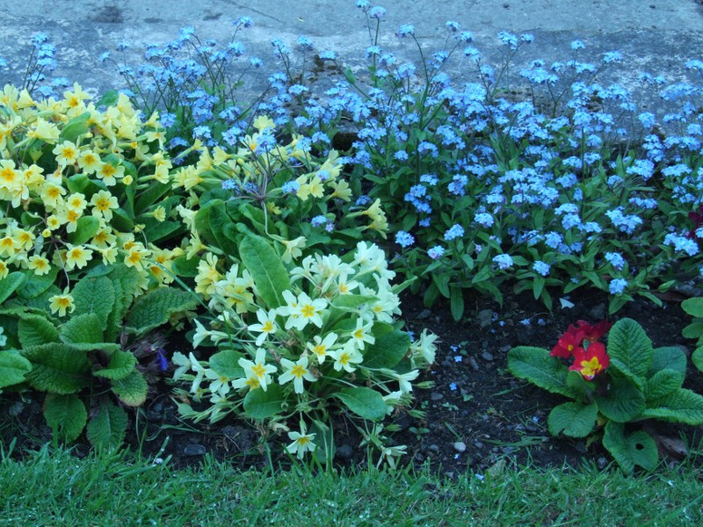
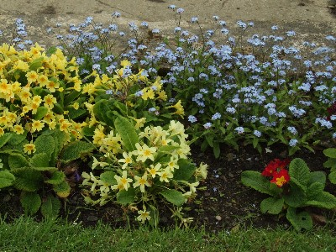
Colour balance
  'temperature'
Notes:
Indoor artificial light is tinted orange, outdoor natural light is tinted blue. This is known as 'colour temperature'. Cameras try to compensate for this automatically; this is known as 'colour balance'. If the camera gets it wrong, this is what happens.
If you've somehow managed to turn off automatic white balance, this will happen all the time. Otherwise, you can fix it by postprocessing.

Slide 43
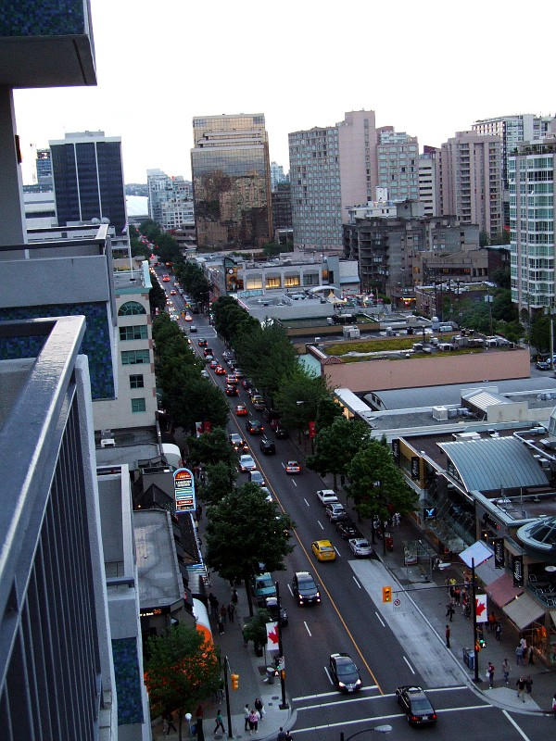
Poor geometry
Notes:
Some people have dozens of photos where the sea slopes upwards. Apparently they don't care.
Maybe there's more excuse when you're hanging over a balcony.
Anyway, you can fix this in postprocessing.

Slide 44

Motion blur
  subject
Notes:
If your subject is moving, you need to take the picture quickly enough (shutter speed) that the blur isn't apparent. So motion blur is really an exposure problem. You need to collect more light in a shorter interval.
It's pretty much impossible to fix this in postprocessing.

Slide 45

Motion blur
  camera
Notes:
Similar problems arise when the camera itself moves. Again, sufficient shutter speed will eliminate the blur, so it's an exposure problem.
Theoretically, motion blur can be fixed in postprocessing by the mathematical process of 'deconvolution'. In practice, however, the results are usually terrible.

Slide 46

Exposure faults
  underexposed
Notes:
This is underexposed. It happens because the camera's automatic metering has been fooled, or because of operator error, or because light levels in the real world cover a greater range of brightness and darkness than a camera sensor can properly capture.
Often one part of the scene will be just right but the rest will be too dark.
You can try to use the 'half-click' mechanism to encourage the camera to find the right compromise between light and dark.
You can try to brighten the image in postprocessing.
Or you can take several photos with different exposures, and then use the one that came out best.

Slide 47

Exposure faults
  overexposed
Notes:
This image is overexposed.
Again, you can try to use the 'half-click' mechanism, or you can try to darken the image in postprocessing, or you can take several photos with different exposures, and then use the one that came out best.

Slide 48


Exposure faults
  blooming
Notes:
When part of an image is seriously overexposed, you can get an effect peculiar to digital cameras known as 'blooming'.
This purple fringeing effect happens when the charge in a CCD cell overflows into its neighbours.
This is usually ascribed to the excess of green-detecting cells over red and blue cells in the CCD matrix (this design feature is intended to match the human eye's greater ability to detect detail in the middle of the visible spectrum).
The answer is to avoid gross overexposure. Alternatively, some commercial photo editing suites have a purple fringe removal filter, but these can be tedious to use and not particularly successful.

Slide 49

Exposure faults
  sensor noise
Notes:
Any electrical circuit has noise. Camera sensors are no exception, and noise becomes visible as speckles and stripes.
This depends on the sensor's current sensitivity setting, which we'll discuss in a moment.
The only way of avoiding noise in image capture is to use a long exposure, possibly requiring a tripod. Otherwise you just have to put up with it.

Slide 50

Exposure
Sensitivity
  (user setting)
Aperture
  (per image)
⇒ Shutter speed
  (calculated)
Notes:
Sensitivity is generally a static, nonvolatile user setting. Alternatively, the camera will determine sensitivity depending on the broad level of illumination just prior to capturing the image.
Aperture determines how much light reaches the sensor. It's selectable per-image by a knob on the camera, or, on a fully automatic setting, the camera will determine the aperture to fine-tune the sensitivity.
As a side effect, aperture also determines the depth of acceptable focus, though this effect is generally not very evident in most digital cameras (due to the small size of the sensor, as compared to 35mm film).
These two settings together determine an appropriate 'shutter speed'. This is a misnomer in a digital camera; it's actually the length of time for which the CCD sensors collect photons before they are read out.
With so many interdependent tunables, it's no surprise that a qualitatively good exposure can be difficult to achieve.

Slide 51

Sensitivity
  (user setting)
Notes:
Sensitivity is usually determined by a nonvolatile user setting.
It corresponds to old-fashioned film speed and is calibrated in the same units - ISO 100, 200, 400 etc.
When your subject is badly illuminated you will need a bigger number.
The bigger the number, the less light you need to make an image (and consequently the quicker the 'shutter speed' will be), but at a cost of more sensor noise in your images.
Ideally your 'shutter speed' needs to be normalised to a sensible range, so you shouldn't just leave this on ISO 100 all the time.

Slide 52

Format Quiz
JPEG
Lossy
Quality metric
Bits per pixel
Notes:
Before we look at the other typical user settings, we need to discuss the JPEG image format.
It's worth emphasising that the format is 'lossy' and images will deteriorate visually when repeatedly re-saved, even as the file size stays the same or even increases.
The degree of compression is controlled by a 'Quality' metric, an integer in the range 0 to 100. At very high quality (>95) the image can actually get larger without any visible improvement. There is no predictable relationship between the quality metric and its aesthetic result; it depends on the image.
In its widely accepted form the JPEG format has a very limited number of bits per pixel - 8 per colour. This is well matched to the capabilities of modern display equipment but can be a serious problem when images are postprocessed.

Slide 53

User
settings
Quality
Notes:
Obviously when your camera spits out JPEG files it will have to have converted the image to this format from the raw sensor data - just like when you use an image editor like the Gimp to save an image as a JPEG. And of course that process is lossy.
Because of this, your camera will probably have a 'Quality' setting. This setting is really just the familiar JPEG quality metric, although it is dumbed down from an integer to just 'Good', 'Better' and 'Best'.
'Best' is best. Your JPEG files will be somewhat bigger, but storage is cheap.

Slide 54

Quality
Resolution
  pixels
Notes:
Another user setting is the image resolution (ie, pixel dimensions).
Most probably the image is captured by the entire sensor and then resampled in software to the desired size for storage.
In this era of cheap storage, the main advantage of storing a smaller image size is actually to minimise the camera's recovery time whilst it stores the image - these days, bandwidth to flash memory is the main constraint in a digital camera's processing cycle.

Slide 55

Colour
  balance
  saturation, contrast
Sharpness
Notes:
Colour balance is best left on 'auto', as we have already seen.
Saturation and contrast are tunables because the raw image captured in the sensor can often look duller than the human vision system would perceive.
Sharpness is an entirely mathematical operation that attempts to compensate for the resampling that occurs when images are downsized from the full sensor dimensions for storage on the camera's memory card. It's a preset tunable because there is no single right amount of sharpness, though the camera's highest level of sharpness will generally produce best results.
Again, all these settings serve to determine how the sensor image is converted to JPEG format.

Slide 56


Other features
  = load of bollocks
'jozjozjoz', flickr
Notes:
What about other features on your camera?
Well, what do they do, exactly? Undocumented proprietary stuff.
Can you rely on them to do what you want?
If they go horribly wrong, can you even turn them off?

Slide 57

5
Postprocessing
Notes:
We've mentioned postprocessing repeatedly. This is the digital equivalent of the mysteries of the darkroom, but it's far more accessible.

Slide 58

Image editors
gimp
krita
cinepaint
F-Spot,
digiKam,
Picasa
Notes:
The most obvious means of postprocessing are the various image editors.
We'll be using the Gimp.
Other choices are krita (KDE) and cinepaint (a fork from ancient Gimp).
And the big image manager applications all include editing facilities, so if you prefer to use F-Spot you'll still be able to perform the simpler postprocessing tasks.

Slide 59

gimp
resize
crop
sharpen
Notes:
Let's look at some common operations in the Gimp.
Resizing necessarily entails resampling the image, and consequently the resized image will benefit from sharpening. Note that rotation by multiples of 90 degrees is lossless, provided that the image is a multiple of 16 pixels in both dimensions. This is why free rotation is, confusingly, under 'Tools -> Transform tools' but 90 degree rotation is under 'Image -> Transform'.
Sharpening is a mathematical operation. It's found under 'Filters -> Enhance'. If you regard the image as a two dimensional signal, sharpening amplifies the high frequencies. You determine the amount of amplification so that the image remains natural-looking. Once you know what an over-sharpened image looks like, you'll see them everywhere on the net and in newspapers.

Slide 60

colour
  white balance
  saturation
Notes:
You can easily adjust the white balance and saturation.
The best means of doing this is 'Colours -> Auto -> White Balance' and 'Colours -> Auto -> Colour Enhance'.
'Colour Enhance' is usually overenthusiastic and needs to be faded: 'Edit -> Fade colour enhance...'

Slide 61

brightness,
contrast
histograms,
curves
Notes:
The auto tools we just saw will usually handle brightness and contrast really well, even on overexposed and underexposed images.
Brightness and contrast are also directly adjustable. One of the best ways is via 'Colours -> Curves'.
However, a light touch is advisable. JPEG files carry only a limited number of quantised levels of brightness and colour, so beware of extreme changes.
If an image is very poorly exposed there's only so much you can do to rescue it.

Slide 62

posterised
Notes:
One symptom of overadjusting brightness and contrast is the appearance of 'posterised' effects in the sky, due to the limited pixel bit depth of the JPEG format.

Slide 63

geometry
  rotate, straighten
  perspective
Notes:
Please take the trouble to straighten the horizon. Even half a degree of rotation can make a huge improvement to the look of your photo.
Upwards and downwards views, and wide angle views, will often benefit from perspective transformations. But don't remove all the perspective. Your photos will look best with a small amount of perspective left in.
Rotation and perspective operations always distort the rectilinear boundaries of your image. You'll probably want to crop the image back to a rectangle afterwards. Unfortunately some of the image will be lost.
Remember that rotation and perspective operations always resample the image, so you'll probably want to sharpen afterwards.

Slide 64
Order
geometry
crop/resize
brightness/colour
sharpen
Notes:
You're best off tackling geometry first because there will be a loss of sharpness due to resampling, and so to minimise this you need to start with the highest resolution you can get your hands on - the original image.
Then you can crop the unusable borders, and resize to a web-friendly size.
Adjusting the brightness and colour is best done on the final size image. It's quicker because the image is smaller, and it avoids incorrect gamma calculation on scaling (though the Gimp apparently no longer suffers from this common error -- see http://www.4p8.com/eric.brasseur/gamma.html).
Sharpening comes last because it's best done once only and all of the preceding operations can erode sharpness.

Slide 65
Things we
don't do
re-edit
make bigger
borders
captions
sepia
Notes:
Don't re-edit, go back to the original and start again.
Don't make your images bigger. Sharpening won't help. And don't take photos with 'digital zoom', which is the same thing; it's a con trick.
Don't add borders to your images - use HTML.
Don't add captions if you can avoid it - use embedded tags.
Don't do silly clichés like sepia images.

Slide 66
Specialised tools
Notes:
This is the really interesting part of the presentation.

Slide 67

exiftool
Manipulate
EXIF tags
Notes:
JPEG files (and other formats too) have embedded information tags, known as EXIF tags. The best tool for manipulating them is exiftool, a perl library module and command line application.

Slide 68
EXIF tags
Date/time
Camera details
  image capture settings
  make, model, serial
Location
Privacy implications
Firefox extension
JFIF
IPTC
XMP
Notes:
What are EXIF tags, and why do they matter?
They contain information like the camera's date/time when the photo was taken. Other information may include the camera shutter speed, aperture, focal length, field of view, etc, as well as the camera's make, model, firmware version, and even sometimes the individual serial number.
Some cameras with integrated GPS - at the moment, this is most likely to be high end phones - record the photo's location. Whilst a really cool thing and useful to do, obviously it can also have very serious privacy implications.
Most image viewers will show you the EXIF tags in detail. There's also a Firefox extension so you can efficiently snoop by right-clicking on random web images.
EXIF was a successor to the earlier JFIF standard. Strictly, the tags themselves were defined by a body known as IPTC, and the resulting mess has recently been stirred up by a further revision known as XMP. The simplistic term 'EXIF tag' is good enough.

Slide 69
http://www.sno.phy.queensu.ca/~phil/exiftool/
exiftool
copy
delete
adjust date/time
exiftool -TagsFromFile dscf3645.jpg dscf3645_corr.jpg
exiftool -all= dscf3645.jpg
exiftool -AllDates+="365 0:0:0" photos/2009-04-01/
exiftool -comment="Ringlet butterfly" dscf3645.jpg
exiftool \
-copyright="D Spencer Creative Commons CC-BY-SA" \
photos/2009-04-01/
Notes:
Some use cases for exiftool are as follows -
You can copy all the tags from one file to another that has lost them in the course of postprocessing.
You can delete all the tags from a file.
You can add a fixed amount of time to all tags in all the files in a directory, because your camera's clock was set wrongly - time zone changes, battery failure, operator error.
You can add a text comment.
You can add another text tag named 'copyright'.

Slide 70


gpscorrelate
Add location to EXIF
time synchronized with GPS tracklog
Notes:
For the majority of us whose cameras don't have an integrated GPS, you can use the EXIF time stamps on your photos to snarf the exact location of each photo from a GPS tracklog.
Just make sure you take a photo of your GPS, showing the time, so that you can retrospectively tweak the timing on the photos to be accurate within a second. (Unfortunately manufacturers don't provide any way of setting the camera clock from your PC.)
The latitude, longitude and altitude will be stored in EXIF tags. Many sites (flickr, Panoramio, Picasa, ipernity) understand these tags and automatically display location information, including a map.

Slide 71
fulla
Correct lens faults
  database needed
export PTLENS_PROFILE=$HOME/.ptlens/profile.txt
fulla -v -p -l Standard dscf3645.jpg
exiftool -TagsFromFile dscf3645.jpg dscf3645_corr.jpg
lensfun
Notes:
There's a really good tool called 'fulla' for correcting optical lens faults mathematically.
The problem is that you need a database of the optical characteristics of all the different camera lenses out there.
Unfortunately the original compiler of the lens database decided to do a Gracenote and monetise it, leaving us with an orphaned snapshot. I'm lucky, my camera happens to be in that database. Or you can calibrate your own camera's lens yourself, there are pages that tell you how to do it.
A project 'lensfun' has recently been started, this is integrated in the latest version of digiKam and consequently we may see an improvement in the availability of freely licensed lens data.
What do we mean by lens faults? Every lens manufacturer tries to minimise them (according to the lens's purpose and price point) but you canna change the laws of physics. Here are the faults we are talking about.

Slide 72

Lens faults
  barrel distortion
Notes:
Barrel distortion is so endemic that we've almost stopped noticing it. Straight lines become curved due to the projection of a three dimensional scene onto a flat sensor plane. This picture is before correction is applied...

Slide 73

Lens faults
  barrel distortion
Notes:
... and this is after correction. It's amazing how much more realistic the image becomes, even though the original distortion wasn't very noticeable.

Slide 74

Lens faults
  vignetting
Notes:
Vignetting is when the lens doesn't illuminate the sensor evenly. This is what it looks like. It's more prevalent at wide angles.

Slide 75


Lens faults
  chromatic aberration
Notes:
Chromatic aberration happens when the lens refracts different frequencies of light by different amounts. It is visible as greeny and purpley fringes on opposite sides of objects, most probably towards the edges of images.

Slide 76

Format Quiz
JPEG bit depth
RAW
TIFF
EXR
Notes:
JPEG is good for display purposes - it is well matched to the capabilities of current display hardware - but due to lossiness and limited pixel bit depth it is not very good for processing.
There are other file formats that overcome these limitations.
Many higher-end cameras can save the raw image data straight out of the CCD. But there is no file format named 'RAW'. Rather, the camera manufacturers each have their own proprietary file formats for storing raw sensor images. This is a mess, serving nobody but the manufacturers.
TIFF is a long established format. It is lossless and supports transparency and high bit depth. It is good for intermediate storage in postprocessing workflow.
EXR is a new format purposely created for storing high resolution, high dynamic range images. It's a free-as-in-freedom format, though not yet really well supported.

Slide 77

Convert raw files
Notes:
It's often asserted that Real Photographers use RAW (in capital letters). This is mostly obnoxious snobbery and elitism; for contrasty subjects, raw sensor images do have advantages in exposure adjustment, but they are huge, and as we will see an 'exposure stack' of several images can be a superior alternative.
UFRaw comes with a Gimp plugin so that you can read and edit raw files directly, avoiding the need for intermediate storage as TIFF files.
The engine underneath ufraw is named dcraw.
There's an up and coming new alternative to ufraw called Raw Studio. Just my opinion - it's crap.
Raw images are considered 'high dynamic range', though that isn't exactly true - rather, the sensor's dynamic range is quantised with a higher granularity than in a 'low dynamic range' format (ie, JPEG).

Slide 78

demosaic
Notes:
The main task in converting a raw file is 'demosaicing' as described in this Wikipedia diagram.
Details of the sensor layout can vary from camera to camera, so it's not just a matter of arbitrage between proprietary file formats.

Slide 79

qtpfsgui
HDR tonemapping
Notes:
A more creative technique of compressing high dynamic range images for display is known as 'tonemapping'. The Linux application to do this is qtpfsgui.
There are a large number of tonemapping algorithms and qtpfsgui has pretty much all of them. However, to most people, 'HDR' is synonymous with the Fattal tonemapping algorithm.
Most tonemapping algorithms are horribly abused. This garish monstrosity is a deliberately created example of how the Fattal algorithm looks when it's abused.
Another reason to be suspicious of tonemapping is that most of the algorithms are sensitive to the pixel dimensions of the input and output images - not a very lovable trait in an algorithm.

Slide 80

'jazamarripae', flickr
Notes:
The ghastly haloes and colour effects are instantly recognisable.
Despite the artiness, this is bad tonemapping. It's a meme that just won't die. In fact, it's almost a form of folk art these days.

Slide 81

'foto43', flickr
Notes:
Not all tonemapped images are so bog-awful. This one's nice (Goole, by the way. Not often someone calls Goole 'nice' but there you go.)

Slide 82

Exposure stack
  HDR without raw
Notes:
There's a better way of capturing and rendering high dynamic range images.
The 'enfuse' tool takes multiple source images and combines them, according to how authoritative it considers each pixel from each image to be.
Higher contrast to adjacent pixels, higher saturation, and mid-range luminosity are considered to be heuristics of high authoritativeness.
By combining multiple images you can get true high dynamic range - higher range, in fact, than is possible with a single raw image.
Let's see how this works.

Slide 83

Notes:
Fancier cameras often have an automatic multiple exposure setting. When the button is pressed, the camera will take three pictures, one on the nominal setting, one overexposed, and one underexposed, in quick succession.
This one's mostly underexposed. The clouds and sky look great - high saturation, mid range luminosity. There's useful detail on the gable wall and vegetation - high contrast with adjacent pixels and high saturation, medium luminosity. The rest of the image is quite useless - low saturation, extreme luminosity.

Slide 84

Notes:
This one's overexposed. The details in the courtyard can be seen well - high contrast with adjacent pixels - but the sky is blown - low saturation, extreme luminosity.

Slide 85

align_image_stack -a /tmp/fuse dscf6*
enfuse -o hdr.tif /tmp/fuse*
gimp hdr.tif
Notes:
This one's in the middle. The gable wall is fine but both the sky and courtyard are poor.
Prior to combining the images, they need to be aligned very carefully. A separate tool called 'align_image_stack' is provided in the enblend-enfuse distribution.
Note that the three intermediate files and the final output are all in TIFF format. You can then change the size, saturation and sharpness in the Gimp and save the final picture as a JPEG file.

Slide 86

Notes:
And here's the result, combining the best of all three images.

Slide 87

Ghosting
Notes:
Unfortunately the slightest movement will give rise to ghosting effects. Water looks quite good that way, but foliage, vehicles and people can look really bad.
You can chop huge lumps out of the source images manually, and software anti-ghosting is in development.

Slide 88

Focus stack
Notes:
Enfuse can also be used to create images with extended depth of field, overcoming focus problems.

Slide 89

Notes:
The subject here is approximately one and a half centimetres wide and about sixty centimetres deep. When the front is in focus, the rear is completely lost.

Slide 90

Notes:
It's impossible to get it all acceptably focussed. When focussed in the middle, both the front and the back are blurred.

Slide 91

Notes:
You need to take multiple photos each with different focus. Obviously you need a camera that is capable of manual focussing. The camera and subject must'nt move (I used blu-tak to anchor the camera to the desk).

Slide 92
align_image_stack -a /tmp/fuse dscf6*
enfuse -o fs.tif --wExposure=0 --wSaturation=0 \
--wContrast=1 --HardMask /tmp/fuse*
Notes:
As with the exposure stack, we align the images and then combine them. Note that focus stacks need to be combined using a different heuristic that stresses detail (contrast to adjacent pixels) and ignores saturation and luminosity.

Slide 93

Notes:
Here's the finished result.
It needed six photos and a great deal of experiment with enfuse's parameters to produce this image and the result is far from perfect - note the halo effects in the background.
Different applications can produce better results, depending on the input - the others are commercial Windows applications - but in general the focus stacking technique isn't as impressively successful as exposure stacking.

Slide 94

Noise reduction
Notes:
Enfuse can also be used for noise reduction. Multiple speckled images taken at high sensitivity can be combined to make a single image with less noise.
Unfortunately, the amount of noise reduction is proportional to the square root of the number of images.

Slide 95

ISO 100
Notes:
So, to form one image with noise at levels typical of ISO 100 sensitivity...

Slide 96

ISO 200
Notes:
... we need four separate photos taken at ISO 200 ...

Slide 97

ISO 400
Notes:
... or sixteen separate photos taken at ISO 400.
Neither the camera nor the subjects can move during the taking of all these photos (or you'll get ghosting), so you really need a tripod, and if you have a tripod you might as well just take a single long exposure at low ISO. In practice, therefore, noise reduction by combining multiple photos is a non-starter.

Slide 98
NL Filter
(nonlinear)
Noise reduction
  Adaptive smoothing
  Edge enhancement
Notes:
An alternative approach to noise reduction is to smooth out the noise between neighbouring pixels using a gaussian blur.
Obviously this has a significant adverse effect on sharpness, so practical smoothing filters vary their operation according to the signal gradient to adjacent pixels, and then an edge enhancement operation is usually applied.
The NL Filter in the Gimp can do both smart smoothing and edge enhancement.
Inevitably, images processed in this way lose a lot of detail. Generally, they have a rather poor 'painted' look. This kind of noise reduction is not recommended for routine use.

Slide 99

hugin
Stitched panoramas
Notes:
You'll have seen multiple images stitched together to form so-called panoramic images. The free software tool to do this is Hugin.
Preferably, all the photos should be taken with the same zoom and exposure settings (use a manual setting).
Hugin uses enblend-enfuse, so it accepts exposure stacks, creating full HDR panoramas if you like that sort of thing.

Slide 100

Parallax
http://www.wikihow.com/Build-a-Panoramic-Tripod-Head!
Notes:
The most important thing to watch out for is to eliminate parallax error when taking photos to be stitched.
The camera should be rotated around the apparent position of the shutter when viewed through the front lens - this will appear to move in and out depending on zoom.
It's just about possible to do this hand-held if you're careful. But tripods don't rotate around this point - neither round and round, nor up and down.
Special tripod mounts to do this are expensive, but you can build your own -
http://www.wikihow.com/Build-a-Panoramic-Tripod-Head

Slide 101

Software patents
Notes:
For some reason, there are a lot of patents in the general area of panorama creation.
Here's a prime example of a software patent stifling innovation within the Hugin project. It's a patent belonging to Microsoft.
Although the excuse is often trotted out that such patents are defensive, you can see that the mere existence of the patent is enough to deter use of independent implementation of a related technique that could be held infringing, even when the patent owner has no competing product.

Slide 102

Software patents
Notes:
Here's another prime example - the SIFT algorithm for creating control points for image alignment. A US patent belonging to the University of British Colombia in Canada.
As a quick reminder, the purpose of Universities is to disseminate knowlege in society. Thanks guys.

Slide 103
Order
fancy stuff
geometry
crop/resize
brightness/colour
sharpen
EXIF tags
Notes:
We can now revisit the right order in which to do these operations.
Generally, all the fancy stuff comes first.
You fiddle the EXIF tags at the end if necessary. Copy them from the original if you've lost them and you want them back. Geotag, or add comments. Or remove them if you don't want them exposed to public gaze.

Slide 104
Other topics
alternative apps
batch processing
retouching
creative effects
Notes:
Just a quick word about things we haven't covered.
In many cases there are alternative applications to do the same job. I've mentioned the ones I find most suitable, other people may have different preferences. Have a look round, ask other people what they use, try them out.
Complex applications like the Gimp have 'batch processing' facilities for applying the same edit to multiple files. This is usually done through some kind of scripting. You may find the learning process is harder than repetitive editing.
In some cases you may want to 'retouch' your images, doing things like removing power lines, litter or whatever. Typically you would do this in the Gimp. It's not necessarily easy, there aren't many short cuts.
The Gimp has a large number of 'creative' filters, but grown-ups don't do that.

Slide 105
Other topics
scanning
video
camera firmware
Notes:
The Linux tool for scanning non-digital images is SANE.
I've not said anything about video, though the distinction between still and moving pictures is really just a matter of custom and practice.
A few projects exist for replacing camera firmware. The idea is to overcome lameness and stupidity in the manufacturer provided user interfaces. For example, why is the Raw setting buried under three levels of setup menu?
Obviously these projects are up against manufacturer hostility and secretiveness. They certainly haven't made the sort of progress that OpenWRT has made in the world of WiFi. In fact progress has gone backwards - ten years ago there was a standardised operating system for cameras; a few models came out, then it sank without trace.

Slide 106

6
Inspiration
Notes:
Having given you the tools, let's give you the inspiration to use them. Here are some examples I admire. In accordance with the century-old debate about photography, the examples alternate between 'Art' and 'Reality'.

Slide 107

Art
Ultra wide views
Michael Bajko
Notes:
High resolution capture allows quite radical reprojection of images. We would call this an interesting and beautiful distortion; in the art world they might say that the distortion explores some deeper underlying reality of how we perceive and react to the landscape. Whatever. It's good.

Slide 108

Realism
Focus stacking
Notes:
We saw my own attempt at a focus stack earlier, here's one I really admire (unfortunately made using commercial software). It's an 'OO' scale model, you can see clearly see that from the loco front, but just look at the realism in the lighting of the side of the loco and the detail in the 'grass' and shed.

Slide 109

Art
'Tilt Shift'
(misnamed)
Notes:
The reverse effect - of making reality look like a model - is widely referred to as 'tilt-shift', a complete misnomer. In fact it's selective blurring of the image. Leeds City station, by the way.

Slide 110

Realism
Photogrammetry
Notes:
Something there's unfortunately almost no free software for - photogrammetry, the use of multiple images to calculate CAD representations of three dimensional surfaces.

Slide 111

Art
HDR
'getty', flickr
Notes:
I've stressed that taste is more important than maths in rendering HDR images. Here's an example done right, taken up by Harewood apparently.

Slide 112

Realism
Light painting
Notes:
Here's something that would be impossible with film technology. This is Gildersome tunnel. The orange is iron oxide leechate, the blue-white is from high powered LED torches used to illuminate the scene progressively, waved round and progressively painting the tunnel in light whilst the camera shutter stays open. You would need a transparency film to capture this scene, yet transparency film will never have the required sensitivity.

Slide 113

Art
360deg by 180deg
high res capture
  explore, reproject
  Pannini, pvQT, MathMap
Yuval Levy
Notes:
When an entire scene is captured in high resolution in the round, you become empowered to explore and project retrospectively, using virtual reality tools (which are really just maths).

Slide 114

Realism
Personal,
pervasive,
invasive
Notes:
When taking a photo costs nothing and your cameras is integrated into your all-singing all-dancing mobile device, it becomes possible to document all the highs, lows and weird offbeat moments of your daily life.

Slide 115

Notes:
Yummy yummy.
The infrequently asked question, however, is - at what point does looking at this become cyberstalking?

Slide 116

My dog just decided to read the paper and share my ice pack with her butt!
Notes:
Does the name Darl McBride mean anything to you? This is his ex-wife's dog, and his ex-wife's leg, just a week or two ago.

Slide 117

7
Wrap-up
Notes:
So that's it. Let's take stock.

Slide 118

GAIN
Democratisation
  everyone's a journalist
  everyone's an artist
  freedom to use works
  fuller historical record
Better technology
'quis eum fucius custodiebat?', flickr
Notes:
Here's the good news about the digital photography revolution.
In the new world of digital photography, everyone's a journalist. Look at the many cameras in the photo above.
However, it's not just about the current affairs bandwagon. Everyone's now an artist. That's doesn't necessarily diminish what professional artists do, but elitism and pretentiousness are no longer sustainable.
The explosive profusion of free images has amply furnished the intellectual commons. When images have zero marginal cost, permission for others to use them freely is entirely logical.
If we're careful, the profusion of images and permissive licensing will permit future generations an unprecedented engagement with how we live our lives today.
And we mustn't overlook the banale facts. Digital technology really is better. More flexible, better quality, no more lost films.

Slide 119



LOSS
'Cathedral' culture
Craft
Authenticity
Notes:
But there's also a downside.
In losing the 'cathedral' culture, we'll never have another Cartier-Bresson or Ansel Adams. We certainly will have new images that rank alongside their works, but they will come from a multiplicity of 'one hit wonders'.
And the craft of the master film photographers - burning in, hard and soft papers - will also disappear. That's a loss that ranks alongside the loss of all the other industrial or agricultural crafts.
Something else perhaps that's lost is the idea that a photo is inherently authentic and can't be faked. Already people are suspicious of 'photoshopped' images. You couldn't do that with film, or, at least, that's the popular superstition. Then again, lots of people are stupid enough to believe in fairies - convinced by fake photos taken ninety years ago just up the road in Cottingley.

Slide 120

LOSS
'Cathedral' culture
Craft
Authenticity
Long term survival
GNU FDL
Notes:
And lastly, there's a big question over how today's digital images will survive in the long term, given that they are not permanently fixed in the medium of a simple physical artifact like a negative or print.
I can confidently assert that there's one good way to ensure that your images will survive. That is, to license your work permissively and make it widely available and useful to other people. The digital images that will survive are the images that are free-as-in-beer and free-as-in-freedom.

Slide 121
Thanks for your attention
Now go and make some pictures!

