Slide 1

David Spencer
Bradford Linux Users Group
16 September 2013

Slide 2



Slide 3

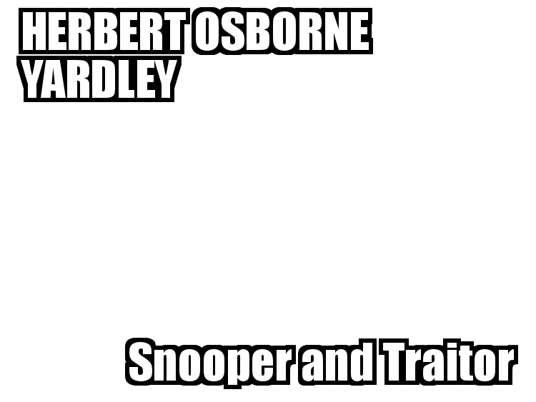
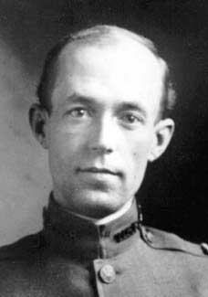

Slide 4
1920
by the end of 1920 the Black Chamber had the secret and illegal cooperation of almost the entire American cable Industry
  Bamford
  The Puzzle Palace

Slide 5

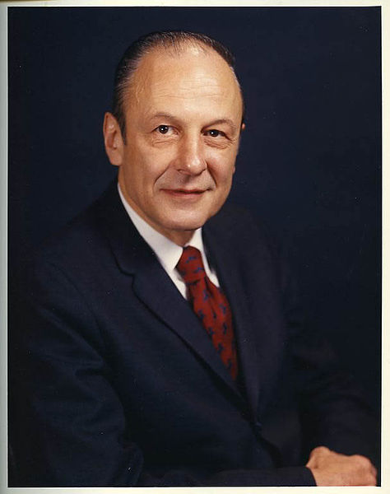

LOUIS W. TORDELLA

Slide 6
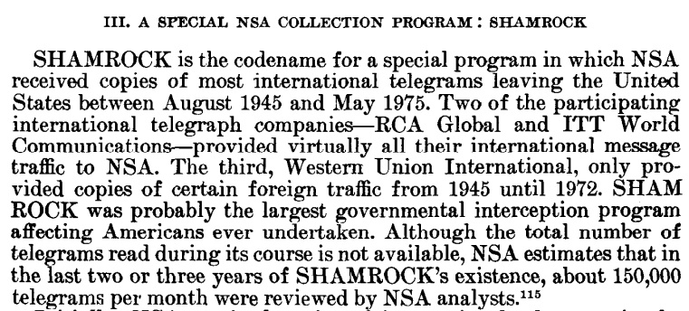

Slide 7
Every day, a courier went up to New York on the train and returned to Fort Meade with large reels of magnetic tape, which were copies of the international telegrams sent from New York the preceding day using the facilities of three telegraph companies
Ars Technica

Slide 8


2001

Slide 9

A lot of people are trying to say that it's a different world today, and that eavesdropping on a massive scale is not covered under the FISA statute, because it just wasn't possible or anticipated back then.
That's a lie.
December 29, 2005

Slide 10
2005 FFS

Slide 11

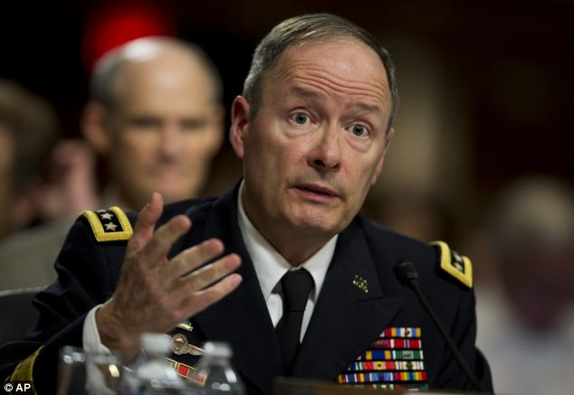
2013

Slide 12
“You need the haystack to find the needle”
Keith Alexander
Aspen Security Forum, 18 July 2013
http://www.foreignpolicy.com/articles/2013/09/08/the_cowboy_of_the_nsa_keith_alexander

Slide 13
BIG DATA
Alexander reportedly gave several presentations that detailed networks of suspected terrorists. In one case it turned out there out that "all those guys were connected to were pizza shops"
MMMM PIZZA OM NOM NOM
Another massive chart, which ostensibly detailed al Qaeda and its connections in Afghanistan, turned out to be completely false. "We found there was no data behind the links. No verifiable sources. We later found out that a quarter of the guys named on the chart had already been killed in Afghanistan."

Slide 14
U R TEH EN3MY OF TEH ST8
Counterencryption programmes
code-named after
first battles of respective Civil Wars
UK: EDGE HILL
US: MANASSAS / BULLRUN

Slide 15
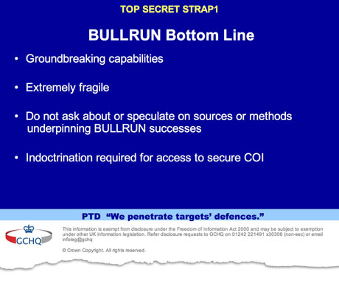

Slide 16
LET US COUNT THE WAYS
A company volunteers to help (and gets paid for it)
Spies copy the traffic directly off the fiber
A company complies under legal duress
Spies infiltrate a company
Spies coerce upstream companies to weaken crypto in their products/install backdoors
Spies brute force the crypto
Spies compromise a digital certificate
Spies hack a target computer directly, stealing keys and/or data, sabotage [zero-day exploits]
Ars Technica

Slide 17
the NSA is able to decrypt most of the Internet. They're doing it primarily by cheating, not by mathematics. Remember this: The math is good, but math has no agency. Code has agency, and the code has been subverted.
Schneier 5 Sep 2013
Encryption works. Properly implemented strong crypto systems are one of the few things that you can rely on
Snowden 17 June 2013

Slide 18
IPSEC
Every once in a while, someone not an NSA employee, but who had longstanding ties to NSA, would make a suggestion that reduced privacy or security, but which seemed to make sense when viewed by people who didn't know much about crypto. For example, using the same IV (initialization vector) throughout a session, rather than making a new one for each packet. Or, retaining a way to for this encryption protocol to specify that no encryption is to be applied.
John Gilmore 6 September 2013
http://www.mail-archive.com/cryptography@metzdowd.com/msg12325.html

Slide 19
Weakness in Dual_EC_DRBG
Dan Shumow and Niels Ferguson
(Microsoft)
Did NSA Put a Secret Backdoor in New Encryption Standard?
Schneier 15 November 2007
Gov’t standards agency “strongly” discourages use of NSA-influenced algorithm
13 September 2013

Slide 20
WTF 2007

Slide 21


Slide 22
Where do I start a petition to raise the IQ and kernel knowledge of people? Guys, go read drivers/char/random.c. Then, learn about cryptography. Finally, come back here and admit to the world that you were wrong. Short answer: we actually know what we are doing. You don't. Long answer: we use rdrand as _one_ of many inputs into the random pool, and we use it as a way to _improve_ that random pool. So even if rdrand were to be back-doored by the NSA, our use of rdrand actually improves the quality of the random numbers you get from /dev/random. Really short answer: you're ignorant.
http://git.kernel.org/cgit/linux/kernel/git/torvalds/linux.git/commit/?id=c2557a303ab6712bb6e09447df828c557c710ac9

Slide 23
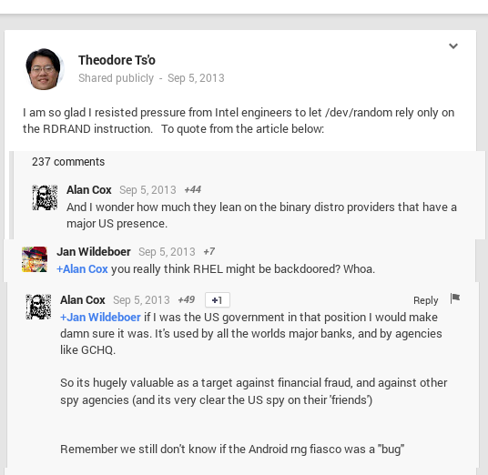
https://plus.google.com/117091380454742934025/posts/SDcoemc9V3J

Slide 24
DIGINOTAR PWNED JULY 2011
Netherlands cert authority
“the list of fraudulent digital certificates obtained from DigiNotar has been growing, expanding to include not just Facebook, Google, Microsoft, Skype, Twitter, and WordPress, but also the CIA, MI6, and Mossad intelligence services, as well as the pro-privacy Tor Project”
Information Week
6 September 2011

Slide 25
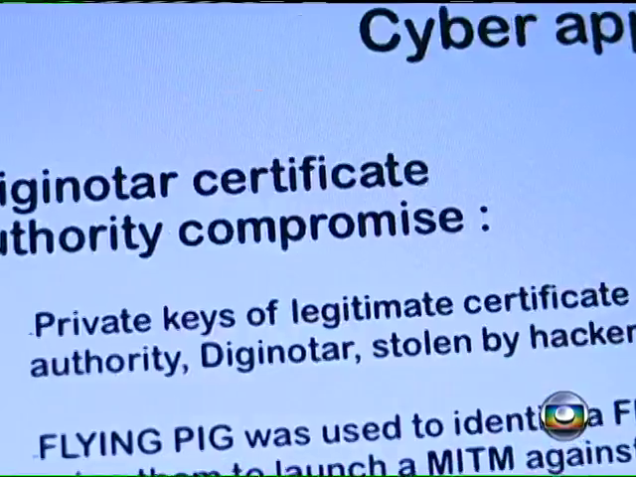
Iran, mostly

Slide 26
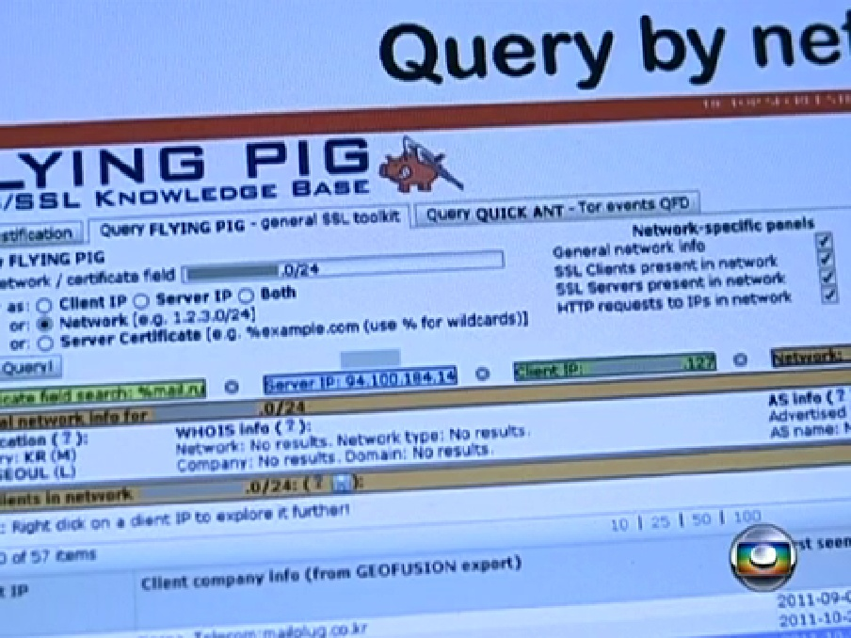
MAN IN THE MIDDLE
“FLYING PIG”

Slide 27
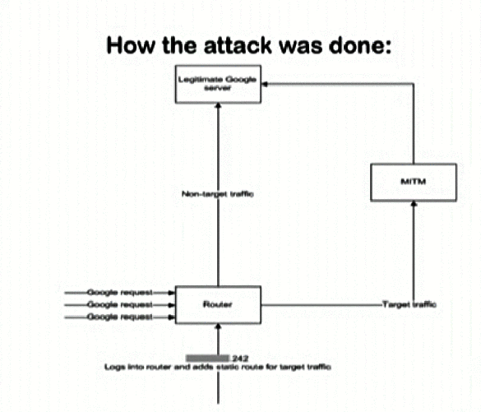
MAN IN THE MIDDLE
“FLYING PIG”

Slide 28
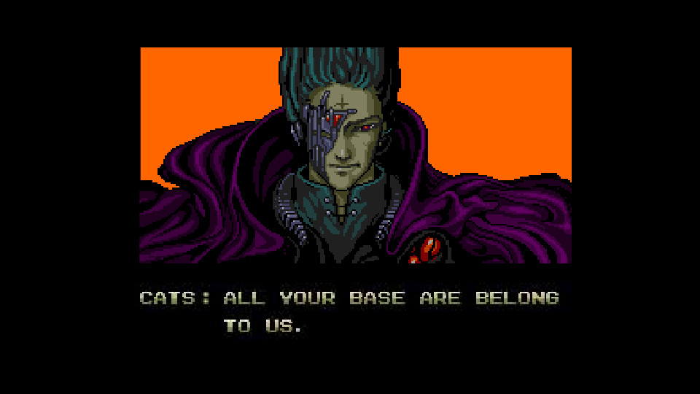
MAN IN THE MIDDLE
“FLYING PIG”

Slide 29
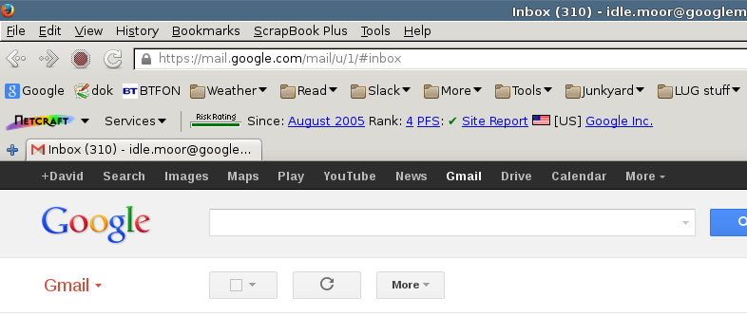
Perfect Forward Secrecy
Netcraft toolbar
http://toolbar.netcraft.com/install

Slide 30
Gmail certificate subverted?
u r teh fuX0r3d
lololol

Slide 31

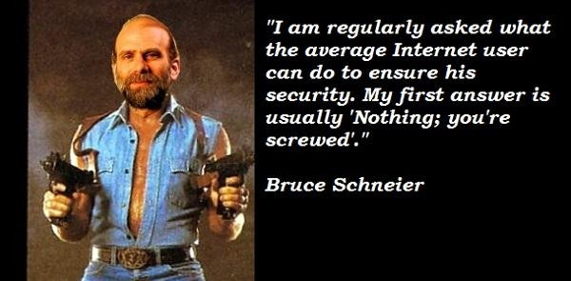

Slide 32
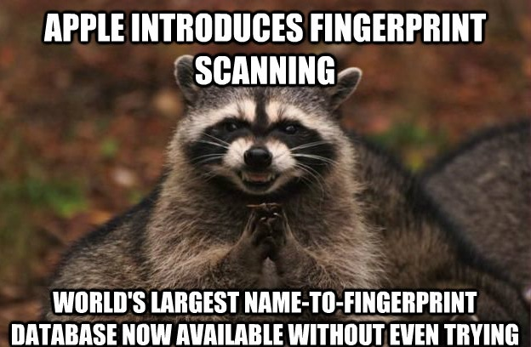

Slide 33
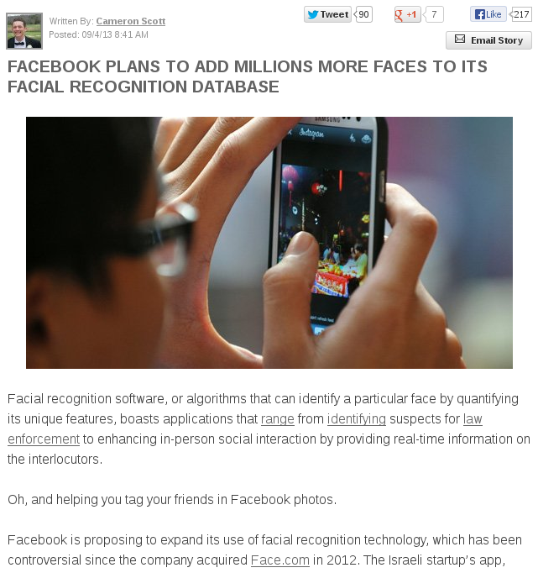
Singularity
Hub

Slide 34
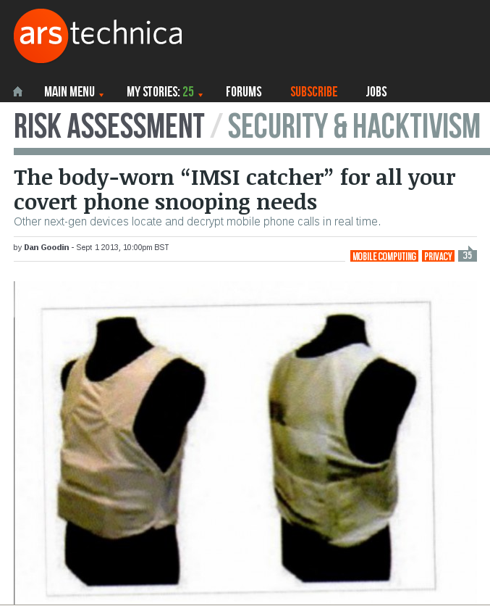

Slide 35
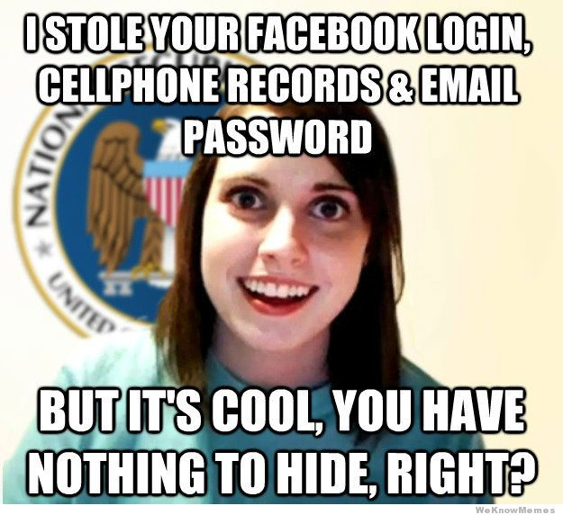

Slide 36
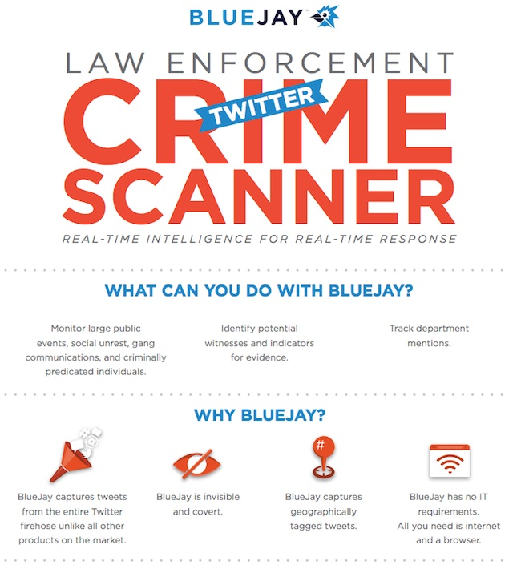
Ars
Technica

Slide 37
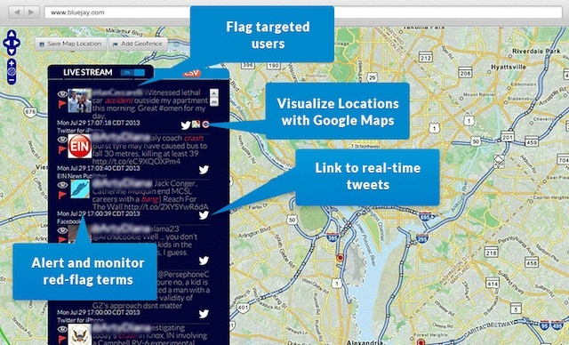

Slide 38
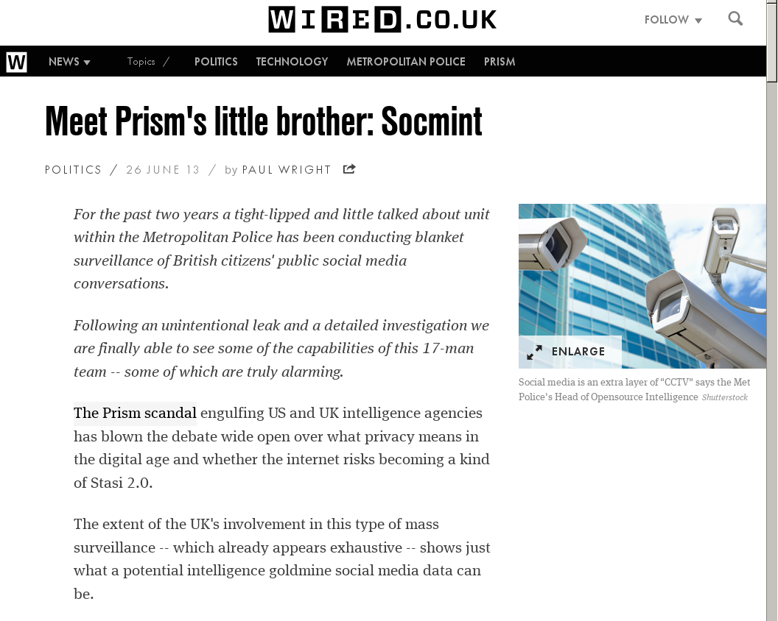

Slide 39
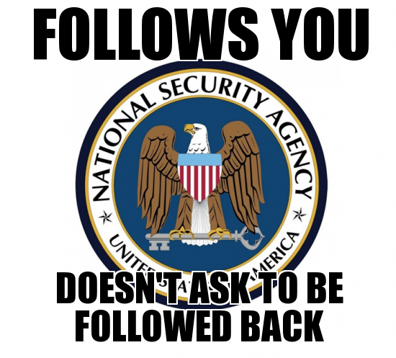

Slide 40

Adam Curtis
http://www.bbc.co.uk/blogs/adamcurtis/posts/BUGGER

Slide 41
Charles Stross
http://www.antipope.org/charlie/blog-static/2013/08/snowden-leaks-the-real-take-ho.html
1970s: deregulation of labour markets and the deliberate destruction of the job for life culture.
Today, around 70% of the US intelligence budget is spent on outside contractors.
Gen Y has never thought of jobs as permanent things. Gen Y will stare at you blankly if you talk about loyalty to their employer.
Edward Snowden is 30: he was born in 1983.
I think he's a sign of things to come.
PS: Chelsea Manning is 25.

Slide 42
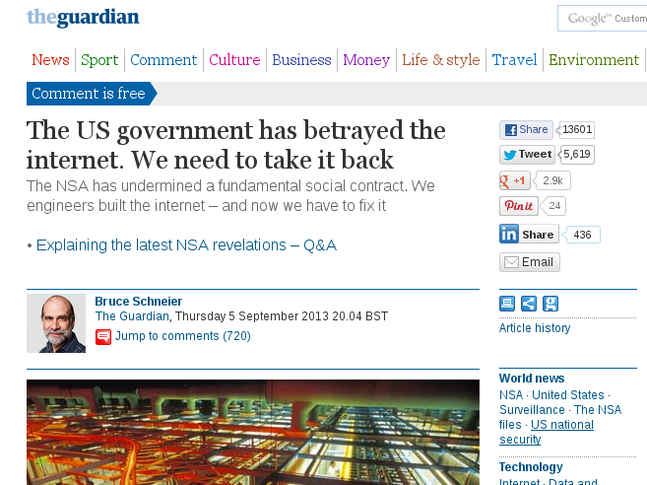

Slide 43
