Slide 1
The Ongoing Command Line Talk From HELL Part Two
David Spencer
Bradford Linux Users Group
29th of so-called August 2012 (yes it's nearly winter again)
If It's Supposed To Be A Tree Then Why Is The Root At The Top?

Slide 2
Last time
You're hopelessly confused because
it's hopeless and confusing

Slide 3
Objects: files
Operations: commands

Slide 4

Hierarchical organisation
Tree
Leaf = File
Branch = Directory
Root = /

Slide 5
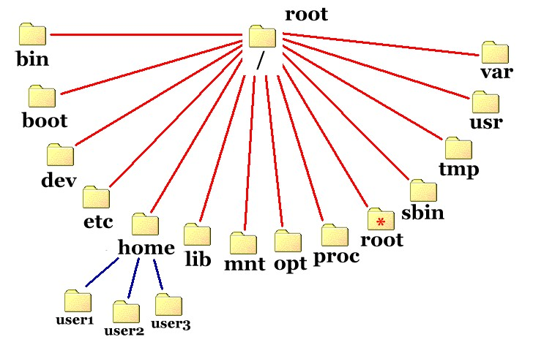

Slide 6
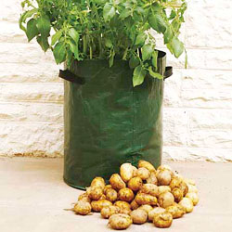
more like a potato

Slide 7
Digression
www.howbigismypotato.com

Slide 9
Files
un
struc
tured

Slide 10
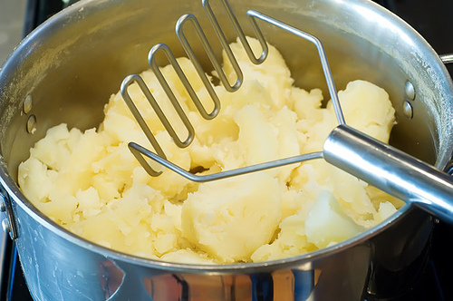

Slide 11
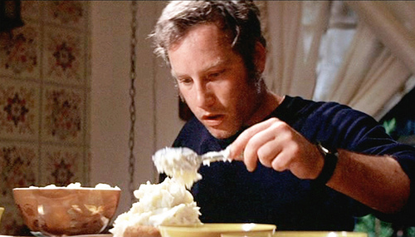

Slide 12
File names
un
struct
ured
README.txt
cultural expectations

Slide 13
hidden files
(hollow laughter)

Slide 14
Files
Directories
Symbolic Links
Device Nodes
Named Pipes

Slide 15
Filesystem
ownership
permissions
date/time
storage details

Slide 16
GNU Coreutils
http://www.gnu.org/software/coreutils/manual/

Slide 17
11 Basic operations
This chapter describes the commands for basic file manipulation: copying, moving (renaming), and deleting (removing).
cp invocation: Copy files.
dd invocation: Convert and copy a file.
install invocation: Copy files and set attributes.
mv invocation: Move (rename) files.
rm invocation: Remove files or directories.
shred invocation: Remove files more securely.

Slide 18
cp: Copy files
mv: Move (rename) files
rm: Remove files or directories

Slide 19
Options
-i
-v
-a
-f

Slide 20
Arguments
cp file1 file2
cp -i file1 file2
cp -a dir1 dir2
cp file1 file2 file3 file4 destdir
Strangeness:
pairs, last one directory

Slide 21
Special file types
ln source destination
mkdir name...
rmdir name...
Strangeness:
why not rmln?

Slide 22
Outputting files
cat

Slide 23
Listing directory contents
ls
lots of options

Slide 24
pwd
cd
(not in coreutils!)

Slide 25
and loads more stuff
df du
chown chgrp chmod
head tail sort cut paste join fmt

Slide 26
Lots of stuff we haven't mentioned
DON'T PANIC

Slide 27

We learned something today
cp mv rm
cd ls cat
mkdir rmdir
everything else is just frills

Slide 28

THE NEXT EPISODE
HUMAN CENTIPEDE!!!

Slide 29
Further reading
Google "basic linux commands"
read more than one!

