Slide 2
L_{Y}X, L^{A}T_{E}X and T_{E}X:
producing
superior documents
John R Hudson
j.rhudson@virginmedia.com

Slide 3
Overview
L_{Y}X features
Maths editor
BibT_{E}X

Slide 4
What are L_{Y}X, L^{A}T_{E}X and T_{E}X?
L_{Y}X is a GUI
for the L^{A}T_{E}X macros
which communicate with
the T_{E}X typesetting engine

Slide 5
T_{E}X
T_{E}X: written in Pascal by Donald Knuth after he received the proofs of the second edition of The art of programming
The hot type set first edition had been OK; the phototypeset second was awful

Slide 6
L^{A}T_{E}X
L^{A}T_{E}X: a set of macros originally created by Leslie Lamport to enable less sophisticated users to use T_{E}X
Placed in the public domain with the agreement of DEC, his employer, it is the foundation for the many packages now available

Slide 7
L^{A}T_{E}X features
Document classes
Paragraph styles
Figure and table handling
Typesetters' rather than computer fonts
Wide range of characters and symbols

Slide 8
L_{Y}X
Implements a subset of the L^{A}T_{E}X macros
Differentiates the input screen from the output
Allows the production of documents without any knowledge of L^{A}T_{E}X

Slide 9
L_{Y}X GUI
Three pane interface
  outliner pane
  text editing pane
  L^{A}T_{E}X source
Fully configurable
Keyboard combinations, icons or drop down menus

Slide 10
L_{Y}X features
In-line or float tables and figures
Table/figure rotation in output without rotation in input
Trackable nesting
Flexible cross-referencing

Slide 11
L_{Y}X features
User input of L^{A}T_{E}X macros
TOC, lists and bibliography
Index
Instant updating
Preview

Slide 12
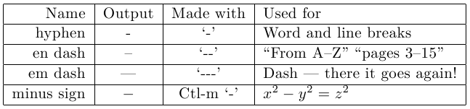
L_{Y}X gotcha
The only typesetting knowledge required is the difference between a hyphen, a dash and the minus sign

Slide 13
Maths editor
Nested containers to hold different parts of expression
Keyboard combinations
Basic toolbar icons
Advanced toolbar icons
AMS document classes

Slide 14
Keyboard combinations
Ctl-m: in-line expression (Ctl-m also enables text mode within a maths expression)
Ctl-M (Ctl-shift-m): display expression
^: superscript
_: subscript

Slide 15

In-line and display modes
Line heights adjusted to expression
Subscripts and superscripts follow symbol
Separate paragraph
Subscripts and superscripts in correct position

Slide 16
Basic toolbar
Icons for basic keyboard combinations
Fractions and roots
Scalable delimiters
Matrices and arrays

Slide 17




Basic toolbar examples

Slide 18
Advanced toolbar
Alternative spaces, display styles, fractions and fonts
Functions, such as cos, det, ln, lim
Decorations, such as hat and arrow vectors
Operators and relations
Greek characters
Arrows and dots
AMS alternative symbols

Slide 19
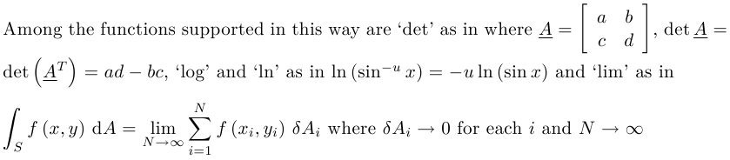
Advanced toolbar example

Slide 20
BibT_{E}X
Bibliographic database
Bibliographic style
The bibliographic styles will be superseded by biblatex but the bibliographic database will be retained

Slide 21
BibT_{E}X database
Mixes record types
First field: record type
Second field: identifier
Remaining fields
  linked to record type
  have fieldname=contents format
Mandatory and optional fields

Slide 22
BibT_{E}X database entries
Distinguish author and editor fields
Use 'and' as delimiter in author/editor fields
Use braces to exclude contents from processing, e.g. organisation names, possible control characters such as '&' and accented characters

Slide 23
BibT_{E}X styles
Add link to database wherever in document references should appear
Select BibT_{E}X style
Choose cited or all references
Enable Natbib or Jurabib in Document>Settings>Bibliography

Slide 24
BibT_{E}X citation
Select Insert>Citation
Choose citation(s)
Decide citation style
Add Text before or Text after

Slide 25
Other features of BibT_{E}X
Parsing personal names
Cross-referencing
Sectioned or multiple bibliographies

Slide 26
Conclusion
Reuses rather than rewrites
Some idiosyncracies
Features genuinely helpful, some unavailable elsewhere
Unrivalled maths editing
Outstanding referencing
Quality output in print or PDF

Slide 27
Thank you
Have a safe journey home

