Slide 1


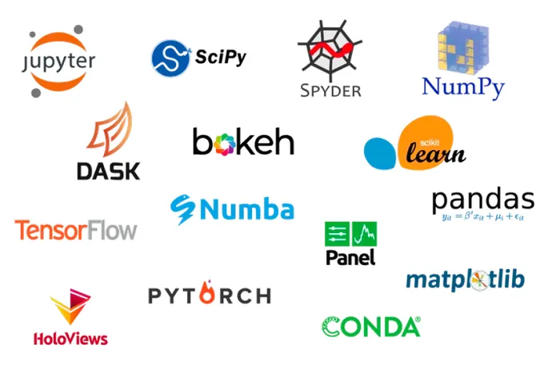
Conda Code Clinic
ARC.LEEDS.AC.UK

Slide 2
What is Conda
Also known as Anaconda, originally (2009) for data science usage with a Python/R focus.
Now more towards general scientific computing usage with packages for wider range of programming languages
Package Manager – provides repository of software, libraries, multi-versions and dependency.
Environment Manager – (allows different packages and versions per environment)
Windows GUI and Command Line
Open Source – BSD license (no licencing or IP worries)
Popular, easy learning curve, well supported, lots of documentation

Slide 3
Why use Conda ?
Configuration Management – Organise and maintain software, their dependencies and environments.
Reproducibility – Verifiable, collaborative, transparent, reusable - The Turing way.
Open Research – Help make all aspects of our research accessible and meet our funding commitments toward open research.
A codified, canonical source of your software configuration.
Security - Does not need admin rights. Individual user installation and configuration.
Universal – No external (or system) dependencies, runs on HPC and desktop (varying levels of cross platform support (Linux/Windows/Mac), ( Intel/IBM/ARM)).
ARC3/ARC4 – Supported on our HPC systems.

Slide 4
Conda is NOT..
NOT Version control ( use Git, Github, Gitlab)
NOT Workflow management (use snakemake, nextflow)
NOT Containers (use Docker, Singularity)
NOT a repository platform (Use Binder, Zenodo)
NOT Automatic – it is a tool to help you manage and maintain your code projects, it won’t do that for you.

Slide 5
Conda Alternatives
The alternatives:
Often have external dependencies
Often need admin rights to install
Often do not work easily on HPC
Often less user friendly (not every researcher is a computer expert).
Examples
Python – pip, venv, poetry
R – CRAN, renv
Other languages – cargo, Maven, npm, RubyGems, Yarn
Containers – Docker/Singularity
Virtual Machines - Vagrant

Slide 6
Getting Conda
Download instructions are provided from the main anaconda.org website
There are 2 main versions of the Conda installer
  The full windows installer, available from the main Anaconda website includes the Navigator GUI.
  Miniconda is available from the conda docs website. This is our preferred option, its a far smaller download, provides just enough packages to manage your packages and environments. Does not include a GUI which can’t be used on HPC, easier to record your packages and enviroments.

Slide 7
Packages
Packages can contain any combination of software, libraries and their metadata (such as version, build, dependencies, architectures will run on)
conda keeps track of the packages and their dependencies
conda can search, install, remove, build, update packages.
Meta packages exist to install a collection of packages, they specify dependencies without containing any software or libraries.

Slide 8
Channels
Channels are the different locations that conda downloads packages from
Common channels are:
  conda (default)
  bioconda - https://bioconda.github.io/
  conda-forge – https://conda-forge.org/
conda allows you to manage channels (add, remove, set default)

Slide 9
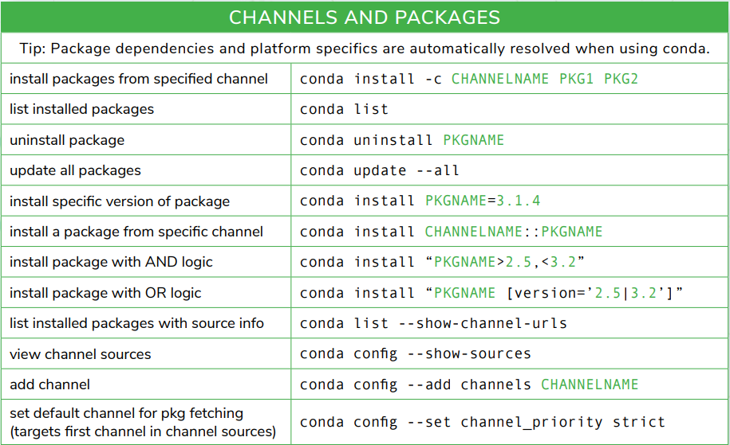

Slide 10
Environments
Conda allows you to create isolated environments containing configuration, packages and their dependencies.
These are individual environments, allow you to install different versions (eg Python) in each environment, one per project is a good start.
Avoids excessive amounts of packages being installed – easier to manage and can slow package management operations down.
Easier to track down issues related to specific packages installed.

Slide 11
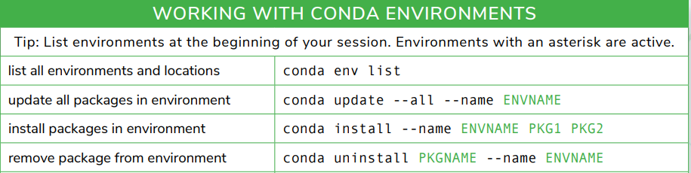
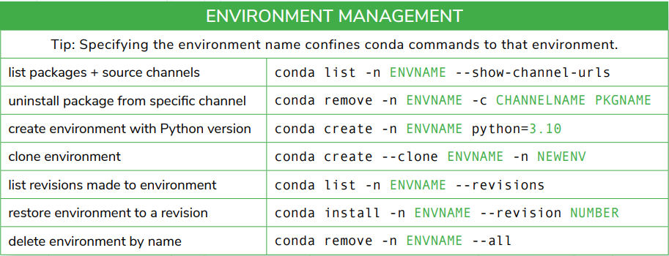

Slide 12
Environment.yml
Possibly the most useful and important file in conda.
Defines the environment name, channels and packages (and their versions) to install into an environment.
Best to create manually (rather than generate from current environment.
Can also be used to specify any pip dependencies.
Is stored separately from the environment (treat as part of your code).

Slide 13
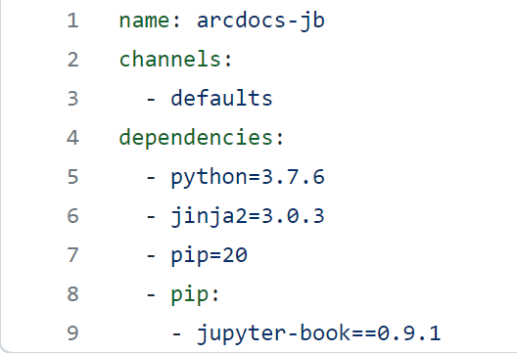
Example environment.yml

Slide 14
Some Best Practices
Use miniconda if possible (far smaller base)
Do not add any packages to the base environment (use a specific environment)
One Environment for each project is a good start (for clean separation and performance)
Only use the minimum packages you need for each project (in each environment), remove unneeded packages.
Manually write your environment.yml, never use an export (exports can by restrictive making updates to packages and adding packages hard).
Specify versions of the top level libraries you need where required (maintain consistancy, could affect your results).
Don’t specify all the dependencies (harder to make changes)
Use version control to store your environment file alongside your code.

Slide 15
Further Reading and References
Anaconda open source - https://www.anaconda.com/products/distribution
Miniconda - https://docs.conda.io/en/latest/miniconda.html
Conda Docs - https://docs.conda.io/en/latest/
Conda Cheat Sheet - https://docs.conda.io/projects/conda/en/latest/user-guide/cheatsheet.html
The Turing Way - https://the-turing-way.netlify.app/
Open Research - https://library.leeds.ac.uk/info/1406/researcher_support/199/open_research
Research Computing website - https://arc.leeds.ac.uk/
Research Computing Documentation - https://arcdocs.leeds.ac.uk/

