Slide 2
LyX vs Word
and the world

Slide 3
LaTeX features
LyX features
When not to use LyX
Conclusion

Slide 4
LaTeX features (1)
Parts, chapters and sections
Front matter, main matter and back matter
Automatic handling of appendices
Floats, images and tables
Multiple bibliographies with wide range of bibliographic styles, multiple indexes, glossary
Mathematics

Slide 5
LaTeX features (2)
Document classes and paragraph styles
Page layout:
  space handling
  headers, footers and two-sided format
  footnotes or endnotes
  multiple columns
Dynamic cross-referencing

Slide 6
LyX features
Three pane view
Context sensitive menus
Tabbed interface, split views and insets
Advanced search
Autosave and emergency save
Version control

Slide 7
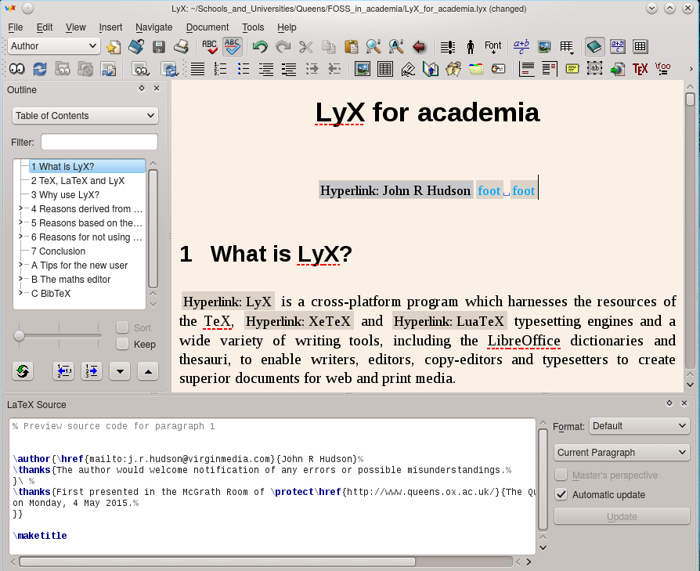

Slide 8
When not to use LyX
For lithographic printing
For highly coloured documents/bleeds
Single use cases
Need for word-processor and spreadsheet import filters
Linked tables

Slide 9
Conclusion
LyX combines and in most cases exceeds the features of a word-processor and the commercial desktop publishing programs
Particular strengths: parts of documents, consistency of presentation, automatic cross-referencing and updates, (multiple) bibliographies, multiple indexes, glossaries, mathematics, authoring tools, version control

