Slide 1

David Spencer
Bradford Linux Users Group
31st October 2012
THE EMPIRE SELLS OUT
COMMAND LINE FOUR

Slide 2
Wildcards

Slide 3

Wildcards
like this

Slide 4
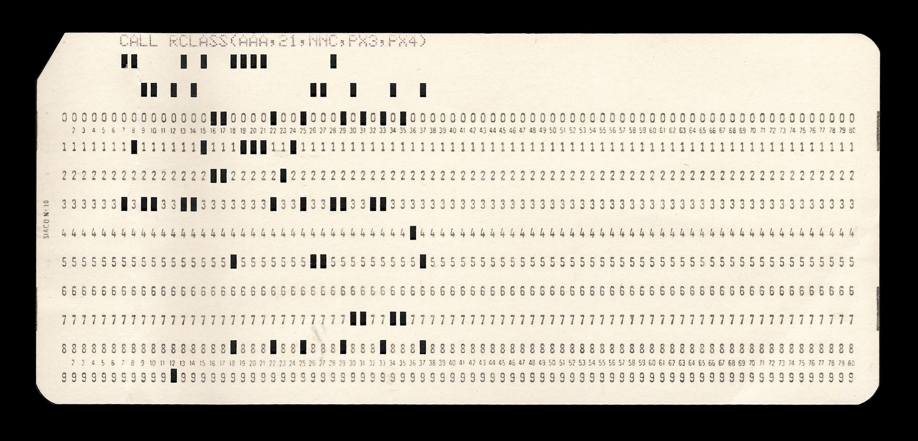
not like this

Slide 5
in filenames
*
?
? = any single character
* = one or more of any character

Slide 6
Expanded by the shell
"globbing"
List of files
(and dirs links etc)
space separated
sorted alphabetically

Slide 7
Done by the shell
Finite fixed sized buffer
$ getconf ARG_MAX
2097152

Slide 8
Done by the shell
The invoked command
doesn't know
Just sees a list of files

Slide 9
What if no such files?
Shell passes the original wildcard string, unaltered
Command tries to process it
Gives an error like this
dscf*.jpg: No such file or directory
(unless it stuffs up and creates the file)
Really bad in scripts! More in a future episode

Slide 10
Other details
.ext not special
... in fact, dot not special at all
... except that "hidden" files need explicit dot
.bash_*
Use \* and \? for real * and ?
(and therefore \\ for real \)
or use "..." or '...'

Slide 11
Other details
Doesn't recurse into subdirectories
(but honours explict /'s)
other solutions are available
eg. 'find' command

Slide 12
Other details
Don't confuse Shell notation with:
Regular expressions
Extended regular expressions
Perl Compatible regular expressions

Slide 13

David Spencer
Bradford Linux Users Group
31st October 2012
THE MOUSE IS EVIL
COMMAND LINE FOUR AND A BIT
AND A BIT MORE
AND MORE AND MORE AND MORE

Slide 14
Lazy hacker's guide to typing
left-arrow, right-arrow
backspace, delete
Mouse paste (middle button)
goes in
AT CURSOR POSITION

Slide 15
Lazy hacker's guide to typing
TAB key lets you pick a file
(or directory)
adds nice backslashes for you
if file has a dodgy name
* ? ! \ space

Slide 16
Lazy hacker's guide to typing
up-arrow, down-arrow
page up, page down
access the shell history mechanism
(GNU Readline)
also invoked by !
(hence need \! or "!" or '!')
Horribly over-complicated

Slide 17
Shell history mechanism
Mess with history settings
in .bashrc
HISTSIZE=1000
HISTFILESIZE=1000
HISTIGNORE='&'
shopt -s histappend

Slide 18
Shell aliases
n00bs love 'em
inflatable armbands
bike stabilisers
Terrible idea
break scripts
weird problems

Slide 19
Next time

Slide 20
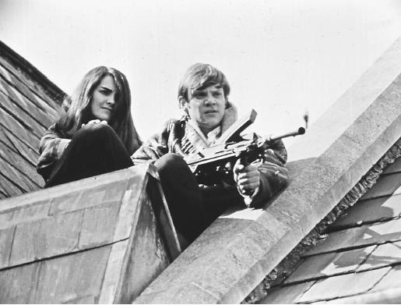

Slide 21

We learned something today

Slide 22
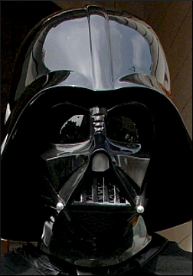
"Thanks to Disney’s unrivalled distribution channels and
pan-galactic reach,
we will, together,
be able to terrorise millions of planets"

