Slide 1
COMM 641 Web Programming Beginning
Zak Ruvalcaba / Emily Kay / Paul Richard
Lecture 7

Slide 2
This week at a glance…
This week at a glance…
Introduction to Responsive Web Design
Responsive Web Design
Mobile Matters
UX of the Modern Web
Flexible Layouts (Grids)
Flexible Type
Flexible Images
Tables
Flat Design
RWD Resources
RWD Frameworks
CSS3 Media Queries
Revisiting the 960 Grid System
Responsive Testing

Slide 3
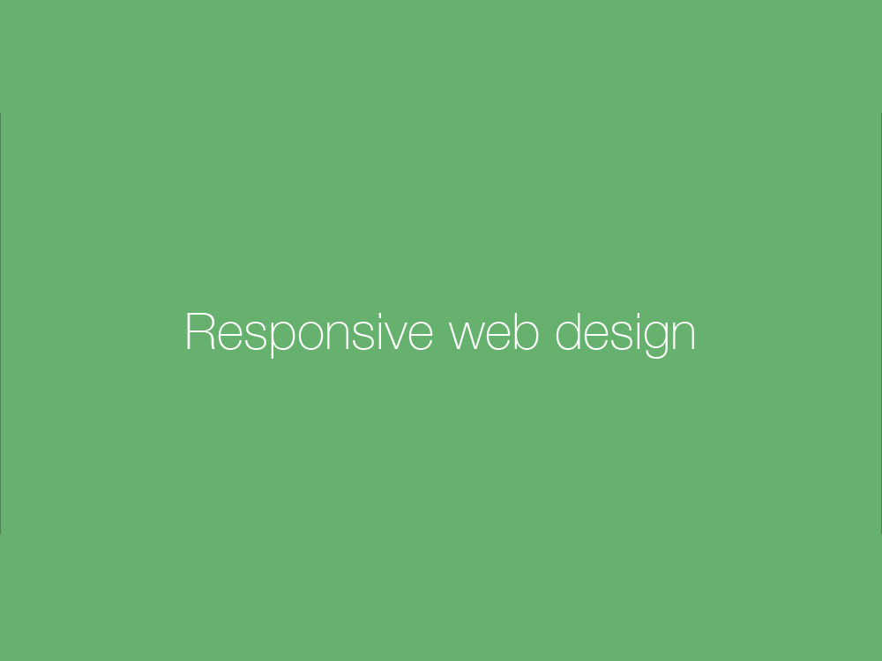

Slide 4
Responsive Web Design
There is a new movement on the web…
1993-1996 – Web sites designed for 640x480 screen resolutions Line breaks and paragraph breaks used. Framesets too.
1996-2000 – Web sites designed for 800x600 screen resolutions Line breaks and paragraph breaks used. Mostly tables used.
2000-2005 – Web sites designed for 1024x768 screen resolutions Flash used. Tables used.
2005-2013 – Web sites designed for 1024x768 screen resolutions DIVs and CSS used.
2013-Future – Web sites designed for? HTML5 section elements and CSS3

Slide 5
Responsive Web Design
Web have become comfortable…
Today, anything that's fixed and unresponsive isn’t web design, it's something else. If you don't embrace the inherent fluidity of the web, you're not a web designer, you're something else. Web design IS responsive design, Responsive Web Design is web design, done right. Andy Clarke Author, Web Developer, Speaker
We need to move from prescribed web design to responsive web design, why?

Slide 6
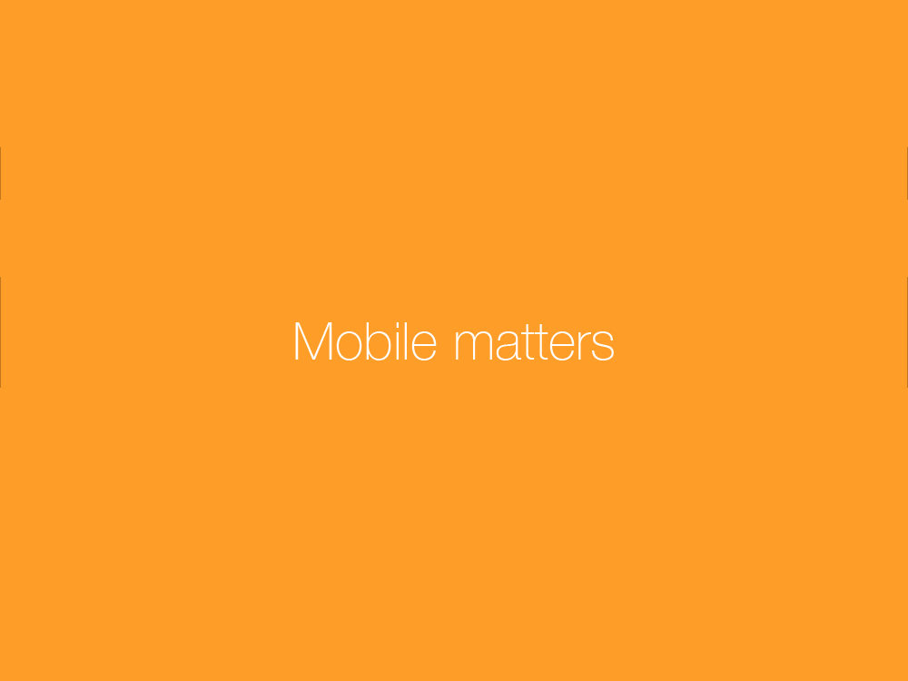

Slide 7
Responsive Web Design
Mobile matters…
More people in the world own smartphones than toothbrushes
4 out of 5 consumers shop on smartphones
70% of mobile searches lead to an action within the hour
40% of people will choose a different search result if the first is not mobile friendly
45% of users ages 18-29 use their smartphones exclusively for searches everyday
Payment processing company Square passed 1 billion transactions in December 2014
1 in 3 kids owns their own tablet
Facebook's Messaging App has over 1 billion users
Phablets (Samsung Galaxy Note, Apple iPhone 6 Plus, Google Nexus 6, Microsoft Surface) outsold the PC in 2014 and will outsell tablets (Samsung Galaxy, Apple iPad and iPad Mini, Amazon Kindle Fire, B&N Nook, etc.) in 2015

Slide 8
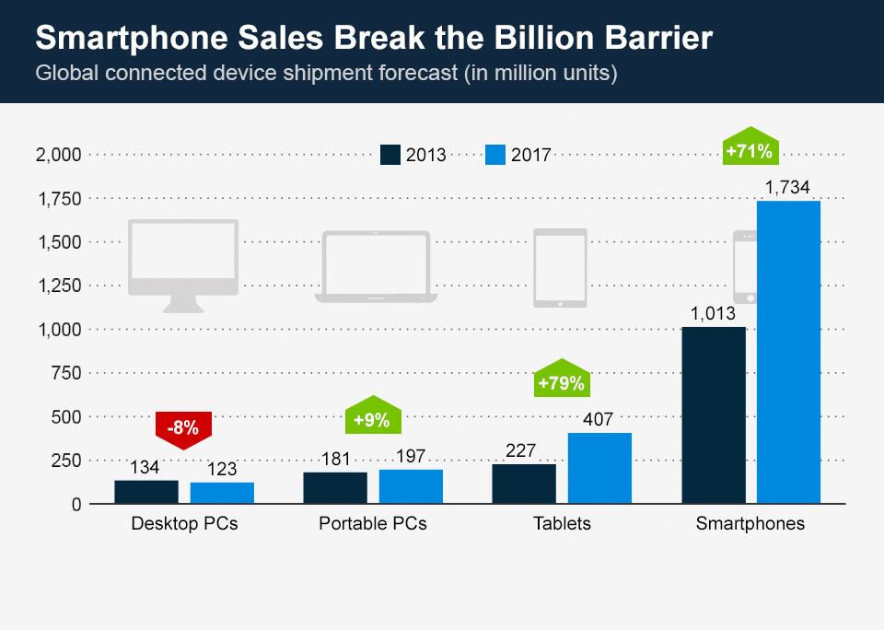

Slide 9
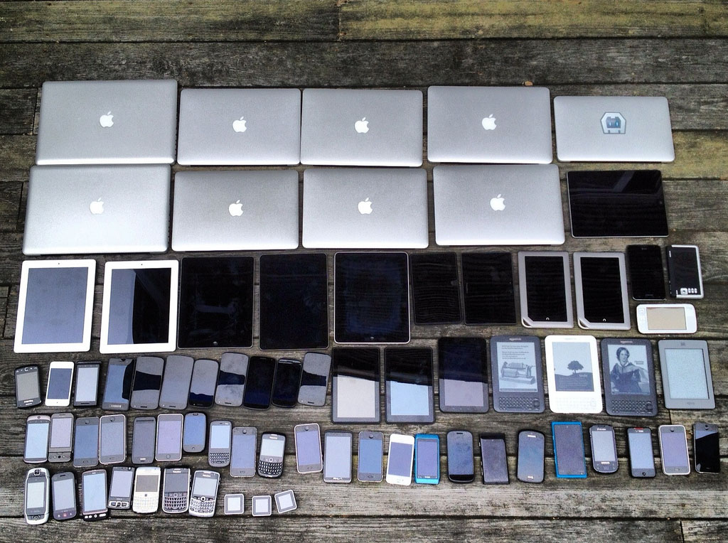
What this means is…we have more screens to design for!

Slide 10
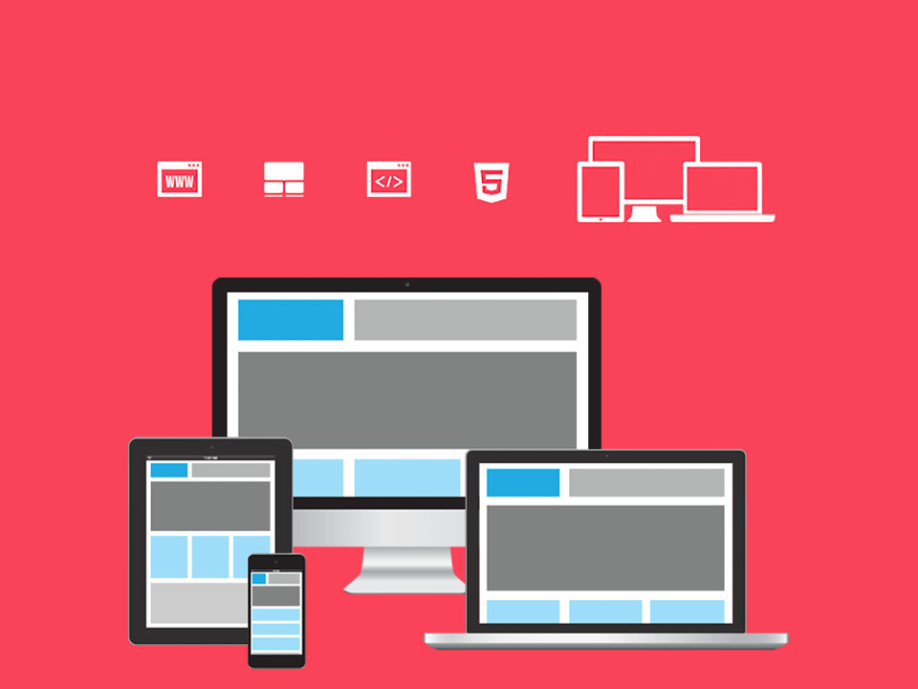
Responsive Web Design
One URL Single Content One Code Media Queries One Development / Multiple Devices

Slide 11
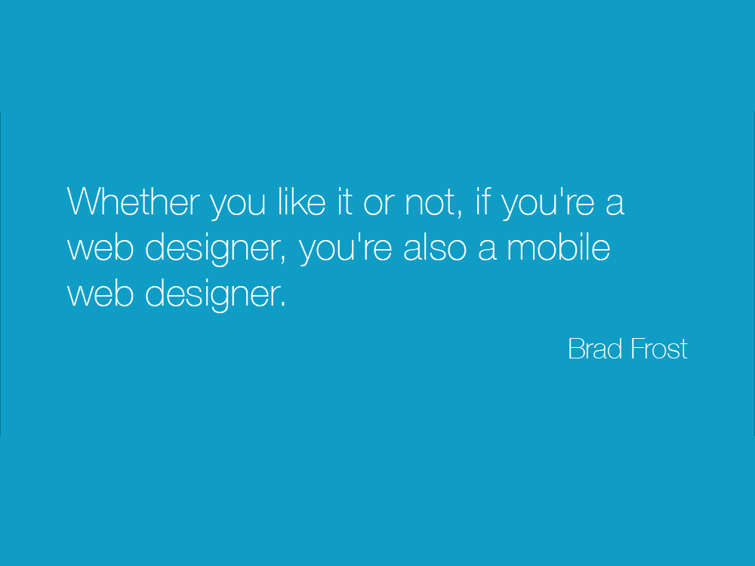

Slide 12


Slide 13
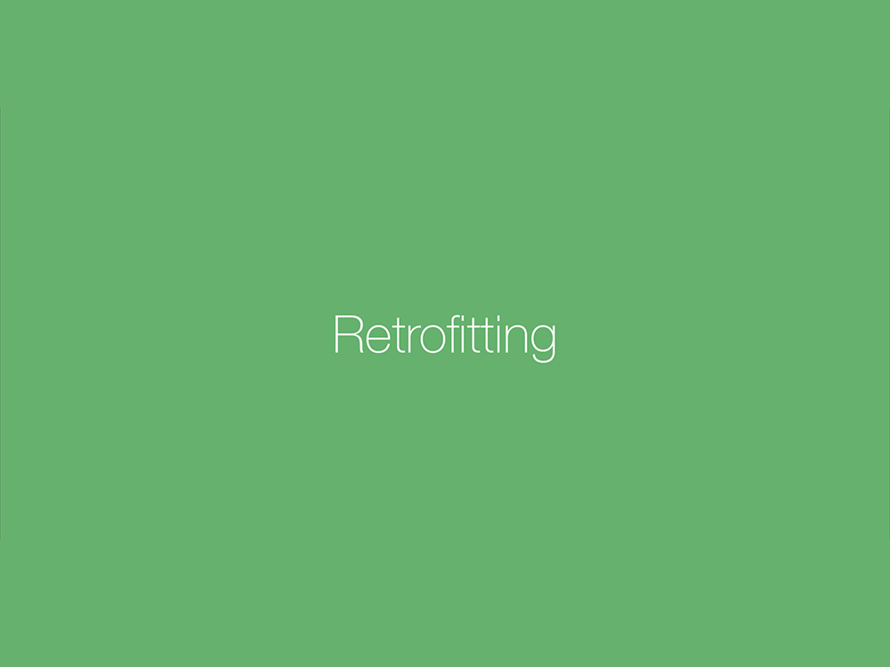

Slide 14
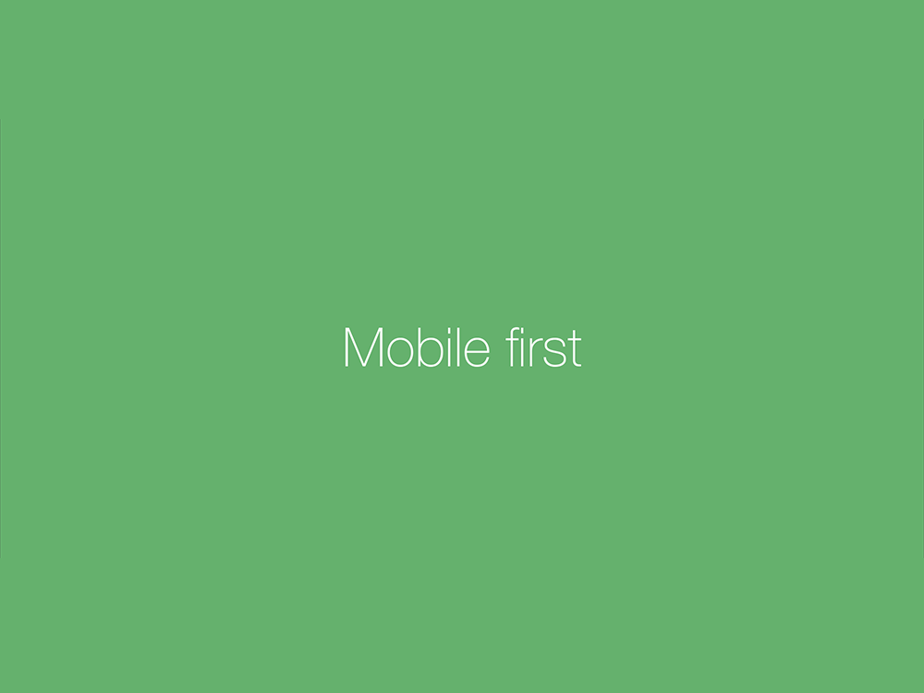

Slide 15
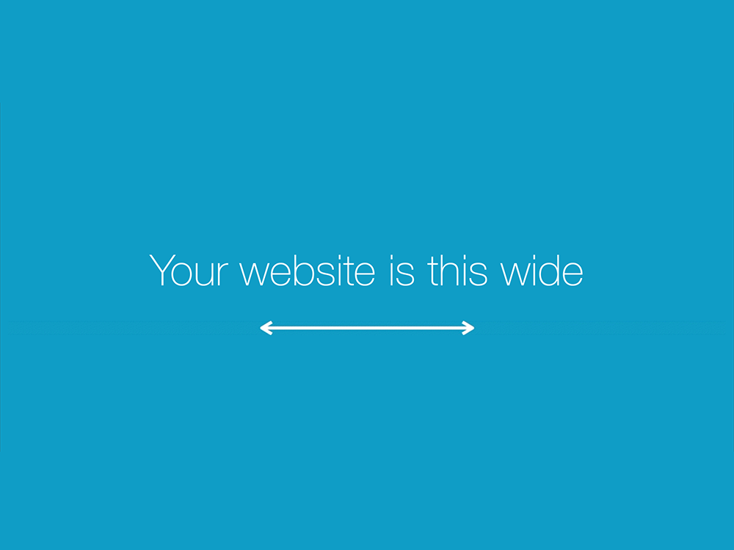

Slide 16
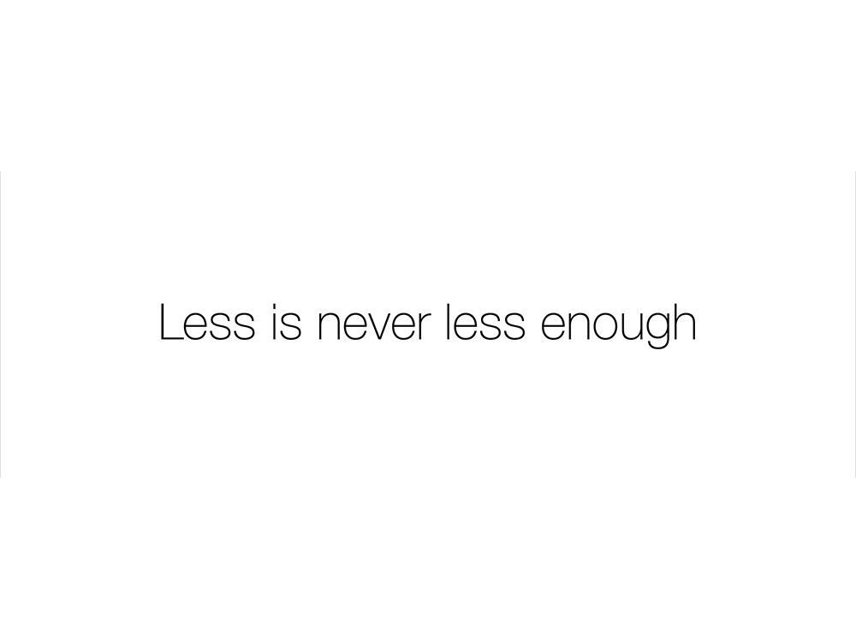

Slide 17
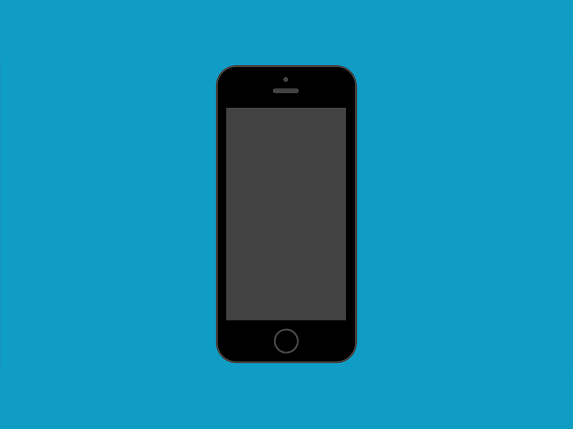

Slide 18
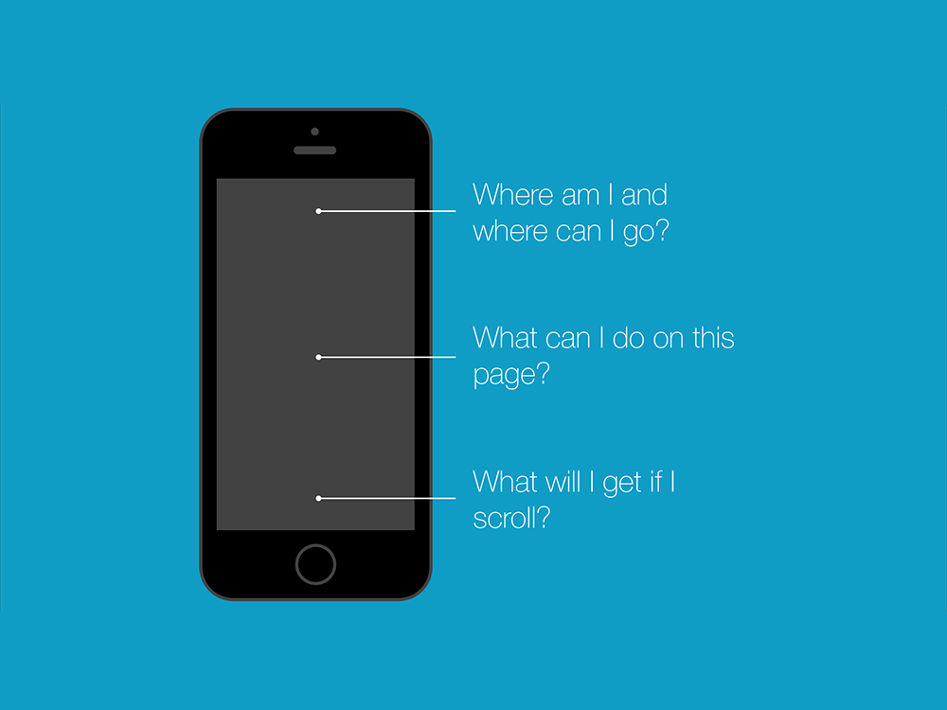

Slide 19
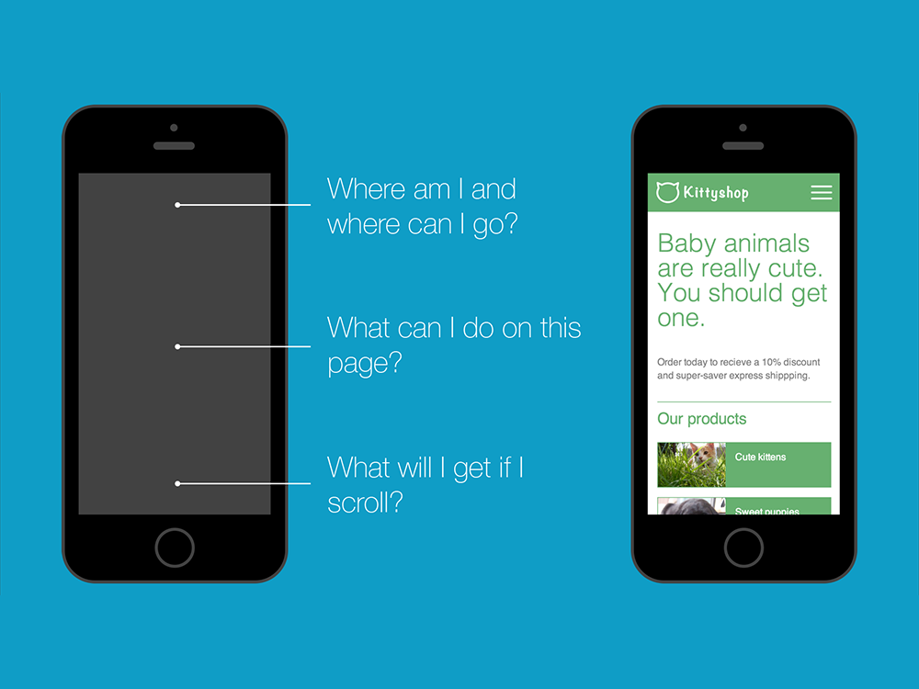

Slide 20
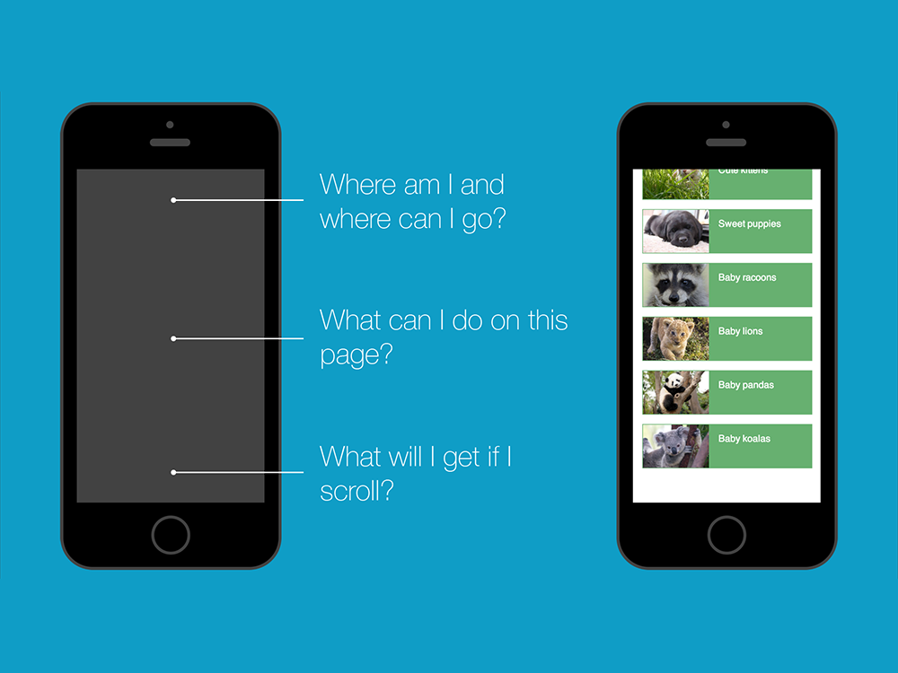

Slide 21
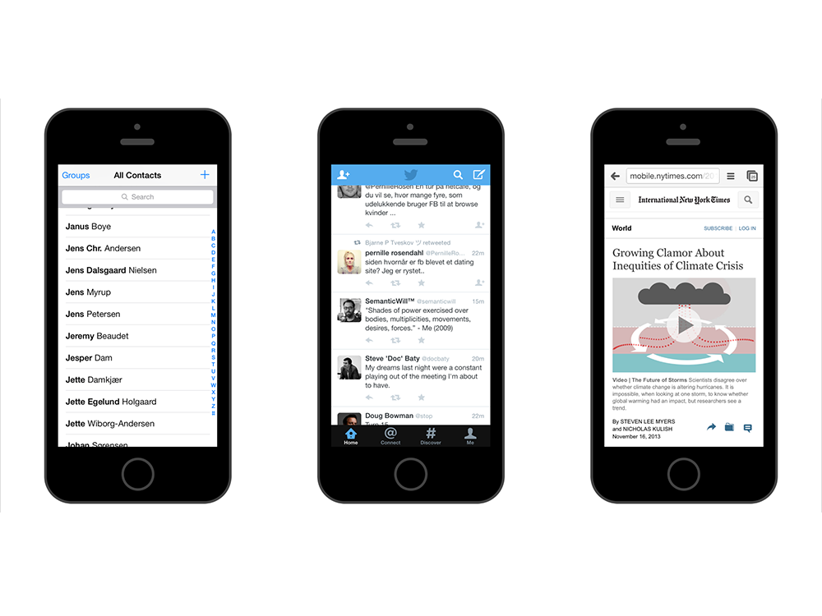

Slide 22
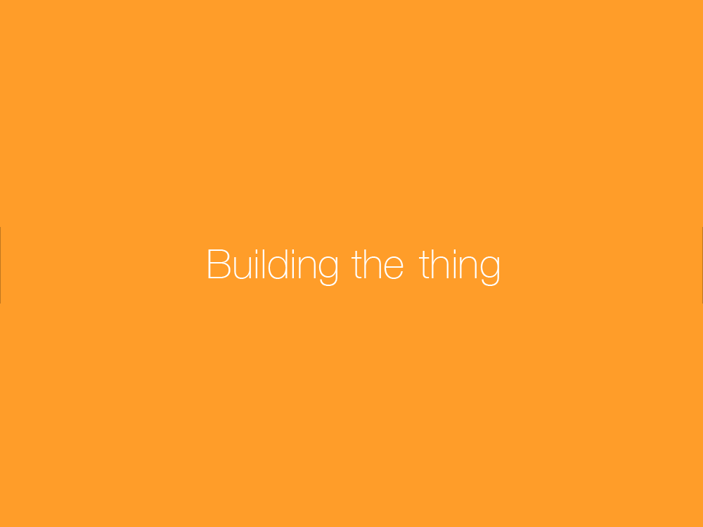

Slide 23
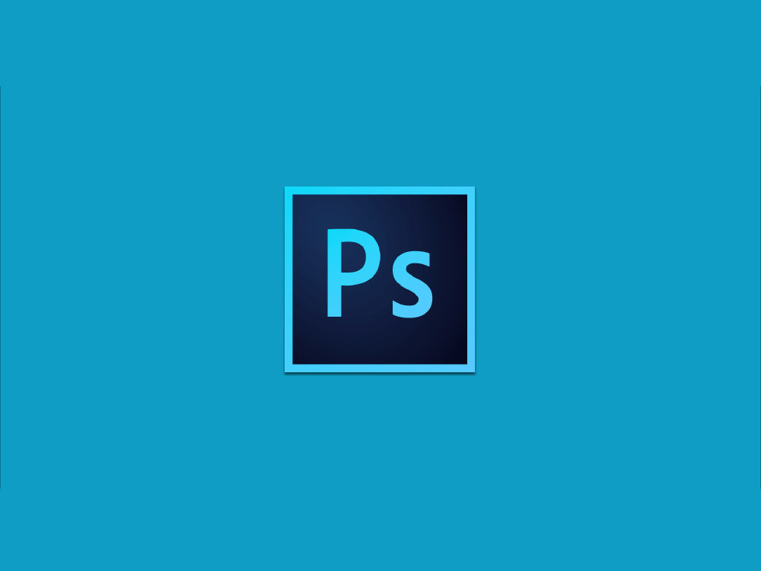

Slide 24
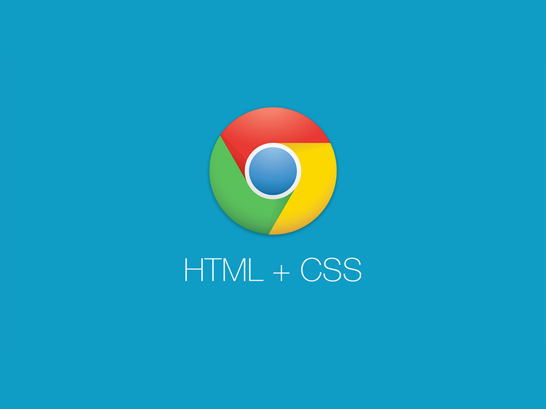

Slide 25


Slide 26
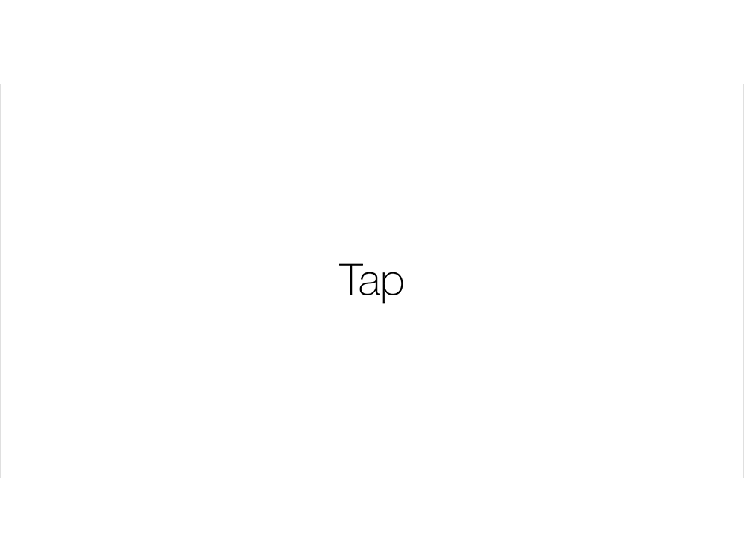

Slide 27
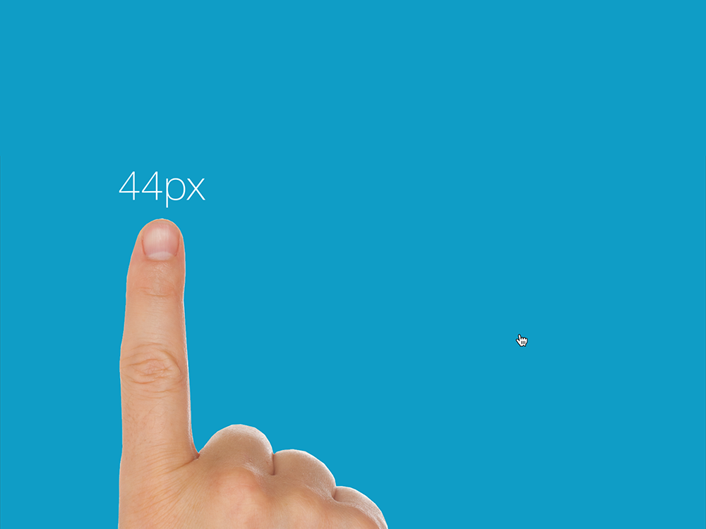

Slide 28
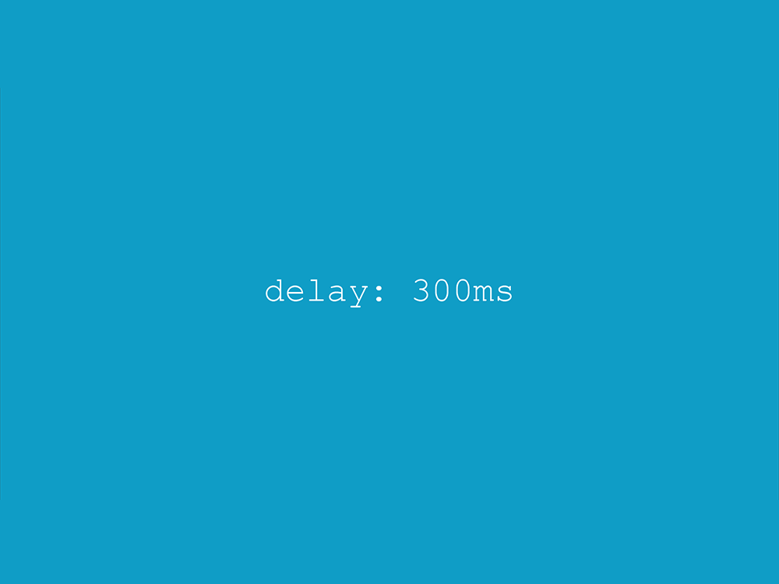

Slide 29


Slide 30
Responsive Web Design
Responsive Web Design is…
Responsive Web Design is flexible device independent design for the web.
Or
A flexible grid, with flexible images, that incorporates media queries to create a responsive, adaptive layout. Ethan Marcotte Web Developer, Speaker, Author Credited with the term "Responsive Design"

Slide 31
Responsive Web Design
Flexible layouts
The most common approach to structuring a site has always been to use pixels. This gives the designer exact control over the elements in the box model.
But we want to start thinking responsive!
Rather than using an absolute measurement type, we need to start using relative sizes.

Slide 32
Responsive Web Design
Flexible layouts
So no more pixels? What are we going to be using instead? Answer = ems or %. To be able to use these measurement types effectively in our design we’re going to have to do a little math: target ÷ context = result
For Type
Target – the font size we ultimately want to be displayed
Context – the base size our browser recognizes (typically 16px)
So if I wanted a headline in my site to be seen at 32px, and I wanted to express that size in ems (for instance), I would plug that into our formula: 32px ÷ 16px = 2em. Or, multiply the final number by 100 and you get the percentage value: 32px ÷ 16px = 2 x 100 = 200%.

Slide 33

Type body {font-size: 16px;} h1 {font-size: 32px;}
Becomes
body {font-size: 1em;} /* 16px/16px */ h1 {font-size: 2em;} /* 32px/16px */

Slide 34
Grids .container {width: 960px;} section {width: 600px;} aside {width: 360px;}
Becomes
.container {width: 90%;} section {width: 62.5%;} /* 600px/960px */ aside {width: 37.5%;} /* 360px/960px */

Slide 35
(target ÷ context) * 100 = result (600 ÷ 960) * 100 = 62.5% and (360 ÷ 960) * 100 = 37.5%

Slide 36


Slide 37


Slide 38
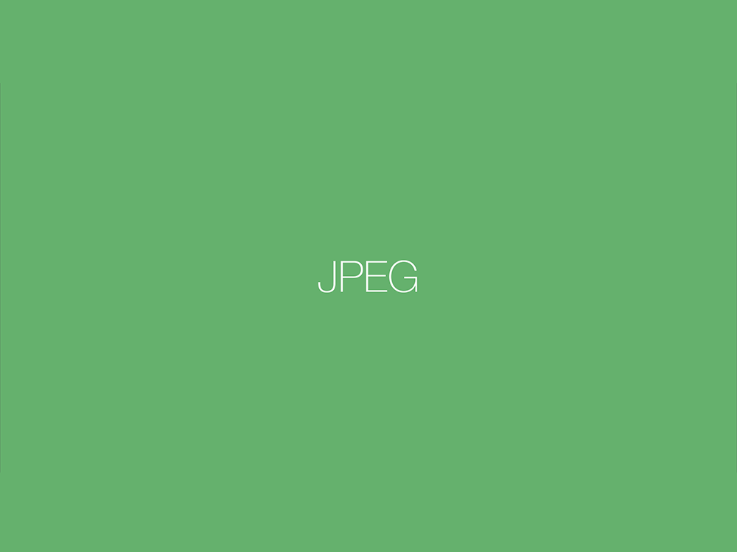

Slide 39
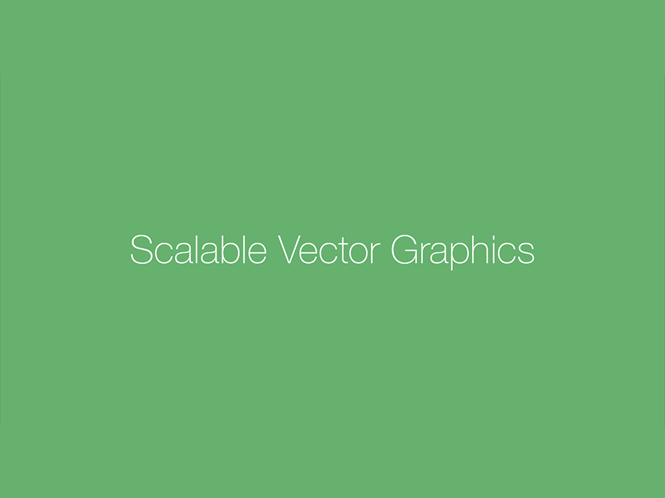

Slide 40
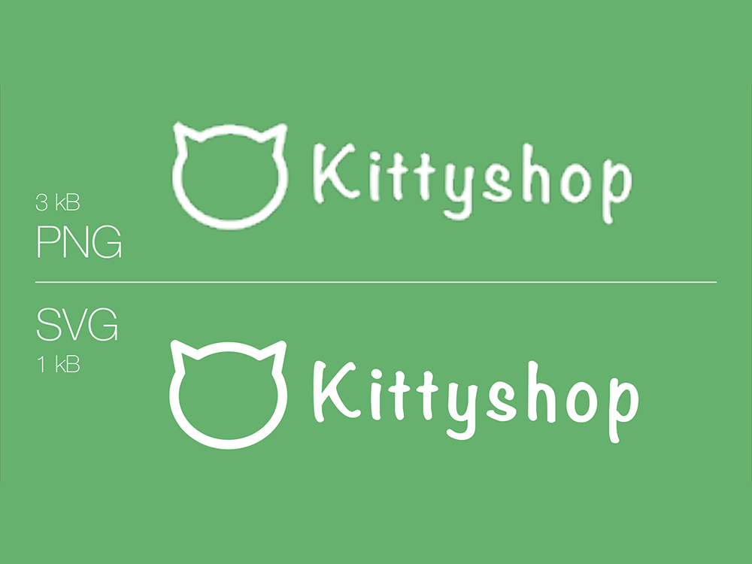

Slide 41
img { max-width: 100%; height: auto; }

Slide 42
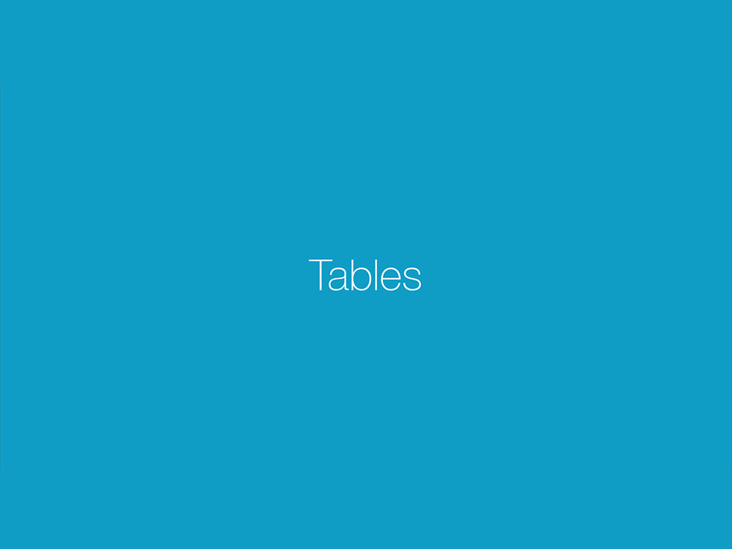

Slide 43


Slide 44
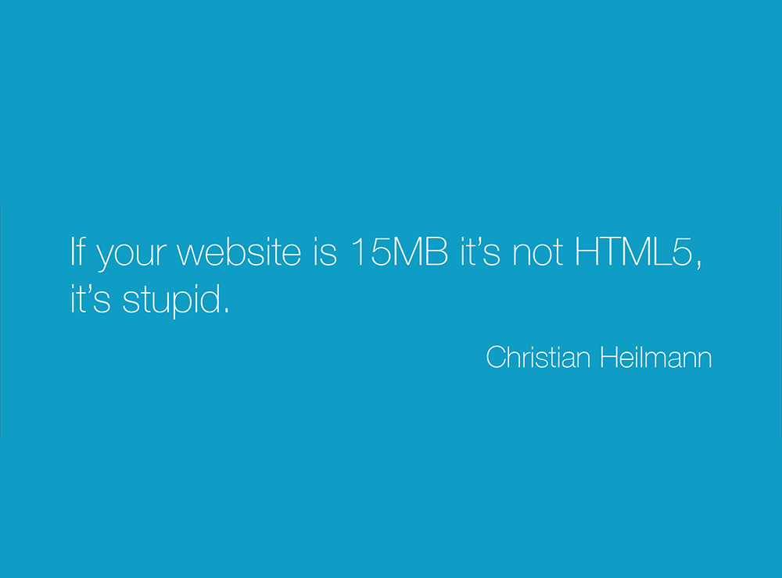

Slide 45
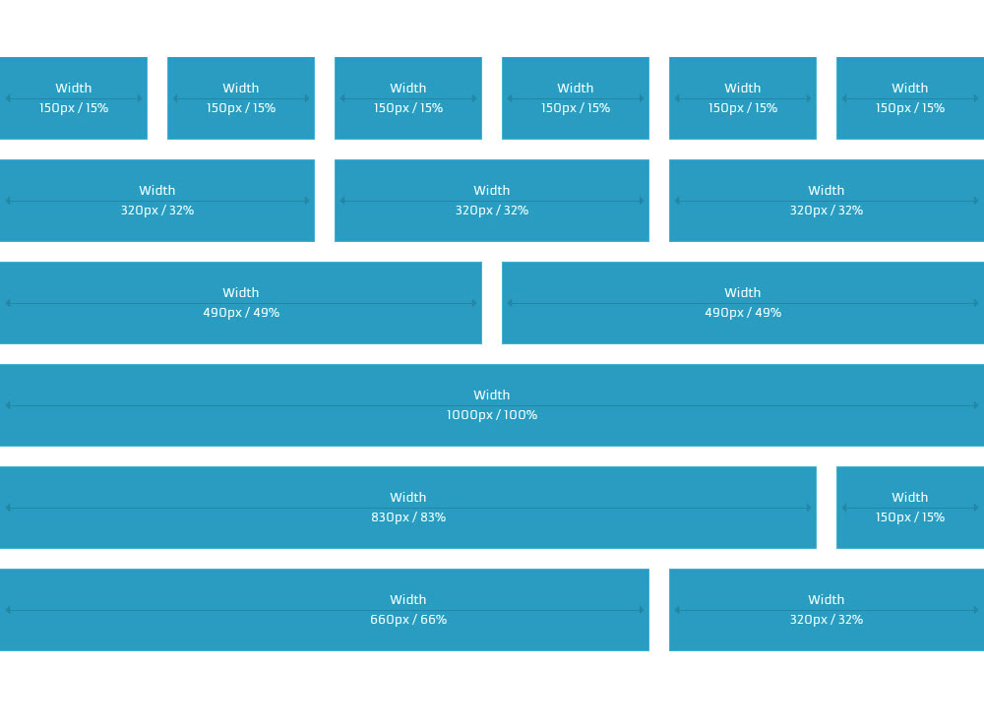

Slide 46
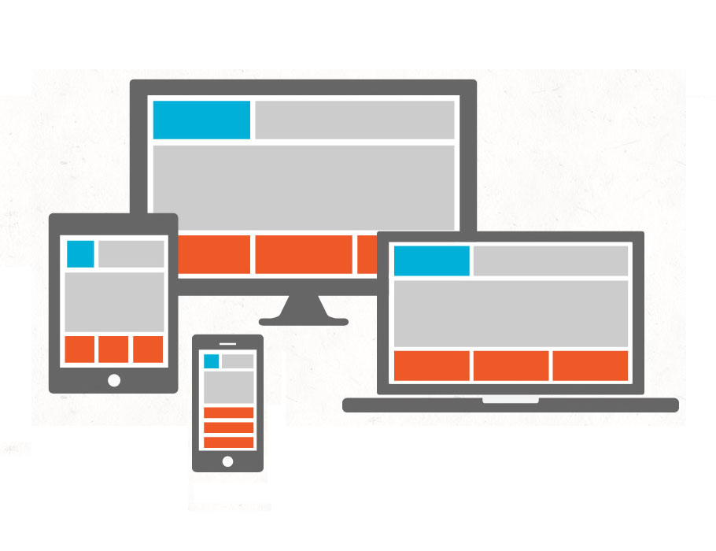

Slide 47
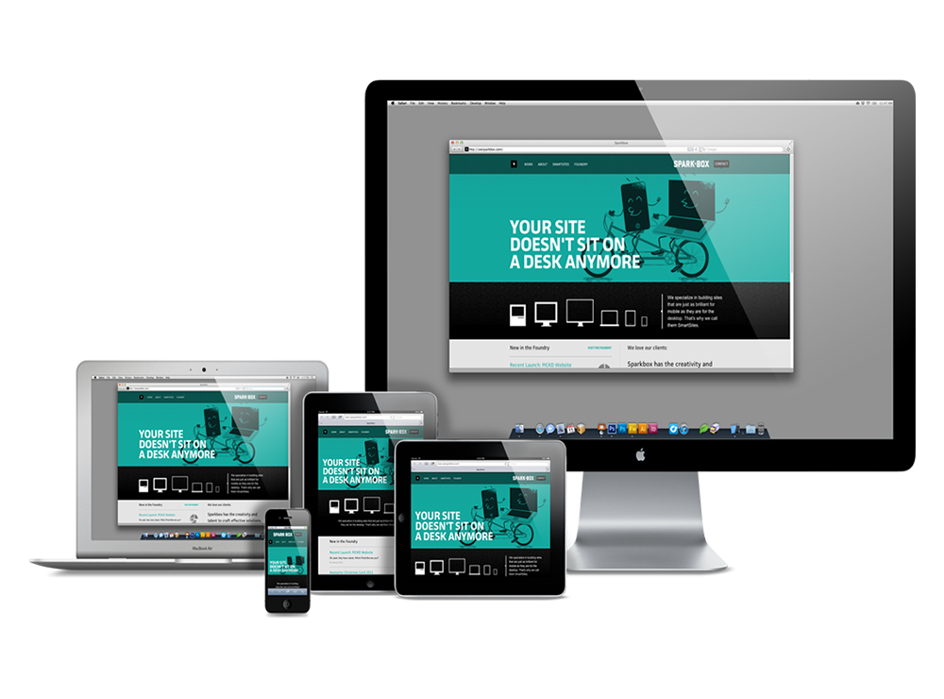

Slide 48
Responsive Web Design
RWD Resources
At some point, check out these cool resources:
Ethan Marcotte's RWD Article alistapart.com/article/responsive-web-design
This Is Responsive by Brad Frost bradfrost.github.io/this-is-responsive/
Responsive Design Inspiration mediaqueri.es
Pixel to ems/percent converter pxtoem.com
Responsive Design Weekly responsivedesignweekly.com
The Haystack by Stephen Hay the-haystack.com
Fastclick.js github.com/ftlabs/fastclick
Mobile First PDF and Audio by Luke Wroblewski
Progressive Enhancement by Christian Heilmann

Slide 49
Responsive Web Design
RWD frameworks that I like…
Skeleton
Twitter Bootstrap
Foundation by Zurb
Gumby
Kube
YAML 4
HTML5 Boilerplate
Less Framework 4
960.gs (Unsemantic)
Base

Slide 50
CSS3 Media Queries

Slide 51
CSS3 Media Queries
Why should you care about Media Queries?
Media queries are one of the most exciting features of CSS3
Media queries prevent us from having to build separate sites for mobile or tablet users
Media queries allow us to control the application of styles based on the presence or absence of specific media features
Most importantly….media queries allow us to change our layouts to suit the exact need of different devices – without changing the content

Slide 52
CSS3 Media Queries
Remember media types?
The concept of delivering alternate content to varying viewports isn't exactly new. Does this look familiar?
There are 10 different media types that you can plug in here including all devices, aural, braille, embossed, handheld, print, projection, screen, TTY, and TV.
This is a CSS2 solution and can still be used today (as you saw in the previous lecture). However, media queries present a better and more robust solution, especially for Responsive Web Design….
CODE
<link rel="stylesheet" href="print.css" media="print">

Slide 53
CSS3 Media Queries
So how are media queries constructed?
A media query is a logical expression that is either true or false
A media query generally consists of a media type and zero or more expressions
Although I'm writing these expressions directly within the <link> element, a more common approach is to write them directly within the CSS as you'll see later
CODE
<link rel="stylesheet" href="styles.css" media="screen and (width:960px)">
Media type
Expression

Slide 54
CSS3 Media Queries
So how are media queries constructed?
An expression consists of zero or more keywords and a media feature
Media features are placed within parentheses
A media feature can be used without a media type or a keyword. In this scenario, the media type is assumed to be "all"
CODE
<link rel="stylesheet" href="styles.css" media="screen and (width:960px)">
Keyword
Media feature
CODE
<link rel="stylesheet" href="styles.css" media="(width:960px)">

Slide 55
CSS3 Media Queries
So how are media queries constructed?
Most media features accept "min-" or "max-" prefixes
A good example of this feature would be to load a style sheet but only if the viewport size is smaller than 420 pixels
CODE
<link rel="stylesheet" href="styles.css" media="screen and (max-width:420px)">

Slide 56
CSS3 Media Queries
The complete media feature list
Feature | Value | min/max
aspect-ratio | ratio (integer/integer) | yes
color / color-index | integer | yes
device-aspect-ratio | ratio (integer/integer) | yes
device-height / device-width | length | yes
grid | integer | no
height / width | length | yes
monochrome | integer | yes
orientation | keyword (orientation / landscape) | no
resolution | resolution (dpi) | yes
scan | keyword (progressive / interlace) | no

Slide 57
5 ways to implement media queries
<link rel="stylesheet" href="styles.css" media="screen">
<?xml-stylesheet rel="stylesheet" href="styles.css" media="screen" ?>
<style media="screen">@import "styles.css";</style>
@import url("styles.css") screen;
@media screen { body { color: blue; } }
Most common method

Slide 58
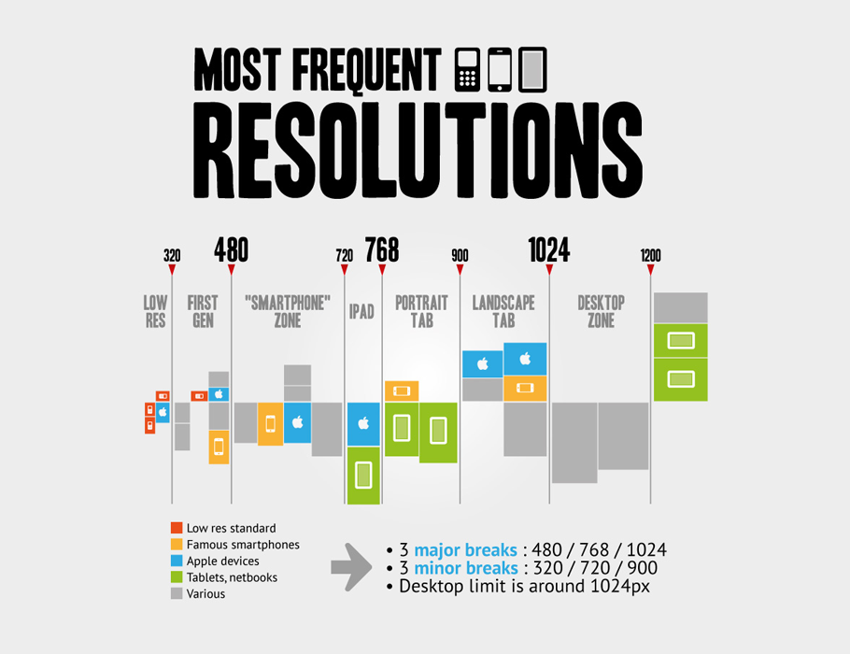

Slide 59
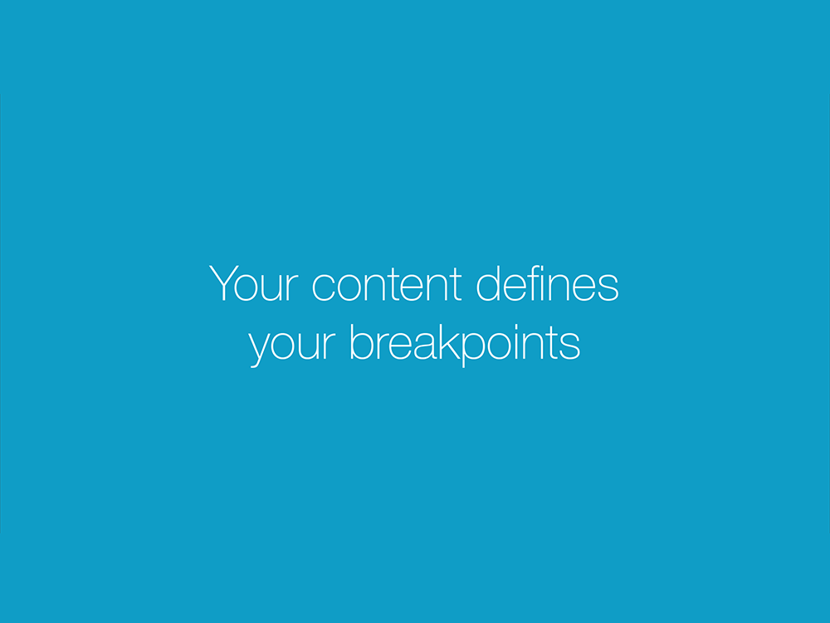

Slide 60
CSS3 Media Queries
A common media query for a mobile viewport
The following example represents a common media query used to load specific styles when the viewport size is smaller than 479 pixels. This will accommodate small viewport sizes such as first gen iPhones in both portrait and landscape views and even newer iPhones in portrait view.
@media screen and (max-width: 479px) {
...styles go here }
CODE

Slide 61
CSS3 Media Queries
A common media query for medium-sized viewports
The following example represents a common media query used to load specific styles when the viewport size is bigger than 480 pixels but smaller than 767 pixels. This is currently known as the "Smartphone Zone". This will accommodate medium sized viewports such as the iPhone 5+ in landscape view, Samsung Galaxy Note in landscape view, most smaller tablets including Barnes & Noble Nook, Amazon's Kindle Fire, Facebook Page Tabs, and iPad Mini in Portrait view.
Notice the use of the and keyword. This allows us to construct a range of possible values.
@media screen and (min-width: 480px) and (max-width: 767px) {
...styles go here }
CODE

Slide 62
CSS3 Media Queries
A common media query for a standard tablet viewport
The following example represents a common media query used to load specific styles when the viewport size is bigger than 768 pixels but smaller than 959 pixels. This will accommodate slightly larger sized viewports or full-sized tablets such as the iPad in portrait mode.
@media screen and (min-width: 768px) and (max-width: 959px) {
...styles go here }
CODE

Slide 63


Slide 64
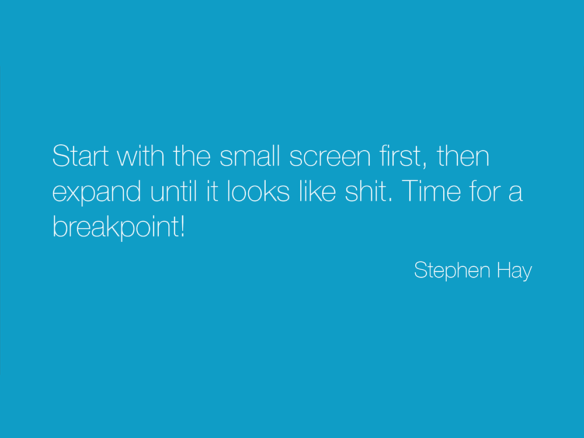

Slide 65
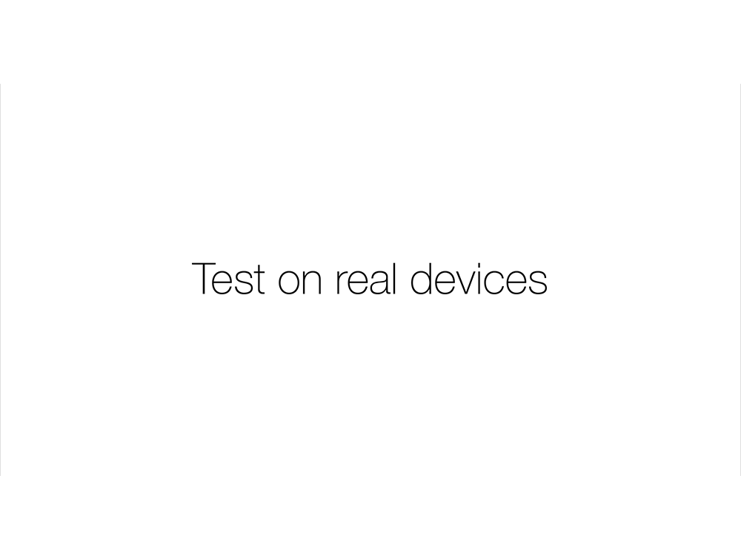

Slide 66
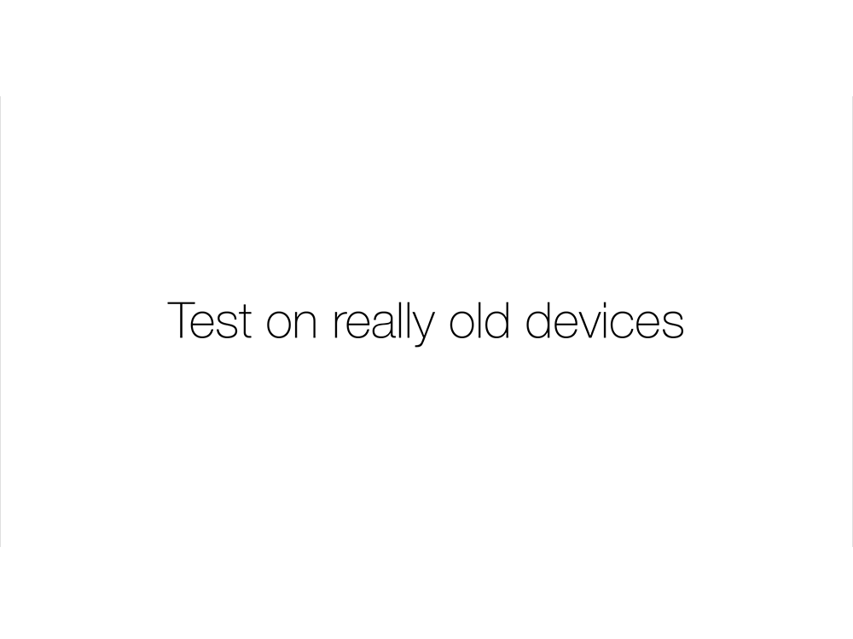

Slide 67


Slide 68


Slide 69
CSS3 Media Queries
One last thing!
In order for media queries to fully work, you'll need to add a mobile specific <meta> tag to your web pages. This <meta> tag allows you to configure the target browser and is useful in browsers such as Safari for the iPhone. Since Safari reports a false width, your media queries won't work without this line of code.
This line of code sets the following values:
width – Use device-width to indicate that the page size should be as wide as the screen permits.
initial-scale – Indicates the initial zoom factor used to display the page. 1 means 100%.
maximum-scale – Indicates the maximum zoom factor for the page.
CODE
<meta name="viewport" content="width=device-width, initial-scale=1, maximum-scale=1">

