Slide 1
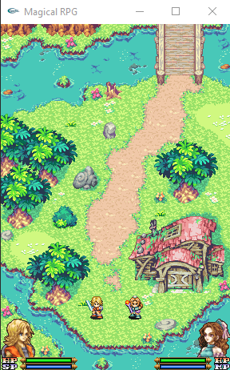
Magical RPG
A Desktop Game Made with
C++
OpenGL
Sockets

Slide 2

Why this project and openGL
Inspired by last quarters “centipede-like” game using C++ and SFML
SMFL uses openGL
Unity uses openGL
Unreal engine uses openGL

Slide 3
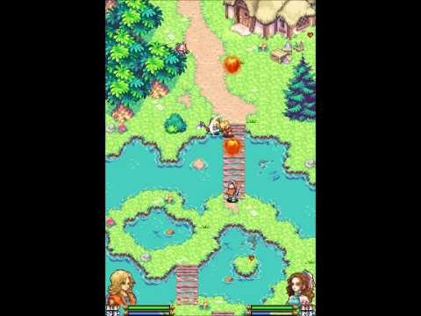
Derived from “Tiny Quest” made by OneGoldenCat

Slide 4
Changes made
Visual Studio ported to Eclipse IDE w/ MinGW compiler for cross platform support
Audio Library changed to Bass Audio
Control keys changed
Multiplayer gameplay added

Slide 5
#include <thread>
Graphics Thread
Game Controls
Frame generation
Sockets Thread
Network communications
Console Thread
Non-blocking console

