Slide 1

UC Davis 3D Electricity Map
By: Brad Lee & Siyi Meng

Slide 2
The problem
Need for better spatial visual tools for data analysis.
2D isn’t always enough

Slide 3
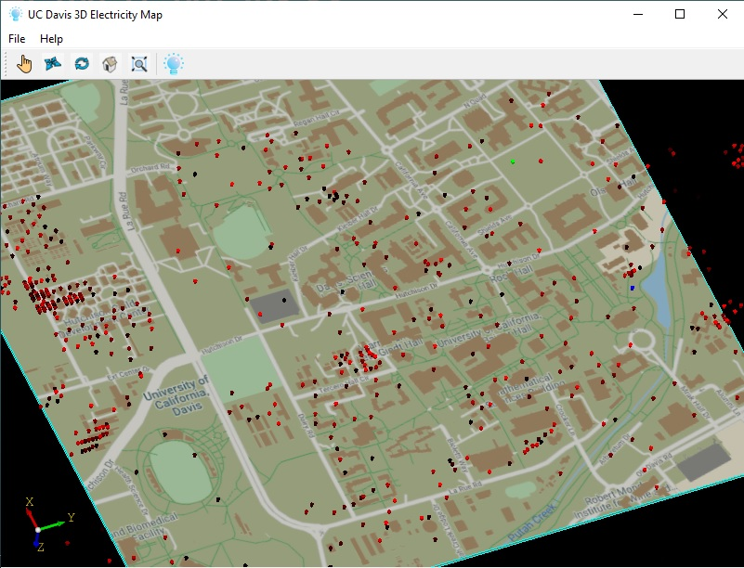
How it works?
Markers = Electricity Meters
Markers Red:
Electricity over baseline usage
Markers Black:
Electricity under baseline usage
Click on a marker to see more information!

Slide 4
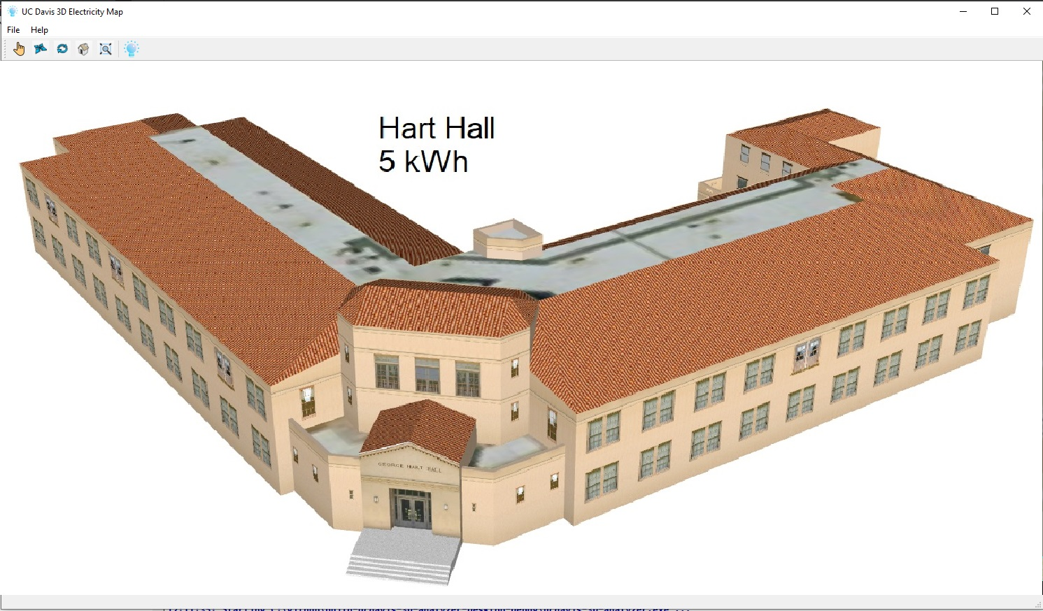
Google model integration
3D models available for virtually all UC Davis buildings!

Slide 5
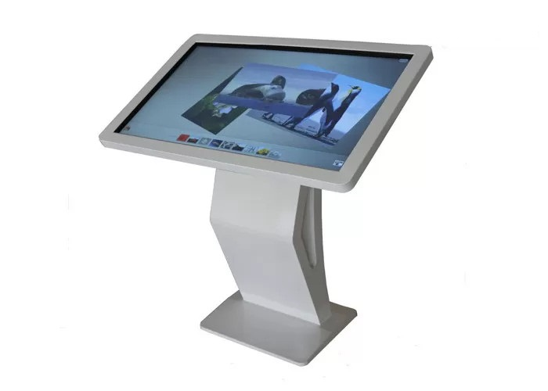
Practical Application
Help Kiosk Visual Software
Embedded systems for engineers and facility managers

Slide 6




Technology
C/C++ Language
Visuals
QT5
OpenCascade
Data
OSIsoft PI powered servers for UC Davis
RapidJSON
CURL

Slide 7
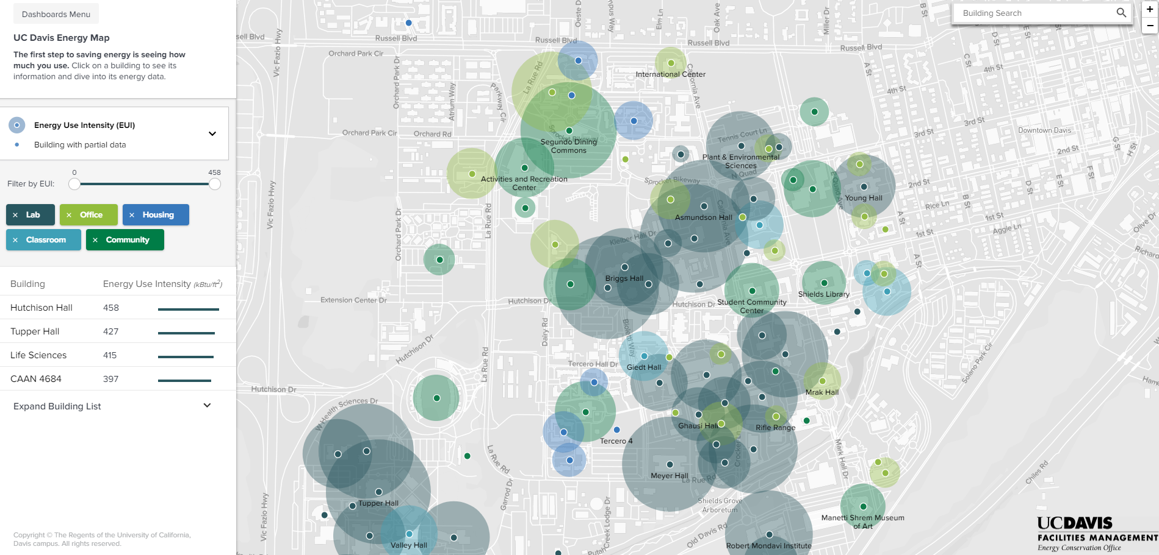
Our competitor, CEED, the 2D visualizer

