Slide 1
WUXI E-INFO
25 JUN
BRAD QIU

Slide 2

WUXI NPI Engineering System

Slide 3
NPI Engineering System
Project Manage
Knowledge share
Trace project yield trend and offer Project NPI process information
Share technical knowledge document with Tag. And push technical document actively
Project Manage
Knowledge Share
Module FA Trace
Debug Tree
FA Trace
Three phase demonstrate: Failure Detail, Rootcasue, Result
standardize Failure Module analyse progress. Make the analyse information can be shared and Traceability
Debug Tree

Slide 4
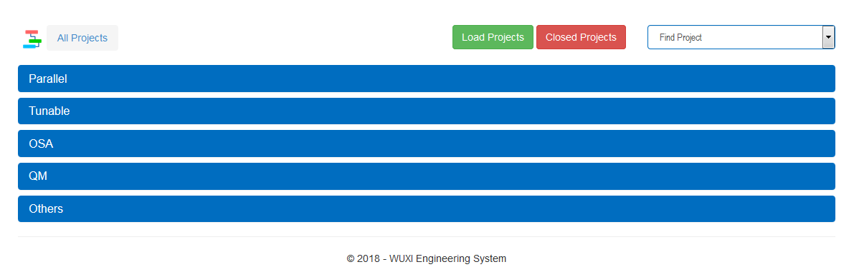
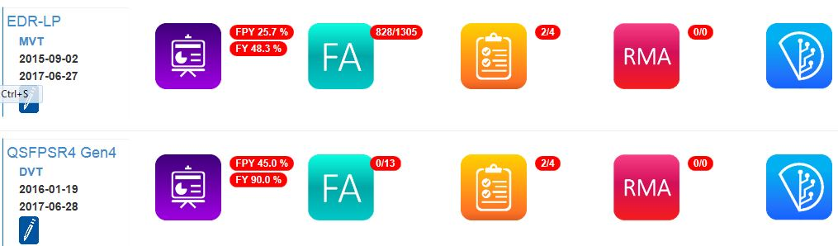
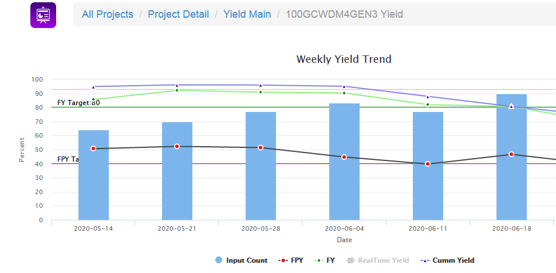
Extensive Project Support

Slide 5
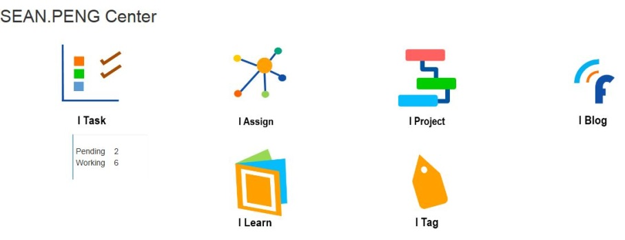
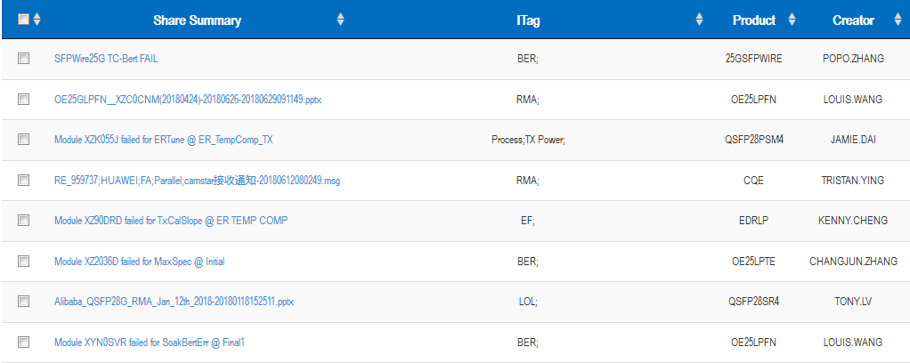
Overall FA Trace and Knowledge Share System
A System developed to trace failure analyze. Base on the FA document, a document share sub-system is build to share knowledge between team member.

Slide 6
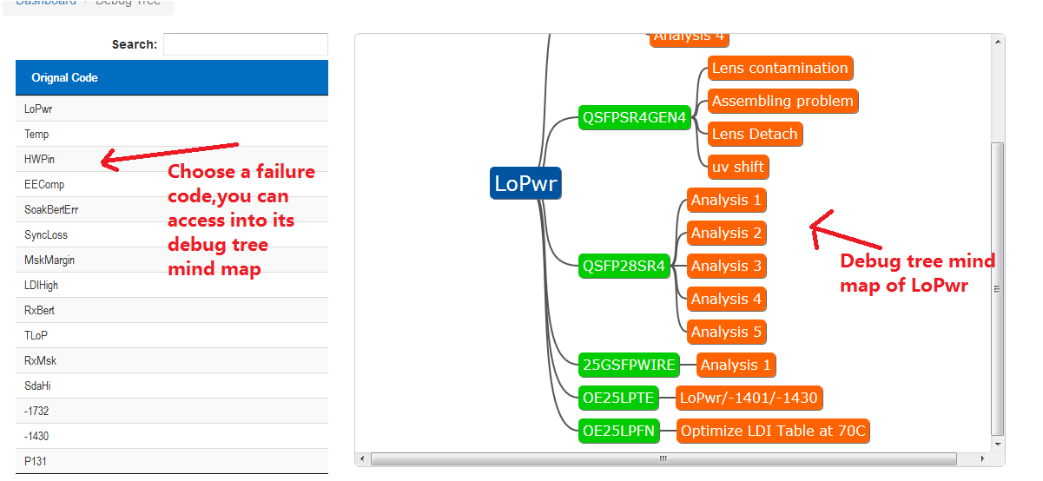
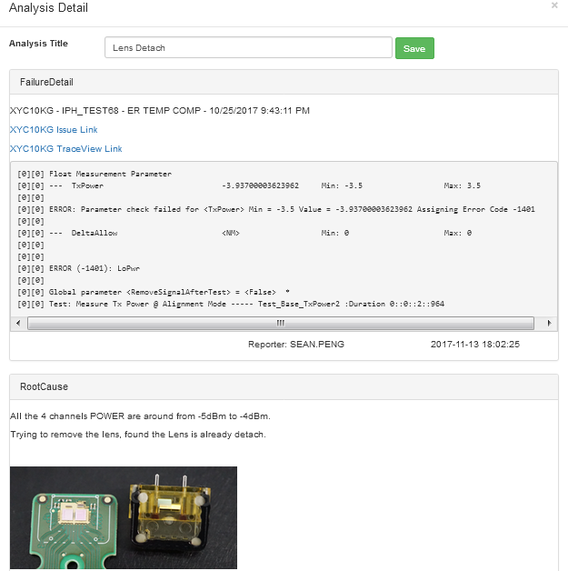
Brevity Debug Tree

Slide 7
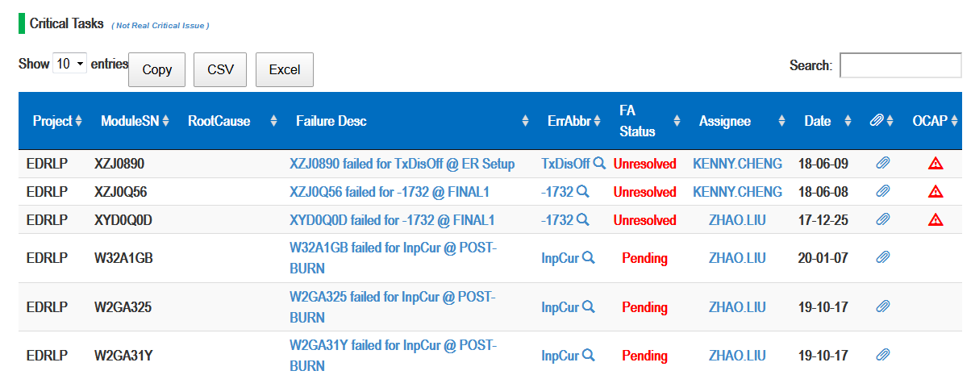
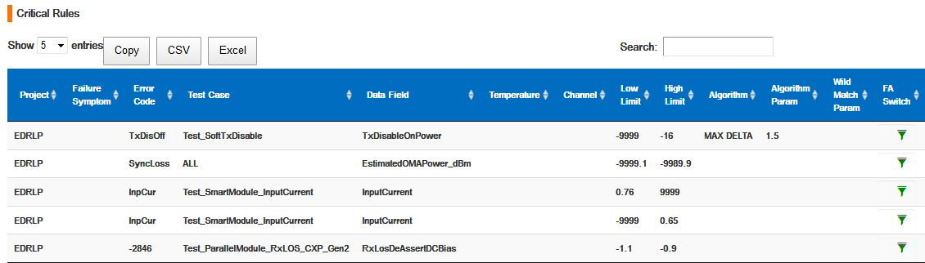
Powerful Critical Failure Catch

Slide 8
Mini-PIP tracking

Slide 9
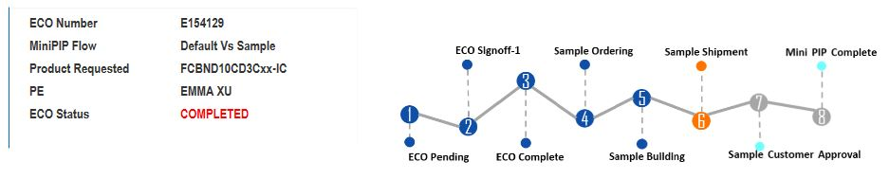
MINI-PIP tracking system
Overall MINIPIP flow display and follow up system
A System developed to control MINIPIP start from request received until first article approved, gather Quality/Planner/Engineering/Production info together timely to trace and monitoring MINIPIP process
93%
Engineering
checking
Different color for
card progress
Link and
supervise
How it looks like?
Step complete;
Info gathered waiting
for check;
Under checking,
no operation needed
MINIPIP complete =
ECO complete +
FA sample approved;
Having inside sales,
planning, mfg, QA,
shipping, Market
feedback info
Check the doc work;
FAI;
Sample build and
engineer sign off;

Slide 10
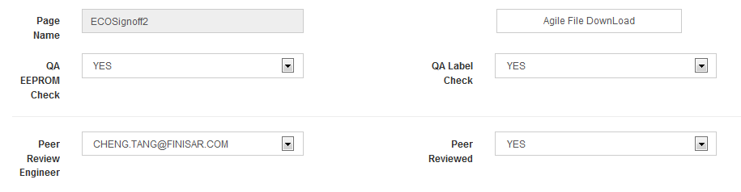
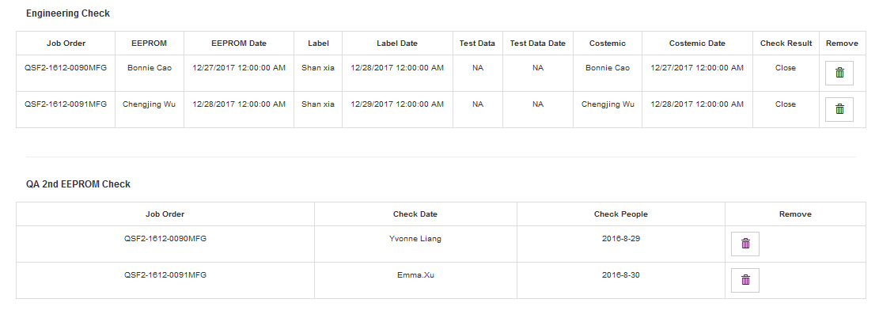
Trace Checking Enhancement
01
Key To Success_ECO completion
Automatically trace FAI check (Quality) and Peer Review check (Engineering)
02
Before dropbox_FAI shipment
Automatically trace article label/DUMP/cosmetic check (Engineering team) and
DUMP check (Quality)

Slide 11
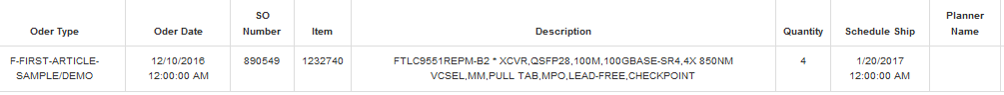
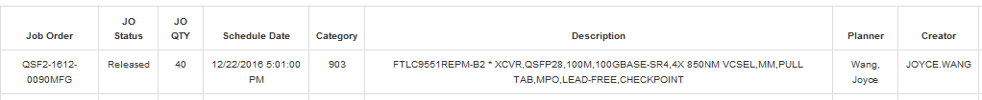
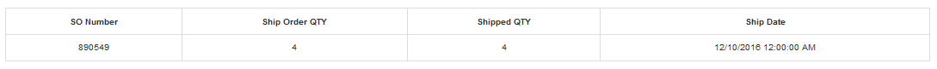
Information Interaction
03
Coordination_linking with other system
Double confirm Order/WO status and monitoring production
Order info
WO info
Shipping info
04
Entire cycle_pushing lifecycle to match with generic
“Life cycle match” is obligatory for every MINIPIP.

Slide 12
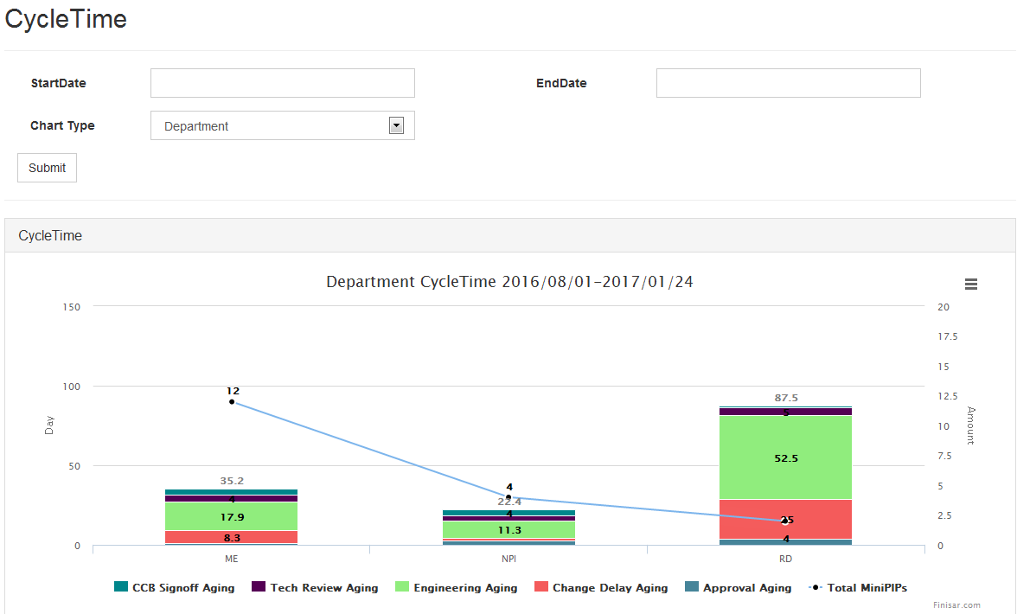
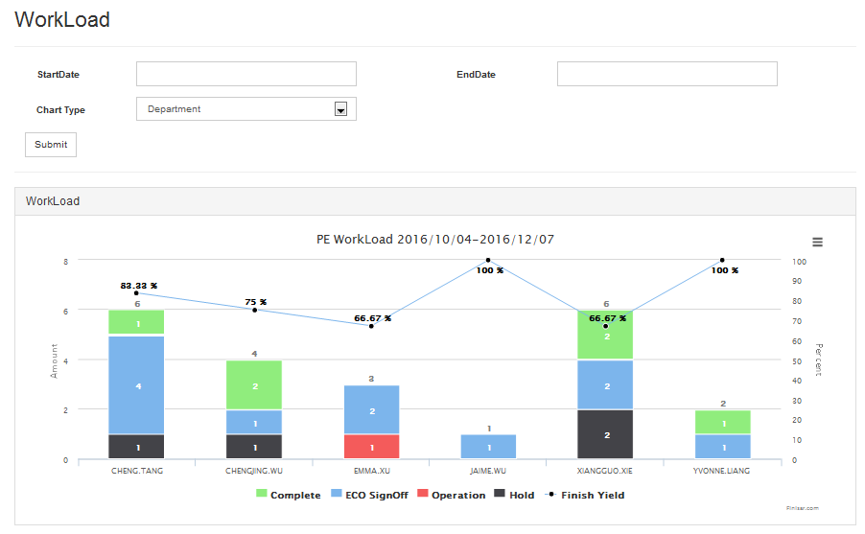
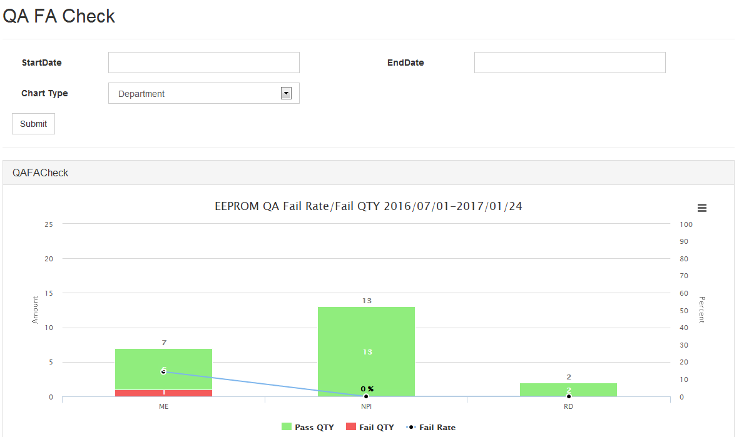
Report show
05
Reflect from multiple angle_real time report system
Convenient for report export;
User select time quantum and report type (workload/Cycle time/FA building time, etc); report can be show by different views (department/PE/overall)

