Slide 1
SNMMI Hands-on Training for AI:
Do’s and Dont’s of Deep Learning
Updated:
April 13, 2020
Contributors:
Tyler J Bradshaw ( tbradshaw@wisc.edu )
Alan B McMillan( amcmillan@uwhealth.org)
Special thanks to Kevin Johnson and Jacob Johnson from University of Wisconsin

Slide 2
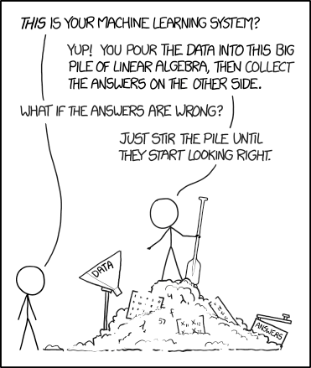
The art of deep learning
Things will not go as planned
https://xkcd.com/1838/

Slide 3
1. Do: double check, triple check your input data
DEEP LEARNING DATA INPUT
EXPECTATION
REALITY
This is hard to diagnose from the model’s output alone
Can send you down the wrong path for a LONG time

Slide 4
2. Do: check your loss plots

Slide 5
2. Do: check your loss plots
Overfitting / not enough data
Stuck in LOCAL minimum
Network too small

Slide 6
3. Don’t: train with large class imbalance
Class balancing methods exist and are simple to implement

Slide 7
4. Don’t: overfit
Options:
Stop training at validation minimum
Use a smaller network
Data augmentation
Add features to network
  Batch normalization
  Dropout
Validation
Training

Slide 8
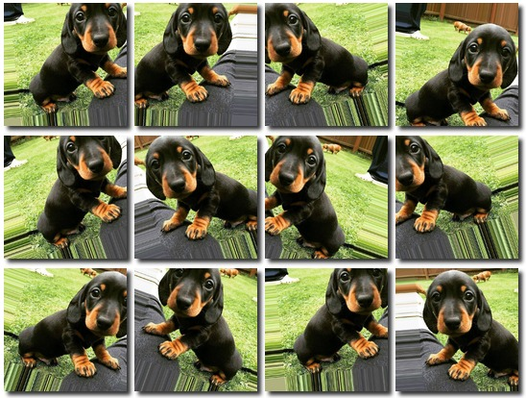
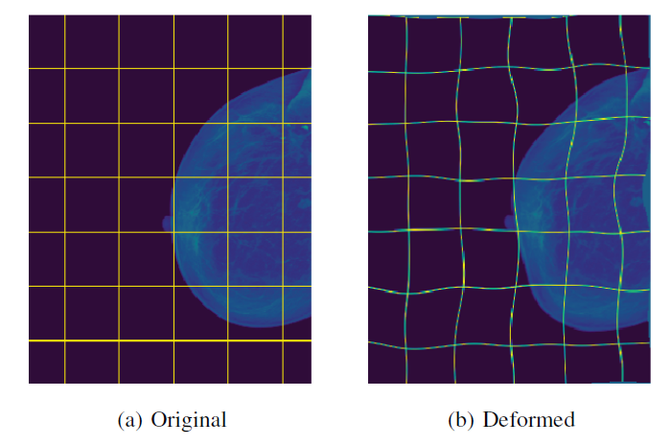
4. Don’t: overfit
Options:
Stop training at validation minimum
Use a smaller network
Data augmentation
Add features to network
  Batch normalization
  Dropout
Validation
Training
Castro et al, 2018

Slide 9
4. Don’t: overfit
Options:
Stop training at validation minimum
Use a smaller network
Data augmentation
Add features to network
  Batch normalization
  Dropout
Validation
Training
Normalize the output of a layer
Improves training
Prevents extreme activations

Slide 10
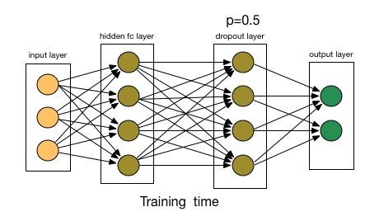
4. Don’t: overfit
Options:
Stop training at validation minimum
Use a smaller network
Data augmentation
Add features to network
  Batch normalization
  Dropout
Validation
Training

Slide 11
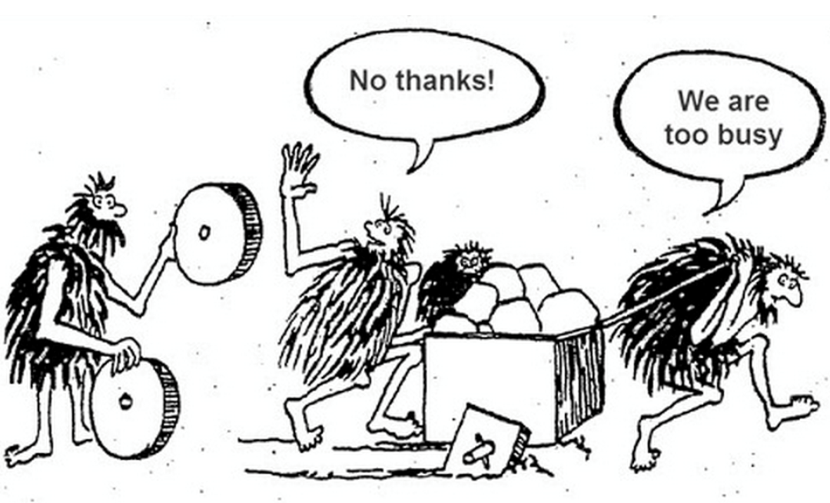
5. Do: explore github for existing networks
https://github.com/nerox8664/awesome-computer-vision-models
https://github.com/qubvel/segmentation_models

Slide 12
Thank you
Resources
  Webinar github page:
  https://github.com/bradshawuw/snmmi_hands_on_training_for_ai
  UW Boot Camp github page:
  https://github.com/kmjohnson3/ML4MI_BootCamp
  Access to data sets via TCIA
  https://www.cancerimagingarchive.net/

