Slide 1
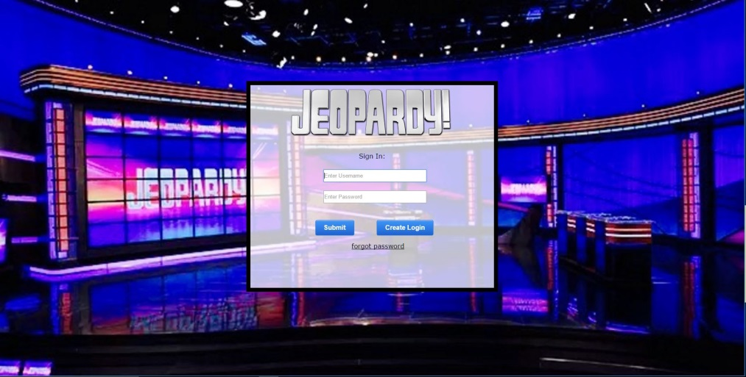
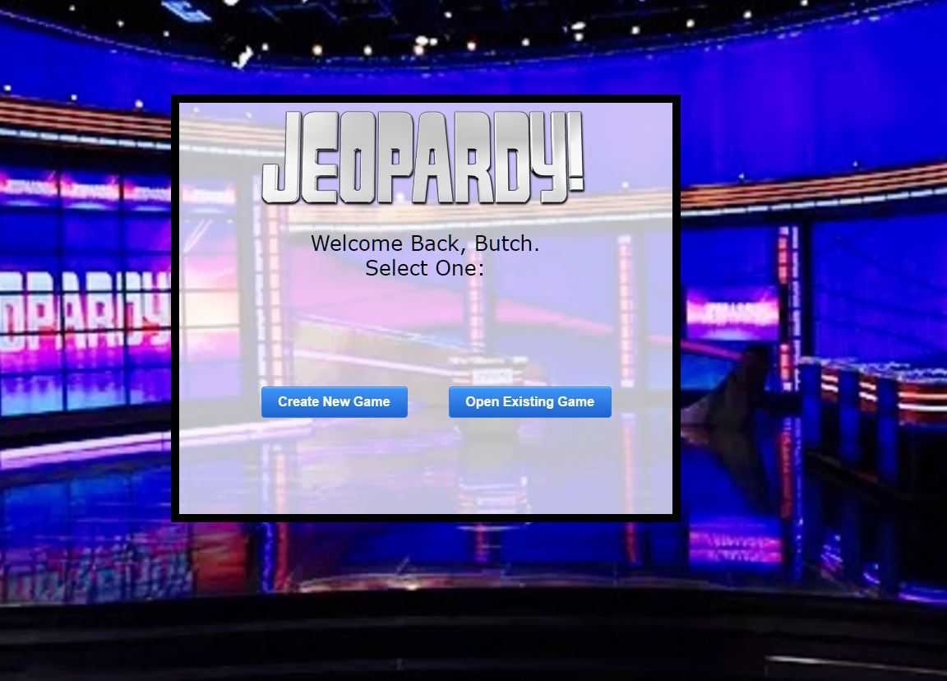
Final Implementation
Goals:
Consistent Design
Simple to locate
Easy to see
Two Main Features:
Custom Game Creator
Play Jeopardy Game

Slide 2
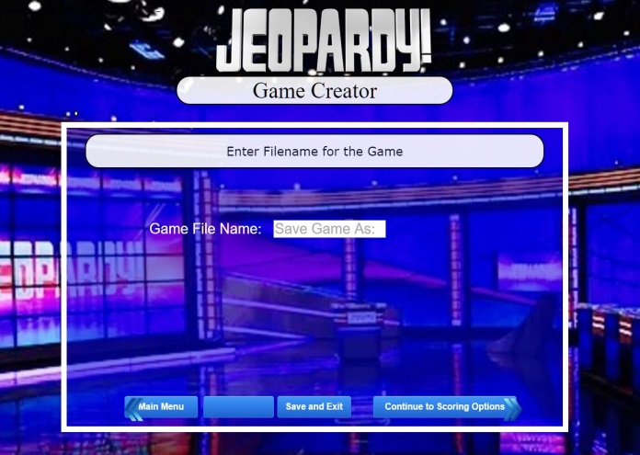
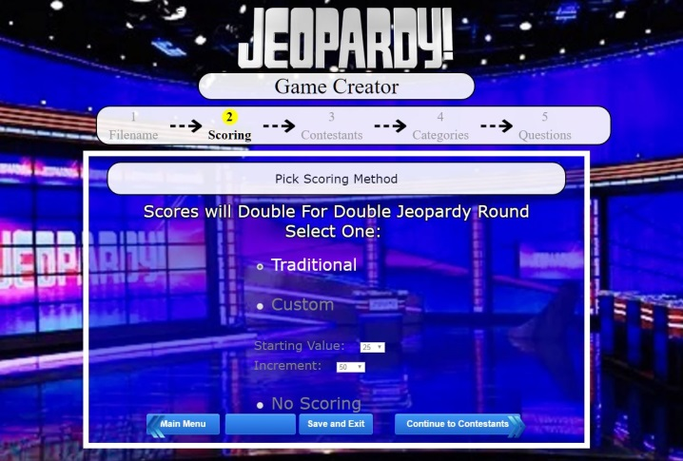
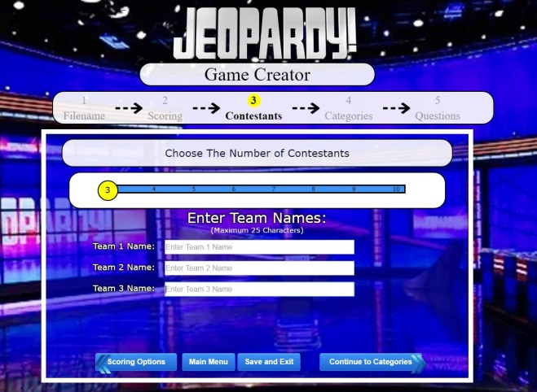
Game Creator
Name the game:
Select Scoring Options:
Choose number of Contestants:
Note:
Navigational buttons have a rotating flow.

Slide 3
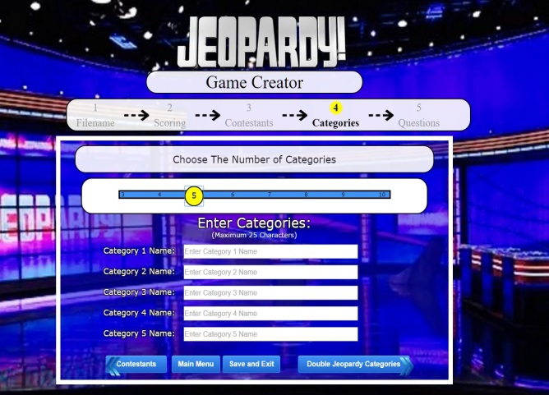
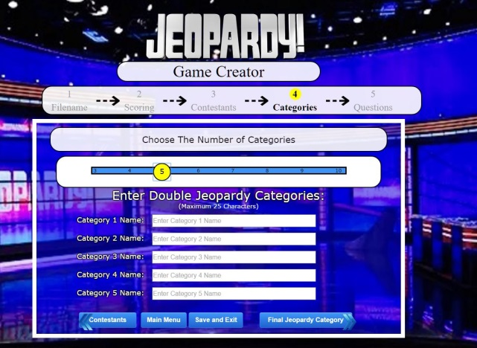
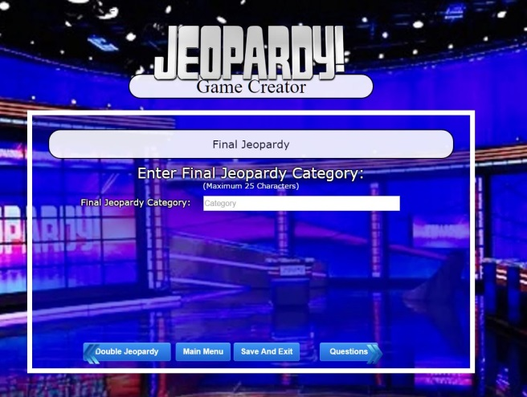
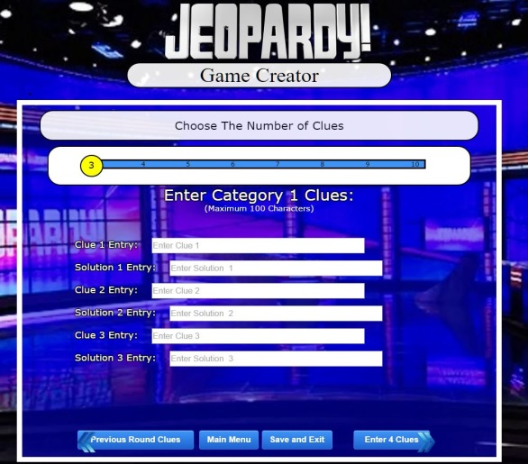
Game Creator
Create Categories:
Double Jeopardy Categories:
Final Jeopardy Categories:
Create Clues and Solutions:

Slide 4
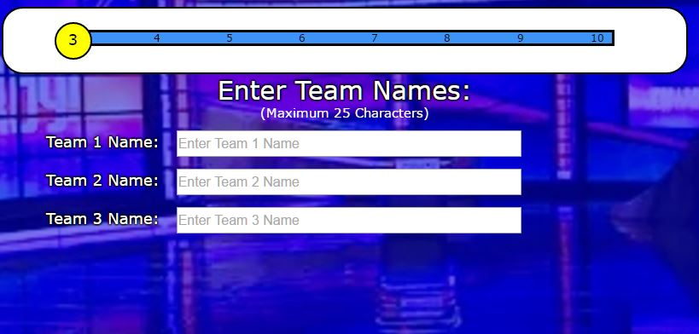
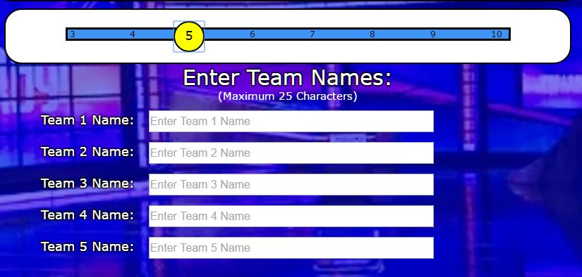
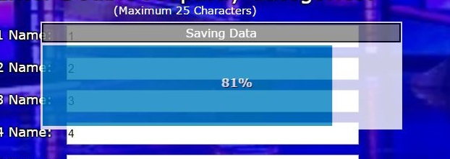
Helpful Design Features:
Slider
Status Bar
Know current progress
in the game creator
Saving Status Bar
Alerts user that data is saving
Dynamically updates page
Create up to 10 teams

Slide 5
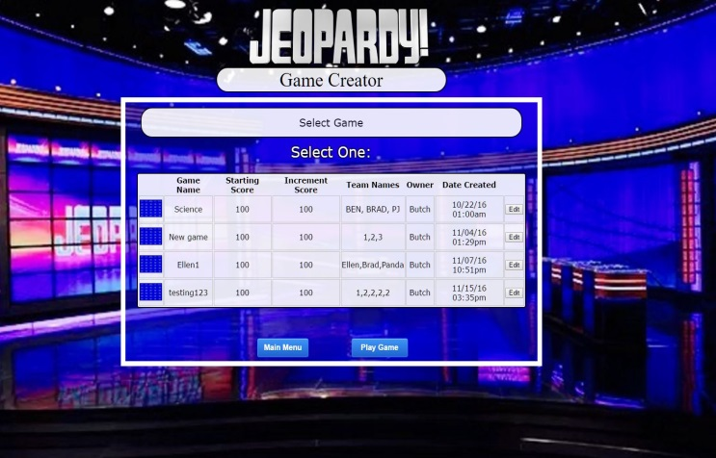
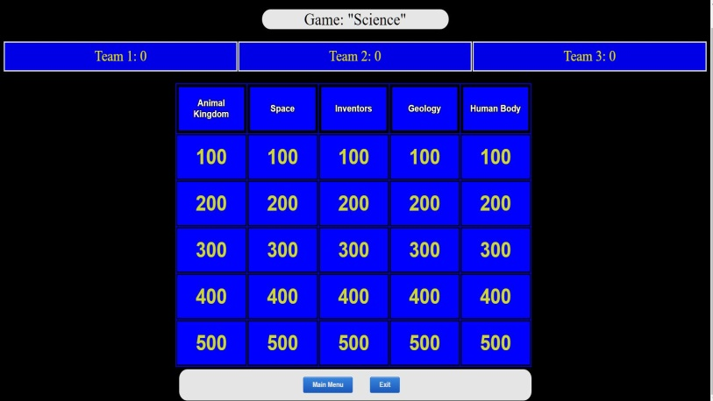
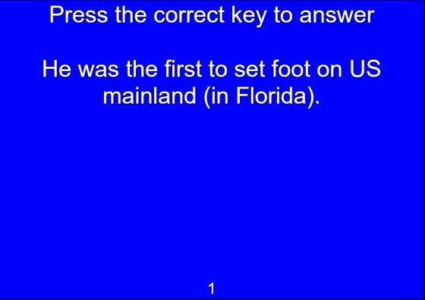
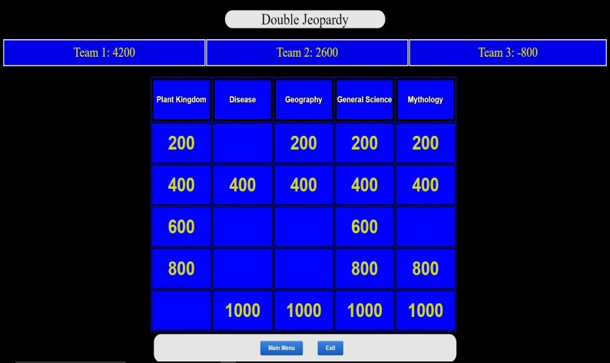
Play The Game
Open Game:
Game Board:
Answer Clue:
Halfway Through:
Note: Used keyboard press
in place of a real buzzer

Slide 6
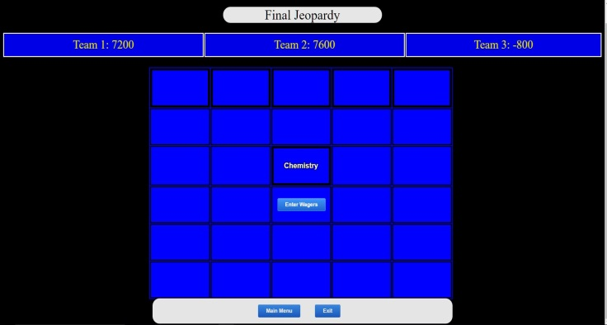
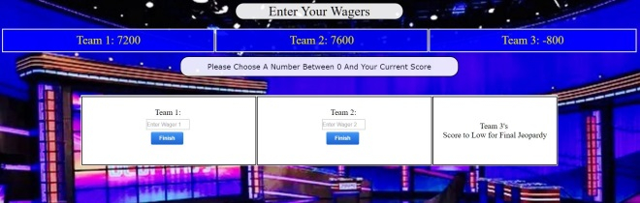
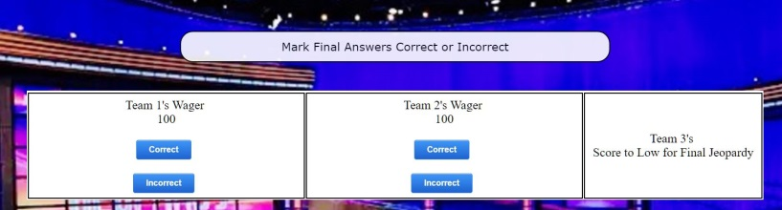
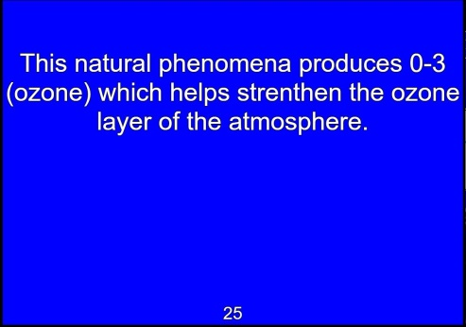
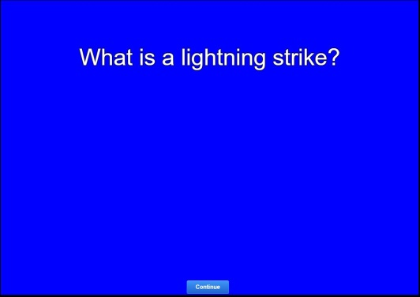
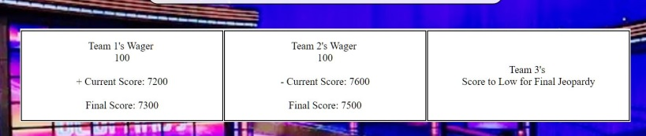
Finish The Game
Final Jeopardy:
Enter Wagers:
Mark Correct or Incorrect:
Final Jeopardy Clue and Solution:
See Final Results:

Slide 7
Usability Test
Metrics Tested
Tasks Given
Task Completion
Task Times
Custom Survey Scores
SUS Scores
Login
Create Custom Game
a. Name game
b. Scoring options
Continue Custom Game
a. Create 4 contestants
b. Create 5 Categories
Create 5 clues and save
Open existing game
Play Single Jeopardy
Play Double Jeopardy
Wager and Play Final Jeopardy

Slide 8
Data
Average Time Per Task
SUS Survey Scores
Task Number | Time in minutes | Time in Seconds
1 | 0.27 | 16.2
2 | 0.57 | 34.2
3 | 1.61 | 96.6
4 | 0.86 | 51.6
5 | 0.34 | 20.4
6 | 1.44 | 86.4
7 | 0.9 | 54
8 | 1.09 | 65.4
Total Avg. Time | 7.13 | ----
Data Recording Session | Scores
Session 1 | 50
Session 2 | 55
Session 3 | 82.5
Session 4 | 100
Session 5 | 60
Session 6 | 85
Session 7 | 90
Total Score | 74.64

Slide 9
Custom Survey Results
 | Login | Create | Continue | Finish | Load | Play Single | Play Double | Play Final
Avg Score | 5 | 4.71 | 4 | 4.14 | 4.86 | N/A | 4.29 | 4.71
Standard Deviation | 0 | 0.49 | 1.41 | 1.21 | 0.38 | N/A | 1.25 | 0.76
Standard Error | 0 | 0.18 | 0.53 | 0.46 | 0.14 | N/A | 0.47 | 0.29
Critical Value | 1.94 | 1.94 | 1.94 | 1.94 | 1.94 | N/A | 1.94 | 1.94
Margin of Error | 0 | 0.36 | 1.04 | 0.89 | 0.28 | N/A | 0.92 | 0.56
90 % Confidence Interval | 5±0 | 4.71±0.36 | 4±1.04 | 4.14±0.89 | 4.86±0.28 | N/A | 4.29±0.92 | 4.71±0.56

Slide 10
Observations and Conclusions
Observations:
Custom Questionnaire has fairly high score
SUS has an OK Score
Conclusions:
The final product is not as good as our custom questionnaire suggest.
Overall, we can be confident that if our interface was widely available that users would be able to properly use it and enjoy it

Slide 11
Post-Mortem
What Worked
What Didn’t Work
Early Collaborative Planning
Fairly even workload
Most design work finished by Low-Fidelity Prototype
Late phases problems arise
Lack of communication
Disagreement on workload divisions

