Slide 1
Personal Transportation in 2054
by Brad Touesnard
Faster,
more efficient,
more convenient

Slide 2
Objective
To demonstrate that personal transportation vehicles of 2054 will be faster, more efficient, and more convenient than vehicles of 2004 by examining current influencing factors and changes of personal transportation in the past.

Slide 3

Outline
Brief History
Major Influencing Factors
  Technology
  Culture
  Environment
  Economy
The State of Personal Transportation in 2054
  Speed
  Efficiency
  Convenience
Conclusion

Slide 4
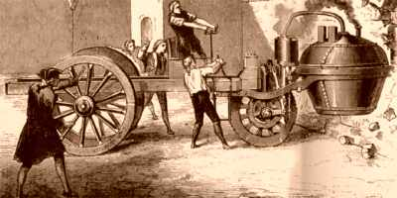
Brief History
3500 BC - wheels on carts
2000 BC - horses domesticated
1790 – bicycle
1862 – automobile
1867 – motorcycle
1908 – assembly line
The History of Transportation
http://inventors.about.com/library/inventors/bl_history_of_transportation.htm

Slide 5
Major Influencing Factors
Technology
  Revolutionizes
    Wheel
    Internal Combustion Engine
    What’s next?
  Enhances
    Speed – e.g. first automobile 2mph
    Efficiency – e.g. regenerative breaking
    Convenience – e.g. electric car starter

Slide 6
Major Influencing Factors
Culture
  “[By 1910] the automobile was changing American life. It had already started to change the language: 'parking', 'necking', and 'petting' had made their way into the language.” ⁽¹⁾
  “…the Japanese--who live in a country where things are small, especially the roads--were stunned at how large the pickups in the lot were, and how many of them they saw.” ⁽¹⁾
Automotive History – A Chronological History (Antique Automobile Club of America)
Dan Lienert (Forbes)

Slide 7

Major Influencing Factors
Environment
  Public health and safety
  Environmentalist pressure
  Government regulations
    California emission
    Idling fines (noise and emissions)

Slide 8
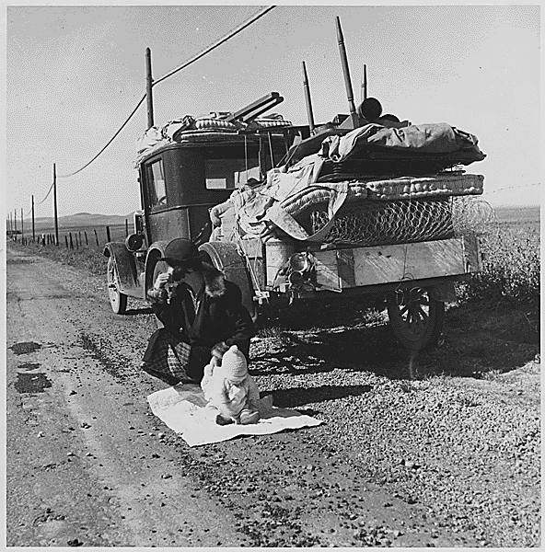
Major Influencing Factors
Economy
  1929 Great Depression
    Vehicle production decrease
  1973 Energy Crisis
    “American Muscle Car”
    Japanese imports gain sales
“Lexus decided to delay the release to accommodate burgeoning demand for the [hybrid] SUV…it has 9,500 confirmed orders for the RX 400h, 8,000 buyers on dealership waiting lists and about 46,000 potential purchasers…Pricing for the RX 400h hybrid has not been announced yet.” – The Associated Press

Slide 9
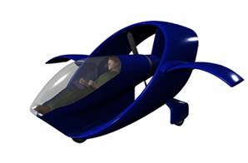
2054: Speed
Satisfies cultural needs
Limited by technology
NASA’s SATS Program ⁽¹⁾
  Highway-In-The-Sky (HITS) with synthetic vision systems
  Simplified software-based flight controls
  Auto-land capability
  Computational algorithms for automated traffic separation and collaborative sequencing
  Airborne Internet communications
  Comprehensive safety systems
(1) Small Aircraft Transportation System (NASA’s Langley Aeronautics Research Center) – http://sats.larc.nasa.gov

Slide 10
2054: Efficiency
Satisfies economic, environmental needs
Limited by technology and culture
Hydrogen Fuel Cell
  Hydrogen production cost > delivered energy
  Solar hydrogen
  “…the people who develop the IP (intellectual property) that works will be the OPEC of the future.” ⁽¹⁾
  Infrastructure
(1) Christopher Sorrel, University of South Wales (from “Hydrogen Fuel Closer to Fruition.” Wired News)

Slide 11
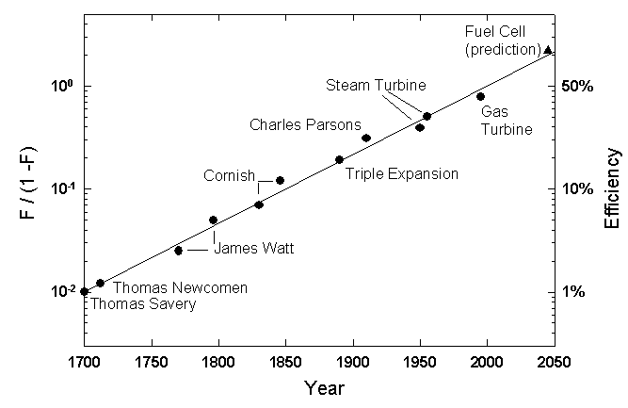
2054: Efficiency
“Seventy percent efficient fuel cells, which are theoretically attainable, are due in 2050.” ⁽¹⁾
Improvement of the Efficiency of Motors
(1) Toward Green Mobility: the evolution of transport (Ausubel, Marchetti)

Slide 12

2054: Convenience
Satisfies cultural needs
Limited by economy
Segway
  Alternative to walking or cycling
  Used by U.S. Postal Service, Amazon.com
  “Cities need cars like fish need bicycles.”⁽¹⁾ – Dean Kamen
  “If enough people see this machine, you won't have to convince them to architect cities around it; it'll just happen.”⁽¹⁾ – Steve Jobs (co-founder of Apple Computers)
(1) Heilemann, John. “Reinventing the Wheel.” Time.com. December 2001.

Slide 13
Conclusion
Bright Future
The Efficiency of Hydrogen power
  Eliminate air pollution and smog in cities
  Greatly reduce dependence on fossil fuels
The Speed of Personal Aircraft
  Cities increase in breadth
  Increase commuter distance
The Segway Convenience
  Change city culture
  Further increase of city bustling
  Complement public transportation
“Prediction is extremely difficult. Especially about the future.” – Niels Bohr

