Slide 1

Software Cost Estimation
SLOC-based Models and the Function Points Model
By Brad Touesnard
For SWE4103
University of New Brunswick, Fredericton

Slide 2

Outline
Introduction
SLOC-based Approach
Function Points Approach
Conclusions

Slide 3
Introduction
Ad-hoc models initially used
Need for formal estimation model
Lines of code easily understood metric
1970 – SLIM (Putnam)
1979 – Function Points (Albrecht)
1981 – COCOMO (Boehm)

Slide 4

Wagerline.com
Total Estimated Hours = 76
76 x $40 per hour = $3040

Slide 5
Wagerline.com
Function | Hours
Web site design | 10
Database model and creation | 10
External data feed integration and creation of individual sports pages | 10
Install, setup, customize phpBB forums | 4
Home, About Us, Contact Us pages | 4
Leader board for each sport | 6
Display user’s pending picks | 4
Modify user profile | 4
Display user profile | 4
User registration and login | 4
User-defined Pools Create a new pool (4 hrs) Display pool leaders (4 hrs) Make picks for a pool (4 hrs) Display all public pools (4 hrs) | 16

Slide 6
How do you estimate SLOC?
Experience
Previous system size
Existing system size
Breaking system into pieces
From “Schaum's Outline of Software Engineering” by David Gustafson

Slide 7
How do you estimate SLOC?
For each piece estimate
  Smallest possible SLOC - a
  Most likely SLOC - m
  Largest possible SLOC - b
From “Example of an Early Sizing, Cost and Schedule Estimate for an Application Software System” by L. H. Putnam

Slide 8
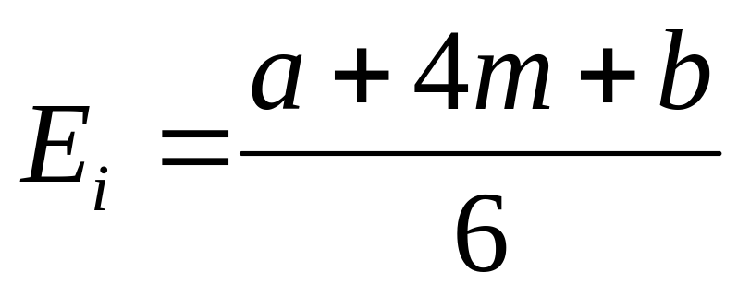
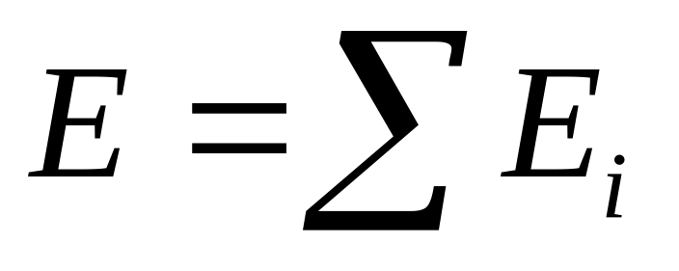
How do you estimate SLOC?
Expected SLOC for each piece
Total Expected SLOC
From “Example of an Early Sizing, Cost and Schedule Estimate for an Application Software System” by L. H. Putnam

Slide 9
SLOC Estimate Example
 | Smallest | Most Likely | Largest
Display user’s pending picks | 200 | 300 | 500
Modify user profile | 100 | 150 | 250
Display user profile | 250 | 300 | 450
User registration and login | 200 | 220 | 250

Slide 10
What are function points?
Functions of a software system
5 Categories
  External Input
  External Output
  Internal File
  External Interface
  External Inquiry

Slide 11
What are function points?
External
Inquiries
System Boundary
Internal Files
External
Outputs
External
Interfaces
External Inputs

Slide 12
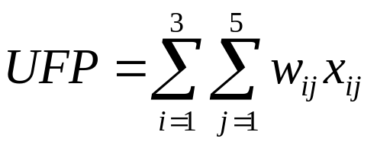
Unadjusted Function Points (UFP)
 | Low | Avg. | High
External Input | __ x 3 | __ x 4 | __ x 6
External Output | __ x 4 | __ x 5 | __ x 7
Internal File | __ x 7 | __ x 10 | __ x 15
External Interface | __ x 5 | __ x 7 | __ x 10
External Inquiry | __ x 3 | __ x 4 | __ x 6
From “Reliability of Function Points Measurement. A Field Experiment,” by Chris F. Kemerer

Slide 13
Adjusting for Other Factors
Data communications
Distributed functions
Performance
Heavily used configuration
Transaction rate
Online data entry
End user efficiency
0 – No Influence
5 – Very Influential

Slide 14
Adjusting for Other Factors
Online update
Complex processing
Reusability
Installation ease
Operational ease
Multiple sites
Facilitates change
0 – No Influence
5 – Very Influential

Slide 15
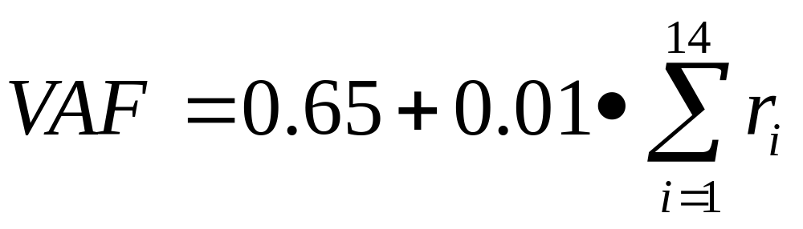
Value Adjustment Factor (VAF)
where r_{i} is the rating of factor i
From “Reliability of Function Points Measurement. A Field Experiment,” by Chris F. Kemerer

Slide 16

Adjusted Function Points (AFP)
From “Reliability of Function Points Measurement. A Field Experiment,” by Chris F. Kemerer

Slide 17
Function Points Model
Advantages
Estimation data available early
Language and implementation independent
Non-technical estimation
Disadvantages
Difficult to automate data collection
Possible subjective counting of function points

Slide 18
SLOC-based Models
Advantages
Easy to automate data collection
Easy to understand SLOC concept
Disadvantages
Highly subjective estimate of SLOC
Highly dependent on experience
Difficult calibration for a non-native environment

Slide 19
Conclusion
“
...even the current cost is small relative to the large sums spent on software development and maintenance in total, and managers should consider the time spent on FP collection and analysis as an investment in process improvement of their software development capability.”
– Chris F. Kemerer, “Reliability of Function Points Measurement. A Field Experiment”

Slide 20
Questions?

