Slide 1

GW-SEM Practical
Brad Verhulst
Department of Psychiatry and Behavioral Sciences
March 29th, 2022

Slide 2
Preliminary Information
We cannot share real genetic data (but there are lots of places where you can get some). Therefore, for the tutorial, we are going to use simulated data.
GWAS are almost always conducted on a Linux/Unix cluster.
Because OSX share many of the same commands as unix, it is pretty simple to install GW-SEM on MACs (it is more complicated on PCs mostly because I’m no longer familiar with how they really work).
For the tutorial, we will work in small groups, and we will make sure that someone from each group is working on a mac or linux machine, so that they can run the analyses.

Slide 3
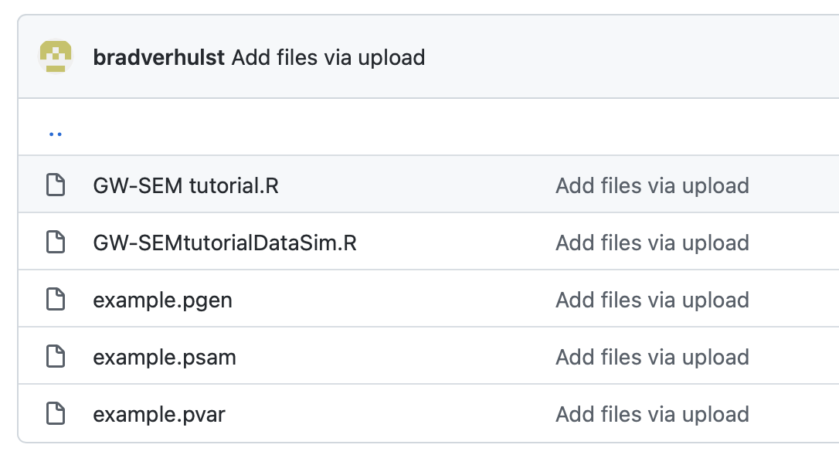
Getting set up for the Practical
Data and scripts can be found here: https://github.com/bradverhulst/gwsem/tree/master/GWSEMtutorial
GW-SEM scripts
Simulated Plink Data

Slide 4
Running the Practical
Using the GW-SEM tutorial.R script, fill in the missing blanks.
What are the results for the factor model before the GWAS?
What are the factor loadings?
Are they reasonable?

Slide 5
Problem 1: Build the Model and look at the Results
Using the GW-SEM tutorial.R script, fill in the missing blanks.
What are the results for the factor model before the GWAS?
What are the factor loadings?
Are they reasonable?
How would we interpret the factor?

Slide 6
Problem 2: Conduct the GWAS and Plot the Results
Using the GW-SEM tutorial.R script, fill in the missing blanks.
Make a “Manhattan Plot”
What are the Most Significant SNPS?

Slide 7
Problem 3: Conduct the Residuals GWAS
Using the GW-SEM tutorial.R script, fill in the missing blanks.
Make a “Manhattan Plot” for each item
What are the Most Significant SNPS for each item?

