Slide 1
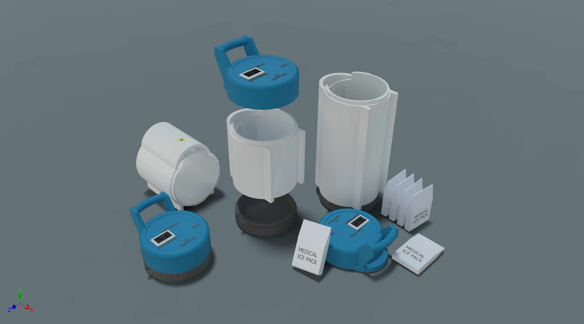

MALIC System:
Modular Acute Limb Cryo-chamber
(Brad) Ziyi Wang, McMaster University, Canada

Slide 2

The Bloody Start
Machinery injury.
Notes:
It all started from a workplace injury that happened at the factory where I was doing my internship.

Slide 3
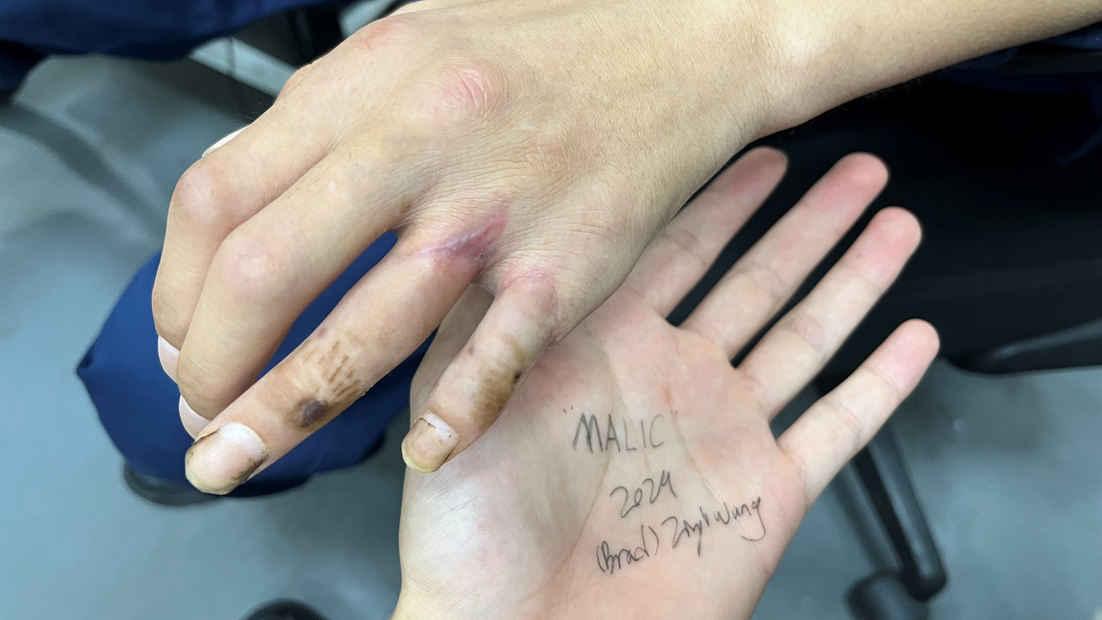
Sheared fingers was replanted 2 months ago.
The person has agreed to use these photos for my project.

Slide 4
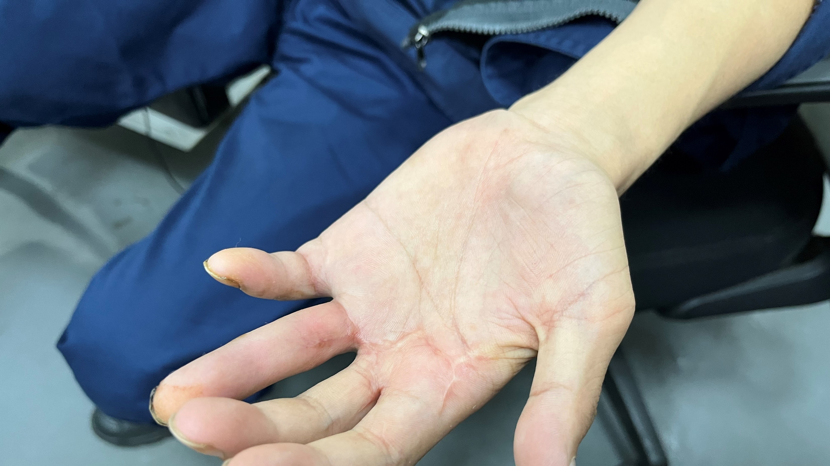
Fingers was wrapped in tissue before replantation.
Reduced mobility and pain.

Slide 5

Initial Brainstorming
Research and experiments.
Notes:
Ideas won’t fly without hard facts backing them up. As soon as I recognized the problem, I started intense research process. Let’s look at some KEY information that I have found.

Slide 6
Quick Facts About Limb Loss[1]
An estimated 2.1 million people are living with limb loss in the US.
About 6,200 work-related amputations happened in the US in 2018.
More than 58% of these involved using machinery.
Notes:
Limb loss hinders mobility, affect appearance, and the serious suffering can result in even more damage like permanent mental health issue. With my design, our society can be transformed by increasing the rate of successful limb replantation.

Slide 7
Improper Preservation of Amputated Parts
Proper preservation consists of wrapping the part in saline-soaked gauze inside a watertight bag and placing it on ice. [2]
Of the 31 patients who had properly preserved parts, 58.1% underwent attempted replant; of the 60 patients who had improperly preserved parts, 23.3% underwent attempted replantation. [2]
Notes:
Following traumatic amputation, preservation of the amputated part plays a crucial role in its viability for replantation. The majority of patients who suffer traumatic amputations do not present with properly preserved amputated parts, making it difficult for surgeons to offer replantation.

Slide 8
Interviewing Professionals
“You must research on the dimensions of human limbs to determine an appropriate size for your design. You don’t know if you will be dealing with a finger or a leg.”
(Orthopedic surgeon, Dr. YeHua W.)
“I don’t want to hike through a jungle holding some big cylinder. It must have some kind of sling or hook to free the hands.”
(Outdoor enthusiasts, Leopold L.)
“The system better be so simple that it requires minimal training.”
(Medical student, WenXuan W.)
Notes:
Face to face interviews in real life is another source of my research. I received many suggestions from professionals working in the medical field and more. I listed three of the comments here.

Slide 9
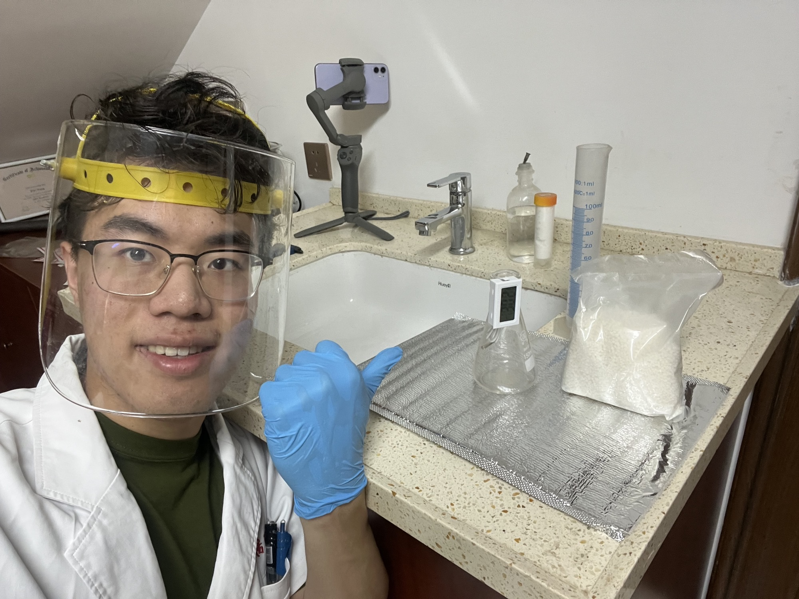
Chemical Cooling Agent
Chemical Agent | Legality (Canada)
Calcium Ammonia Nitrate (CAN) | Legal
Ammonia Nitrate | Restricted
Urea | Legal
CAN: CaH4N4O9
Std enthalpy of solution: +19.53 kJ mol^-1 [3]
Me, testing the chemicals obtained for the project.
Notes:
I chose to use chemical cooling agent to lower the temperature of the limbs. Because they do not need power to preserve, which is a great advantage over conventional ice from freezers. When mixed with water, these chemicals absorb a great amount of heat from the surroundings. I also tested thermoelectric cooler, but they are inefficient and requires power. Eventually I decided to use Calcium Ammonia Nitrate as my cooling chemical, because it is cheap and legal in almost everywhere. It has a standard enthalpy of solution of 19.53 kilo Joules per mole.

Slide 10

Cost & Sustainability
Advantage
Minimal maintenance compared to powered alternatives.
Prolonged shelf life, ready to go at any time.
Only the cooling units and the plastic bag needs replacement after use. (Other parts can be sanitized for reuse)
Notes:
Cost and sustainability is yet another advantage of my design as an innovative medical device. The system requires minimal maintenance compared to powered alternatives and is ready to go at any time. Also, most of the device can be reused after sanitization, thereby reducing waste.

Slide 11

Fast prototyping
Just like how Dyson products are designed.
Notes:
After much research, I moved into the fast prototyping phase, as promoted by Dyson designers.

Slide 12
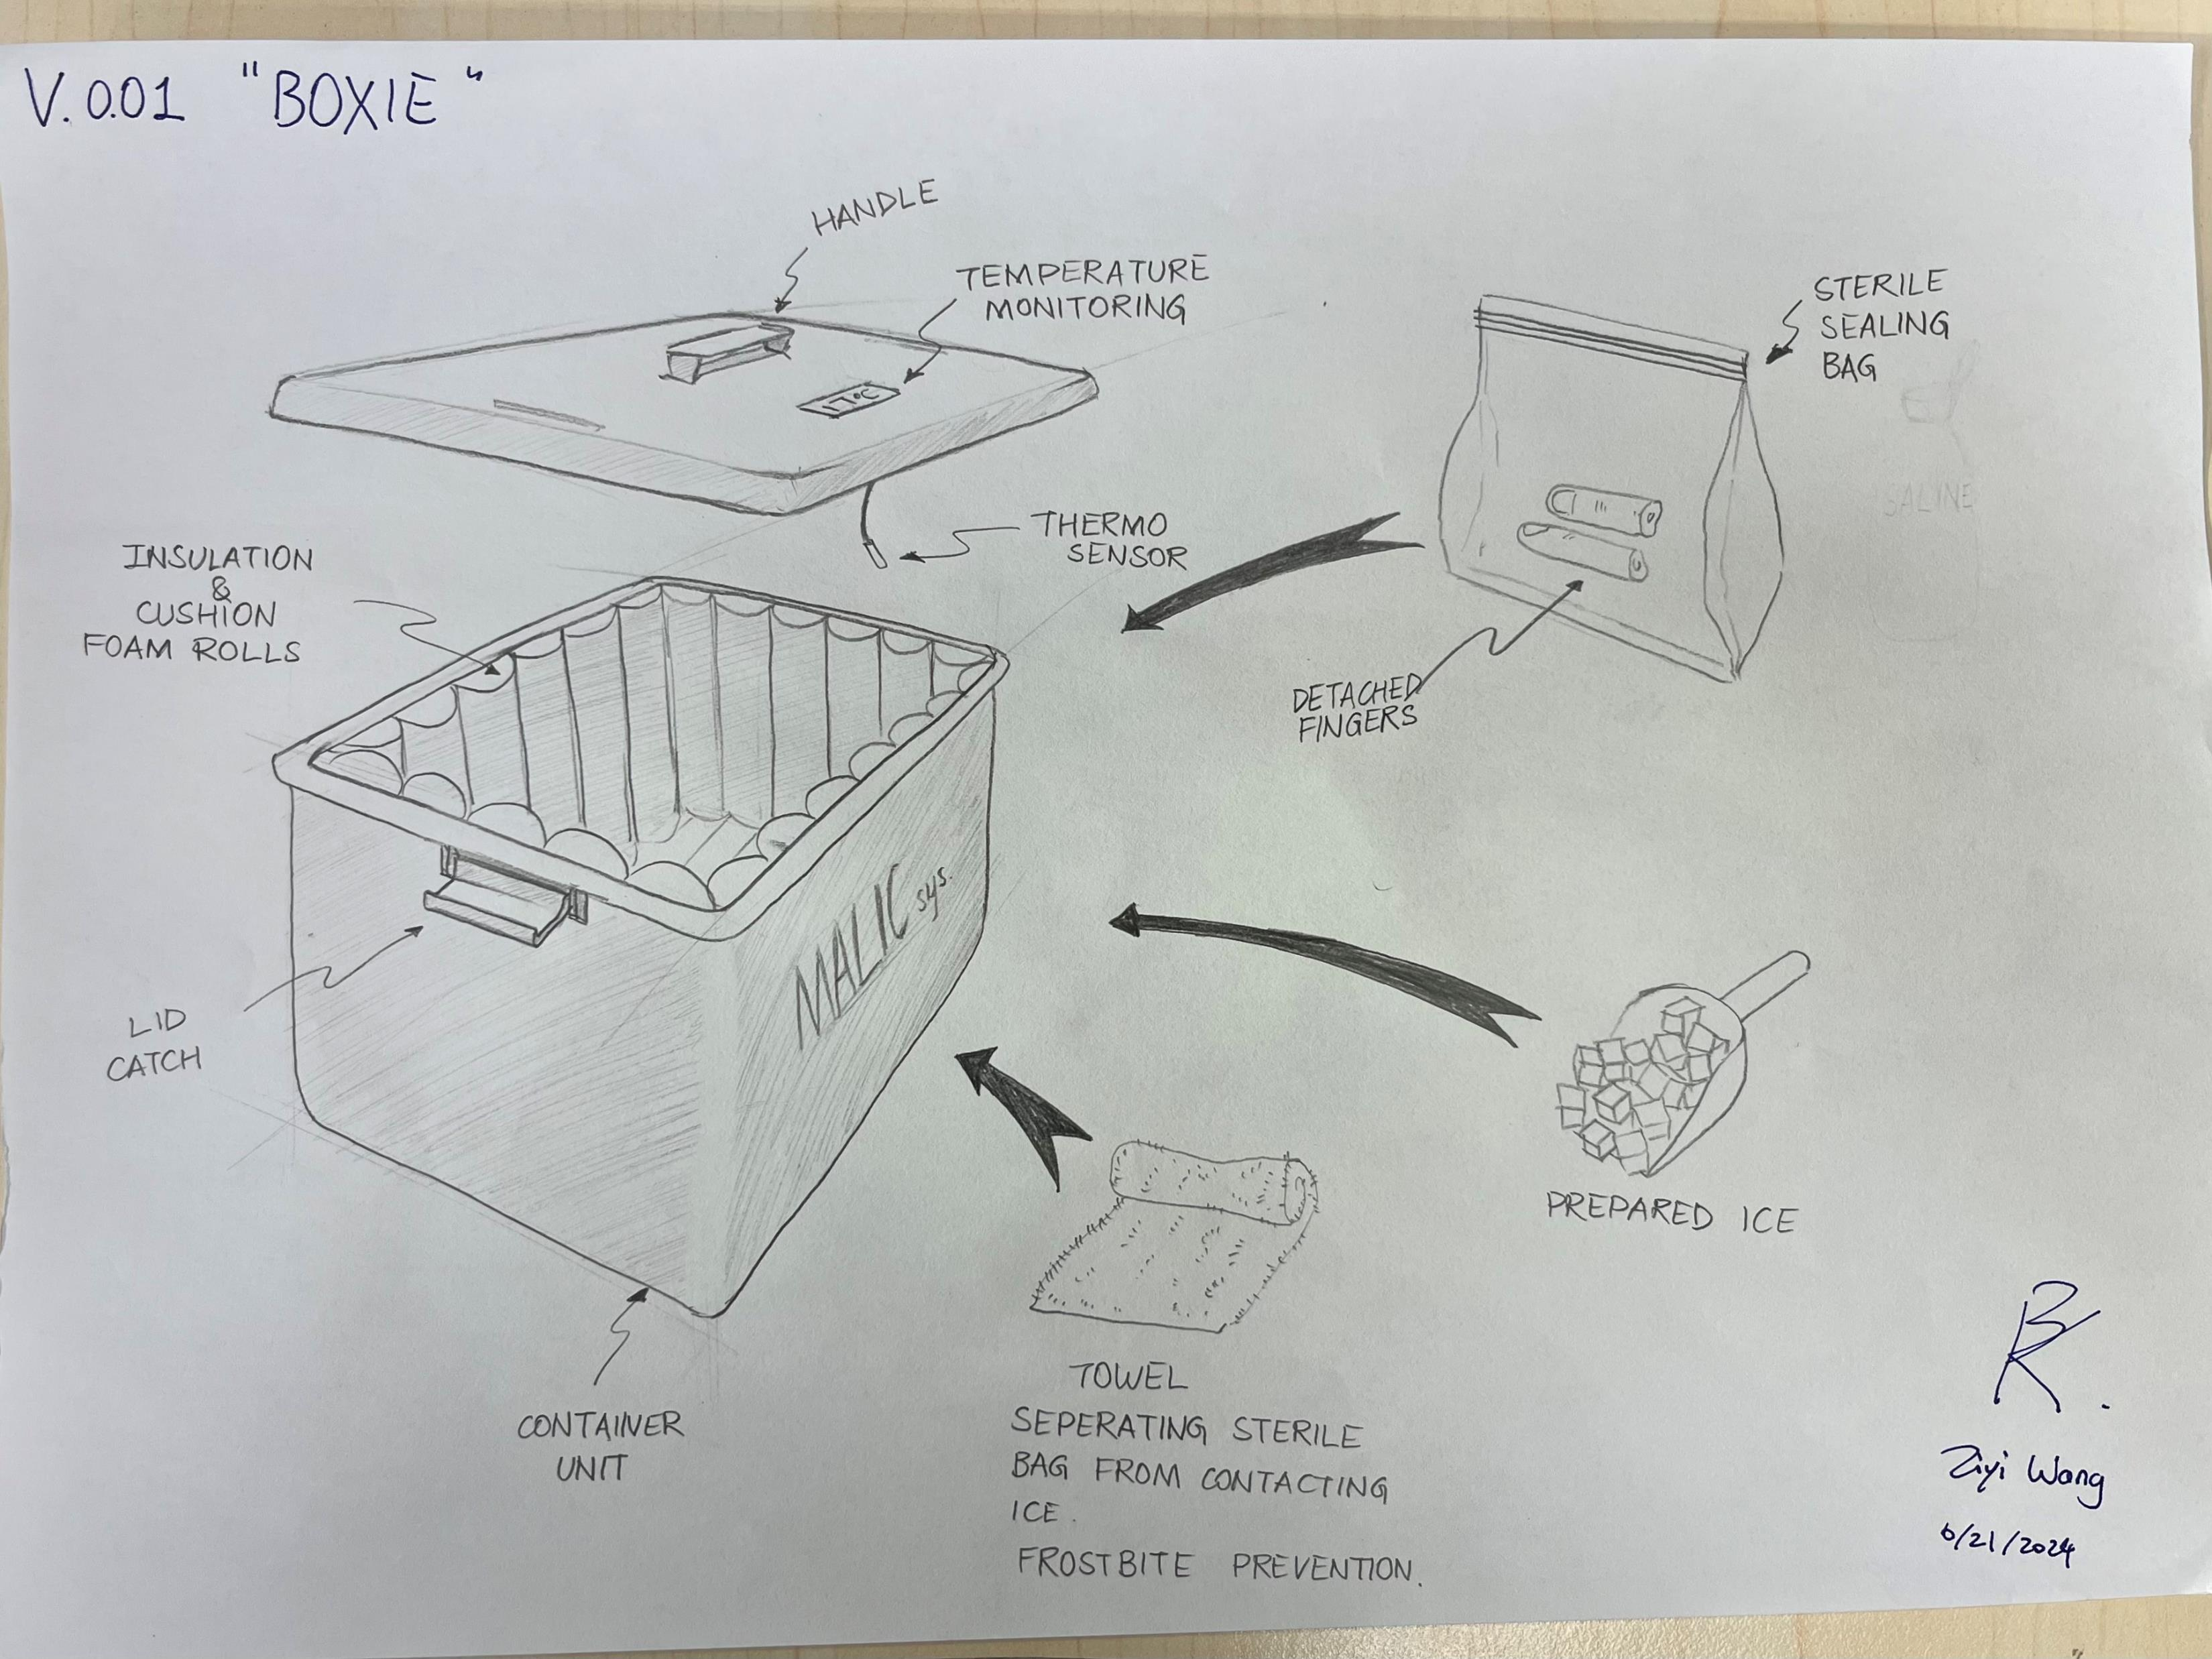

Slide 13
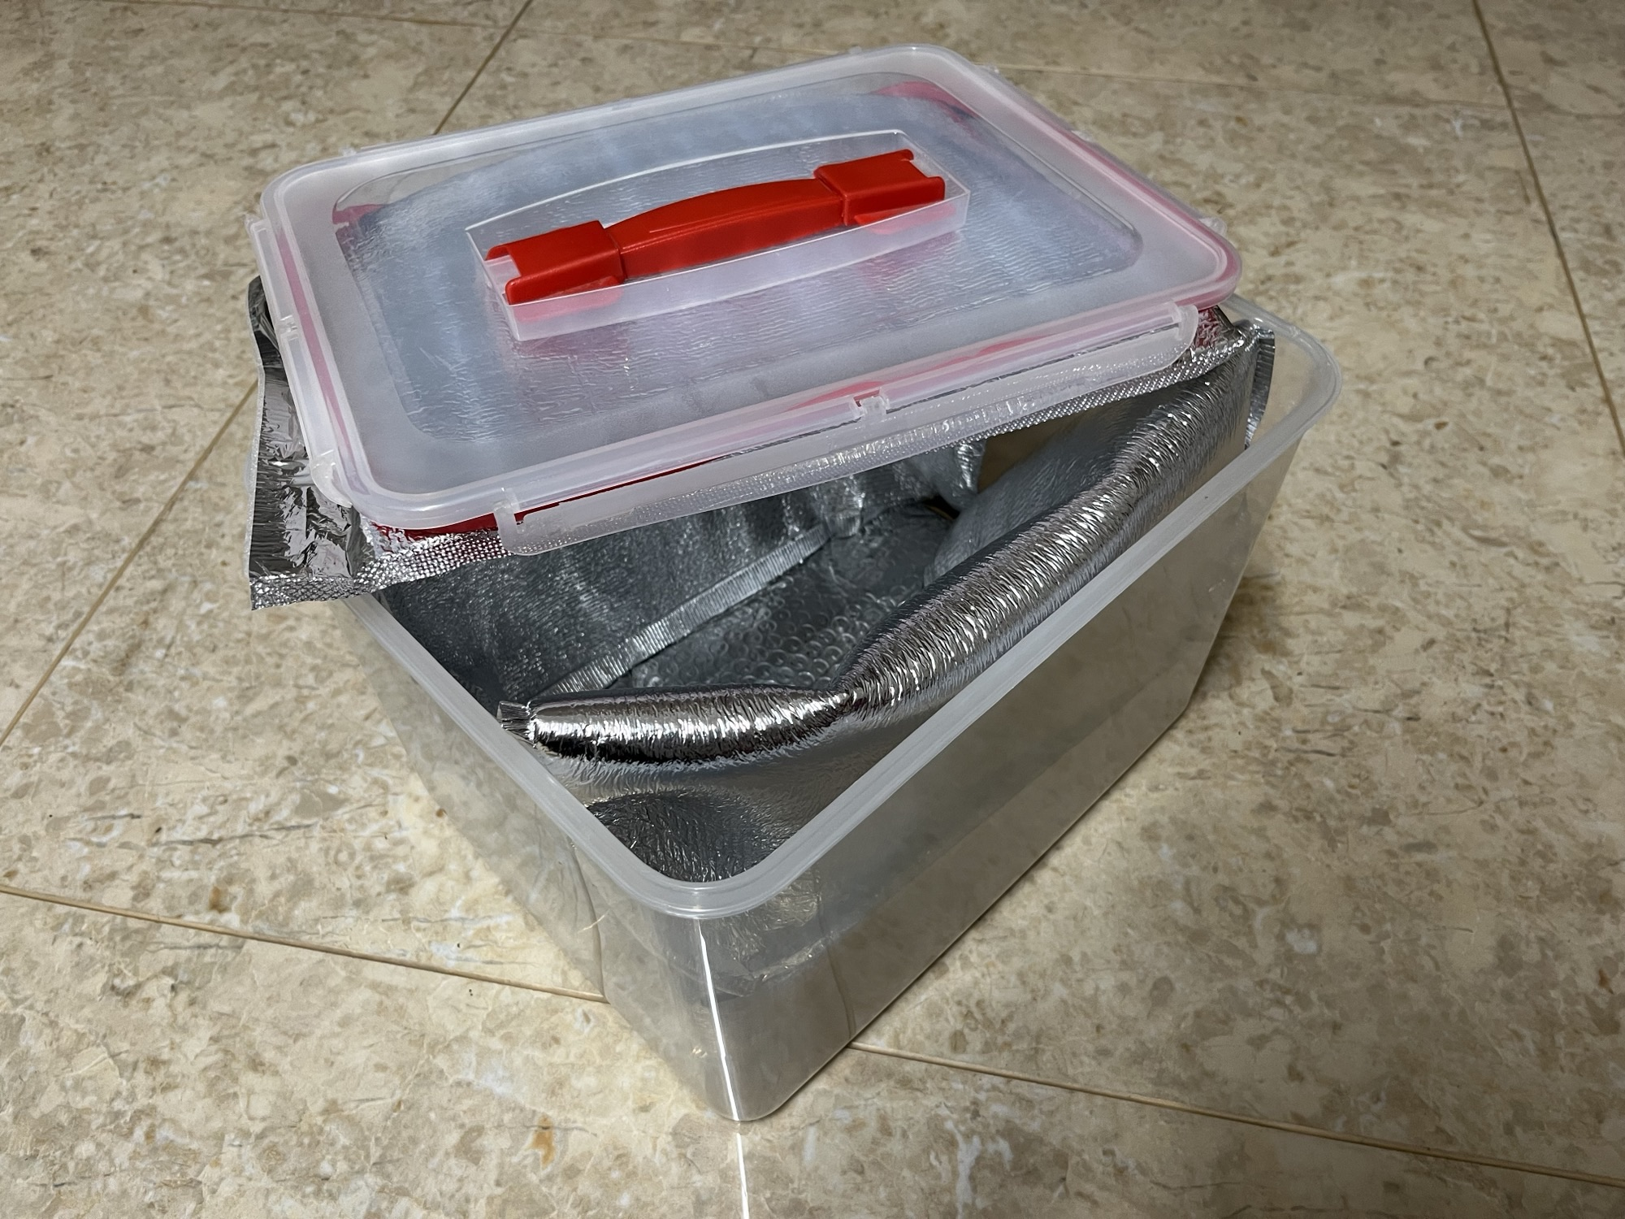

Slide 14
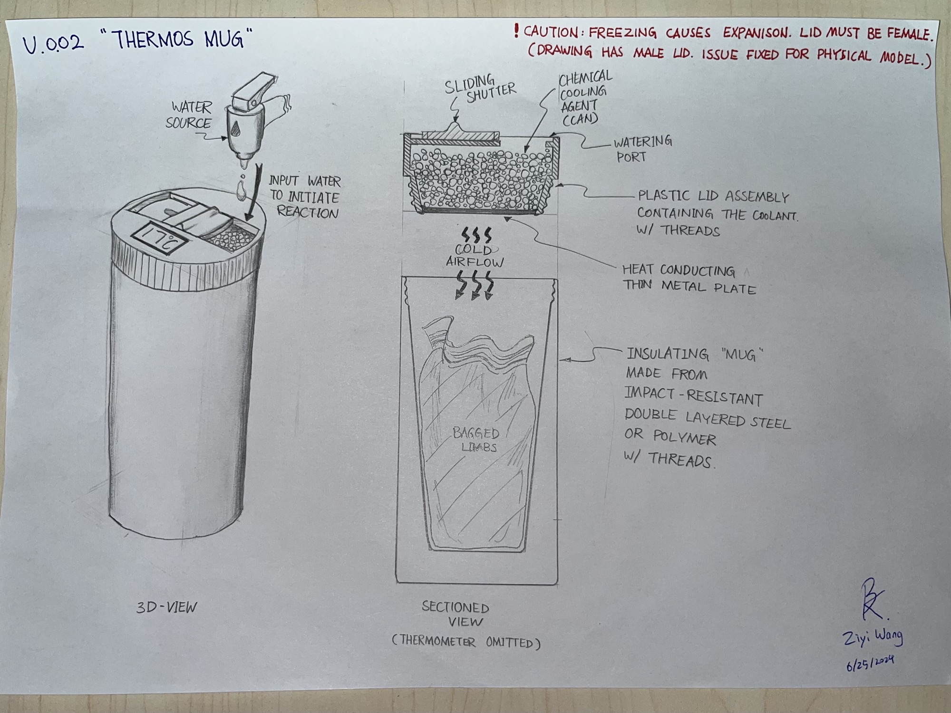

Slide 15
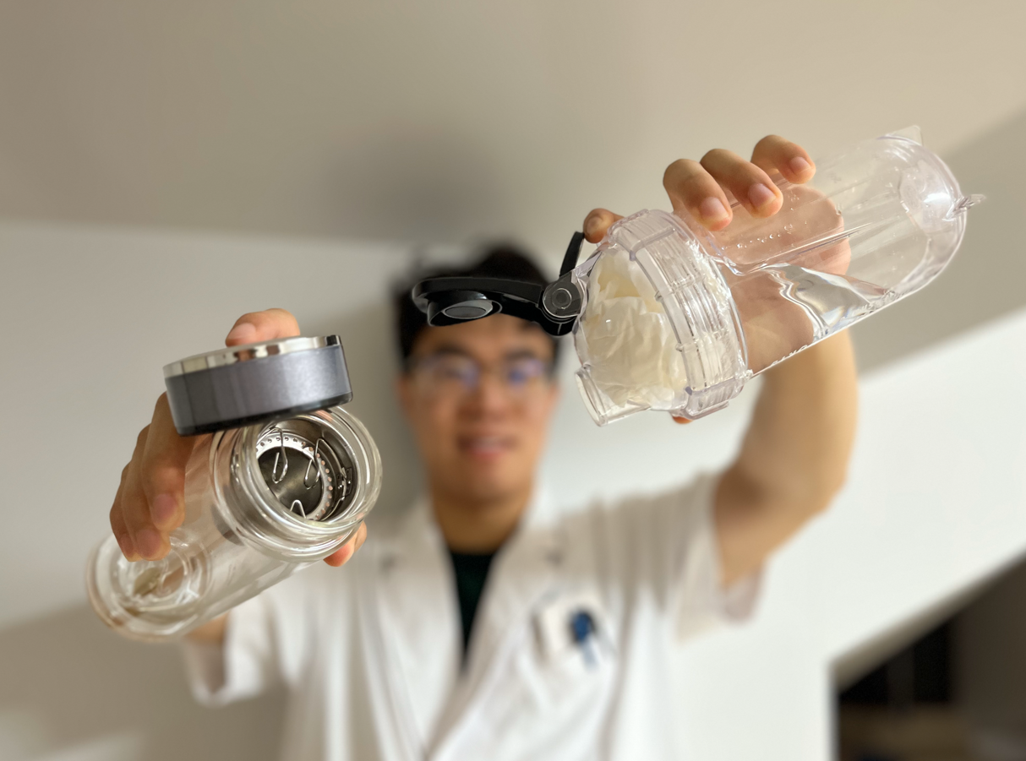

Slide 16
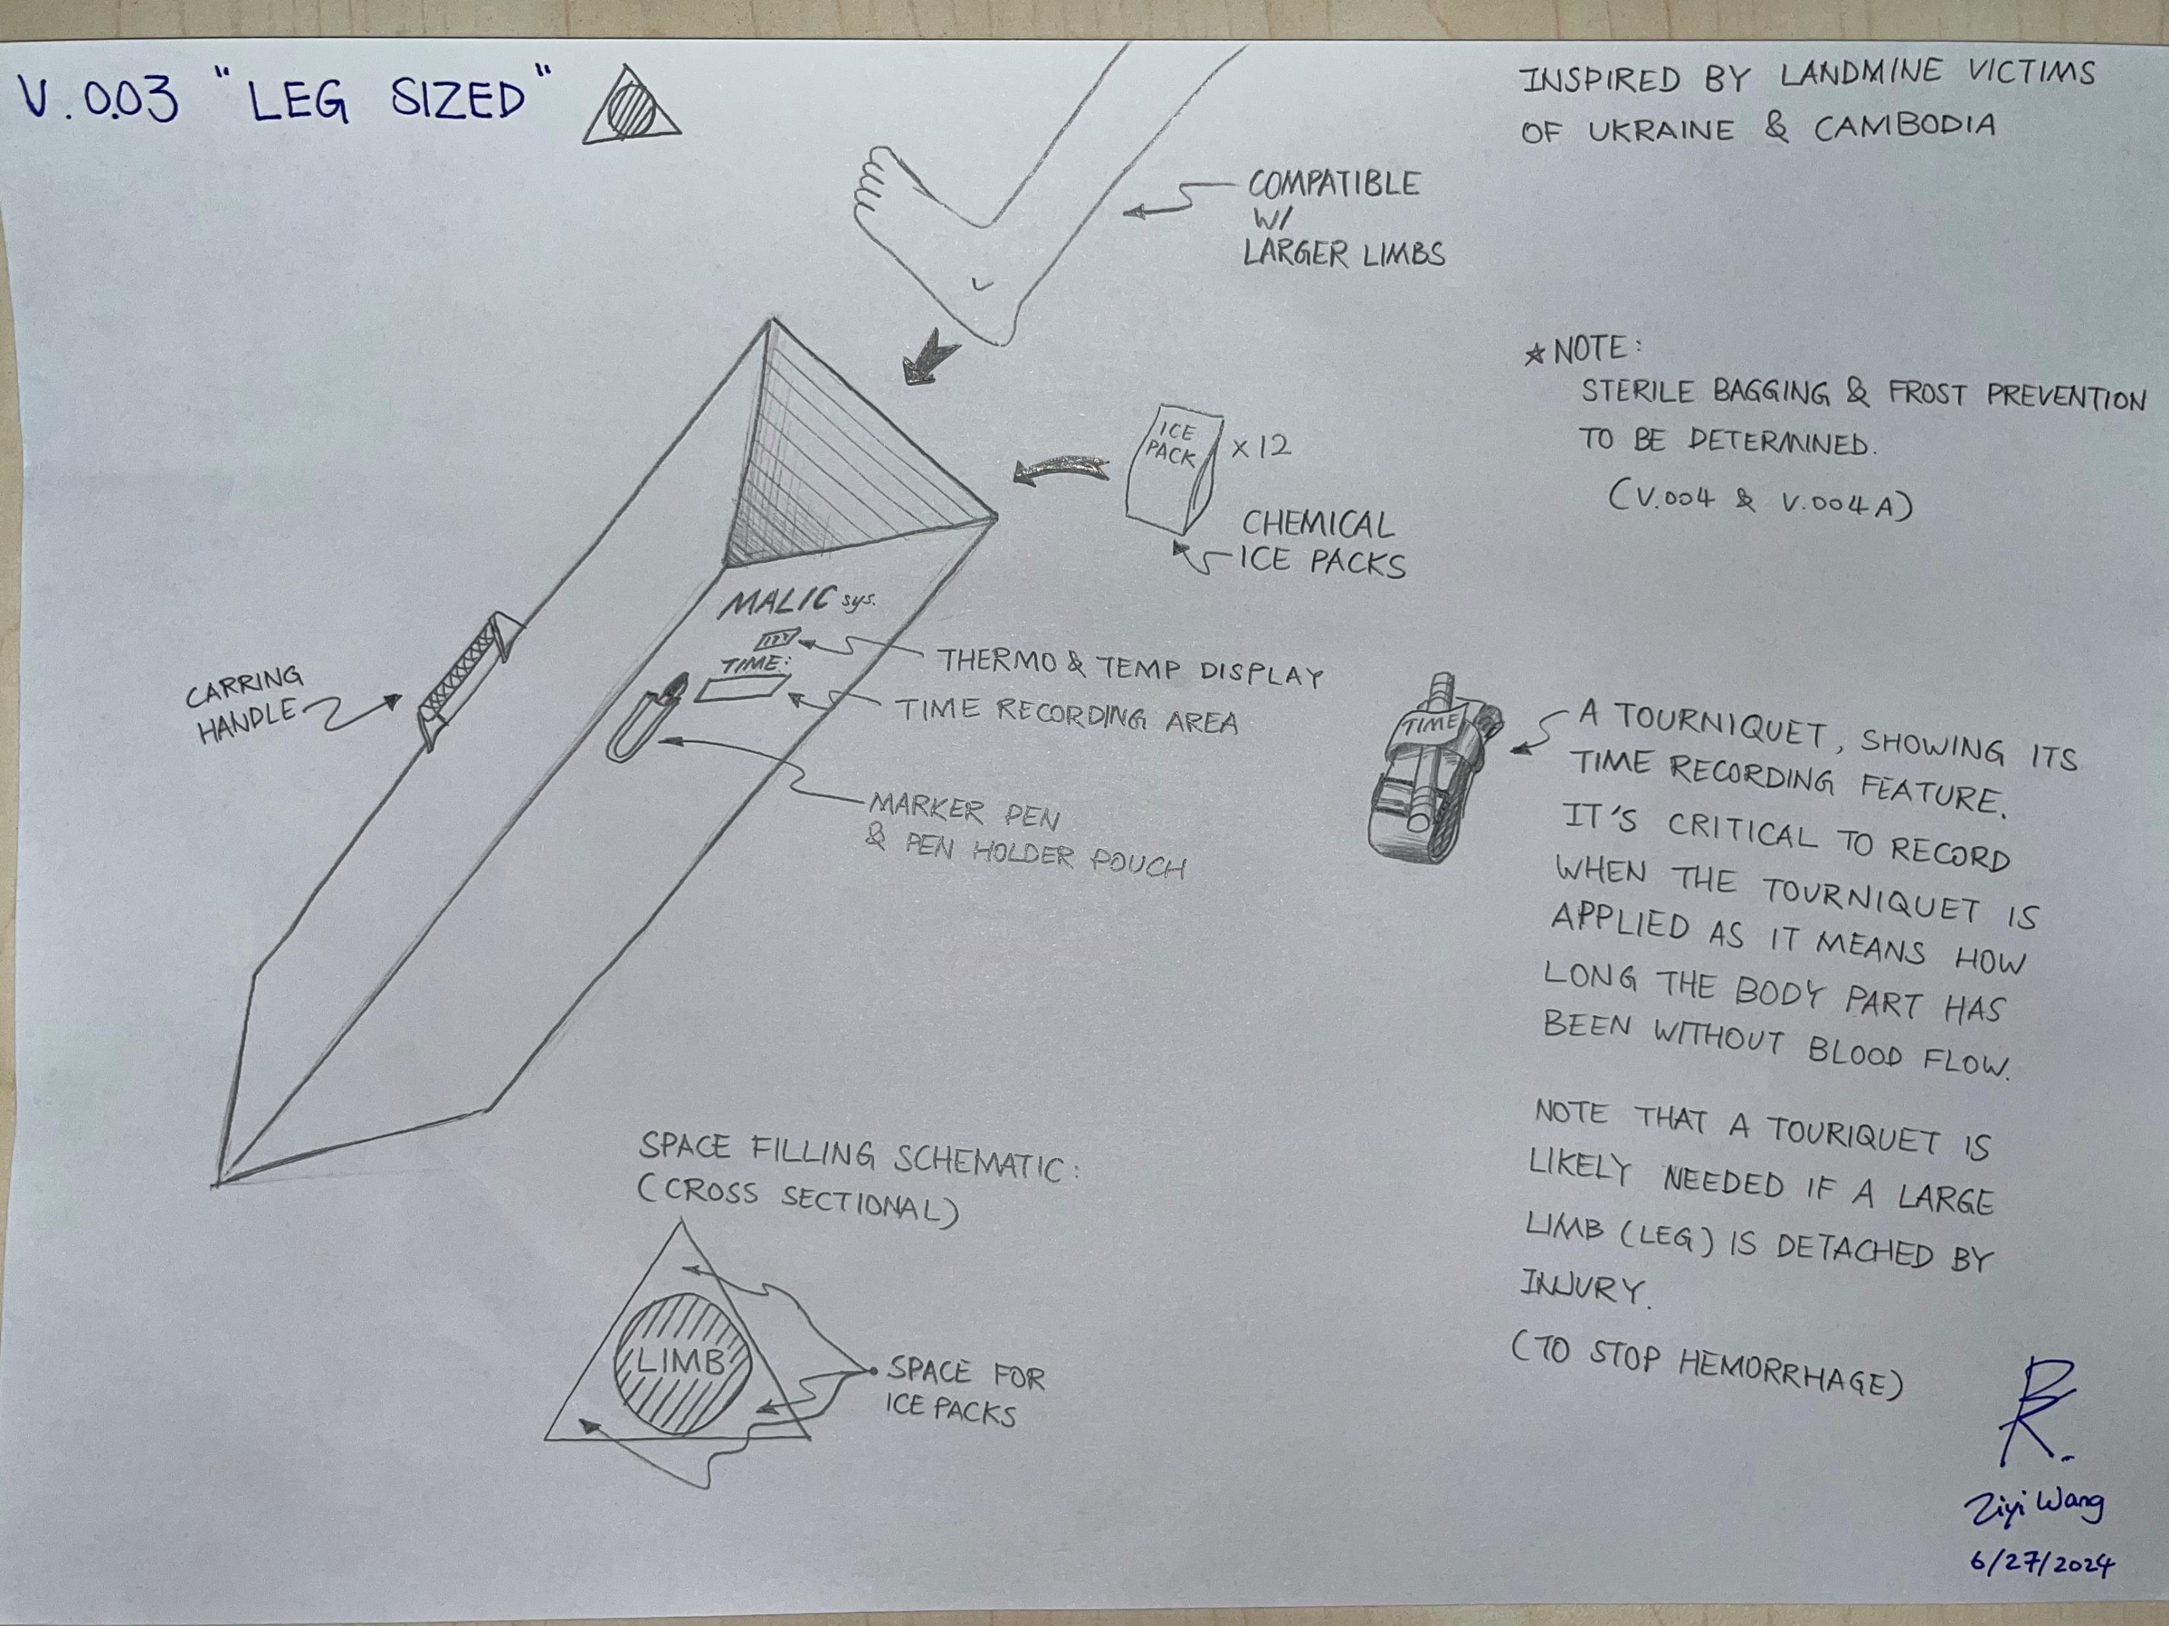

Slide 17
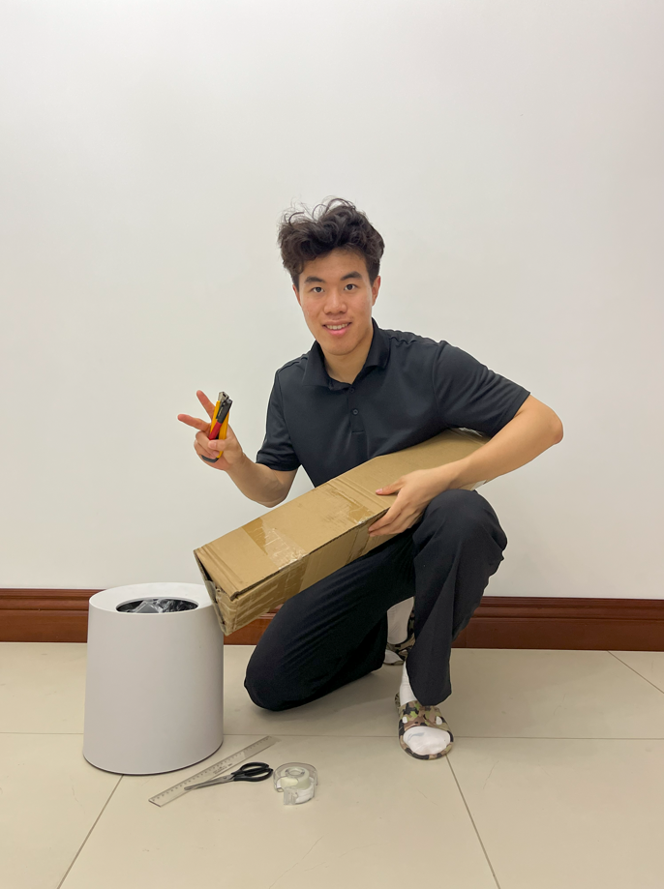

Slide 18
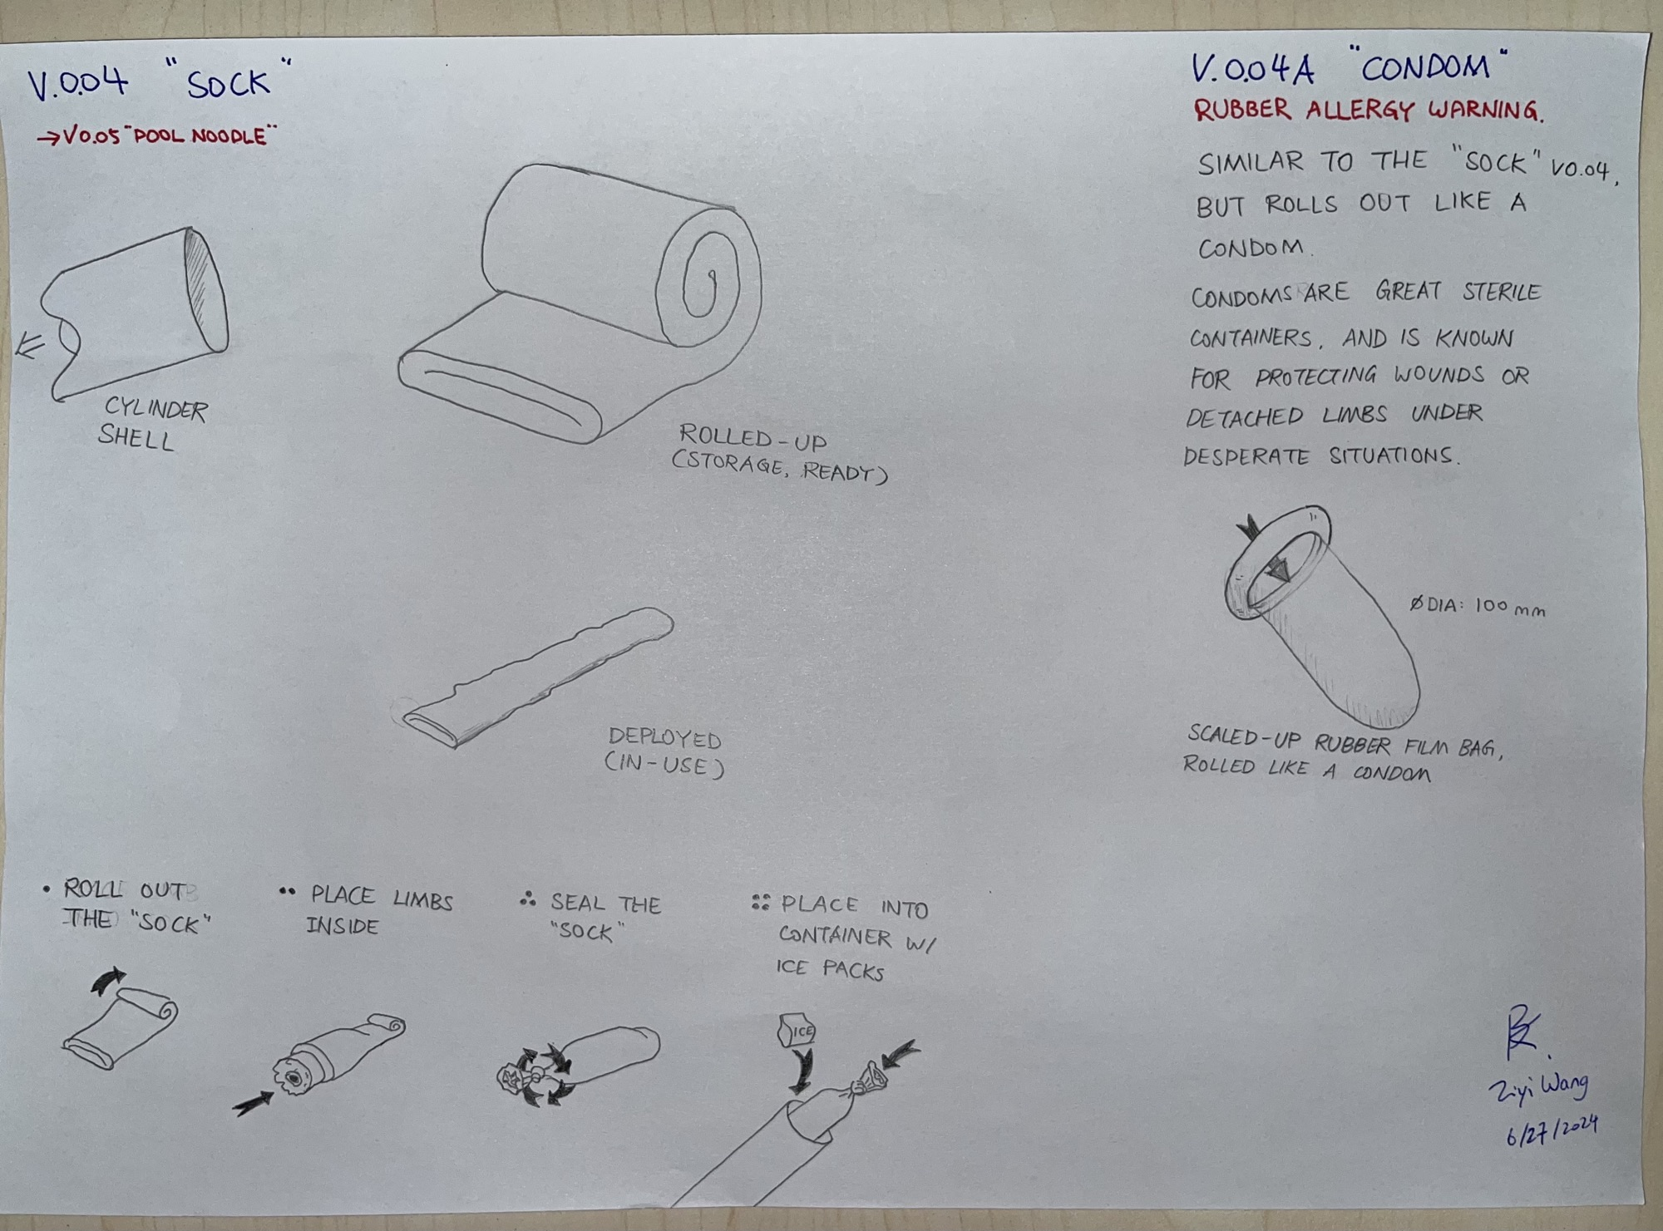

Slide 19
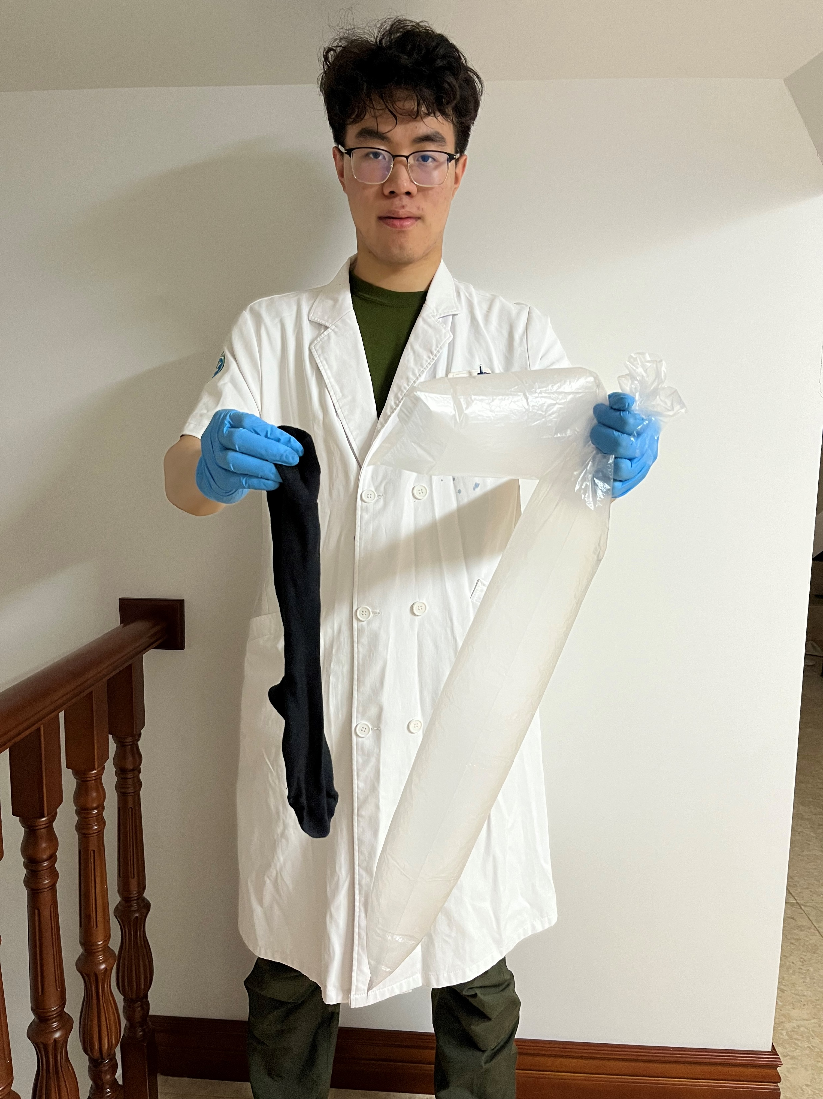

Slide 20
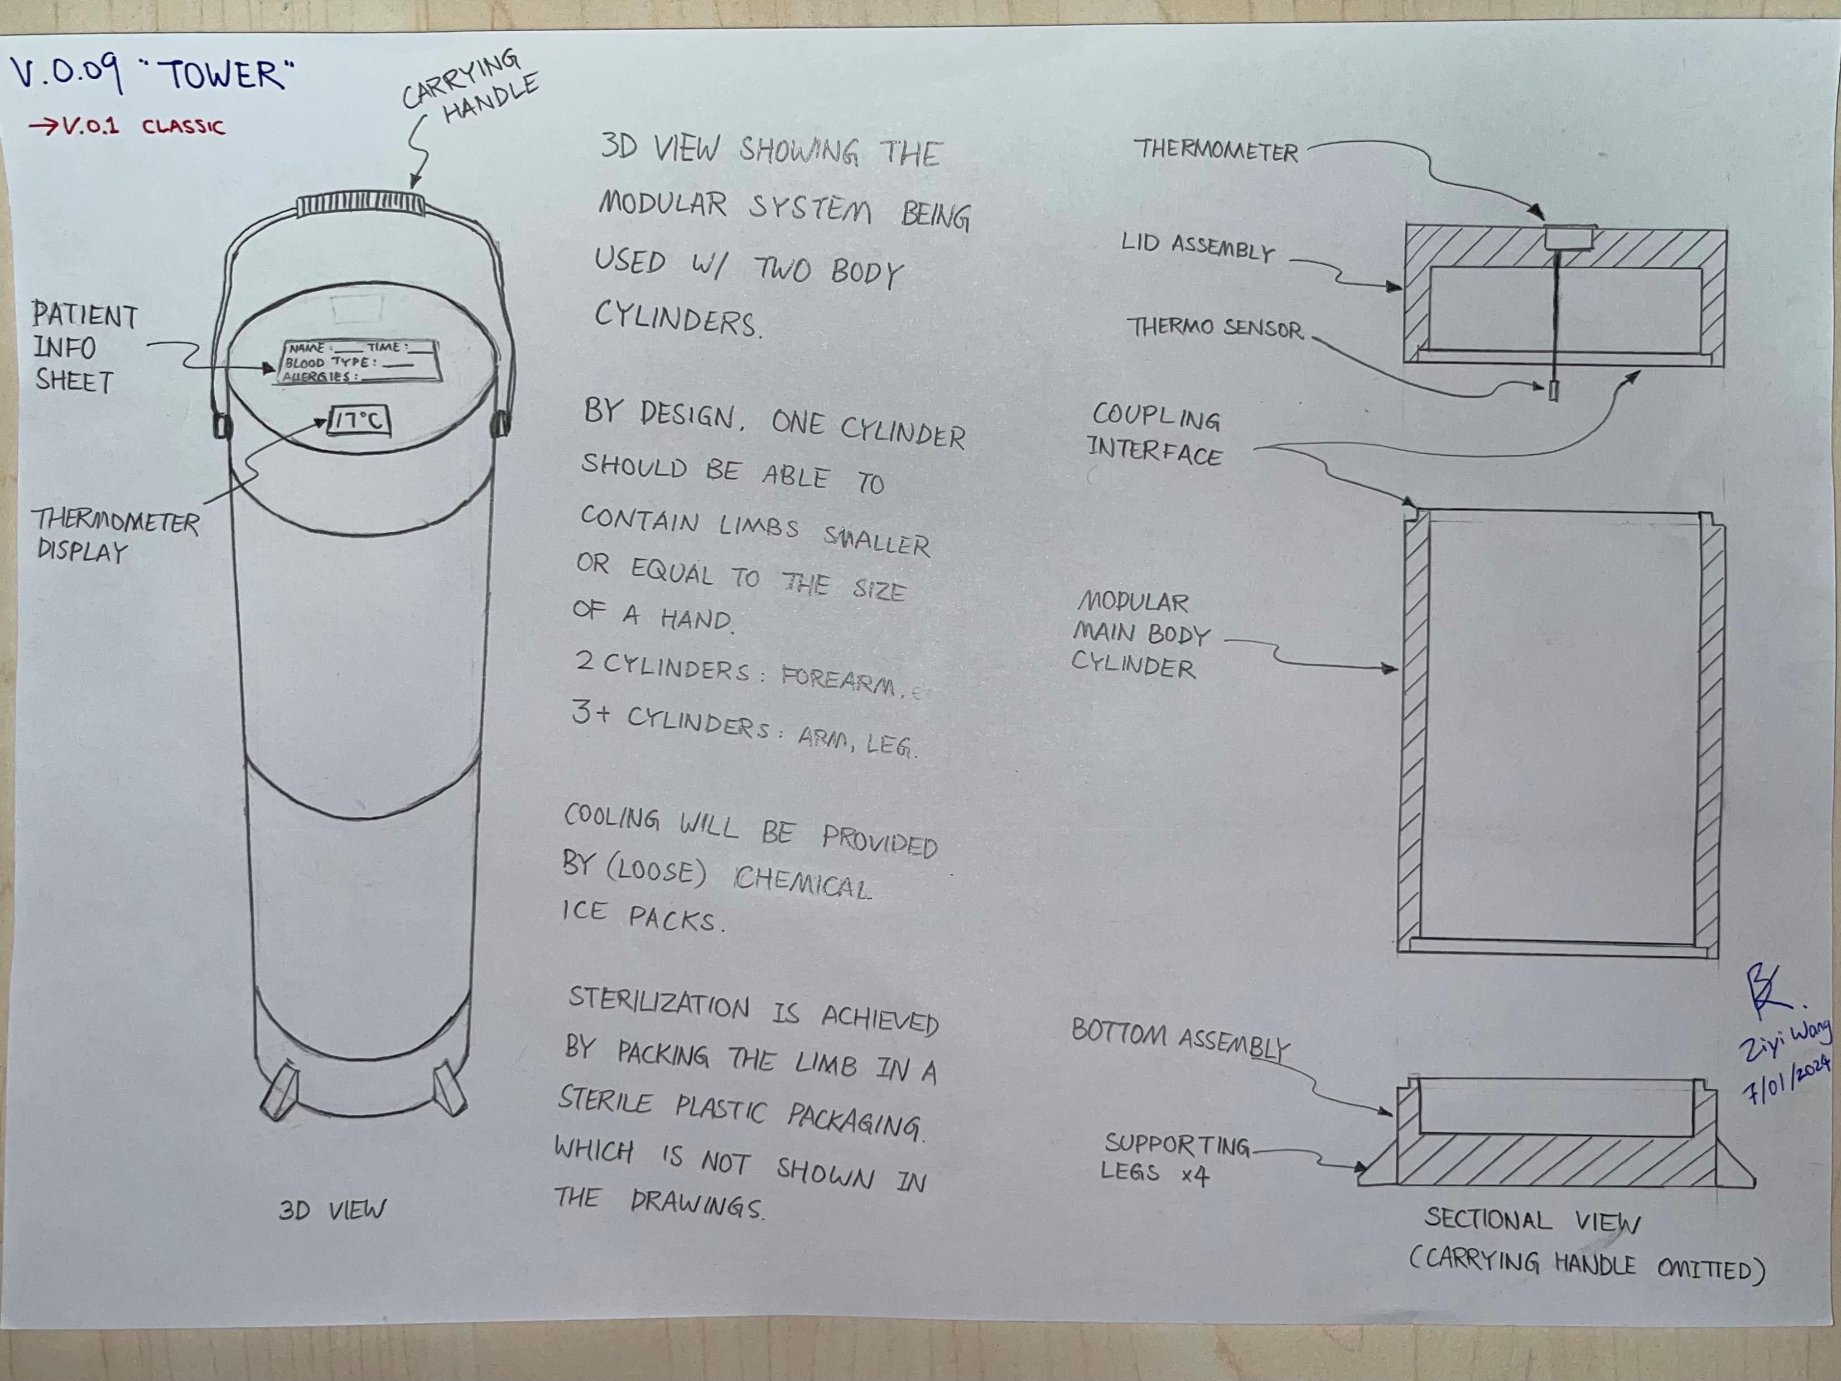

Slide 21
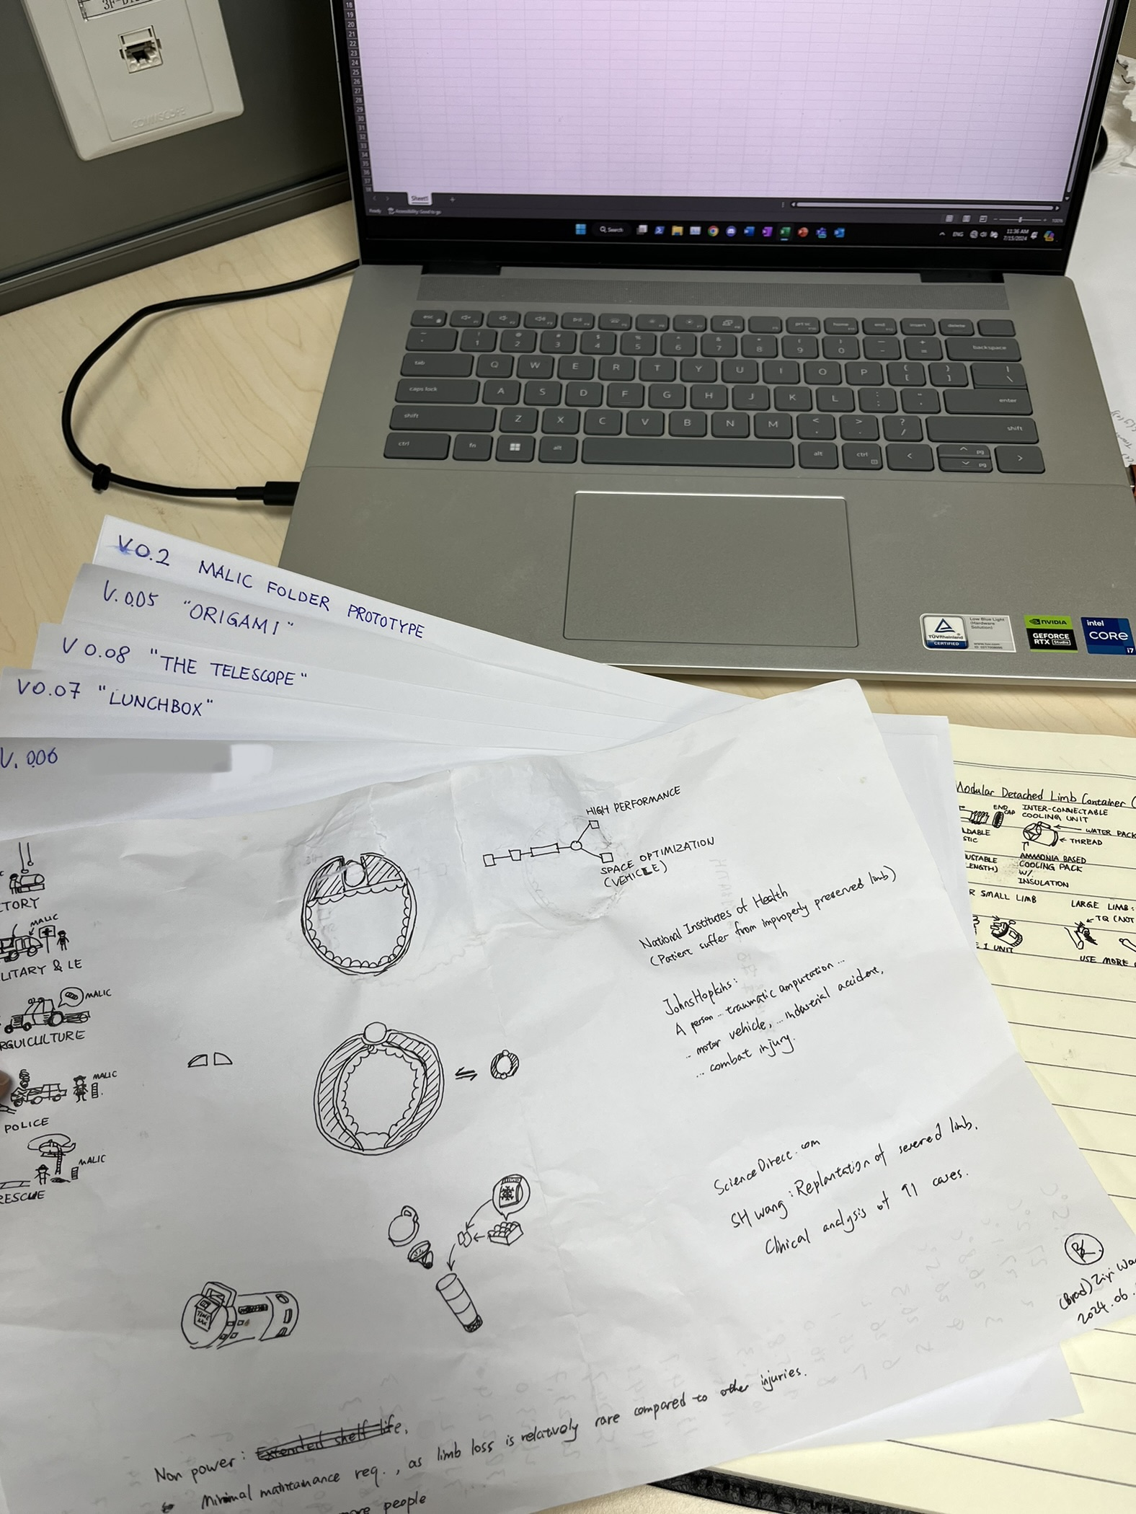
Notes:
There are actually some more sketches and designs that were terminated along the iterating development cycles. They are not shown in the presentation.

Slide 22
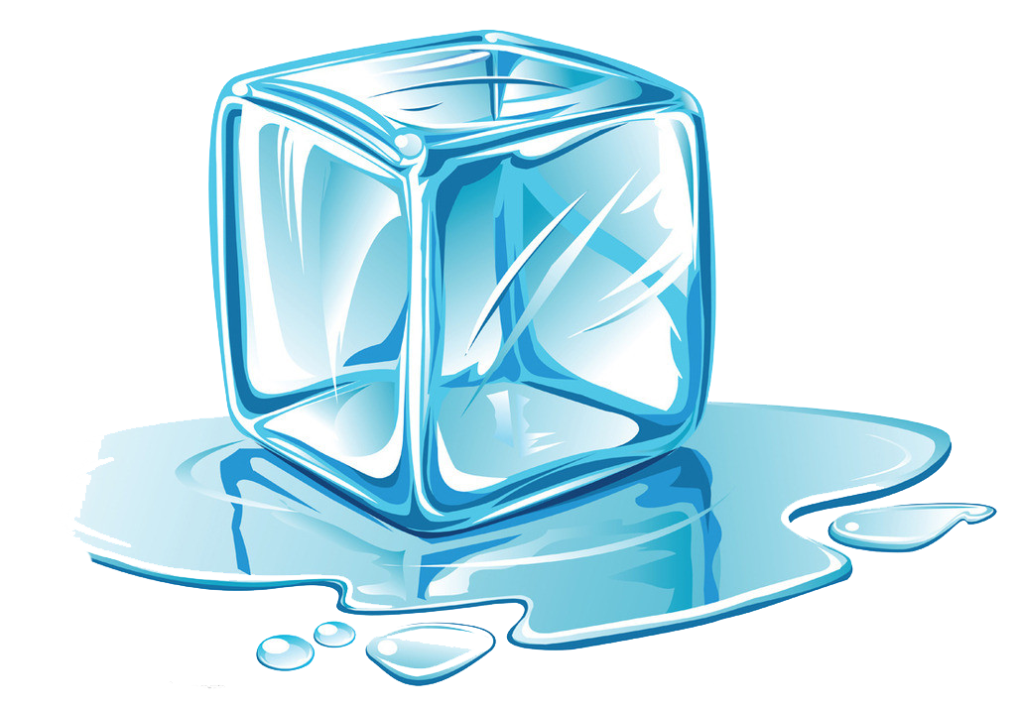
Freeze!
The first functional prototype.

Slide 23
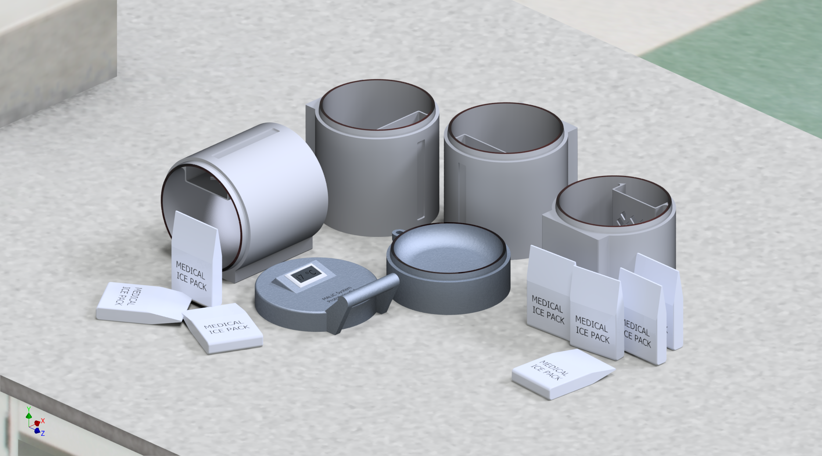

Slide 24
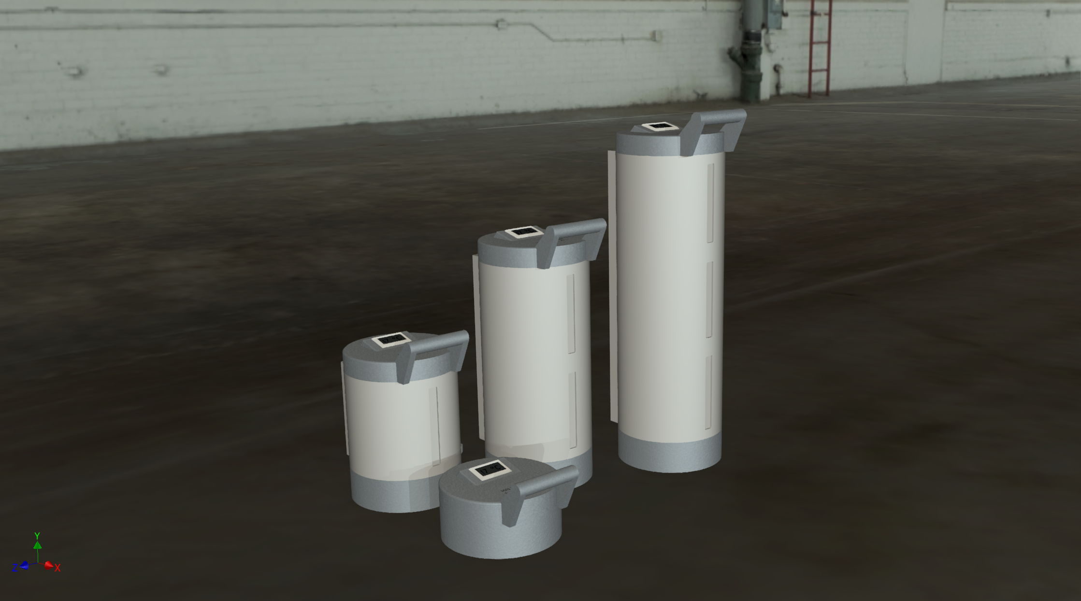
Variable sizes.

Slide 25
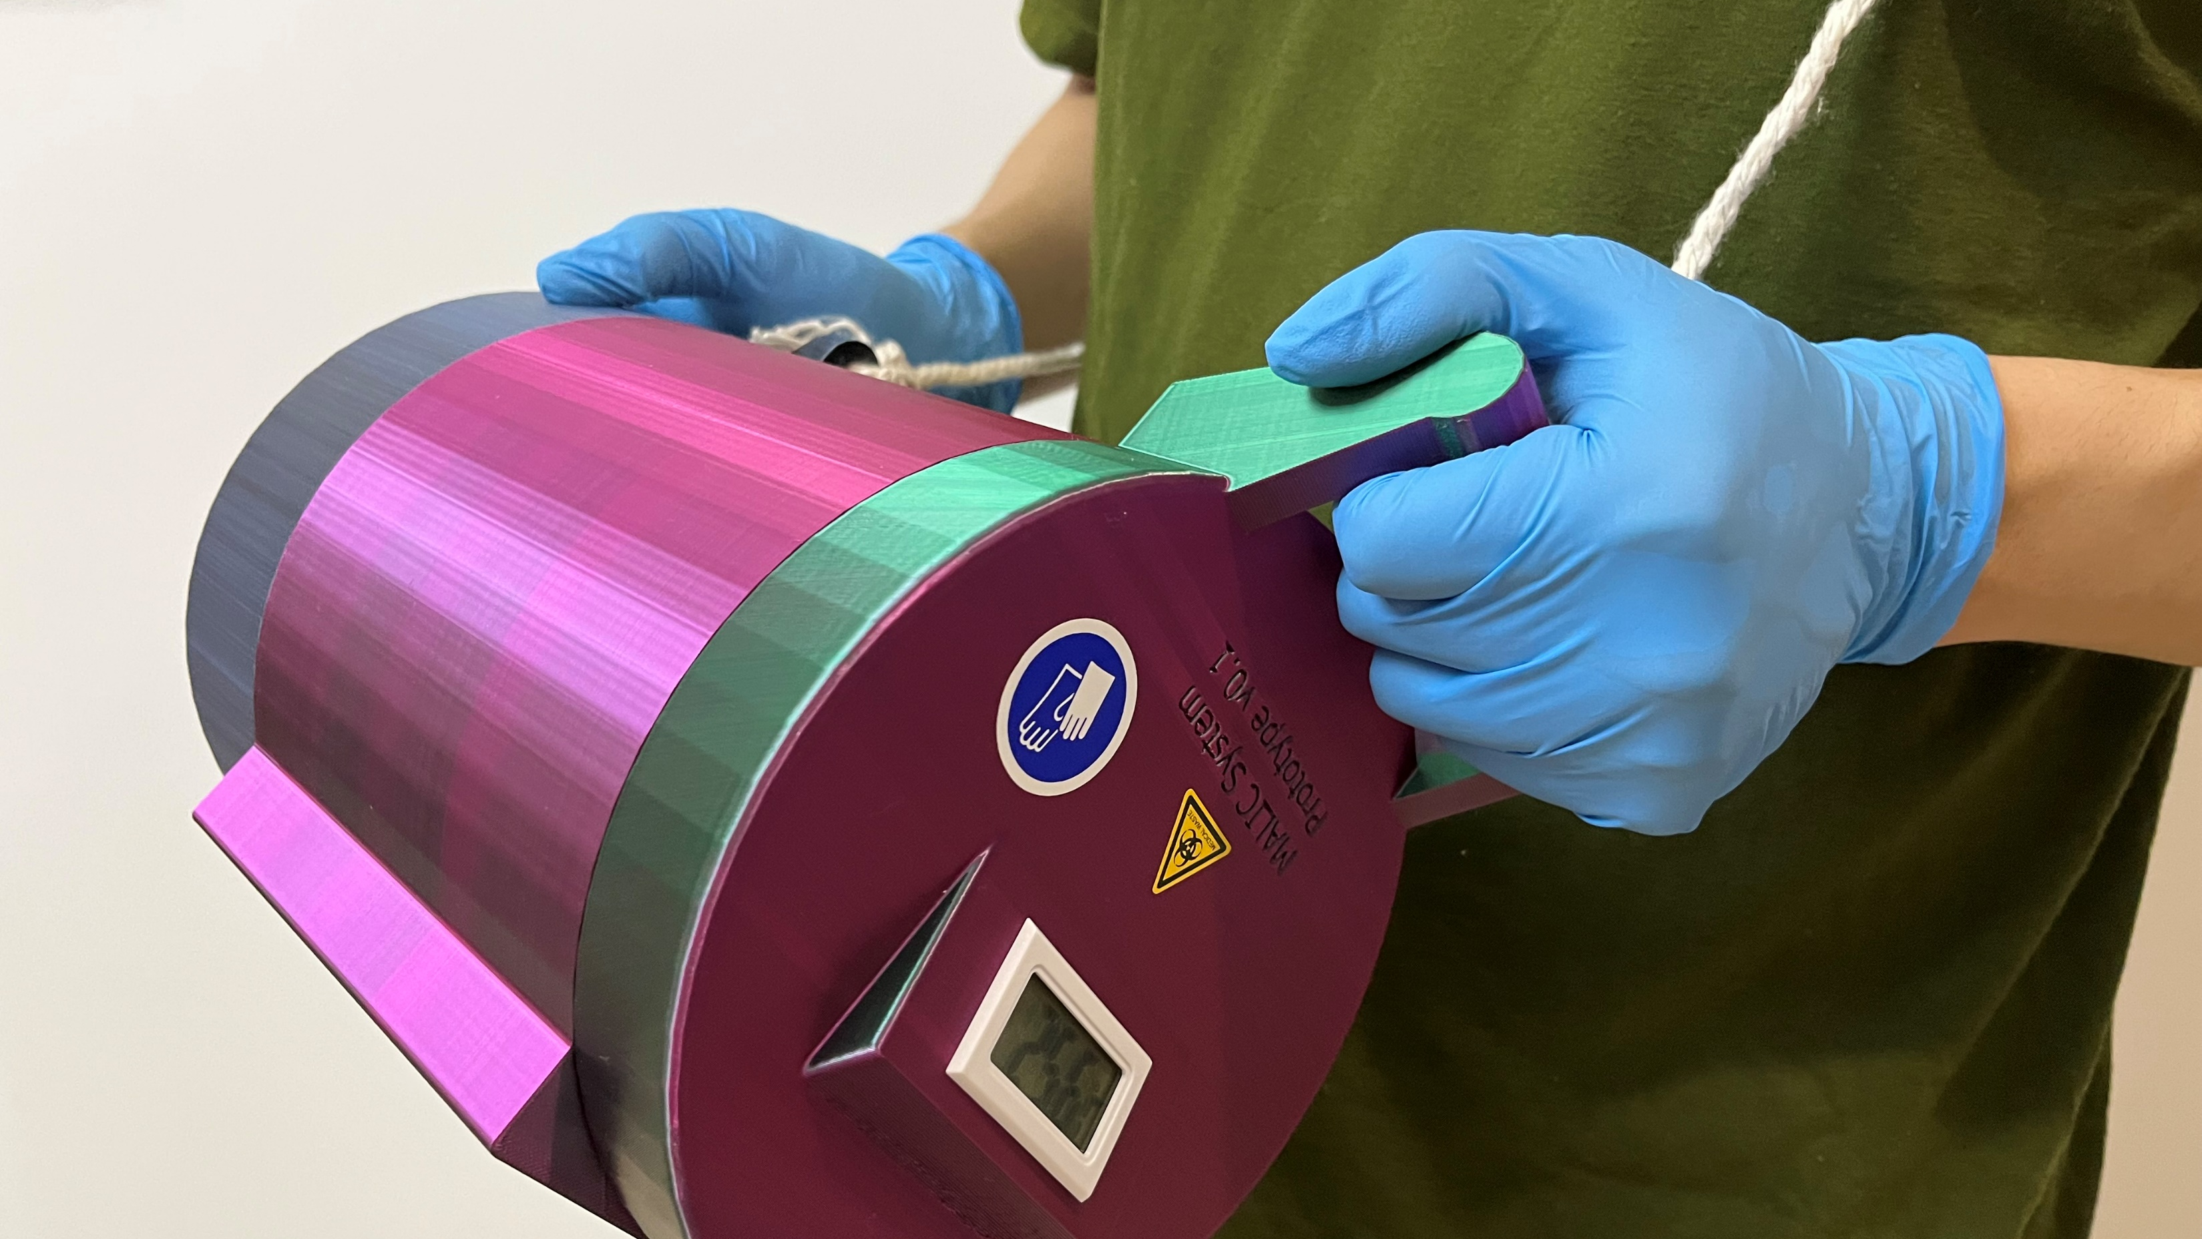

Slide 26
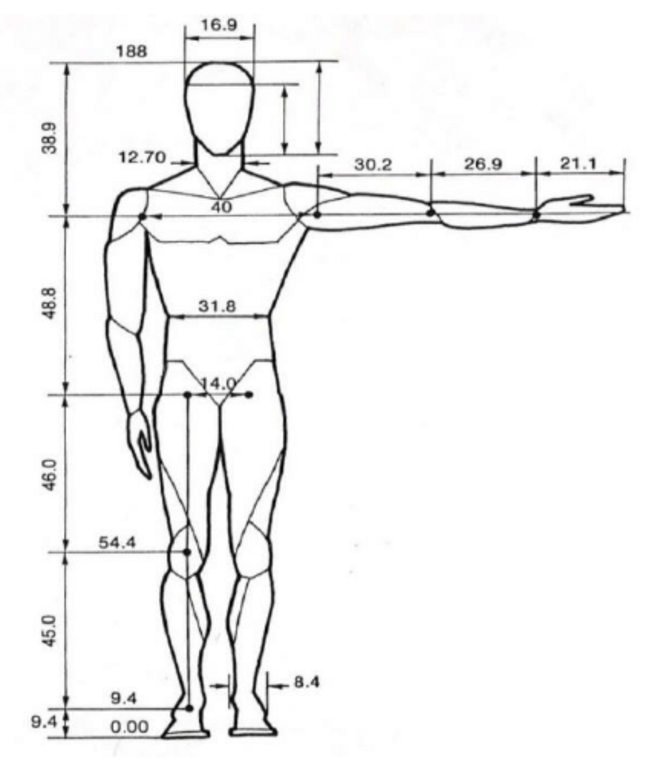
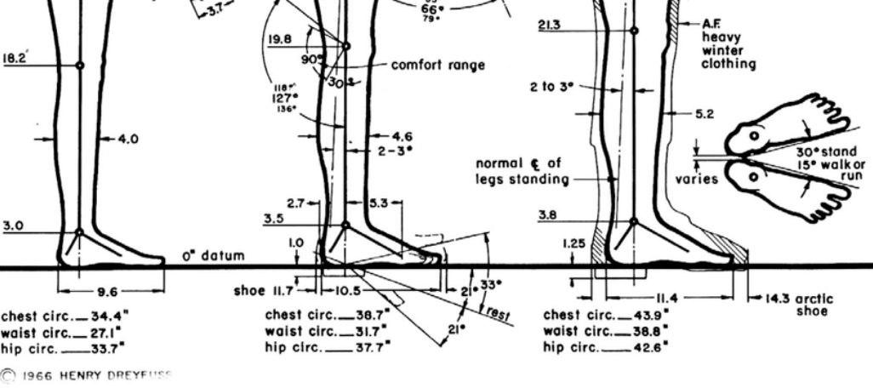
Dimensioned Based On Data [4][5]

Slide 27
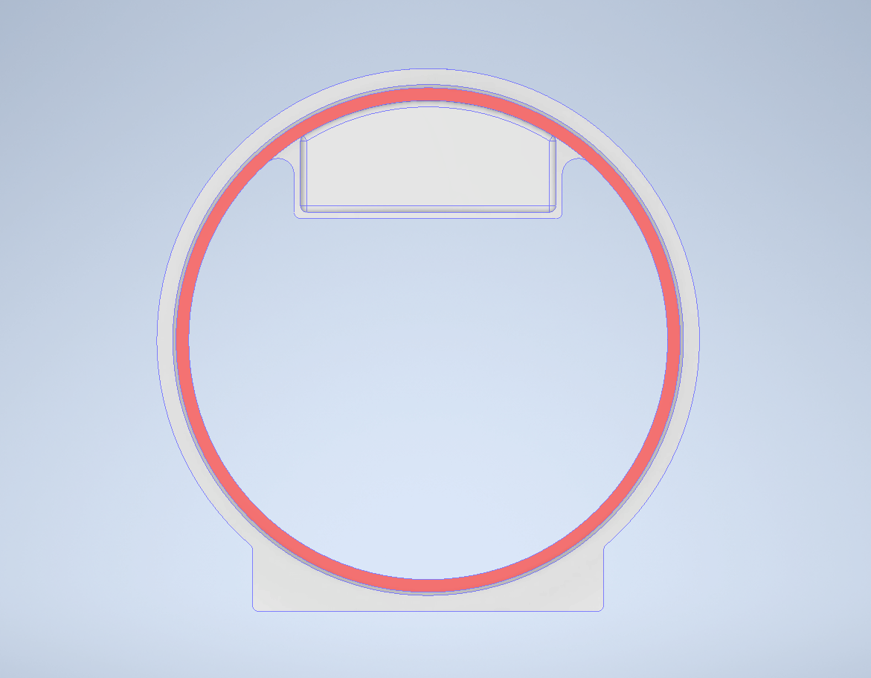
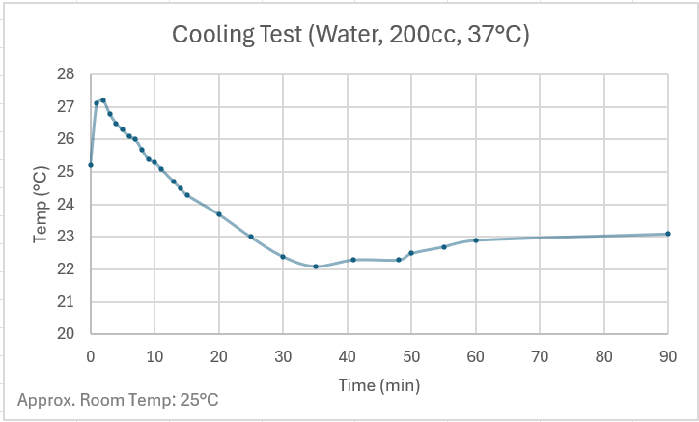

Chemical Icepacks
Circulation feature
Cooled the “limb” for ~15 °C
Ice packs
Flow of cold air
Sectional View of the Body Cylinder
Notes:
To eliminate frost bite hazard, the icepacks are placed inside a solation slot, preventing them from contacting the limb. The slot is located at the top of the cross section, creating circulation flow with the denser cooled air. In the very first test run, the system cooled 200 grams of water from 37 degrees to about 22 degrees, therefore proving the concept.

Slide 28
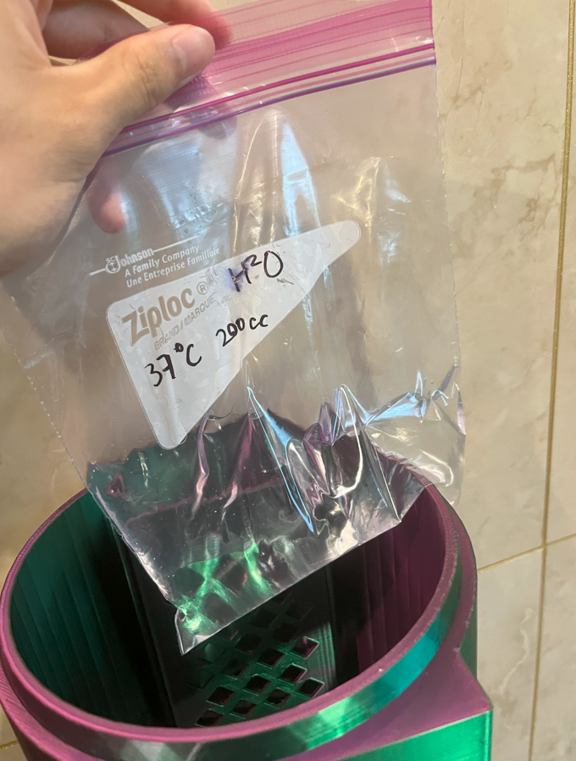
Simulating a limb with 200g of water heated to body temperature

Slide 29
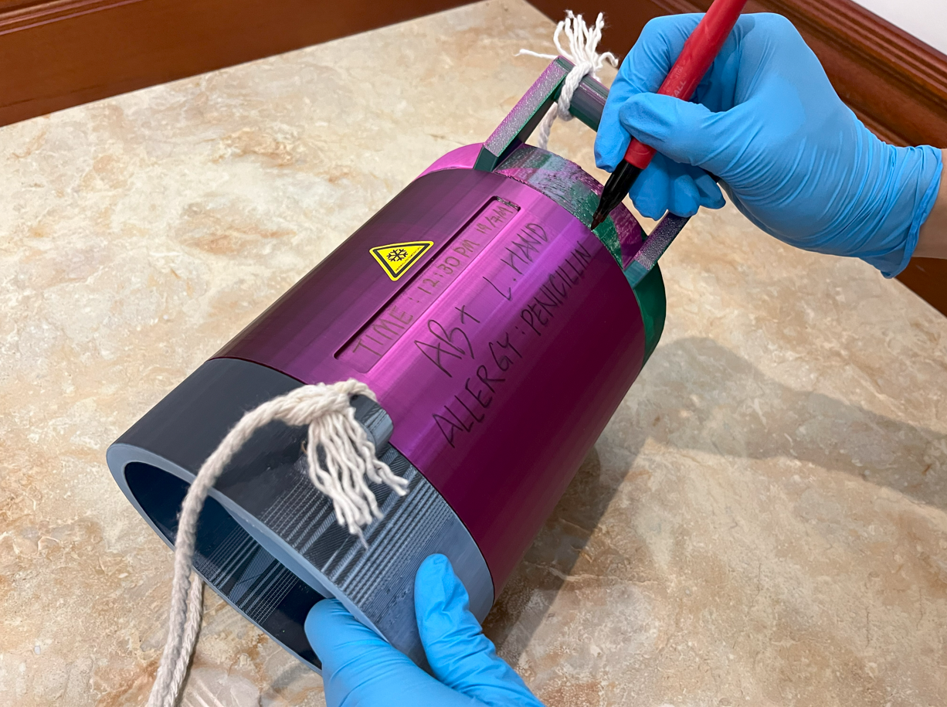
Temperature and Time
“Time” slot inspired by CAT Tourniquets.
Digital thermometer for monitoring.
Notes:
Inspired by CAT tourniquets, the device has a slot to record the time of cooling. It also has a digital thermometer on the lid for monitoring internal temperature, as a safety feature.

Slide 30
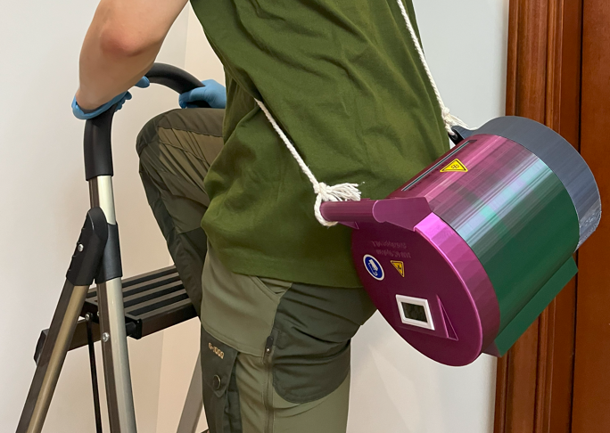
Ready to Sling
Frees the hands of the rescuer.
Notes:
The sling offers operators the precious mobility in complex situations.

Slide 31
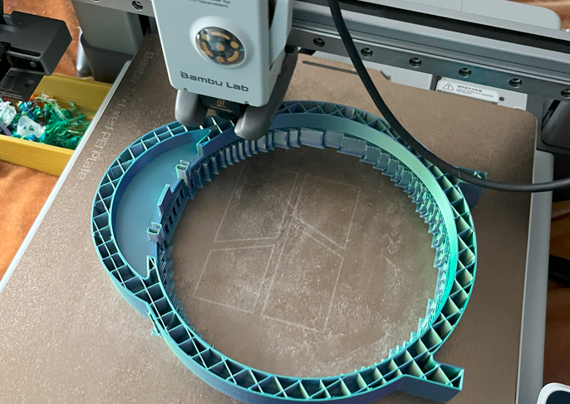
Insulation
3D printed insulating structure.
Bio-degradable polymer.
Notes:
3D printing allows for insulating structure withing the hollowed-out walls.

Slide 32
Feedbacks from trials
“The lid and the bottom are difficult to print vertically as they require too much support structure. We had to print them sideways.”
(3D printing technician, Shang D.)
“The time recording slot is a good idea, but the writings are easily smeared. Also, a locking feature is necessary for the assembly.” (Orthopedic surgeon, Dr. YeHua W.)
“The handle is rough and requires much force to open”
(Engineering student from McMaster, Shawn Z.)

Slide 33

One Step Further
The latest prototype.

Slide 35
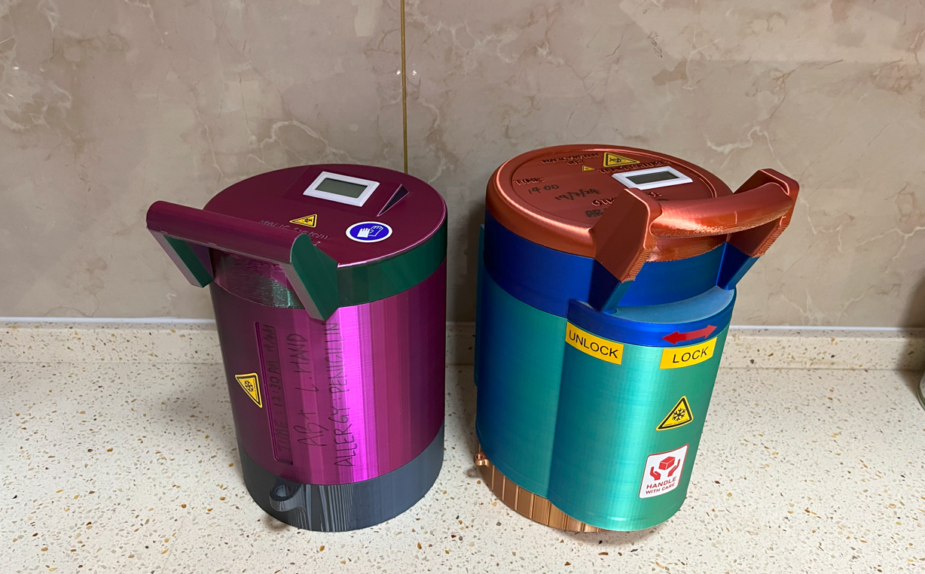
Potential pitfalls addressed in the new design.
Previous Prototype
Latest Prototype

Slide 36
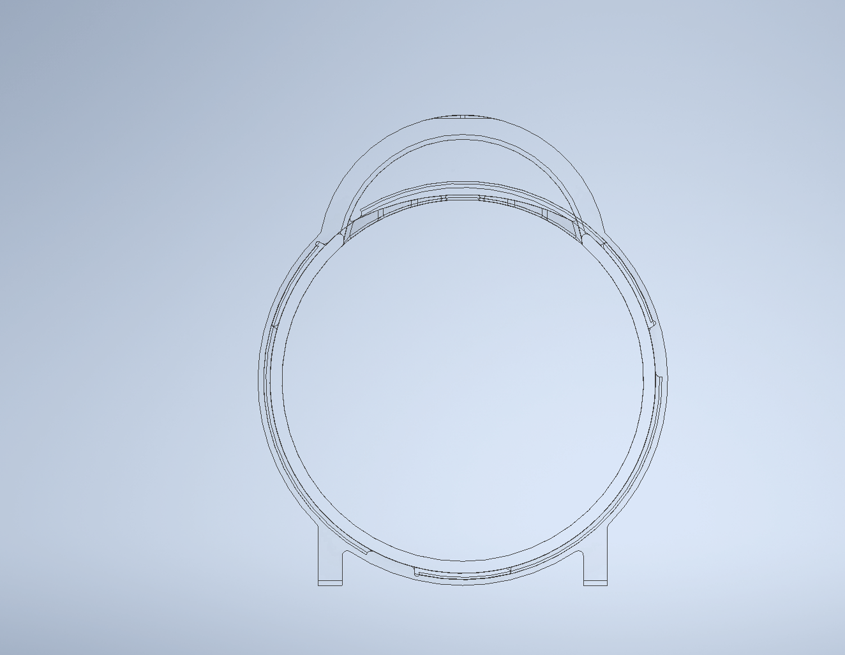
New Features
Increased capacity compared to the previous prototype.

Slide 37
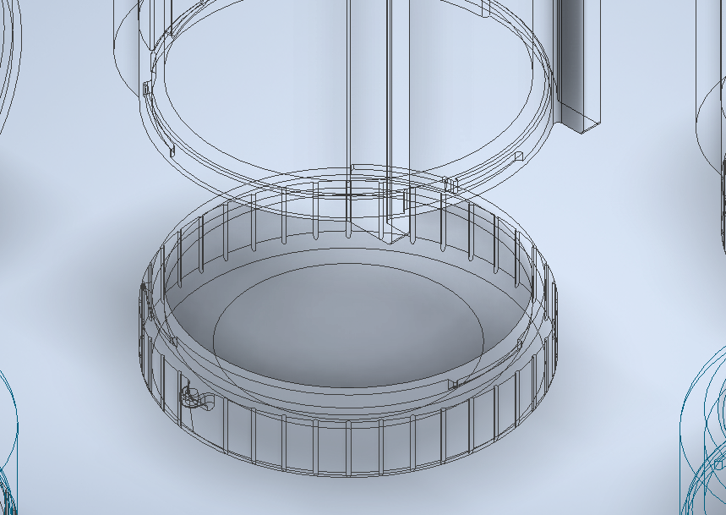
New Features
Interlocking system secures the parts.

Slide 38
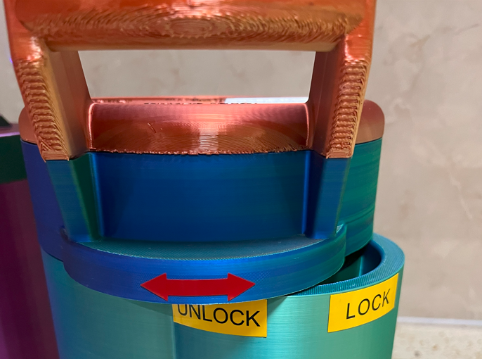

Slide 39

New Features
Icepack insertion is made easier with flared isolation slots.
Notes:
The icepack insertion is made easier with flared isolation slots.

Slide 40
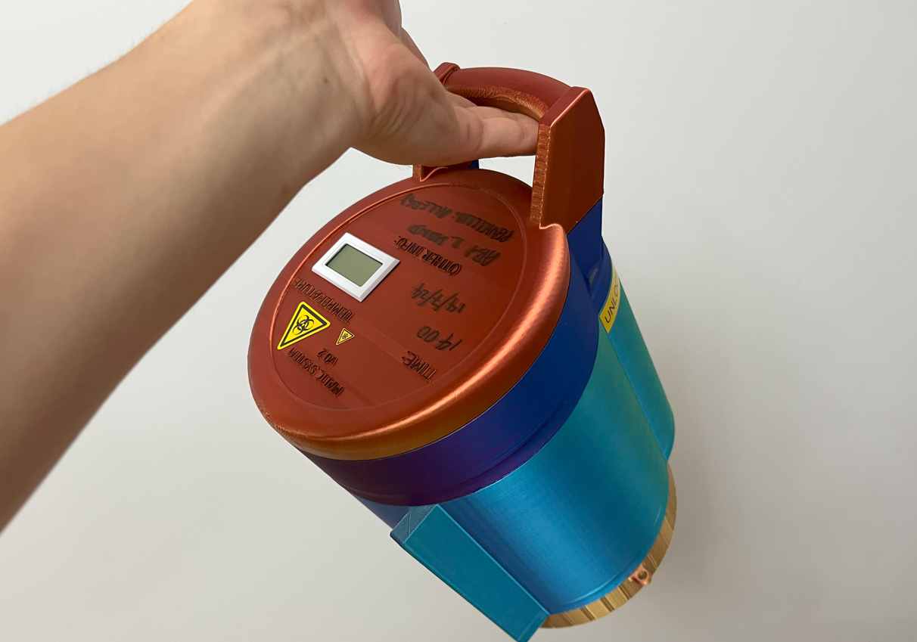
New Features
Enhanced ergonomics.
Curved handle.
Anti-slip grooves.
Notes:
Ergonomics is enhanced comparing to the previous design, featuring curved handle and anti-slip grooves.

Slide 41
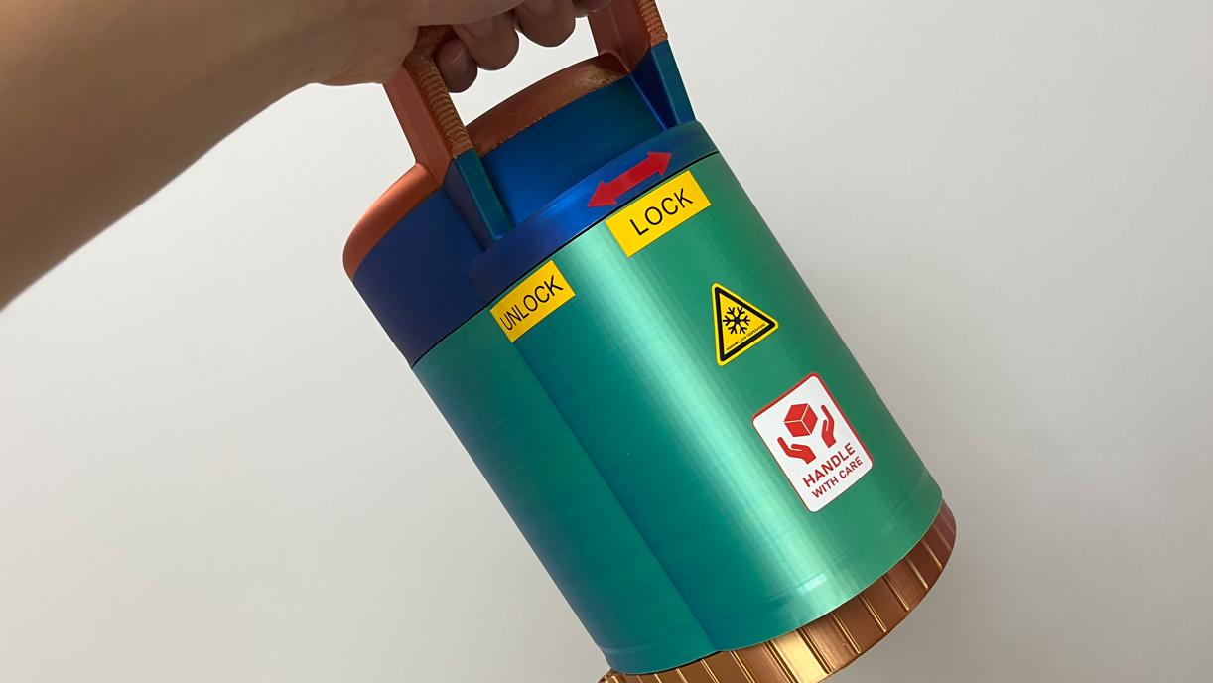

Slide 42
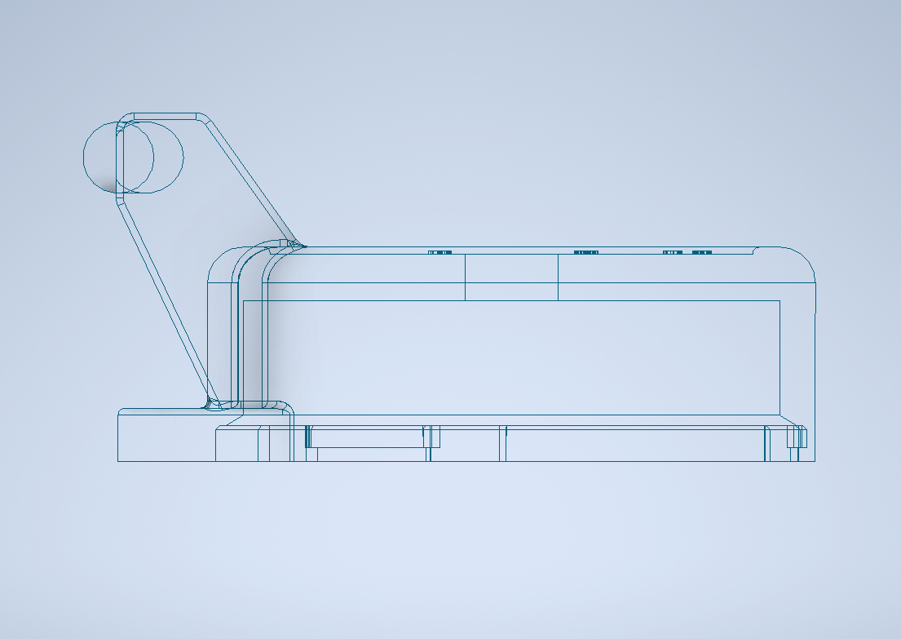
New Features
Anti-scratch geometry
(Top of the lid).
Protecting the thermometer and any writings from being scratched.
Notes:
The top of the lid is lower than the rim by 1 mm, protecting the thermometer and any writings from being scratched.

Slide 43
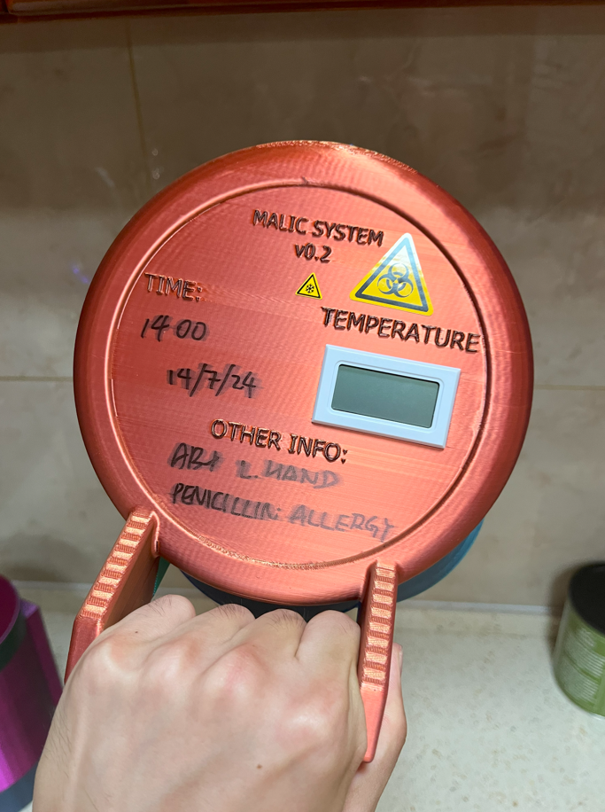

Slide 44
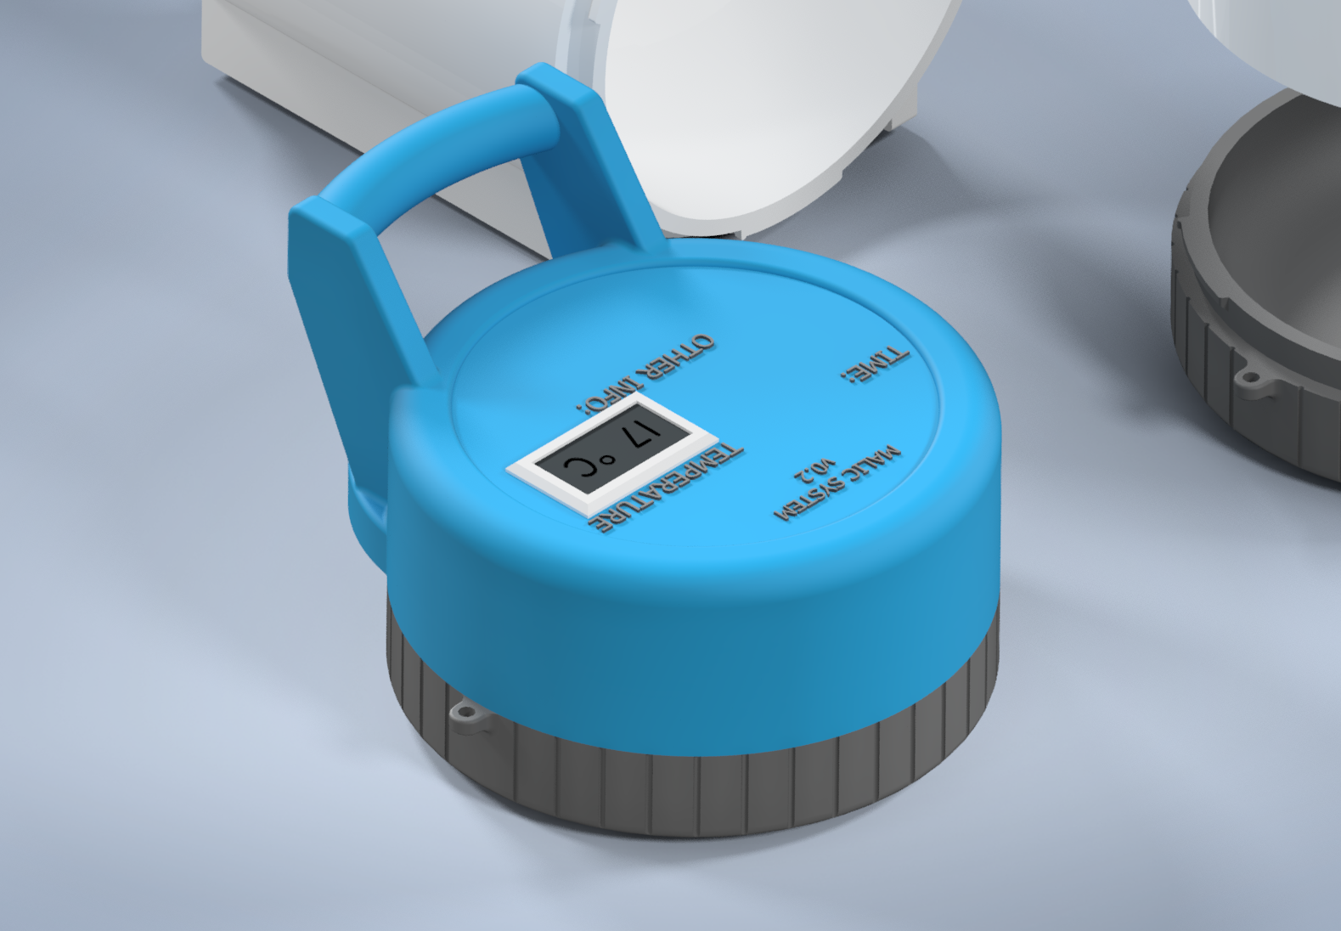
New Features
The smallest functional unit without the body cylinder.
Making the modular system even more adaptive.
Notes:
Limb injuries involving smaller limbs like fingers are more common, and this new feature enables the user to put together the smallest functional unit without the body cylinder, making the modular system even more adaptive.

Slide 45
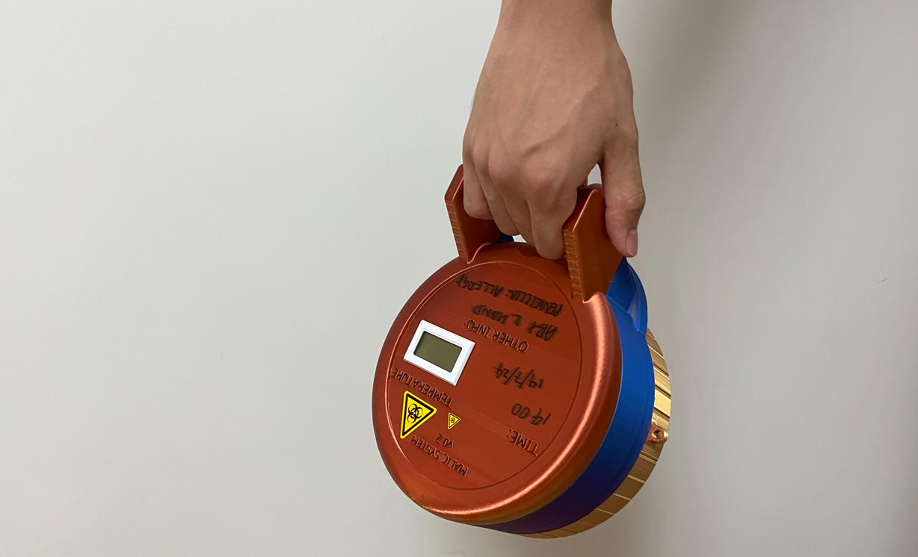

Slide 46
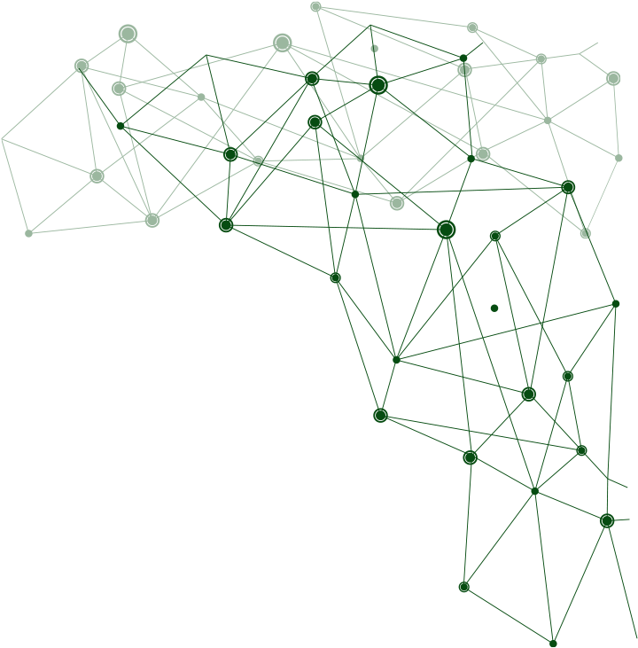
The Future
Unlimited applications.

Slide 47
Iterative Development Techtree
Fast paced iterations just like the Dyson designers.
Initial Sketches
Design V0.01
Boxie
Design V0.09 Tower
Prototype V0.1
Design V0.07
Lunchbox
Final Prototype V0.2 (July 2024)
Design V0.02
Thermos Mug
Design V0.03
Leg Sized
Design V0.04
Sock
Design V0.05
Origami
Design V0.08
Telescope
Design V0.06
MALIC FLEX
Modular device
Telescopic
Box line
3D-Printed Prototypes
Cross-over
Cylinder line
Enhancing reliability
Larger device
Too big
Foldable
Size issue
Cross-over
Ongoing development
Tubular device

Slide 48
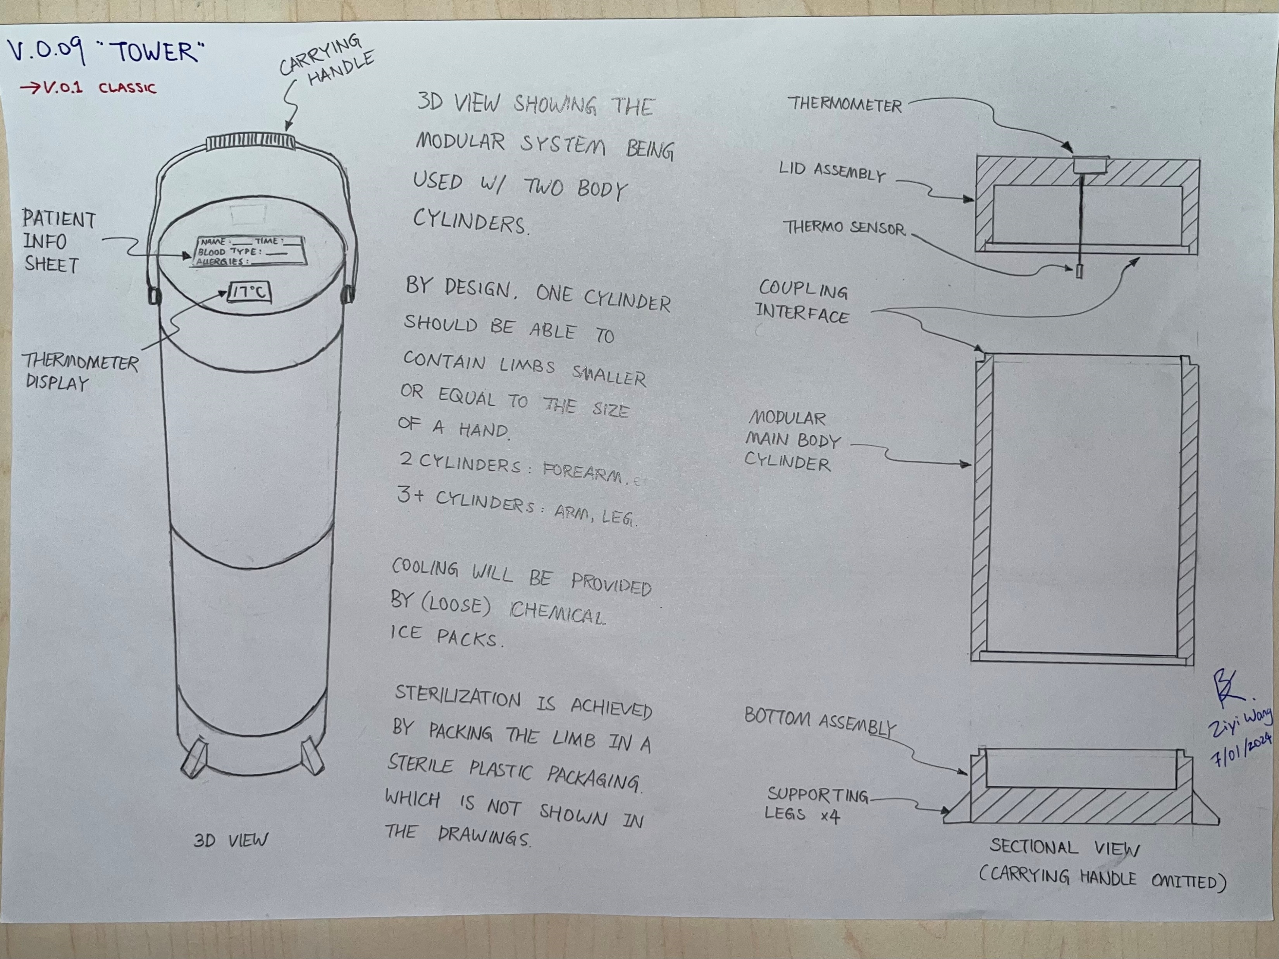
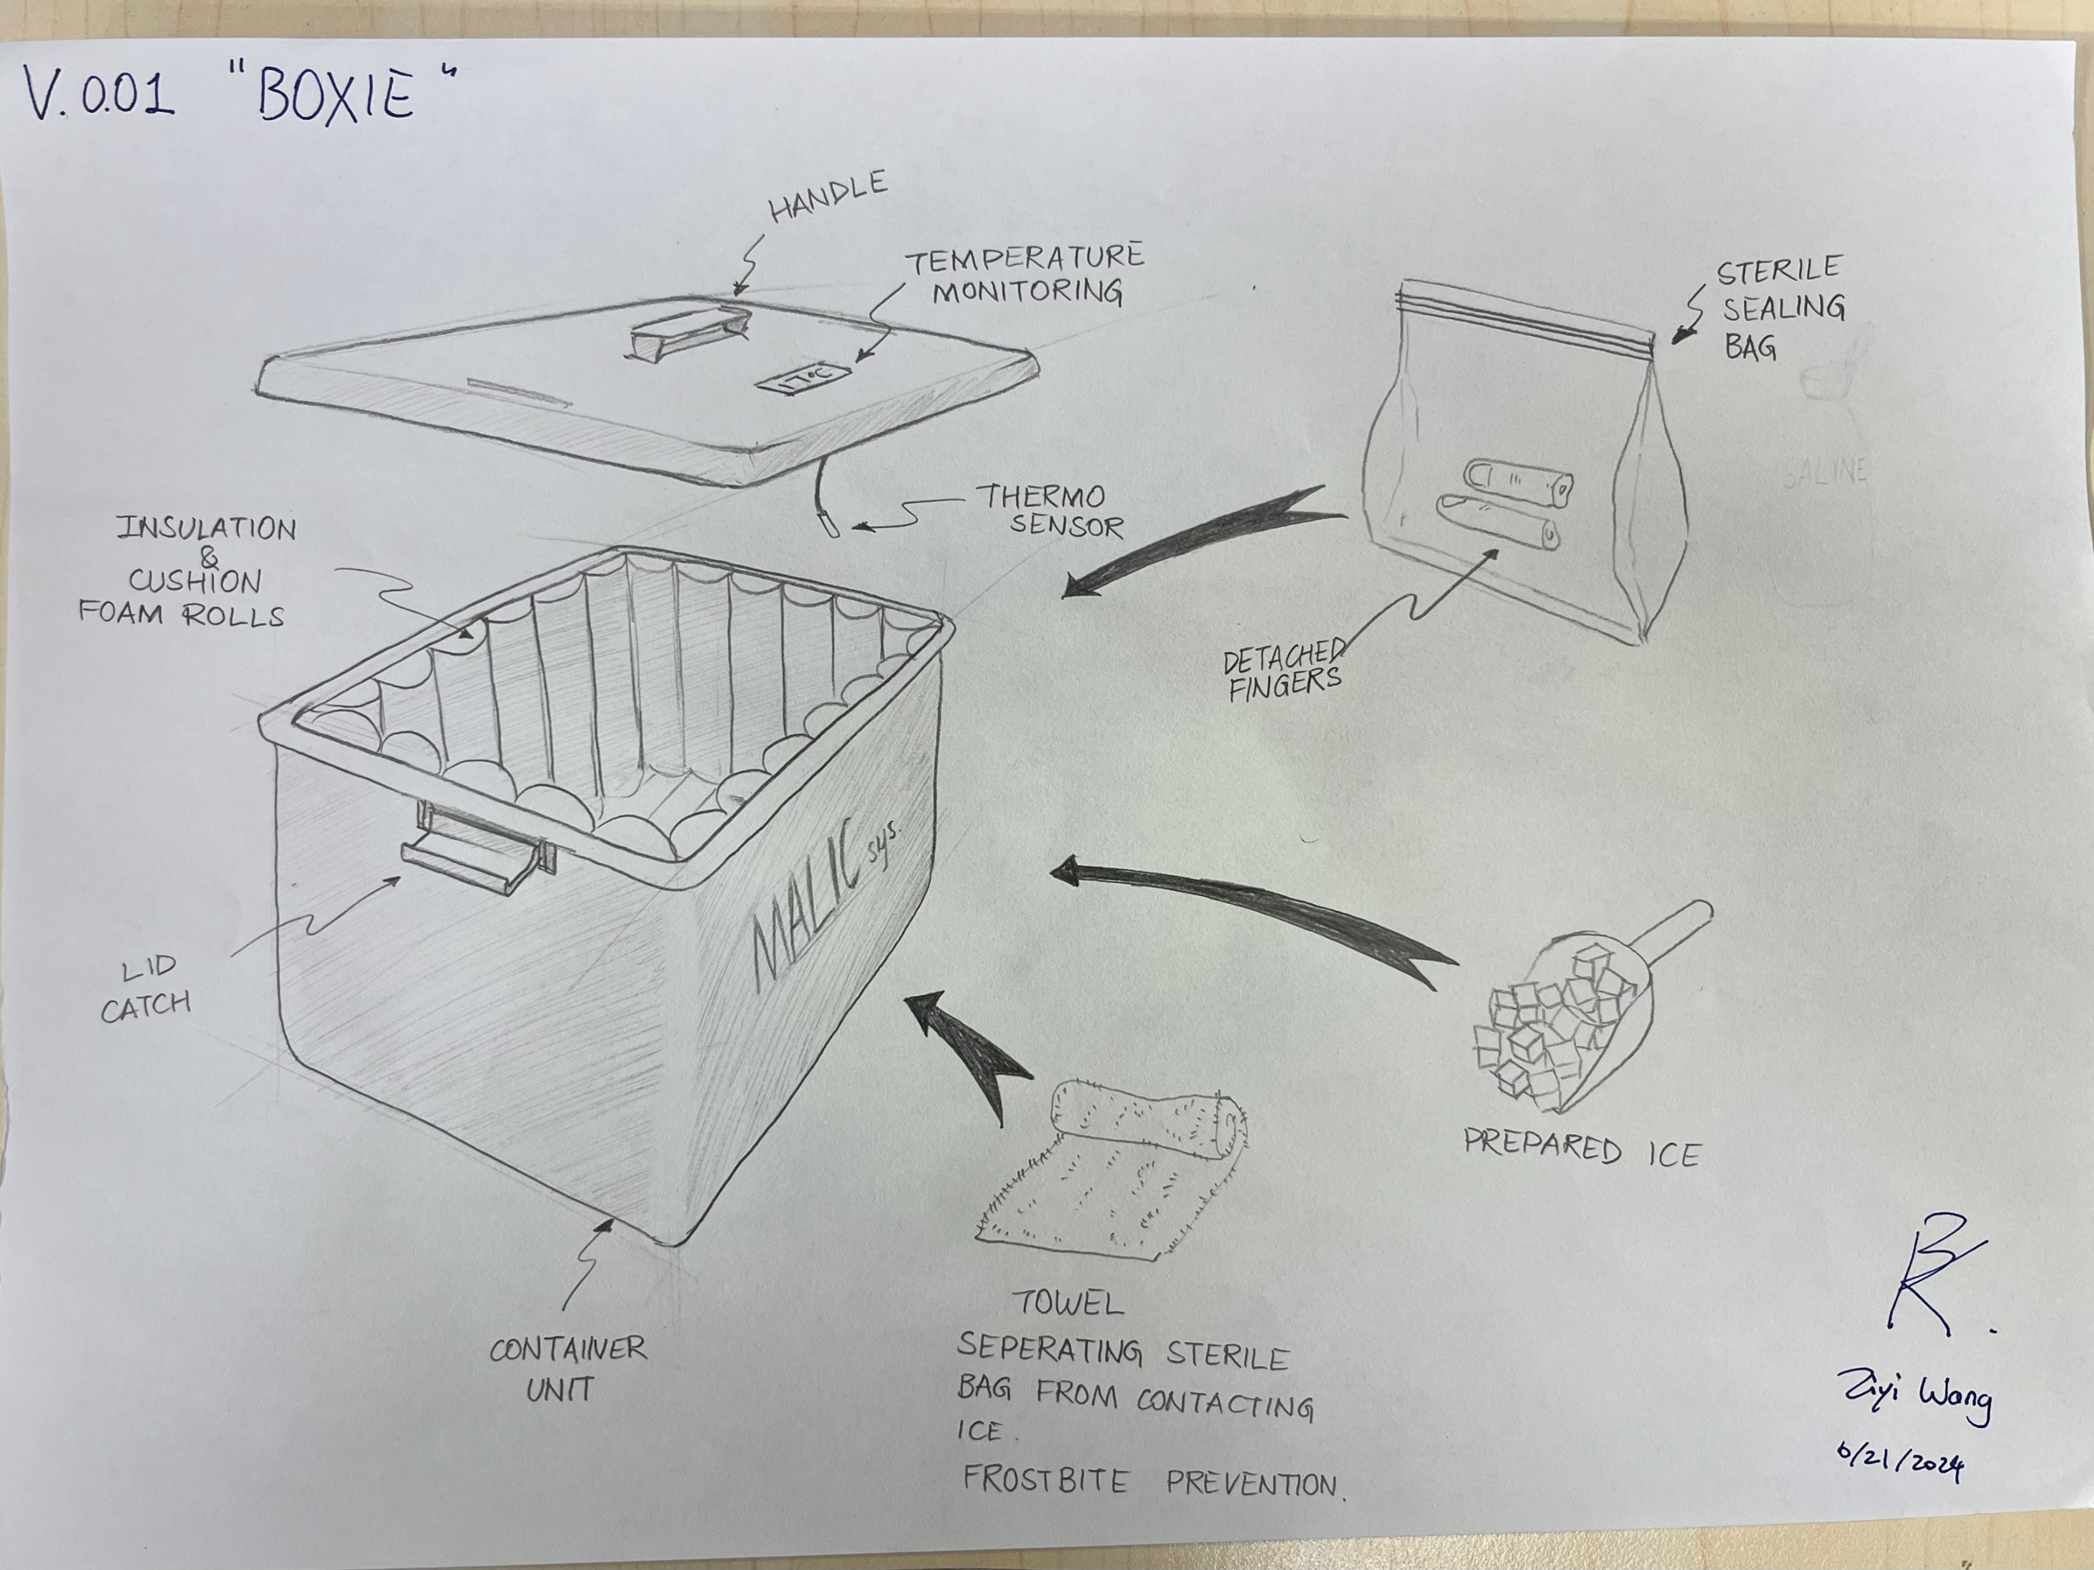

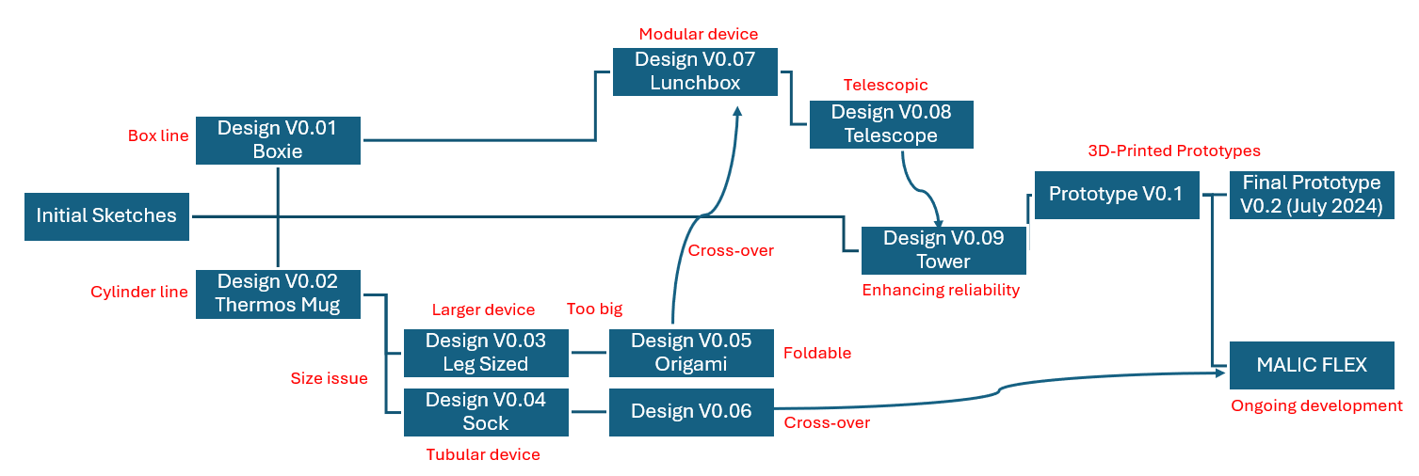
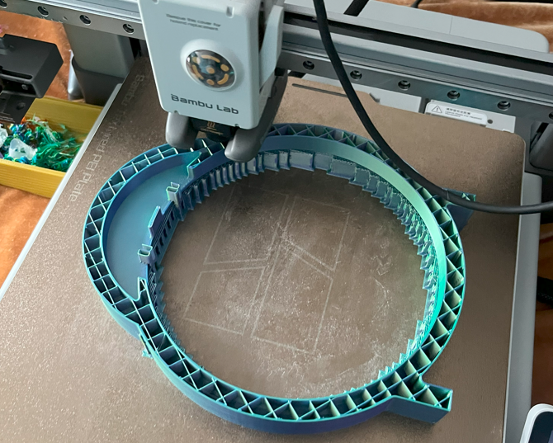
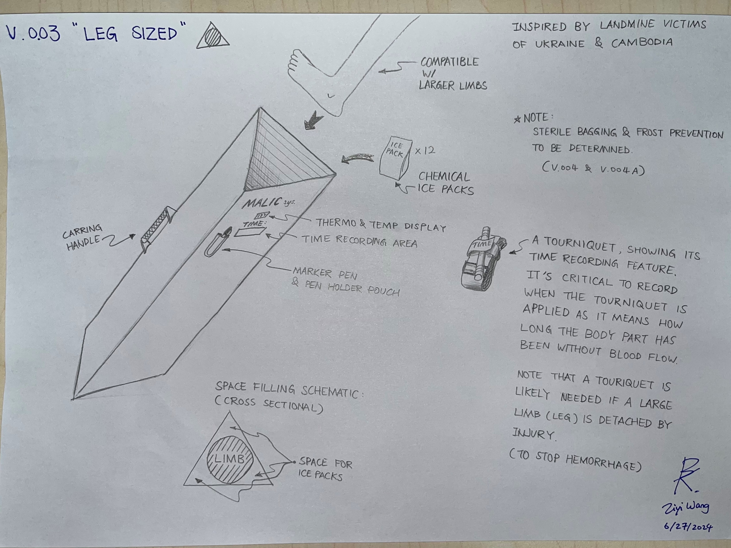
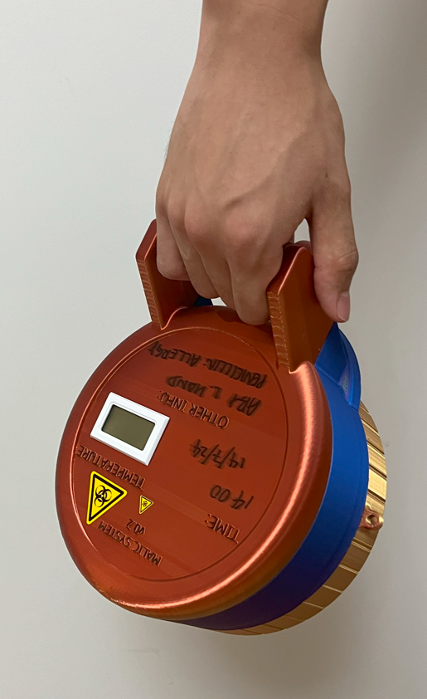
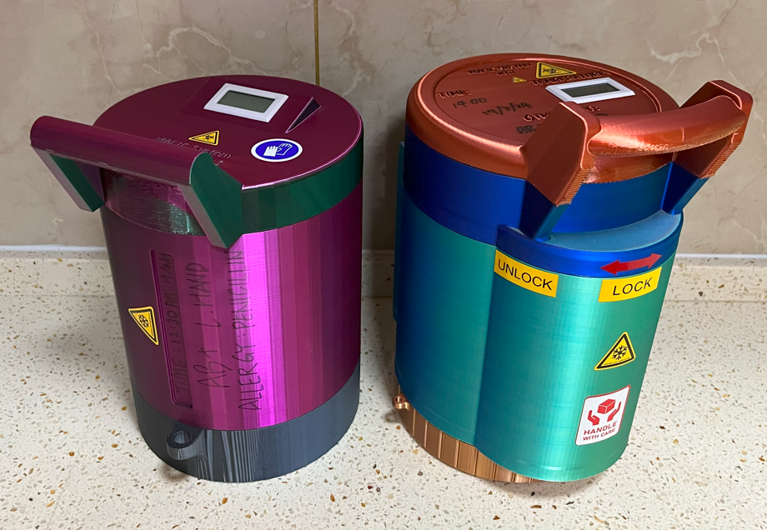

Development Briefing Diagram
June 2024

Slide 49

Practicability
The product is different from existing solutions.
Innovations based on mature technologies.
Can be realistically produced at a low cost and sold at profit.
Easy and intuitive to use.
Tested. (Slide 27)

Slide 50
Marketing Plan
Patent and Approvals
Medical Product Show
Batch Production
Currently I am working on the patent pending.
Notes:
The first step into marketing is patents and approvals. I am currently working on patent pending. Once these legal document are ready, they will enable us to attend medical product shows. I had experience being a visitor, so I know that the shows are the go-to place for presenting a new product. Then, batch production shall start as soon as orders are received.

Slide 51
Commercial Applications
A person can experience a traumatic amputation from a motor vehicle, occupational or industrial accident or combat injury. [6]
Factory
First Responders
Rescue
Agriculture
Military/LE
Notes:
The MALIC system has a lot of potential. Quoting John’s Hopkins University, A person can experience a traumatic amputation from a motor vehicle, occupational or industrial accident or combat injury. Here are the five areas that’s the most attractive. Factory, First responders, rescue, agriculture, and military slash Law enforcement.

Slide 52
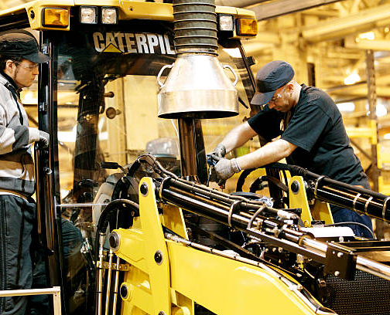
Factory
Image: http://www.gettyimages.se/h%C3%A4ndelse/caterpillar-inc-uk-production-of-bulldozers-108306761
Lack of sterile and cooled containers.
Located away from urban areas.
Limited budget and training.
Notes:
Factory settings are what the project started for. Factories lack sterile and cooled containers. They are usually located away from urban areas, resulting in long transporting time to hospital. Moreover, factories have limited budget and training for using advanced first aid equipment. The current MALIC system have already addressed these constraints. Eventually, the MALIC system should ready to go on the walls alongside with the existing AEDs.

Slide 53
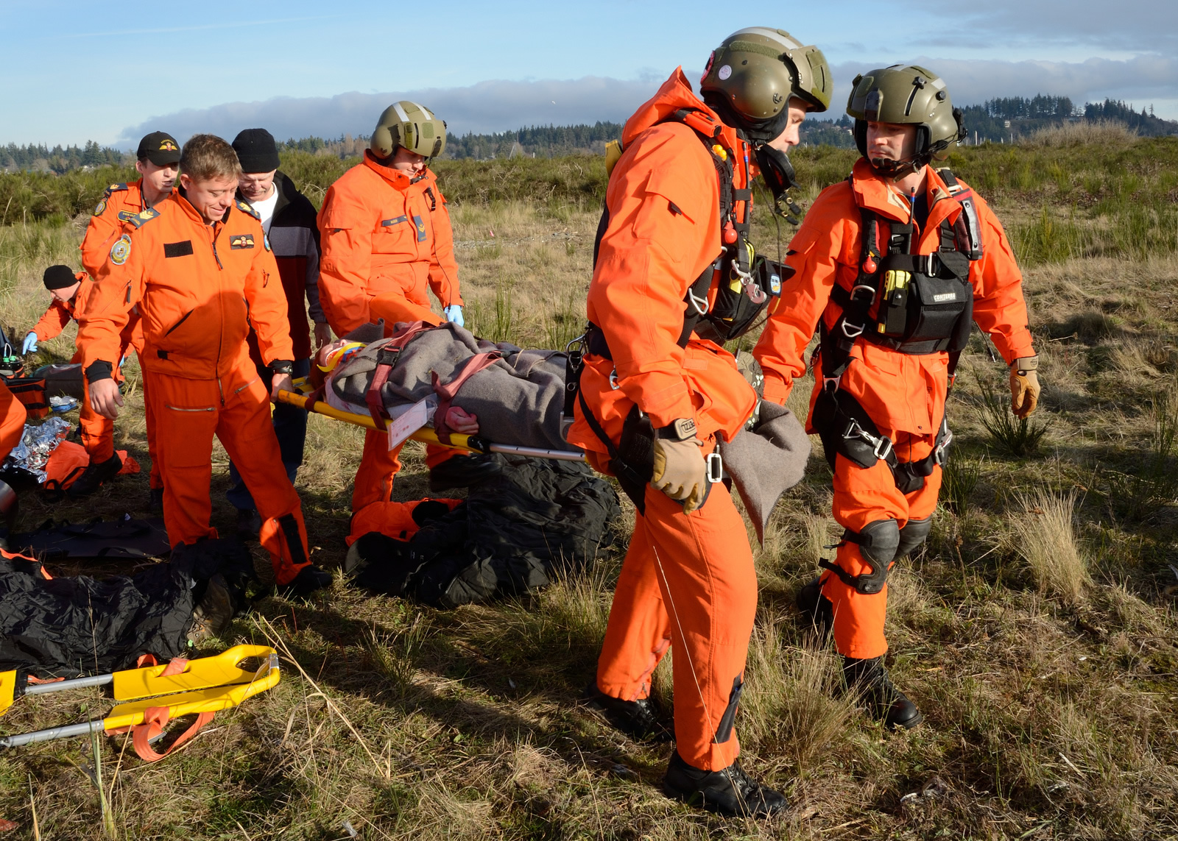
Rescue
Image: https://www.canada.ca/en/department-national-defence/services/operations/military-operations/types/search-rescue/about.html
Vehicle may not reach the site.
(i.e. forests, caves, earthquake)
MALIC must be optimized for manual handling.
Long transporting and waiting time.
Notes:
The key constraint for rescuing is complex terrain, where vehicles may not reach the site. For example, a helicopter cannot land in a dense forest, requiring the rescue team to extract the injured person to a landing zone. Therefore, the MALIC must be optimized for manual handling. I have proven the slinging concept can be very convenient when climbing, lifting stretchers and more. In addition to the long transporting time, waiting time could also be a killer when hospitals are overwhelmed in cases like an earthquake. Overall, rescue teams can benefit a lot from the use of MALIC system.

Slide 54

First Responders
Image: https://conquerthislife.com/first-responders-getting-the-most-from-retirement.html
Risk of being stuck in traffic.
MALIC require no power, allowing fast response.
MALIC must be optimized for vehicles.
(ie. Ambulances, helicopters)
Notes:
First responders, like ambulance, police and firefighters, are also likely to encounter limb injuries during their mission. The main concern is getting stuck in the traffic, increasing the transporting time to hospitals.
MALIC suit this use case well because its powerless chemical cooling is always ready, allowing fast response. The next step will be to optimize the system for vehicles, focusing on reducing the overall size of it. The currently developing MALIC FLEX design is my approach. The operational complexity will no longer be a constraint like the factory, because it will be operated by professional personnels.

Slide 55
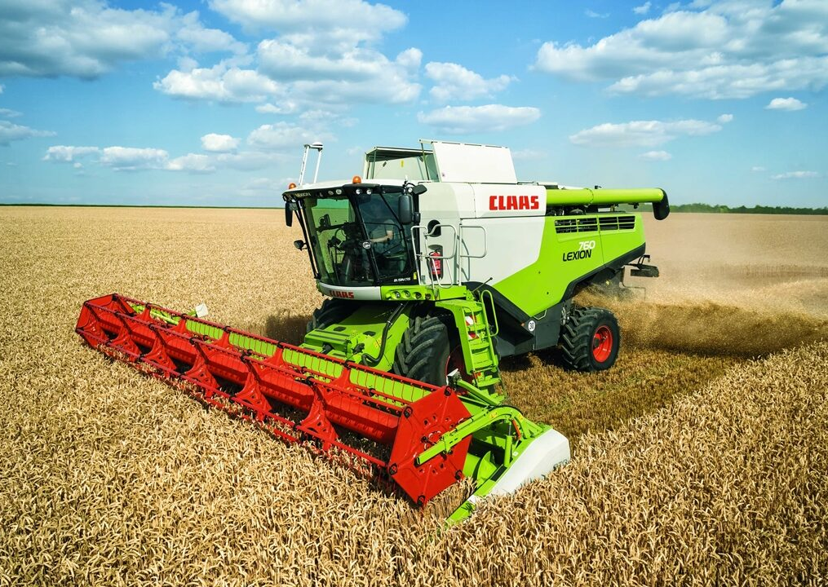
Agriculture Machinery
Image: https://www.agriland.ie/farming-news/irish-farm-machinery-sales-are-on-the-up/
Operates in remote location, prolonged waiting time.
Few people on scene, lack of immediate help.
MALIC must be optimized for vehicles.
Notes:
Agriculture machinery is really an neglected area for work related trauma, especially limb injuries comparable to the factory setting. Getting sheared by giant machines in the middle of a field with no one around is not a joke. It would be a great upgrade if MALIC system can be added to the vehicles’ first aid kit, giving the victim more time before losing the limbs forever.

Slide 56
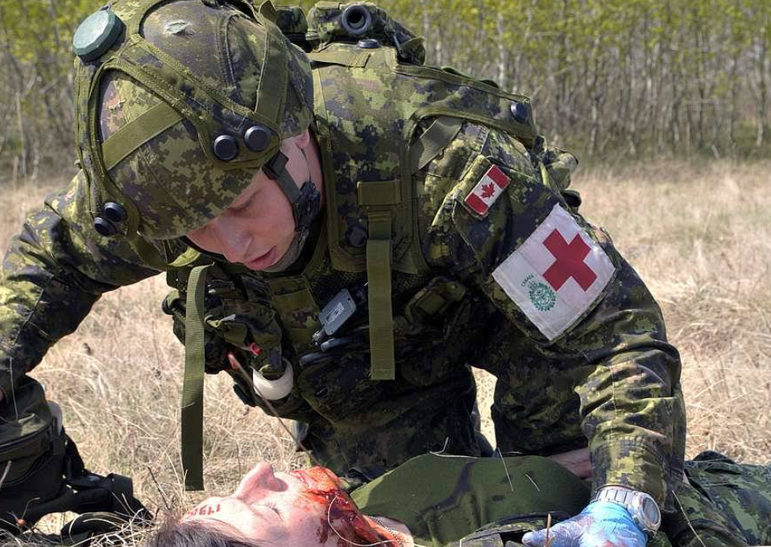
Military/LE
Image: https://nara.getarchive.net/media/a-canadian-army-medic-with-5-field-ambulance-valcartier-d47a6bz
Possible long waiting before receiving medical care beyond first aid.
Unpredictable scenarios.
Complex injuries.
Notes:
Military and law enforcement are high risk jobs and limb injuries are not uncommon. Amputation existed as long as human’s history of war. In these cases, it usually takes prolonged wait time before the wounded receives advanced treatments like replantation. Scenarios are highly unpredictable, and injuries are usually not limited to limb injuries. For example, a case I studied was a landmine injury occurred in Ukraine, where the victim suffered simultaneously from concussion, hemorrhage and a detached leg. MALIC system can definitely give the medics more options, and ultimately increase the morale of the related military or law enforcement personnels.

Slide 57
References (IEEE format)
[1] R. Nall, “Amputation: We answer your most-searched questions,” Healthline, https://www.healthline.com/health/amputation#statistics (accessed Jul. 16, 2024).
[2] S. Massand, H. Sinatro, A. T. Liu, C. Shen, and J. M. Ingraham, “Improper preservation of amputated parts: A pervasive problem,” Plastic and Reconstructive Surgery Global Open, https://www.ncbi.nlm.nih.gov/pmc/articles/PMC7553449/ (accessed Jul. 16, 2024).
[3] C. Sigtryggsson, “Laboratory studies on dissolution of nitrogen fertilizers by humidity and precipitation - sigtryggsson - 2020 - Agricultural & Environmental Letters - Wiley Online Library,” acsess.onlinelibrary.wiley.com, https://acsess.onlinelibrary.wiley.com/doi/pdf/10.1002/ael2.20016 (accessed Jul. 16, 2024).
[4] G. Singh, “Dimensions of average male human being [23]. | download scientific diagram,” Research Gate, https://www.researchgate.net/figure/Dimensions-of-average-male-human-being-23_fig1_283532449 (accessed Jul. 16, 2024).
[5] M. Hamzah, “Design of a Novel Carbon-Fiber Ankle-Foot Prosthetic by Using Finite Element Modeling,” Research Gate, https://www.researchgate.net/figure/Prototypes-designed-based-on-the-simple-prosthetic-foot-models-shown-in-Fig-2-While_fig1_326528096 (accessed Jul. 16, 2024).
[6] “Amputation,” Johns Hopkins Medicine, https://www.hopkinsmedicine.org/health/treatment-tests-and-therapies/amputation (accessed Jul. 16, 2024).

