Slide 1

THE POWER OF PUBLIC HEALTH DATA
Turning numbers into informed decisions — starting with CDC WONDER
Every screenshot in this deck is real — not a mockup. Follow along on your own laptop.
Public Health Merit Badge · Requirement 7(b)(1)

Slide 2




BEFORE WE START
What Is CDC WONDER?
WONDER (Wide-ranging ONline Data for Epidemiologic Research) is a free public tool that lets anyone query official U.S. government health statistics — no login, no cost, no special software.
Any place
Many topics
Real numbers
National, state, or county-level data
Deaths, births, cancer, natality, and more
The same data health departments use
Why it matters for this badge
Requirement 7(b)(1) asks you to compare your community's leading causes of death and disease over the past five years. WONDER is where you go to actually find those numbers.
CDC WONDER WALKTHROUGH · PUBLIC HEALTH MERIT BADGE, REQ. 7(b)(1)
2

Slide 3
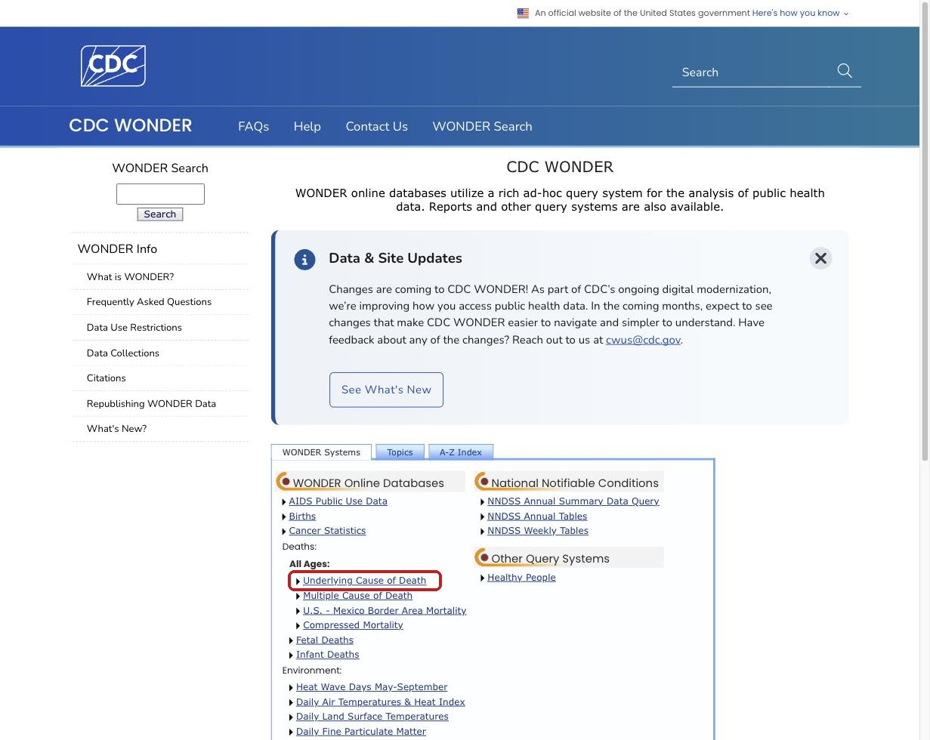
STEP 1 OF 7
Go to CDC WONDER
wonder.cdc.gov
Open wonder.cdc.gov and find the mortality databases. We'll use Underlying Cause of Death — the dataset behind most “leading causes of death” statistics.
Click: “Underlying Cause of Death”
CDC WONDER WALKTHROUGH · PUBLIC HEALTH MERIT BADGE, REQ. 7(b)(1)
3

Slide 4
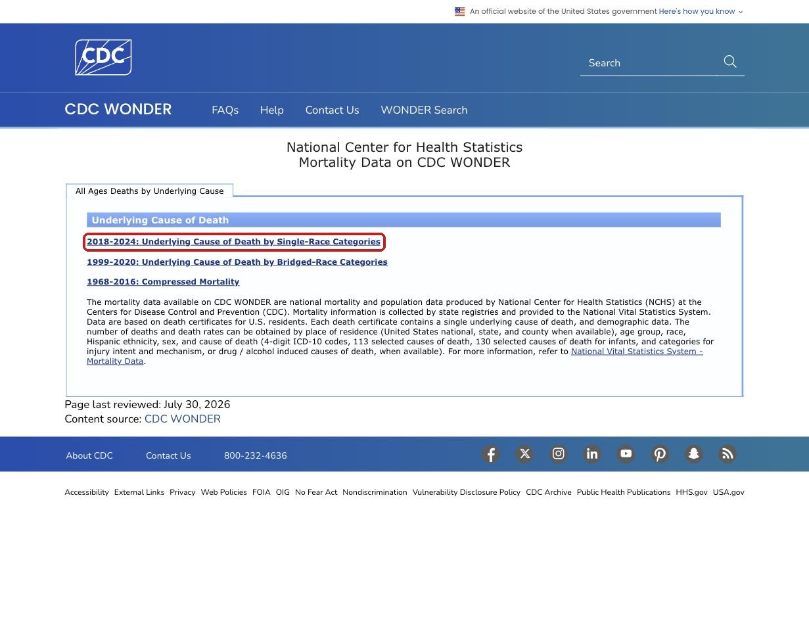
STEP 2 OF 7
Pick a Dataset
wonder.cdc.gov/deaths-by-underlying-cause.html
WONDER offers a few versions of the mortality data. Use the most current one — it covers the widest, most recent span of years.
Click: “2018–2024: Underlying Cause of Death by Single-Race Categories”
CDC WONDER WALKTHROUGH · PUBLIC HEALTH MERIT BADGE, REQ. 7(b)(1)
4

Slide 5
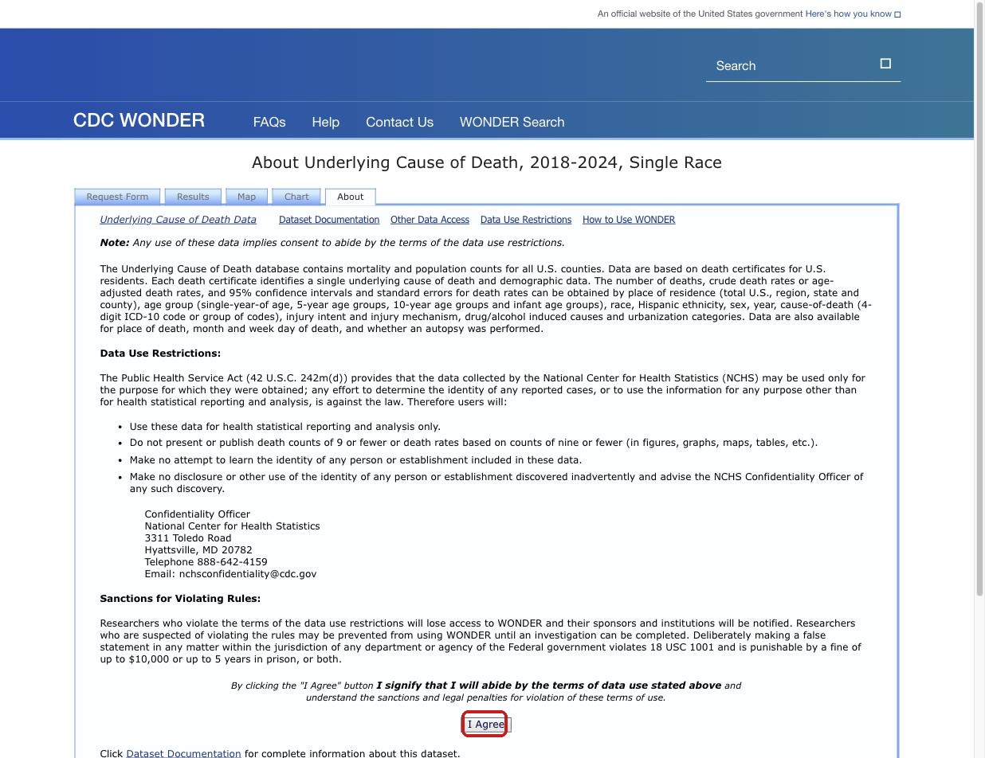
STEP 3 OF 7
Accept the Data Use Rules
wonder.cdc.gov/ucd-icd10-expanded.html
Every WONDER dataset opens with its data use restrictions. This isn't boilerplate — read it. It's a real lesson in health data ethics.
A key rule to notice:
“Do not present or publish death counts of 9 or fewer” — this protects the privacy of small communities where individuals could be identified.
Click: “I Agree”
CDC WONDER WALKTHROUGH · PUBLIC HEALTH MERIT BADGE, REQ. 7(b)(1)
5

Slide 6
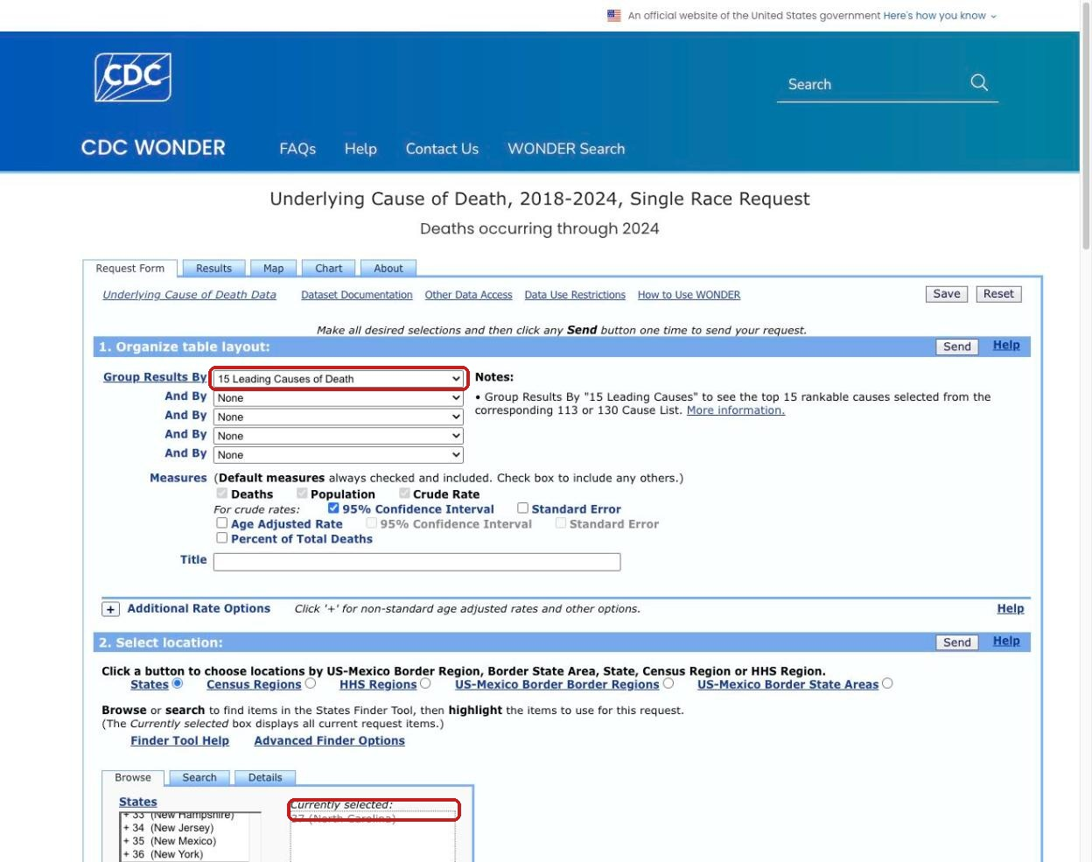
STEP 4 OF 7
Build Your Query
wonder.cdc.gov/controller/datarequest/D158
Two choices shape everything: what to group by, and where. We'll rank causes of death and narrow the location to one state.
Group Results By: 15 Leading Causes of Death
Select Location: your state (e.g. North Carolina)
Tip: the Year/Month section further down lets you pick a single year instead of the full range.
CDC WONDER WALKTHROUGH · PUBLIC HEALTH MERIT BADGE, REQ. 7(b)(1)
6

Slide 7
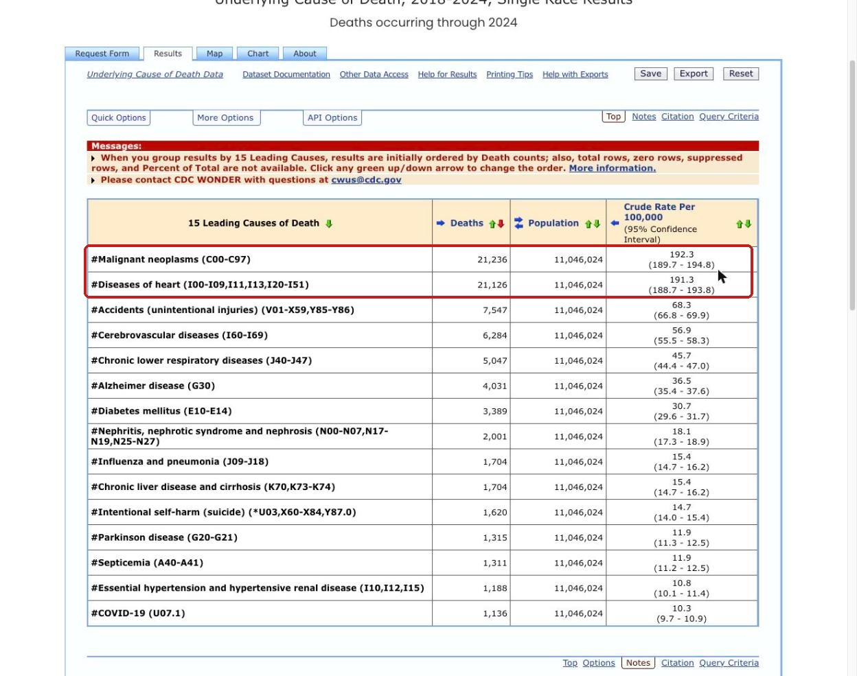
STEP 5 OF 7
Send It, Then Read the Table
wonder.cdc.gov — Results
Scroll down and click any Send button. WONDER returns a ranked table — largest cause of death first.
North Carolina, 2024 — top 2 causes:
#1 Malignant neoplasms (cancer) — 21,236 deaths
#2 Diseases of heart — 21,126 deaths
Those two are nearly tied — a real, current snapshot of the state's biggest health challenges.
CDC WONDER WALKTHROUGH · PUBLIC HEALTH MERIT BADGE, REQ. 7(b)(1)
7

Slide 8
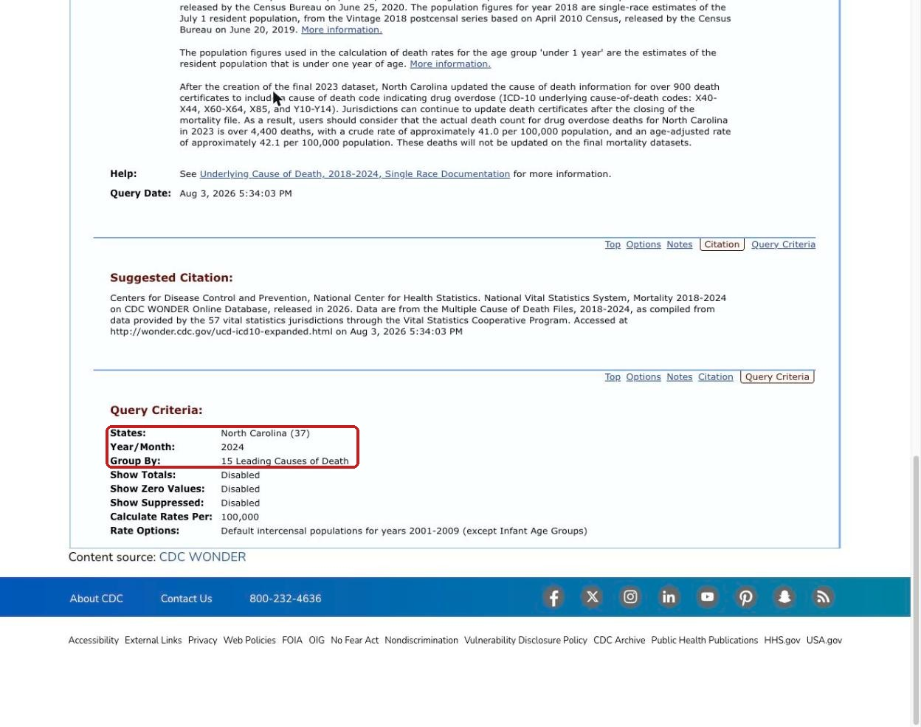
STEP 6 OF 7
Double-Check Your Query
wonder.cdc.gov — Query Criteria
Before you trust any result, click “Query Criteria.” It's a plain-English receipt of exactly what you asked for.
Good habit for any data tool:
Always verify the state, year, and grouping match what you meant to ask — it's easy to mis-click a dropdown.
This is exactly how we caught a wrong year during this deck's own research!
CDC WONDER WALKTHROUGH · PUBLIC HEALTH MERIT BADGE, REQ. 7(b)(1)
8

Slide 9
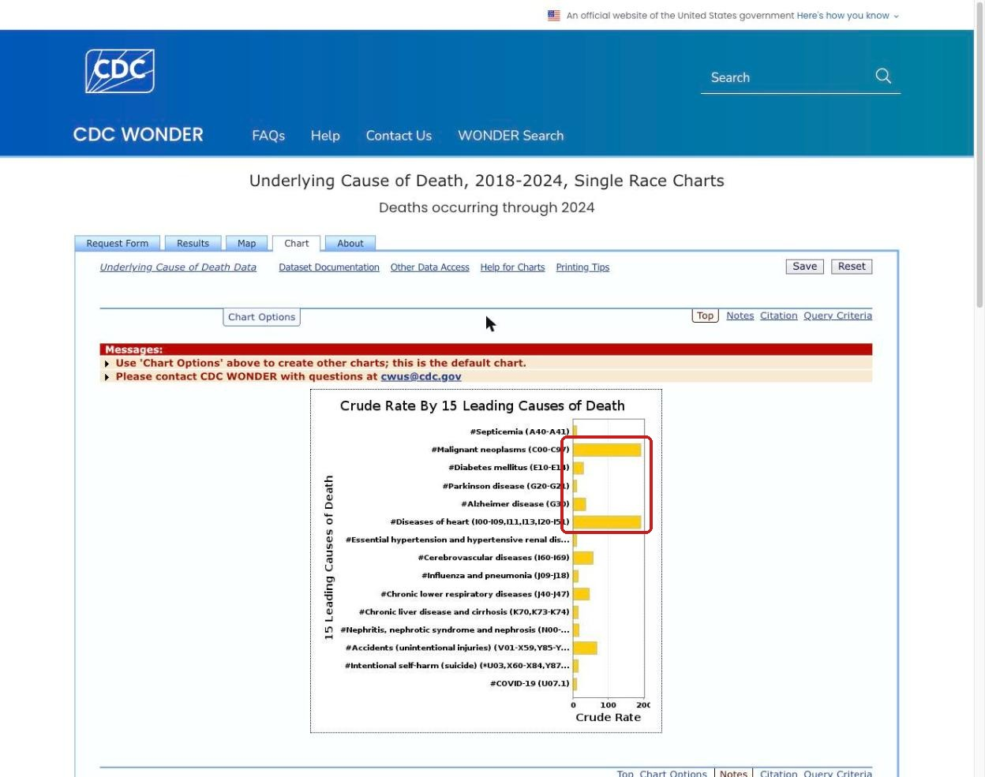
STEP 7 OF 7
Visualize It
wonder.cdc.gov — Chart
Click the Chart tab for an instant bar graph — no spreadsheet work required. Great for a presentation to your counselor.
What jumps out visually:
Two bars tower over the rest — cancer and heart disease dominate NC mortality far more than any other single cause.
CDC WONDER WALKTHROUGH · PUBLIC HEALTH MERIT BADGE, REQ. 7(b)(1)
9

Slide 10


CONNECTING THE DOTS
Mortality Is Only Half the Picture
Requirement 7(b)(1) asks for two different lists — don't stop at WONDER for both of them.
Mortality (death)
Morbidity (illness)
This is exactly what CDC WONDER's Underlying Cause of Death database gives you — what we just queried.
For leading causes of disease, check your state health department's website or the CDC's BRFSS / County Health Rankings data instead.
Discussion prompt for your counselor
Do the same conditions show up on both your mortality list and your morbidity list? What might explain the overlaps — or the differences?
CDC WONDER WALKTHROUGH · PUBLIC HEALTH MERIT BADGE, REQ. 7(b)(1)
10

Slide 11


NOW IT'S YOUR TURN
Try It Yourself
Same steps, your own questions. Here are four easy tweaks to explore on your own laptop.
Change the state
Change the year
Try Multiple Cause of Death
Group by age or sex
Swap North Carolina for your own state, or compare two states side by side.
Pick a different year from Step 4 — has the ranking shifted over the past 5 years?
A related dataset on the WONDER homepage — counts every condition listed on a death certificate, not just the underlying one.
Add an “And By” selection in Step 4 to see how leading causes shift across groups.
CDC WONDER WALKTHROUGH · PUBLIC HEALTH MERIT BADGE, REQ. 7(b)(1)
11

Slide 12
BEYOND WONDER
Real Dashboards, Real Publications
A firsthand look at how one state health department's dashboards — and the scientists behind them — tracked COVID-19 from the very first case to today.
CDC WONDER WALKTHROUGH · PUBLIC HEALTH MERIT BADGE, REQ. 7(b)(1)
12

Slide 13
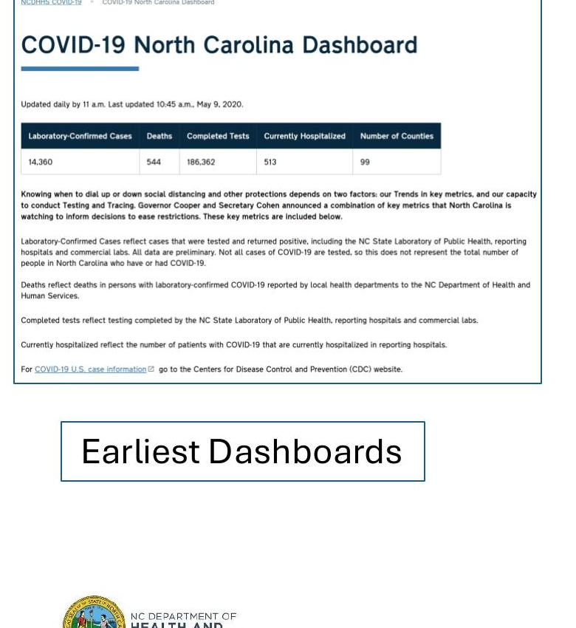
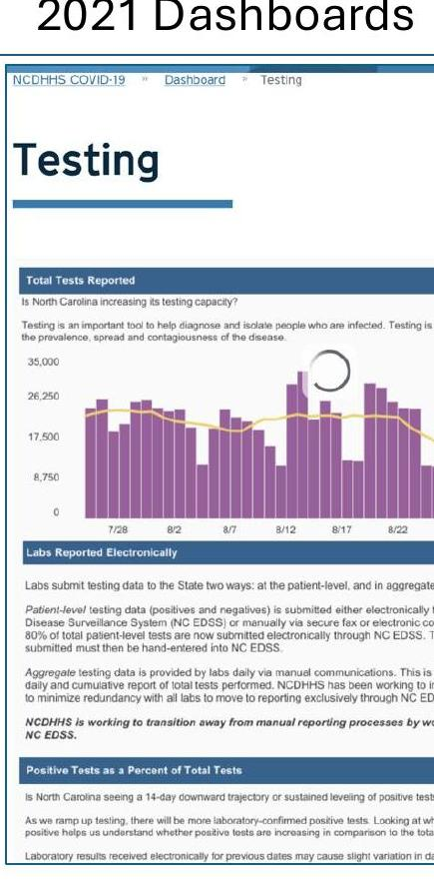
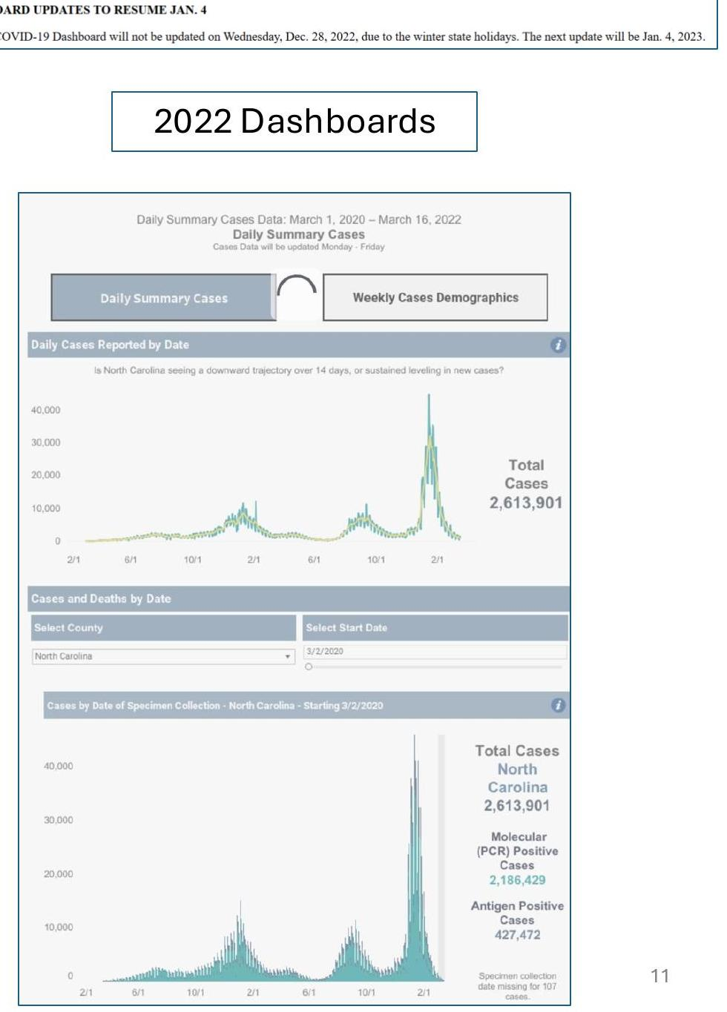
A DASHBOARD'S LIFE, PART 1
From Day One of the Pandemic
The same North Carolina COVID-19 dashboard, captured at three points in its life — as the pandemic itself changed.
May 2020
2021
2022
Source: Brad Wheeler, “Seed, Storm, and Stewardship” — NCPHA Public Health Data Summit, May 2026
CDC WONDER WALKTHROUGH · PUBLIC HEALTH MERIT BADGE, REQ. 7(b)(1)
13

Slide 14
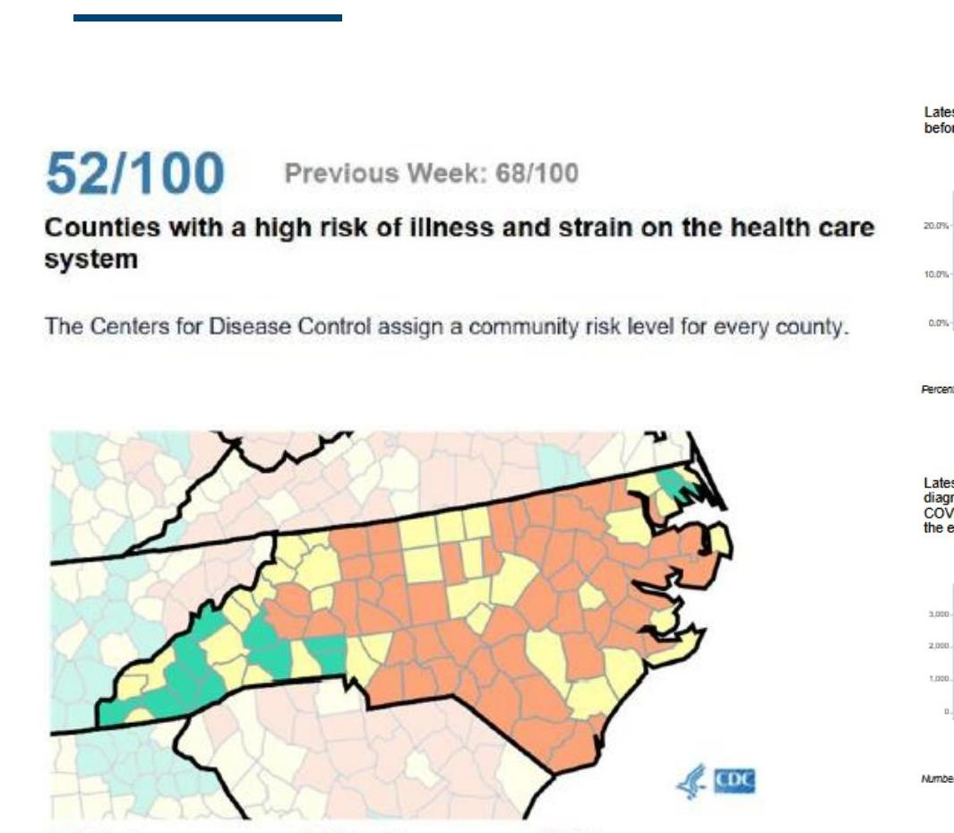
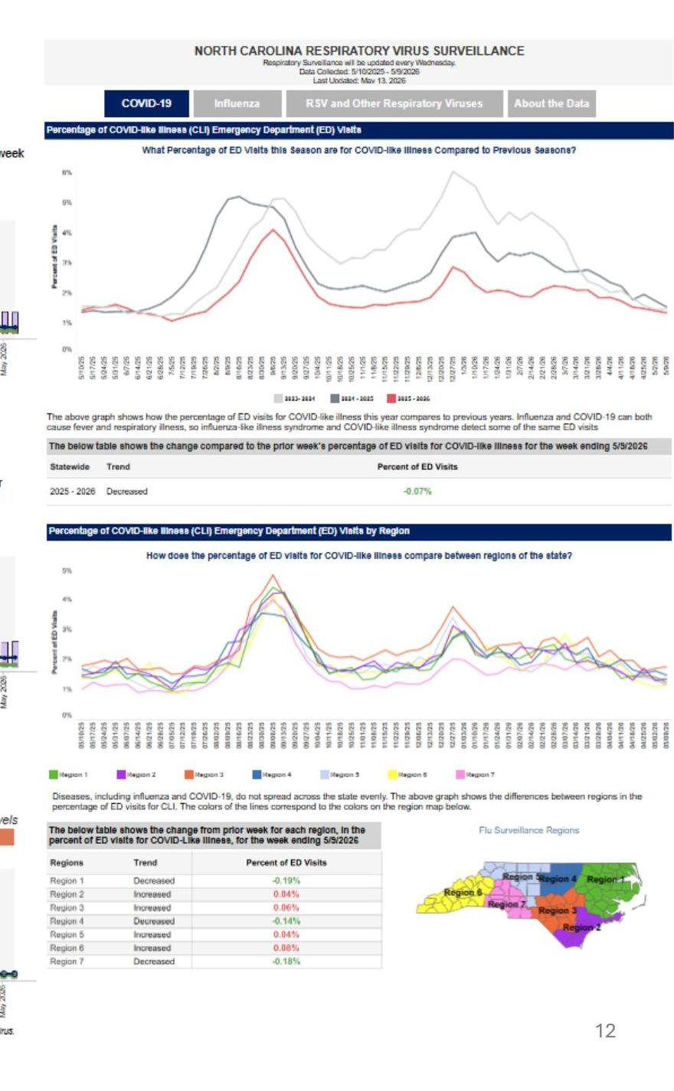
A DASHBOARD'S LIFE, PART 2
Still Running Today
The COVID-only dashboard was eventually folded into a broader respiratory-virus surveillance system — covering flu and RSV too.
Same mission, wider lens
COVID-19 dashboards eventually retired in favor of a combined respiratory-illness view — because by 2023, COVID was one of several viruses driving ER visits each winter, not the only one.
Try it: dph.ncdhhs.gov — search “Respiratory Virus Summary Dashboard”
A county-by-county risk map, 2022
Live today: NC Respiratory Virus Surveillance
CDC WONDER WALKTHROUGH · PUBLIC HEALTH MERIT BADGE, REQ. 7(b)(1)
14

Slide 15
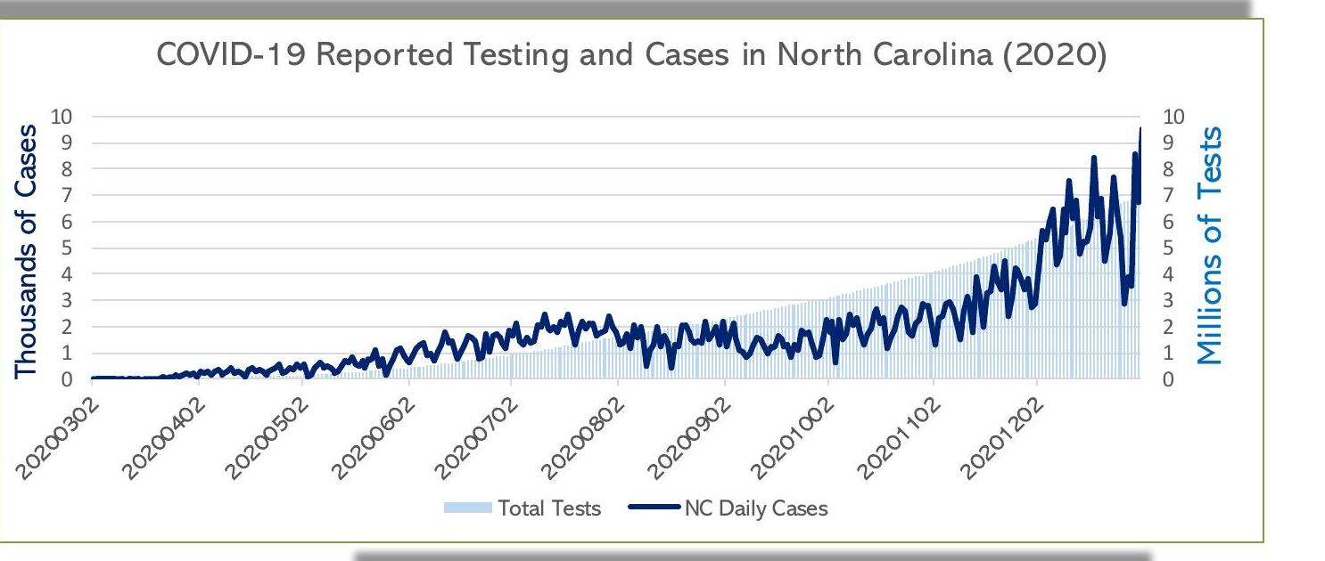
ONE LEVEL DEEPER
Behind Every Dashboard Is Raw Data
Before a single chart renders, someone builds a pipeline to clean, link, and validate the numbers feeding it — every single day.
The exact case and testing data that fed the public dashboard above — 2020, North Carolina.
CDC WONDER WALKTHROUGH · PUBLIC HEALTH MERIT BADGE, REQ. 7(b)(1)
15

Slide 16
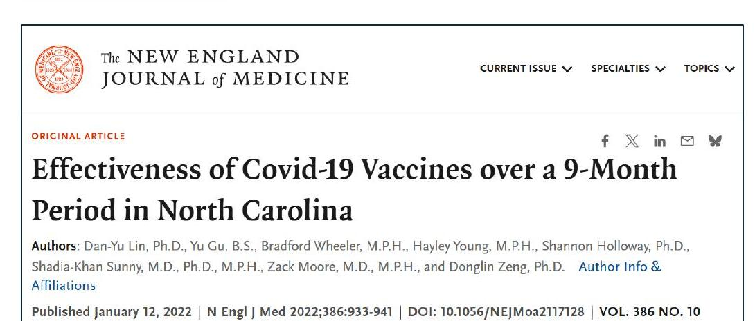
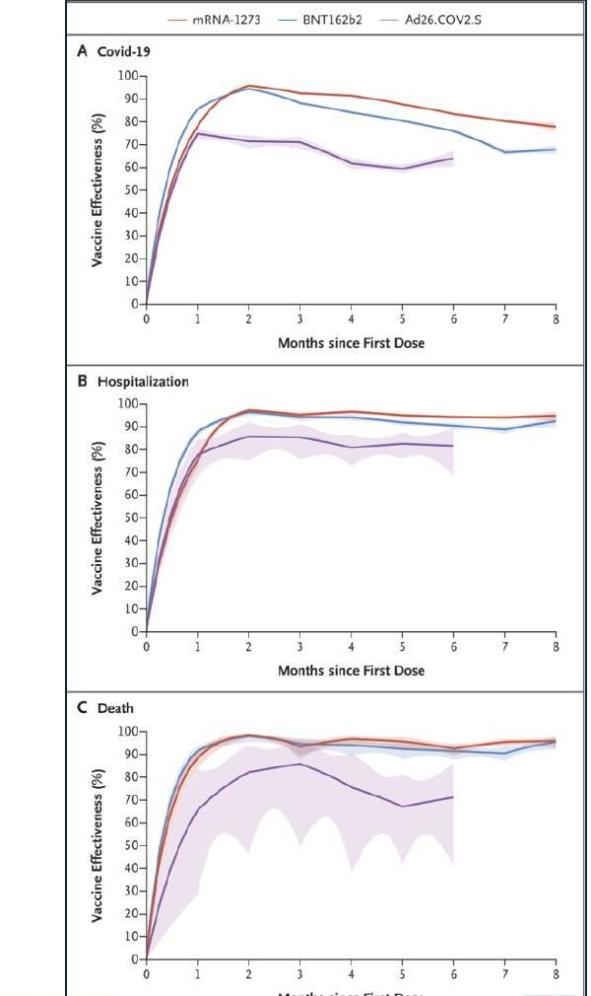
PUBLIC HEALTH IN PRINT
Surveillance Data Becomes Science
The same linked case, testing, and vaccination data behind the dashboards was also used to answer a bigger question: how well did the COVID-19 vaccines actually work?
Vaccines were highly effective at preventing infection, hospitalization, and death — but that protection waned over the following months.
CDC WONDER WALKTHROUGH · PUBLIC HEALTH MERIT BADGE, REQ. 7(b)(1)
16

Slide 17
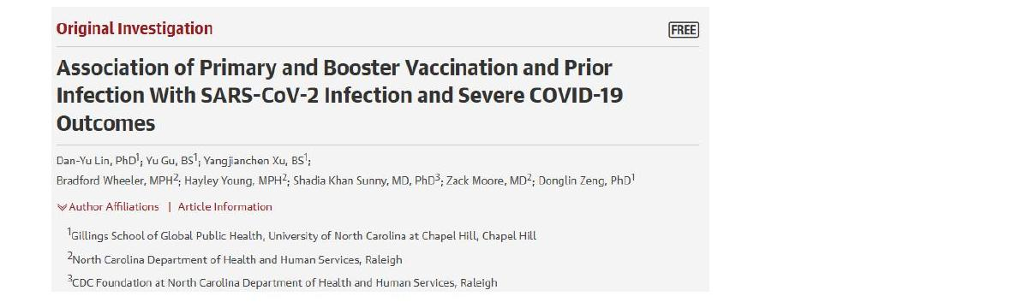
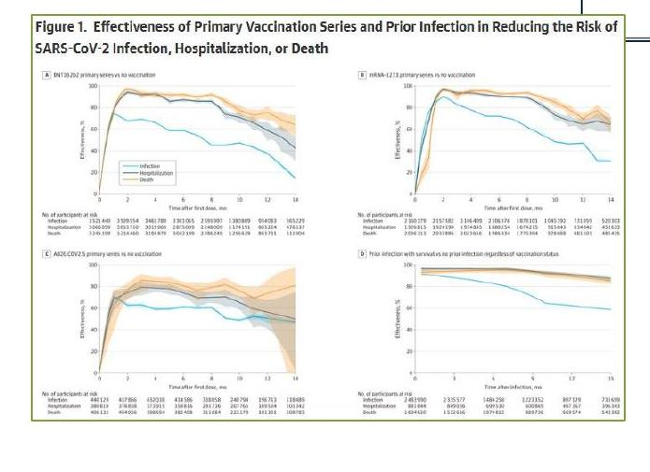
A SECOND STUDY, ONE YEAR LATER
Adding Boosters and Prior Infection
A follow-up study asked a more complete question: how does protection compare across primary vaccination, boosters, and prior infection?
Both papers, one dataset
The same linked NC COVID-19 Surveillance System and Vaccine Management System data powered both studies — a reminder that good infrastructure pays off more than once.
Discussion prompt:
Why might researchers publish a second, more detailed study instead of just updating the first one?
CDC WONDER WALKTHROUGH · PUBLIC HEALTH MERIT BADGE, REQ. 7(b)(1)
17

Slide 18
A DIFFERENT KIND OF PUBLICATION
When a Public Health Report Triggers a National Recall
Napier MD, Huneycutt A, Moore C, et al.
“Childhood Lead Exposure Linked to Apple Cinnamon Fruit Puree Pouches — North Carolina, June 2023–January 2024.”
MMWR Morb Mortal Wkly Rep 2024;73:622–627 · All nine authors: NC DHHS (Children's Environmental Health, State Lab of Public Health, Environmental Health Section)
4
~500
1
asymptomatic NC children
first flagged the signal
cases detected
nationwide
nationwide recall
prevented further exposure
The pattern: routine surveillance → a health department notices a signal → investigation → published report → nationwide action. It's the same cycle as the cyclosporiasis case study — just with a different pathogen and a different food.
CDC WONDER WALKTHROUGH · PUBLIC HEALTH MERIT BADGE, REQ. 7(b)(1)
18

Slide 19

Now You Know Where to Look
From a query you ran yourself to the dashboards and papers behind real decisions — public health data isn't hidden. You just have to know where to look, and how to read it.
Public Health Merit Badge · Requirement 7(b)(1)

